Slide 1
Session 1 - Thread
A Guide to Advanced Java
Faculty:Nguyen Ngoc Tu

Slide 2


Thread
Concurrent programming in Java
How to make all things run-able?

Slide 3
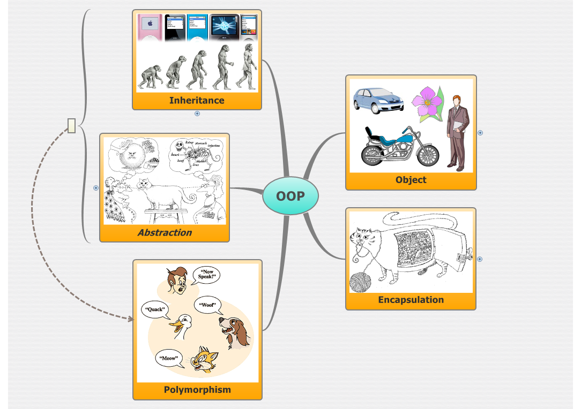
Review First!
Object Oriented Programming

Slide 4
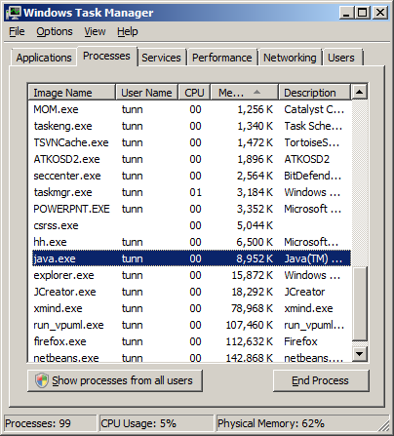
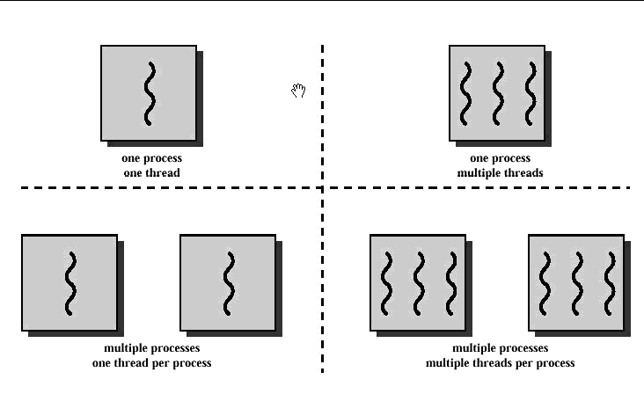
What is a thread?
When a modern operating system wants to start running a program, it creates a new process
A process is a program that is currently executing
Every process has at least one thread running within it
We can think of a thread as basically a lightweight process
http://www.cs.cf.ac.uk/Dave/C/node29.html

Slide 5
Let’s try HelloWorld again!
public class HelloWorld {
public static void main(String[] args) {
System.out.println("I want to say...");
System.out.println("...Hello World!");
}
}
C:\java HelloWorld ↵
I want to say…
…Hello World!

Slide 6
What’s happening?
OS run HelloWorld program
The Main Thread
New Process
(new instance of JVM)
Begin
main()
{
System.out.println(“I want to say…”)
System.out.println(“…Hello World!”)
}
Background Threads
End
(the garbage collection thread for example)
Even a simple Java program that only prints Hello World to System.out is running in a multithreaded environment

Slide 7
Why Use Multiple Threads?
Better Interaction with the User
Simulation of Simultaneous Activities
Exploitation of Multiple Processors
Do Other Things While Waiting for Slow I/O Operations
Simplify Object Modeling

Slide 8
When Multiple Threads Might Not Be Good?
A thread has it own complete set of basic run-time resources to run it dependently.
So, It’s not always a good idea to add more threads to the design of a program. Threads are not free; they carry some resource overhead.
For example: in a pc game, there’re a thousand behavior of a thousand objects happening at the same time. Don’t use Multiple thread!

Slide 9
How to create a Thread?
Which way you can create a thread?
Inherits the Thread class?
Implements the Runnable interface?

Slide 10
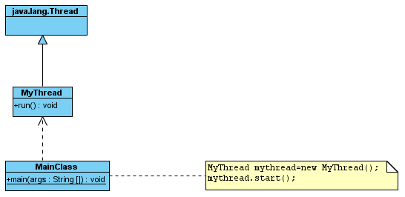
Inherits the Thread class
Step 1: Create a class that extends the java.lang.Thread class
Step2: Overrides the run() method of the Thread class in that subclass
Step3: Create an instance of this new class
Step4: Start the new thread by invoke the start() method on the instance.

Slide 11
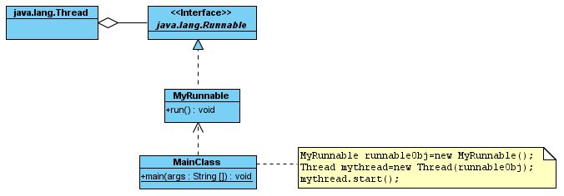
Implements the Runnable interface
Step1: Create new class that implements the java.lang.Runnable interface
Step2: Implements the run() method on this class
Step3: Create an instance of this new class
Step4: Start the new thread by invoke the start() method on the instance.

Slide 12
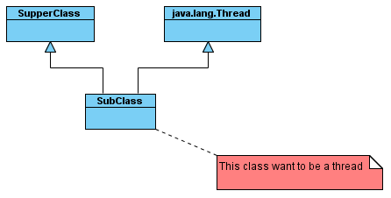
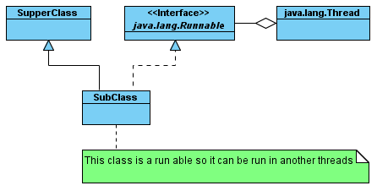
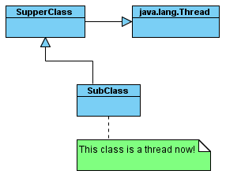
Implementing Runnable vs Extending Thread
Solution
Problem!!!
Solution

Slide 13
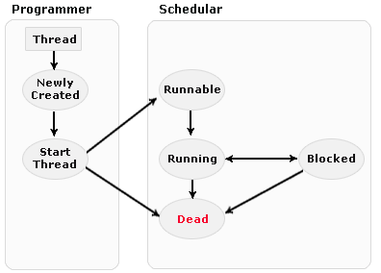
Thread States
Difference state of a thread are:
1. New state
2. Runnable (Ready-to-run) state
3. Running state
4. Blocked
5. Dead state

Slide 14
Methods of the Thread class
Method | Return Type | Description
currentThread( ) | Thread | Returns an object reference to the thread in which it is invoked.
getName( ) | String | Retrieve the name of the thread object or instance.
start( ) | void | Start the thread by calling its run method.
run( ) | void | This method is the entry point to execute thread, like the main method for applications.
sleep( ) | void | Suspends a thread for a specified amount of time (in milliseconds).
isAlive( ) | boolean | This method is used to determine the thread is running or not.
activeCount( ) | int | This method returns the number of active threads in a particular thread group and all its subgroups.
interrupt( ) | void | The method interrupt the threads on which it is invoked.
yield( ) | void | By invoking this method the current thread pause its execution temporarily and allow other threads to execute.
join( ) | void | This method and join(long millisec) Throws InterruptedException. These two methods are invoked on a thread. These are not returned until either the thread has completed or it is timed out respectively.

Slide 15
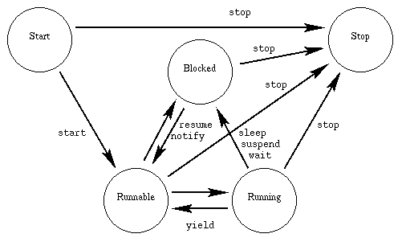
Life Cycle of thread

Slide 16
Thread Prioritization
Java allows you to give each of the threads running in a virtual machine a priority.
Higher-priority threads generally get more of a chance to run than lower-priority threads.
Thread Priority Constants:
Thread.MAX_PRIORITY
Thread.MIN_PRIORITY
Thread.NORM_PRIORITY
Getter/Setter for priority:
setPriority()
getPriority()

Slide 17
Daemon Threads
The characteristics of daemon threads are:
Daemon threads work in the background providing services to other threads.
They are fully dependent on user threads
If any non-daemon thread is still alive, the VM will not exit.

Slide 18
Need for Daemon Thread
Daemon threads are used for background supporting tasks and are only needed while normal, non-daemon threads are still running.
Daemon threads are designed as low-level background threads that perform some tasks such as mouse events for java program.

Slide 19
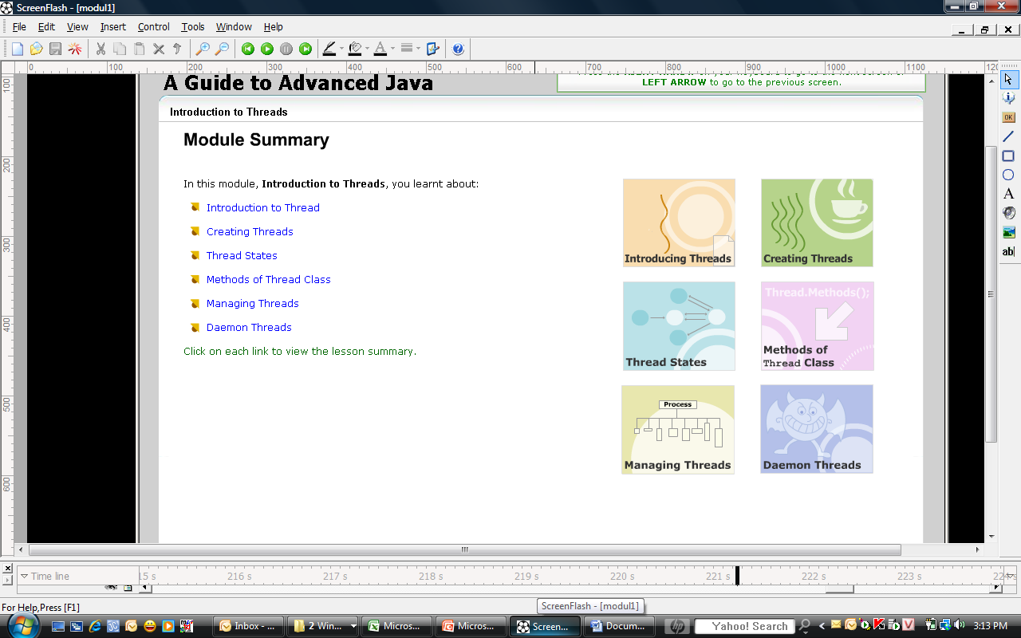
Summary

Slide 20
Thread
A Guide to Advanced Java
Q&A

Slide 21
References
Java Thread Programming by Paul Hyde
http://java.sun.com/docs/books/tutorial/essential/concurrency/
http://www.javaworld.com/javaworld/jw-04-1996/jw-04-threads.html
http://www.javapassion.com/javaintro/index.html#Threading_Basics

