Slide 1

A Guide to Advanced Java
Faculty:Nguyen Ngoc Tu

Slide 2







Operating System
Application #1
Local Memory
Application #2
Local Memory
Shared Memory
Local Memory
Java Virtual Machine #1
Daemon Thread #1
Local Memory
Main Thread #2
Local Memory
Global Memory
Local Memory
Your Thread #3
Threads in a multithreaded environment

Slide 3

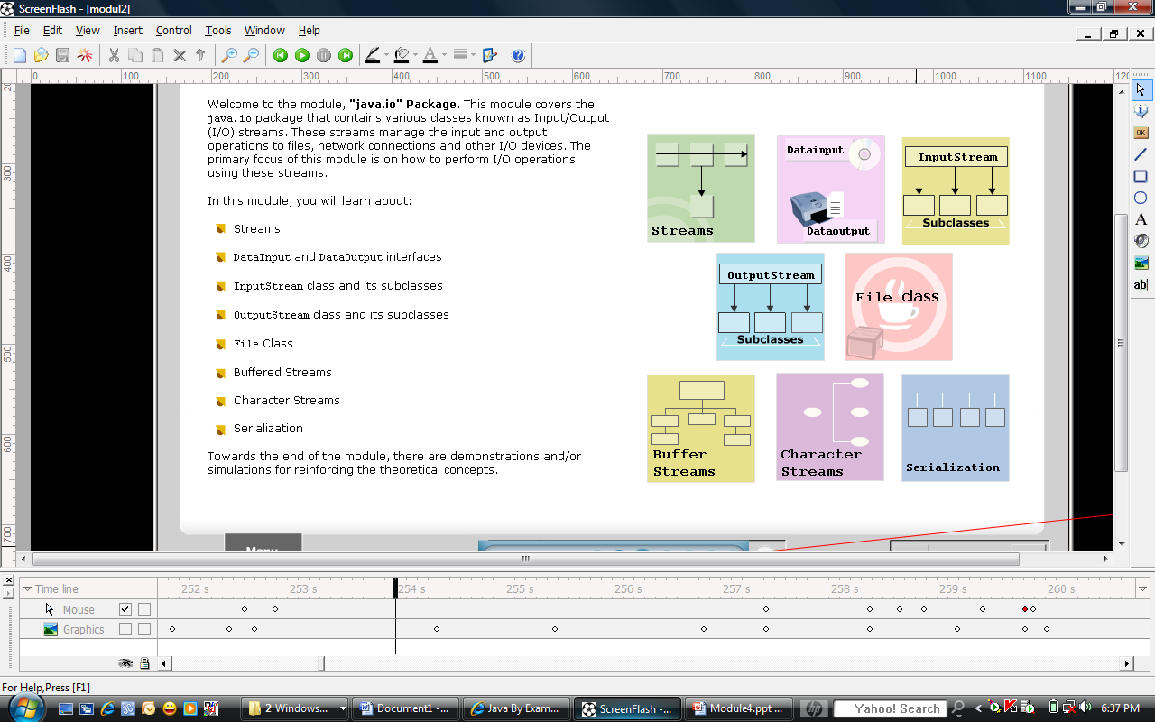
Objectives

Slide 4



Java Input Output(IO) is one of the most important topics in Java

Slide 5

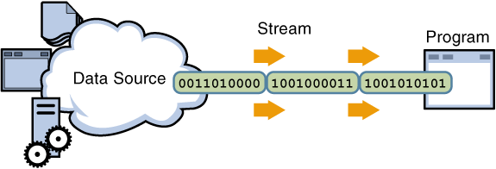
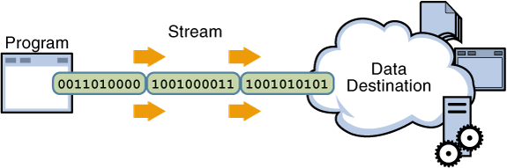
A stream is an ordered sequence of bytes of indeterminate length.
A data stream is a channel through which data travels from a source to a destination
There are two type of stream:
  Input Stream
  Output Stream

Slide 6

The Stream classes in Java's I/O libraries are designed in an abstract way that enables you to read from external data sources and write to external targets.
Reading and writing without caring where your data is coming from or where it's going is a very powerful abstraction.
For example: You use the same methods to read from a file that you do to read from a console, a network connection, a serial port device etc..

Slide 7

IO operations involved three steps:
Open an input/output stream associated with a physical device (e.g., file, network, console/keyboard), by constructing an appropriate IO-stream object.
Read from the opened input stream until "end-of-stream" encountered,
or Write to the opened output stream (optionally flush the buffered output).
Close the input/output stream.

Slide 8

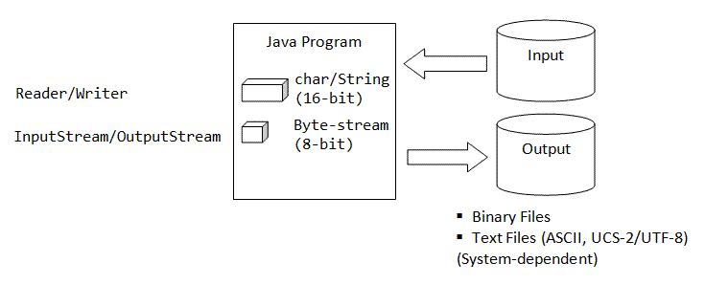
Java's IO operations is more complicated than C/C++
Java uses 16-bit character set (instead of 8-bit character set).
As a consequence, it needs to differentiate between byte-based IO and character-based IO.

Slide 9

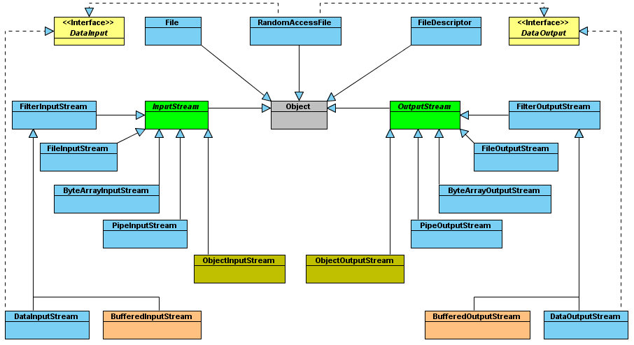
Byte-Based IO & Byte Streams

Slide 10
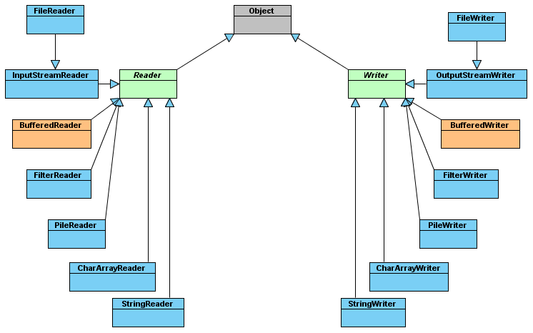
Character-Based IO & Character Streams

Slide 11

Reading bytes from a binary stream and convert the data to any of the Java primitive types
Convert data from Java modified Unicode Transmission Format (UTF) - 8 format into string form
Methods:
  readBoolean()
  readByte()
  readInt()
  readDouble()
  readChar()
  readLine() and readUTF()

Slide 12

Convert data present in Java primitive type into a series of bytes and write them onto a binary stream
Convert string data from into Java modified UTF-8 format and write it into a stream
Methods:
  writeBoolean()
  writeByte()
  writeInt()
  writeDouble()
  writeChar()
  writeChars() and writeUTF()

Slide 13

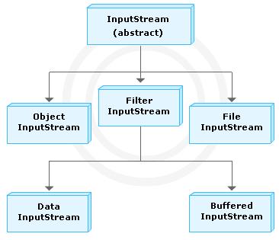
InputStream class is an abstract class that defines how streams receive data and is the superclass of all stream classes
Methods: read(), available(), close(), mark(), skip() and reset()

Slide 14

FileInputStream class is used to read bytes from a file.
FileInputStream class overrides all the methods of the InputStream class except mark() and reset().
ByteArrayInputStream class contains a buffer (a byte array) that stores the bytes that are read from the stream.

Slide 15

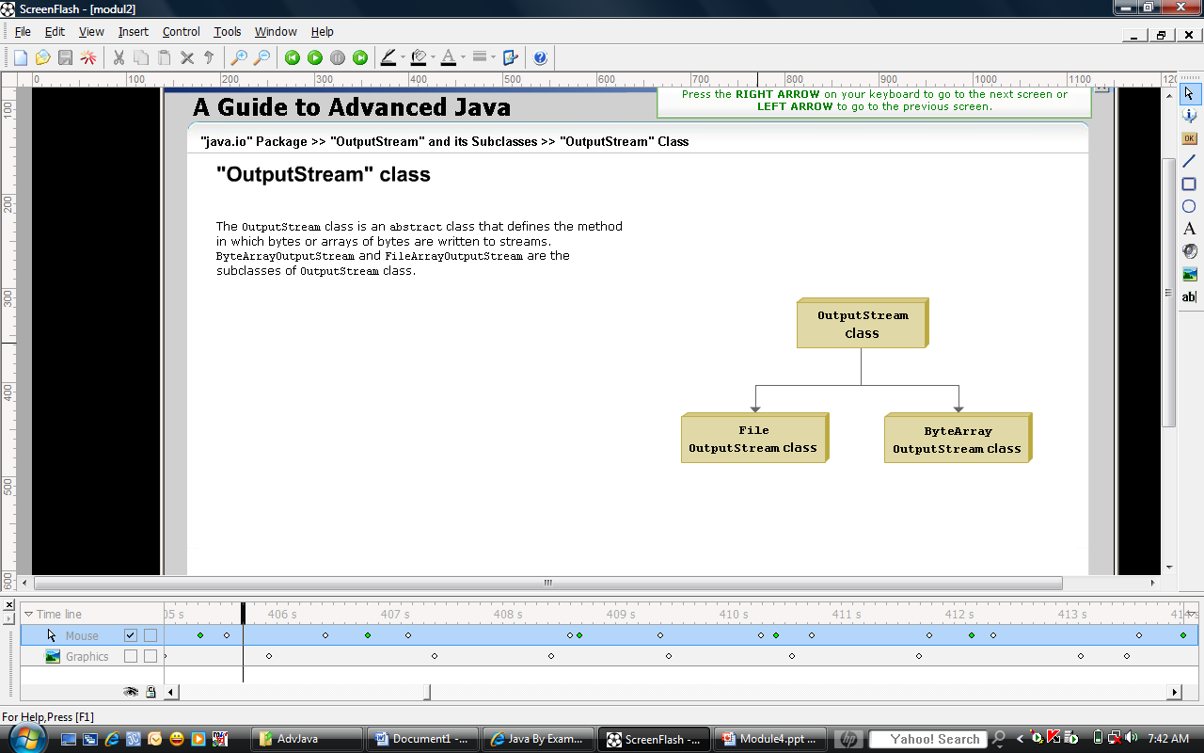
OutputStream class is an abstract class that defines the method in which bytes or array of bytes are written to streams
Methods: write(), flush(), close()…

Slide 16

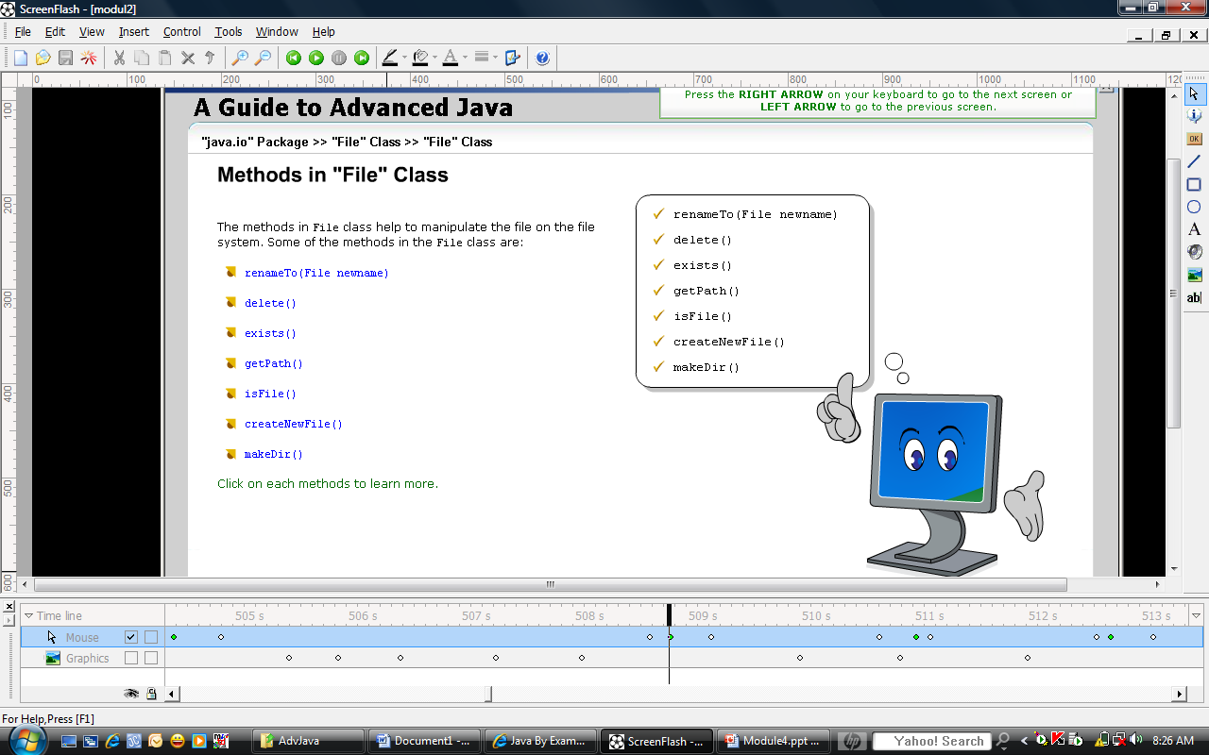
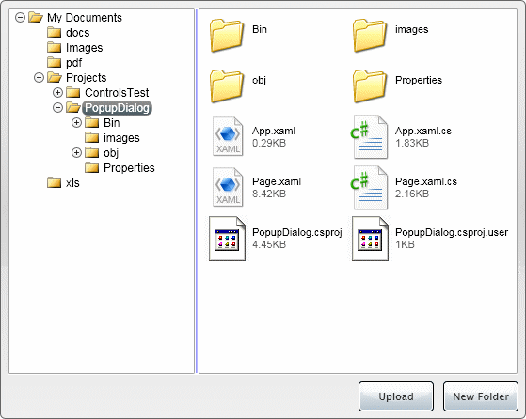
File class directly works with files and directories.
Some common methods:

Slide 17

FileDescriptor class provides access to the file descriptors that are maintained by the OS when files and directories are being accessed
In practical use, a file descriptor is used to create a FileInputStream or FileOutputStream.
Public fields: err, in and out

Slide 18

Open a file:
File file = new File(“filename");
FileInputStream in=new FileInputStream(file);
int byteRead=0;
while (byteRead!=-1) {
byteRead=in.read();
}
Read data:
Save data to a file:
File file = new File(“filename");
FileOutputStream out=new FileOutputStream(file);
int byteRead=0;
while (byteRead!=-1) {
byteRead=in.read();
out.write(byteRead);
}
Close all:
try{
//Do Open, Read, Write data
}catch(IOException ex) {
ex.printStackTrace();
}finally {
try {
if (in != null) in.close();
if (out != null) out.close();
} catch (IOException ex) {
ex.printStackTrace();
}
}

Slide 19

A buffer is a temporary storage area for data.
By storing the data in a buffer, time is saved as data is immediately received from the buffer instead of going back to the original source of the data.(Demo)

Slide 20

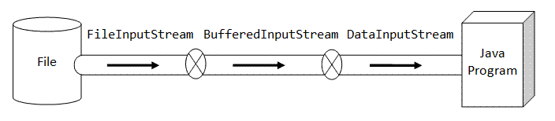
FileInputStream fin = new FileInputStream("in.dat");
BufferedInputStream bin = new BufferedInputStream(fin);
DataInputStream din = new DataInputStream(bin);
// or
DataInputStream in = new DataInputStream(
new BufferedInputStream(
new FileInputStream("in.dat")));

Slide 21
Character-Based IO & Character Streams

Slide 22

Reader class is an abstract class used for reading character streams.
Writer class is an abstract class and supports writing characters into streams.
PrintWriter class is a character-based class that is useful for console output. This class provides support for Unicode characters.

Slide 23

Serialization is the process of reading and writing objects to a byte stream
ObjectInputStream class extends the InputStream class and implements the ObjectInput interface
ObjectInput interface extends DataInput interface and has methods that support object serialization
ObjectOutputStream class extends the OutputStream and implements the ObjectOutput interface
Important methods: ObjectInputStream.readObject(), ObjectOutputStream.writeObject()

Slide 24
Save serialized objects to a stream:
ObjectOutputStream out = new ObjectOutputStream(
new BufferedOutputStream(
new FileOutputStream("object.dat")));
out.writeObject("The current Date and Time is "); // write a String object
out.writeObject(new Date()); // write a Date object out.flush(); out.close();
Load serialized objects from a stream:
ObjectInputStream out = new ObjectInputStream(
new BufferedInputStream(
new FileInputStream("object.dat")));
String str = (String)in.readObject();
Date d = (Date)in.readObject(new Date());
in.close();

Slide 25

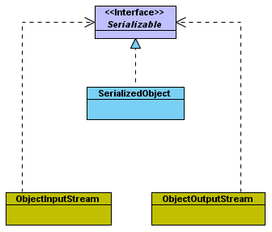
In Java, object that requires to be serialized must implement java.io.Serializable or java.io.Externalizable interface
Serializable interface is an empty interface (or tagged interface) with nothing declared
Its purpose is simply to declare that particular object is serializable.

Slide 26






Input Stream
Character - base
Java Program
Stream
Data Source
Byte- base
Output Stream

Slide 27

Java™ I/O, 2nd Edition By Elliotte Rusty Harold
http://www.meshplex.org/wiki/Java/Java_IO_and_file_Handling
http://72.5.124.55/docs/books/tutorial/essential/io/streams.html
http://www3.ntu.edu.sg/home/ehchua/programming/java/J5b_IO.html

