Slide 1

A Guide to Advanced Java
Faculty:Nguyen Ngoc Tu

Slide 2






Input Stream
Character - base
Java Program
Stream
Data Source
Byte- base
Output Stream

Slide 3

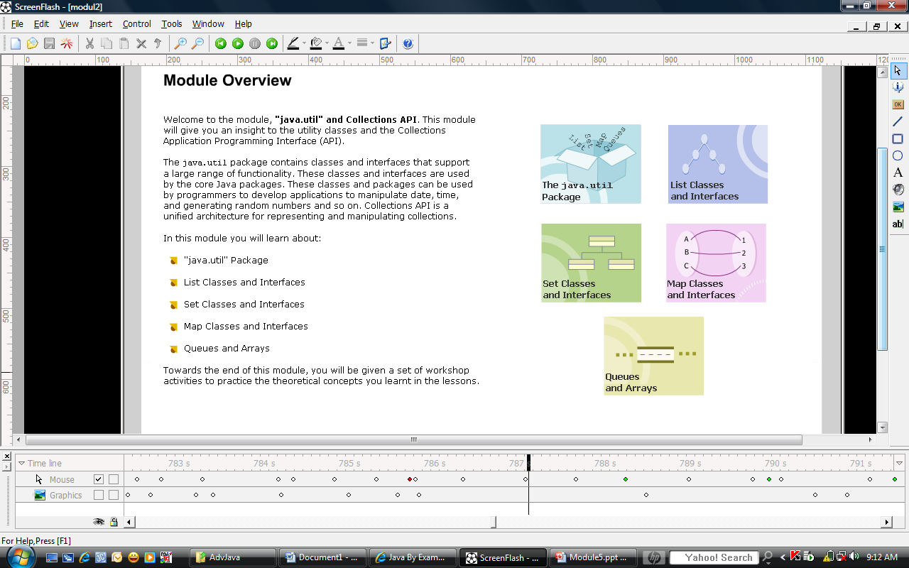
Collections are very important
“If you can program
with Java but you don't understand interfaces yet, you may have some trouble getting through the material in
this session.”
“The topics such as linked lists, queues, stacks, and binary trees, among many other data structures are related topic for this session.”

Slide 4


The java.util package contains the definition of a number of useful classes providing a broad range of functionality
The Historical Collection classes and the Collections Framework belongs to this package.
It consists of interfaces and classes for working with large group of data.
Notes:
http://www.littletoncoin.com/LCC/html/images/st3284a-wc.jpg

Slide 5

These classes are in the standard Java library support available for working with collections of data in Java 1.0 and Java 1.1:
  Arrays
  The Vector and Stack classes
  The Enumeration interface
  The Dictionary, Hashtable, Property classes
  The BitSet class

Slide 6

Let’s try the “historical” collection classes first
Arrays are the only collection support defined within the Java programming language (*).
They are objects that store a set of elements in an order accessible by index, or position.
A simple arrays example:
int[] ary = new int[10];
for(int i=0;i<ary.lenth;i++) {
ary[i]=i*i;
}
(*:so don’t have any java source file for you to see how the internal work)

Slide 7

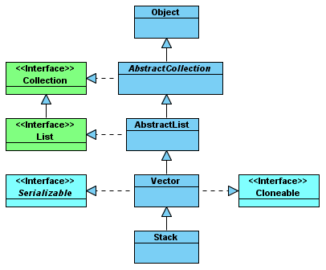
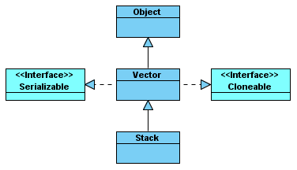
Arrays are good when you know the size of your collection but not suite for dynamically growing collection.
The Vector and Stack (LIFO data structure) class provide the solution for the arrays’ problem.
The Java 1.0/1.1 Vector and Stack class hierarchy
The Vector and Stack class hierarchy

Slide 8

The importance methods in the Vector class:
  addElement(Object e)
  removeElement(Object e)
  elementAt(int pos)
  toArray(): Returns the elements of a vector as an array.
  capacity(): Returns the capacity of an internal buffer for a vector.
  clear(): Clears all elements from a vector.
  size():

Slide 9

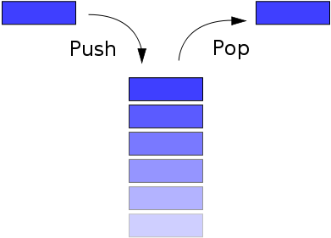
The importance methods in the Stack class:
  Stack() : Constructs an empty stack.
  empty(): Checks if the stack is empty.
  peek(): Fetches an element at the top of the stack.
  pop(): Removes an element from the top of the stack.
  push() : Adds an element to the top of the stack.
  search() :Checks if an element is on the stack.

Slide 10

Summary of Interface Enumeration:
  hasMoreElements() : Checks for more elements in the enumeration.
  nextElement() : Fetches next element of the enumeration.
Vector v;
//…
for(int i=0;i<v.size();i++) {
Object obj=v.elementAt(i);
//do something with obj
}
Vector v;
//…
Enumaration enum=v.elements();
while(enum.hasMoreElement()) {
Object obj=enum.nextElement();
//do something with obj
}
Vector v;
//…
for(Object obj : v) {
//do something with obj
}

Slide 11

The Java Collections Framework added to the core set of Java classes with the release of the Java 2 platform, version 1.2
The Collections Framework consists of three parts: interfaces, implementations, and algorithms .
It should be of high-performance
The different types of collections should work similar to each other and should have interoperability.
It should be easy to use and extend a collection

Slide 12

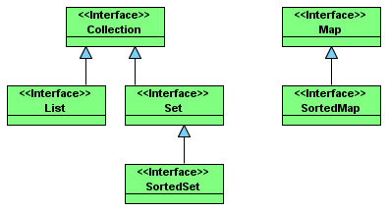

Slide 13

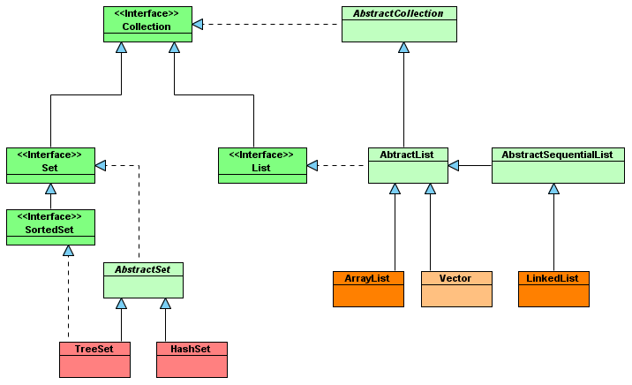

Slide 14

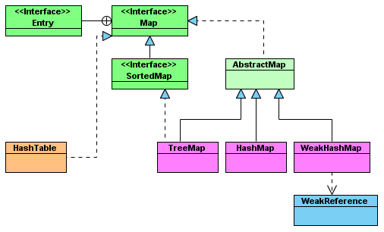

Slide 15

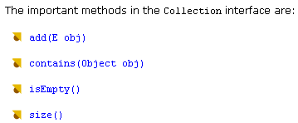

Slide 16

The List interface is an extension of the Collection interface.
It defines an ordered collection of data and allows duplicate objects to be added to a list.
The List interface uses an index for ordering the elements while storing them in a list. List has methods that allow access to elements based on their position.

Slide 17

Method of the List interface:
  add(int index,Object o)
  addAll(int index,Collection c)
  get(int index)
  set(int index)
  remove(int index)
  subList(int start,int end)

Slide 18

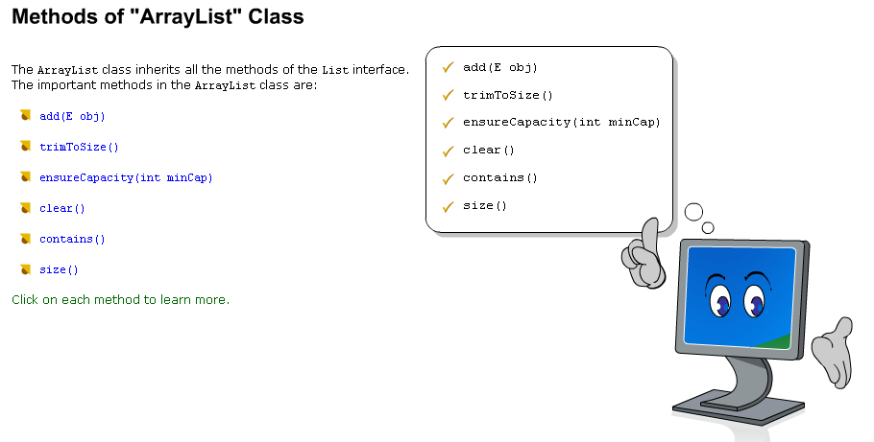

Slide 19

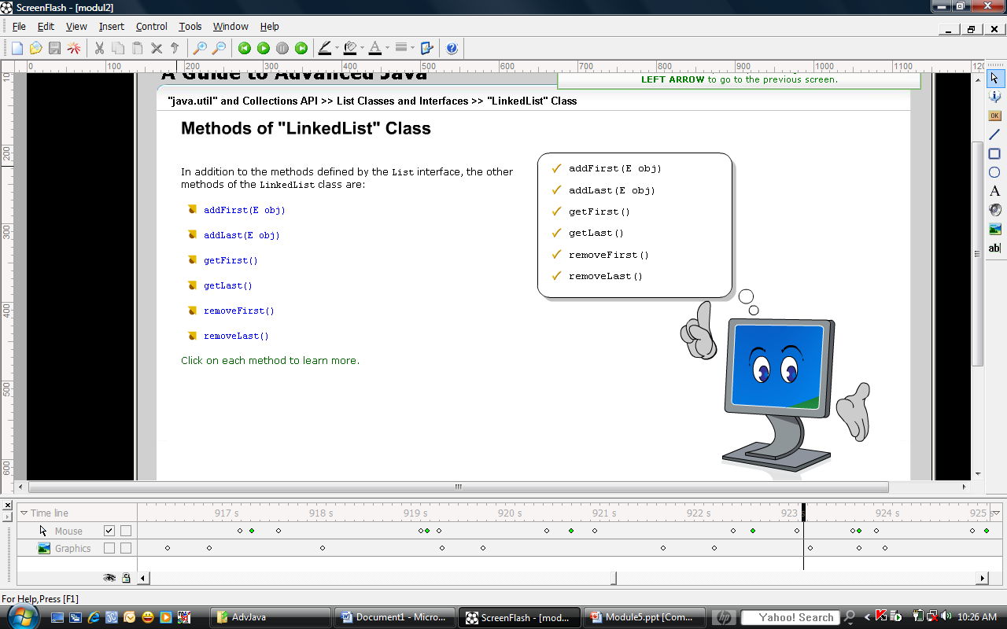

Slide 20

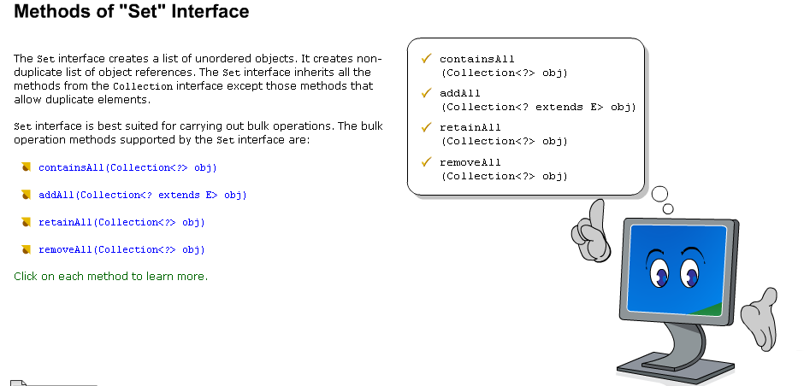

Slide 21

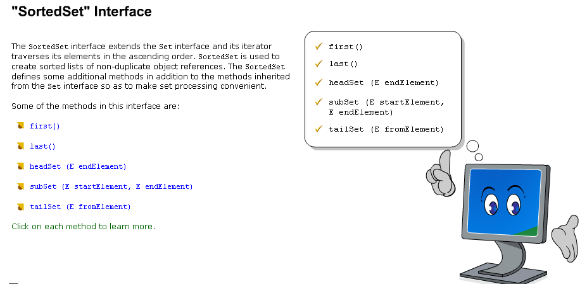

Slide 22

HashSet class implements the Set interface, a HasSet creates a collection that makes use of a hash table for data storage
LinkHashSet class creates a list of elements and maintains the order of elements added to the Set
TreeSet class implements the Set interface and uses the tree structure for data storage. Objects are stored in ascending order

Slide 23

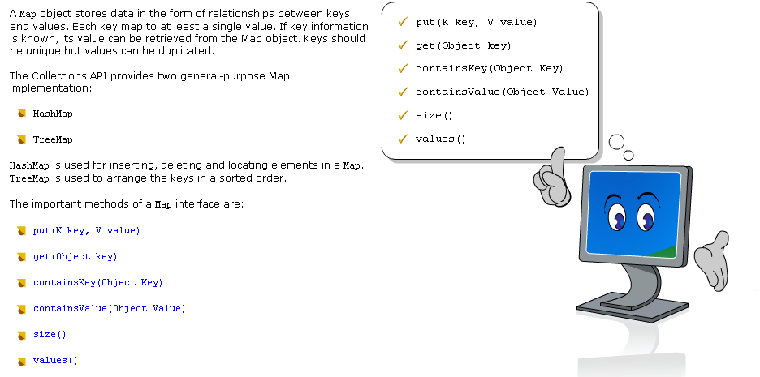

Slide 24

HashMap class implements the Map interface
Hashtable class stores elements as a key/value pairs in the hash table
TreeMap class stores elements as tree structure and returns keys in sorted order. Important methods of the TreeMap class are firstKey(), lastKey(), headMap(), tailMap()
LinkedHashMap class implements the concept of hash table and the linked list in the Map interface. Important methods of the LinkedHashMap class are clear(), containsValue(), get(), removeEldesEntry()

Slide 25

In Queue, the elements are normally ordered in First In First Out – FIFO order
The priority queue orders the element according to their values
The important methods are
  poll(),
  peek(),
  remove(),
  offer()
  elements()

Slide 26

Priority queues similar to queues but the elements are not arranged in FIFO structure. They are arranged in a user-defined manner.
The elements are ordered either by natural ordering or according to a comparator.
A priority queue is unbound and allows the queue to grow in capacity.

Slide 27

Arrays class provide a number of methods for working with arrays such as searching, sorting and comparing arrays
The important methods are
  equals(),
  fill(),
  sort(),
  binarySearch(),
  toString()

Slide 28

If you need to store primitive elements, you must use an array unless you want to place every item into a wrapper class like Integer or Float. Consider using a BitSet instead of an array of booleans.
Rarely, if ever, should you use an historical collection class like Hashtable or Vector. Sometimes you need to use a Properties object, which is a type of Hashtable. Unless explicitly called for—as when using the JavaMail API—the historical collection class should be avoided in favor of the newer framework implementations.

Slide 29

Use a List if you need ordered access. Pick an ArrayList for indexed access. Definitely use a LinkedList when you need to add and remove elements from the beginning or middle of the list. If you only need ordered access through an Iterator, believe it or not, LinkedList is actually faster. Lists are also good if your collection requires the storing of duplicates, triplicates, or more.
Sets are for storing unique items in a collection. If you need ordered access, use a TreeSet. Otherwise, use a HashSet. If you only need ordered access after all the elements have been added, consider creating the set with a HashSet, then copying all the elements into a TreeSet.

Slide 30
Use a Map if you need to store key−value pairs and the key isn't an integer. (Consider using an array or List for indexed access.) Like Set, you should always use the hashed version of the collection (HashMap) unless you need sorted access (TreeMap).
Rely on the Collections class to make collections and maps read−only and thread−safe.
Use the WeakHashMap if you need to maintain weak references to keys stored in the map.

Slide 31


Slide 32

Java Collections John Zukowski
http://www.ibm.com/developerworks/java/library/j-arrays/

