Slide 1

Module 6 – Generics
Module 7 – Regular Expressions

Slide 2

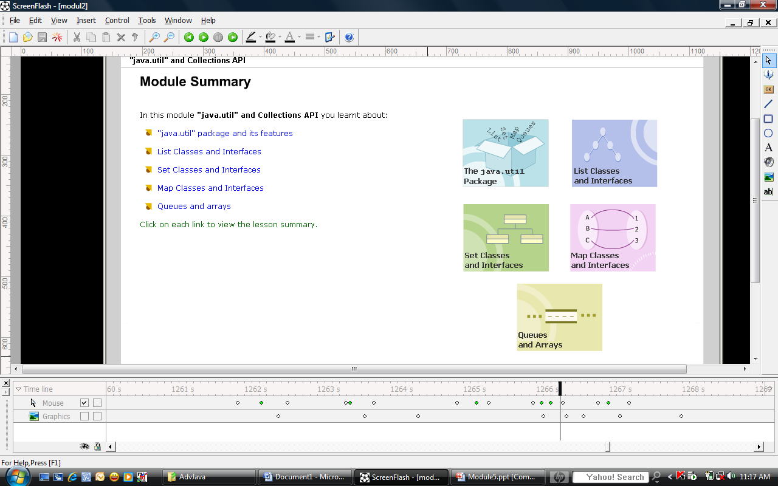

Slide 3

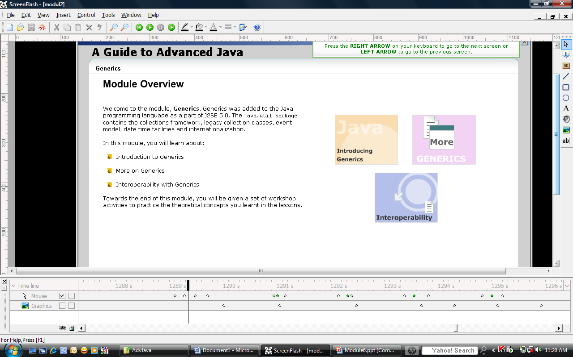
Objectives
A Guide To Advanced Java – Module 6
Advanced Java / Session5 / <number> of 29

Slide 4

Genericity is a way by which programmers can specify the type of object that a class can work with via parameters passed at declaration time and evaluated at compile time.
Generic allows the programmer to communicate the type of a collection to compiler so that it can be checked.
A Guide To Advanced Java – Module 6
Advanced Java / Session5 / <number> of 29

Slide 5

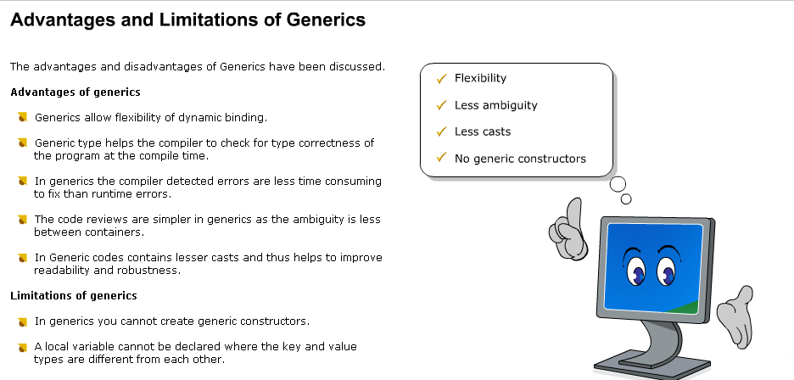

Slide 6

A generic class is a mechanism to specify the type relationship between a component type and its object type
Syntax for declaring a generic class
class ClassName <T> {}
Syntax to create an instance of the generic class
ClassName<specific datatype> obj = new ClassName<specific datatype>();
A Guide To Advanced Java – Module 6
Advanced Java / Session5 / <number> of 29

Slide 7

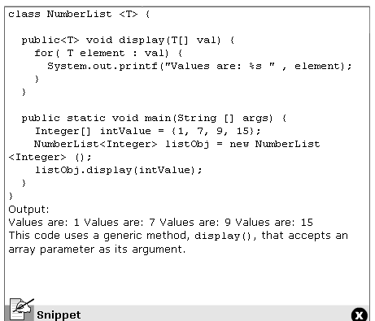

Slide 8

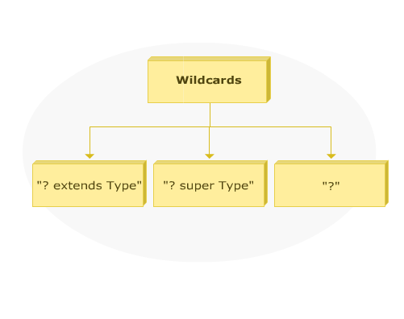

Slide 9

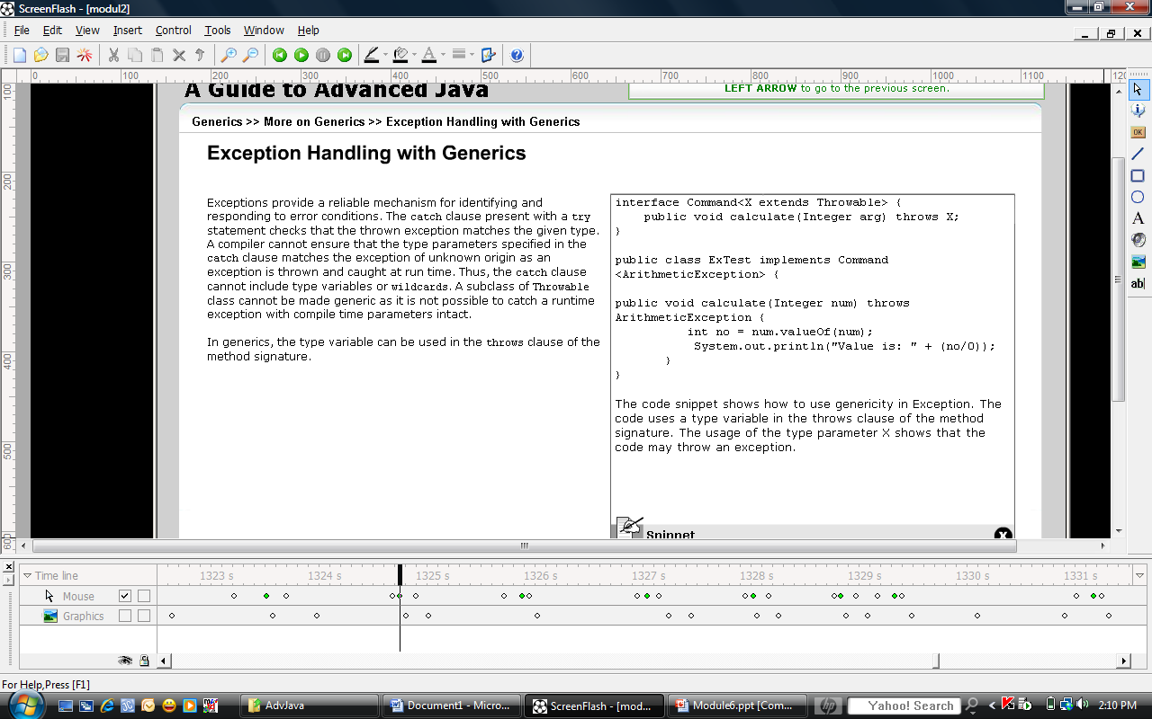
A Guide To Advanced Java – Module 6
Advanced Java / Session5 / <number> of 29

Slide 10

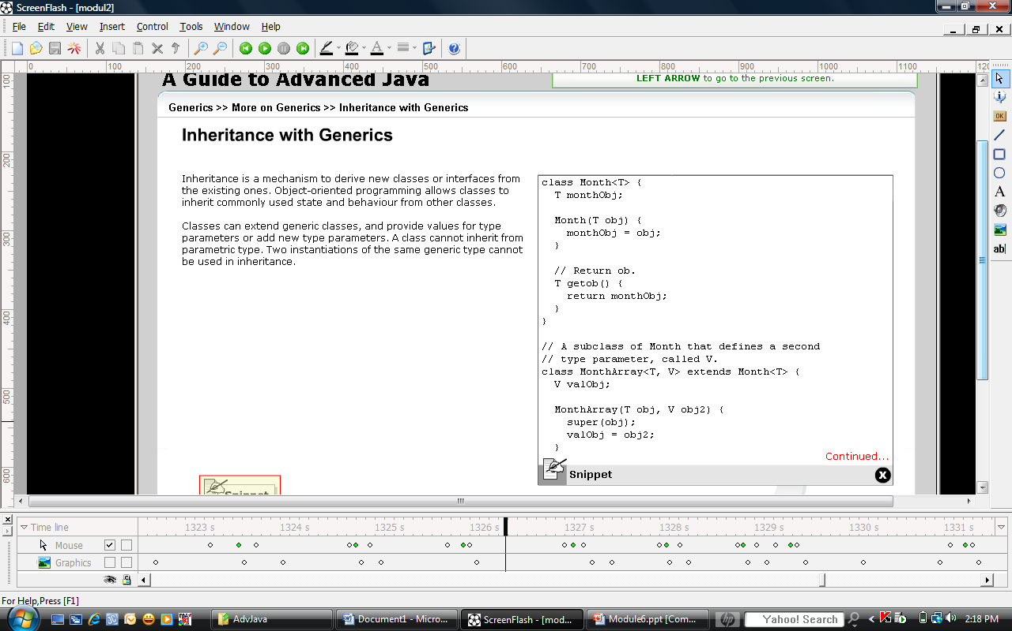

Slide 11

In Java, genericity ensures that the same class file is generated by both legacy and generic version with some additional information about types.
In generic code, the classes are accompanied by a type parameter. When a generic type like collection is used without a type parameter, it is called a raw type
Erasure removes all generic type information. All the type information between angle brackets is thrown out.
A Guide To Advanced Java – Module 6
Advanced Java / Session5 / <number> of 29

Slide 12

A generic library should be created when there is access to source code.
Update the entire library source as well as the client code to eliminate potential unchecked warning.
A Guide To Advanced Java – Module 6
Advanced Java / Session5 / <number> of 29

Slide 13

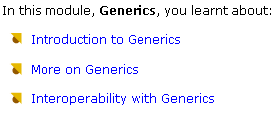

Slide 14

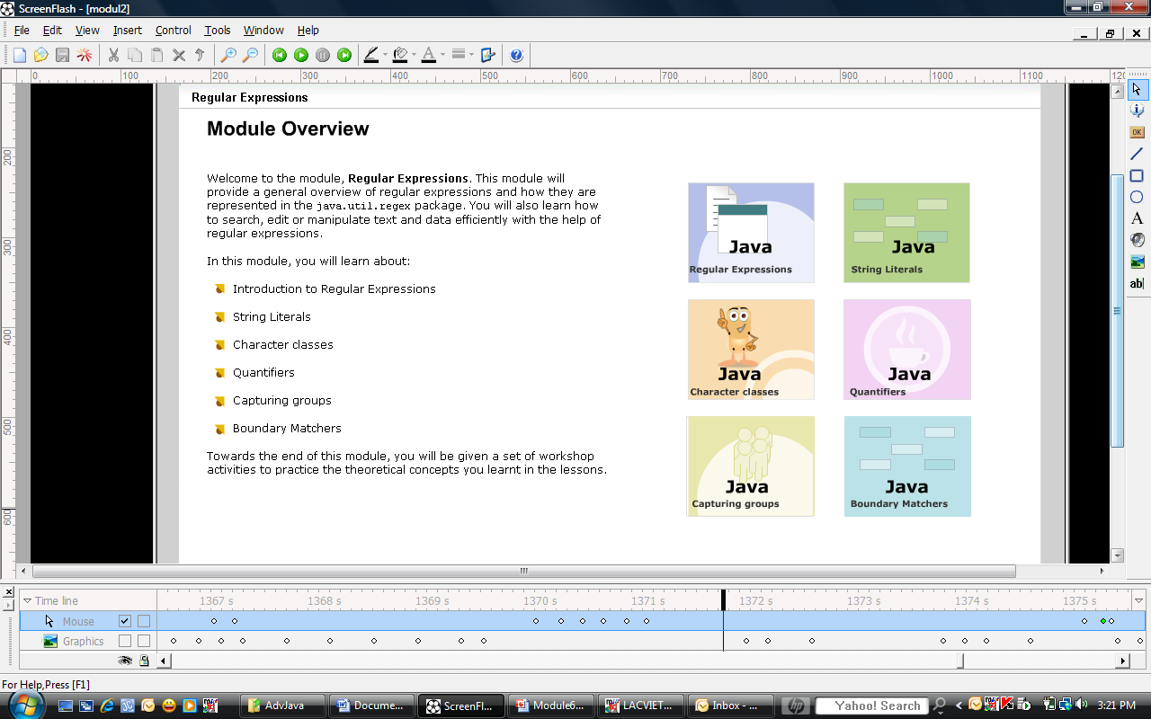
Writing a regular expression is more than a skill -- it's an art.
-- Jeffrey Friedl

Slide 15

Regular Expression (regex) is a string consisting of characteristics that matches a string in the set of strings.
They are used to search, edit and manipulate text base on patterns.
Regular expression package, java.util.regex consists of classes which allow pattern matching.
A Guide To Advanced Java – Module 7
Advanced Java / Session5 / <number> of 29

Slide 16

The three main classes present in the regex API
  java.util.regex.Pattern: the Pattern object is a compiled regular expression that can be applied to any number of strings
  java.util.regex.Matcher : the Matcher object is an individual instance of that regex being applied to a specific target string
  java.util.regex.PatternSyntaxException: object is an unchecked exception that indicates a syntax error in a regular expression pattern.
A Guide To Advanced Java – Module 7
Advanced Java / Session5 / <number> of 29

Slide 17

String Literals
Character classes
Quantifiers
Capturing Groups
Boundary Matchers
Backreferences
Advanced Java / Session5 / <number> of 29

Slide 18

Literal is a constant value used to initialize variables
Metacharacters are the special characters which effect the way a pattern is matched. They are ([{\^-$|}])?*+.
The two ways by which a metacharacter can be treated as an ordinary character:
  Precede the metacharacter with a backslash
  Enclose the metacharacter by specifying \Q at the beginning and \E at the end.
A Guide To Advanced Java – Module 7
Advanced Java / Session5 / <number> of 29

Slide 19

Simple classes is formed by placing a set of characters side-by-side within square brackets
Negation classes can be represented by inserting the metacharacter “^” at the beginning of character class.
Range classes:
  The metacharacter, “-”, is inserted between the first and last character to specify a range of value to be matched
  Different ranges can be placed by the side of each other to increase the matching probabilities
A Guide To Advanced Java – Module 7
Advanced Java / Session5 / <number> of 29

Slide 20

Character Classes
[abc] | a, b, or c (simple class)
[^abc] | Any character except a, b, or c (negation)
[a-zA-Z] | a through z, or A through Z, inclusive (range)
[a-d[m-p]] | a through d, or m through p: [a-dm-p] (union)
[a-z&&[def]] | d, e, or f (intersection)
[a-z&&[^bc]] | a through z, except for b and c: [ad-z] (subtraction)
[a-z&&[^m-p]] | a through z, and not m through p: [a-lq-z] (subtraction)
Advanced Java / Session5 / <number> of 29

Slide 21

Unions create a single character class comprising of two or more separate character classes, such as [X[Y]]
Intersection create a single character class which matches to characters that are common to all its nested class, such as [X&&[Y]]
Subtraction is used to negate one or more nested character classes, such as [X&&[^Y]]
A Guide To Advanced Java – Module 7
Advanced Java / Session5 / <number> of 29

Slide 22

Predefined Character Classes
. | Any character (may or may not match line terminators)
\d | A digit: [0-9]
\D | A non-digit: [^0-9]
\s | A whitespace character: [ \t\n\x0B\f\r]
\S | A non-whitespace character: [^\s]
\w | A word character: [a-zA-Z_0-9]
\W | A non-word character: [^\w]
Advanced Java / Session5 / <number> of 29

Slide 23

Quantifiers allow the user to specify the number of occurrences for a match to match against
There are three types of quantifiers:
  Greedy
  Reluctant
  Possessive
A Guide To Advanced Java – Module 7
Advanced Java / Session5 / <number> of 29

Slide 24
Quantifiers |  |  | Meaning
Greedy | Reluctant | Possessive
X? | X?? | X?+ | X, once or not at all
X* | X*? | X*+ | X, zero or more times
X+ | X+? | X++ | X, one or more times
X{n} | X{n}? | X{n}+ | X, exactly n times
X{n,} | X{n,}? | X{n,}+ | X, at least n times
X{n,m} | X{n,m}? | X{n,m}+ | X, at least n but not more than m times
Advanced Java / Session5 / <number> of 29

Slide 25

Greedy quantifiers force the matcher object to read in the entire input string as one before attempting even the first match
If the entire input string fails, the matcher will leave one character from the input string until a match is found or there are no more characters left to back off from
A Guide To Advanced Java – Module 7
Advanced Java / Session5 / <number> of 29

Slide 26

The start from the beginning of the input string, and then reluctantly accept one character at a time looking for a match.
Reluctant behavior is specified by appending the "?" symbol to the pattern.
A Guide To Advanced Java – Module 7
Advanced Java / Session5 / <number> of 29

Slide 27

Possessive quantifiers match as many characters as it can like the greedy quantifiers. At some instances if this character is not able to be performed then it fails.
Possessive behavior is specified by appending the "+" symbol to the pattern.
A Guide To Advanced Java – Module 7
Advanced Java / Session5 / <number> of 29

Slide 28

"The red fox jumped over the red fence"
/(.*)red/ => \1 = "The red fox jumped over the "
/(.*?)red/ => \1 = "The "
"aaa"
/a?a*/ => \1 = "a", \2 = "aa"
/a??a*/ => \1 = "", \2 = "aaa"
"Mr. Doe, John"
/^(?:Mrs?.)?.*\b(.*)$/ => \1 = "John"
/^(?:Mrs?.)?.*?\b(.*)$/ => \1 = "Doe, John"
Advanced Java / Session5 / <number> of 29

Slide 29

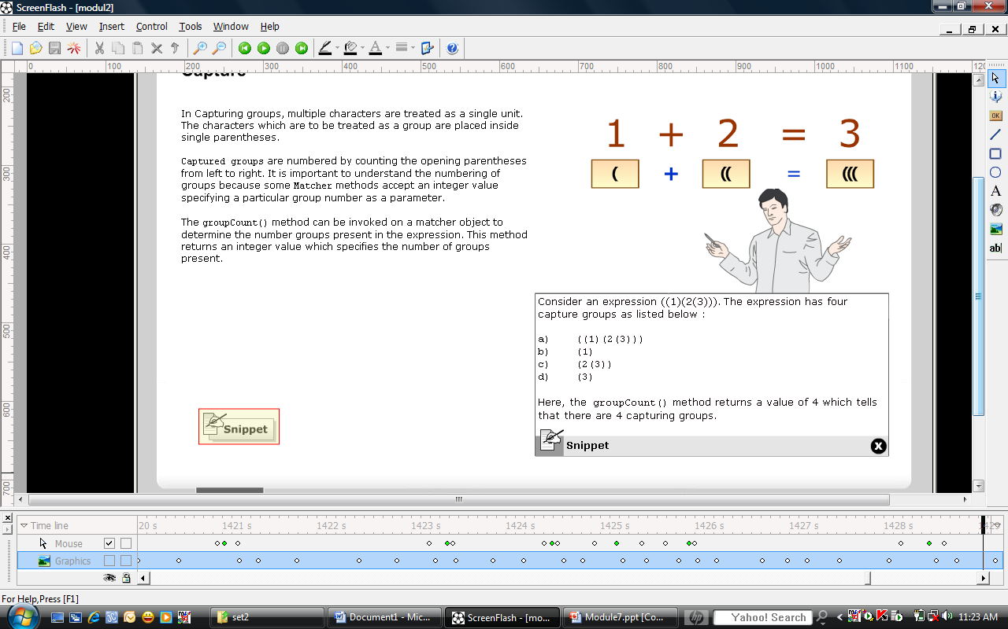
In capturing group, multiple characters are treated as a single unit, which are placed inside single parentheses
Captured groups are numbered by counting the open parentheses from left to right
A Guide To Advanced Java – Module 7
Advanced Java / Session5 / <number> of 29

Slide 30

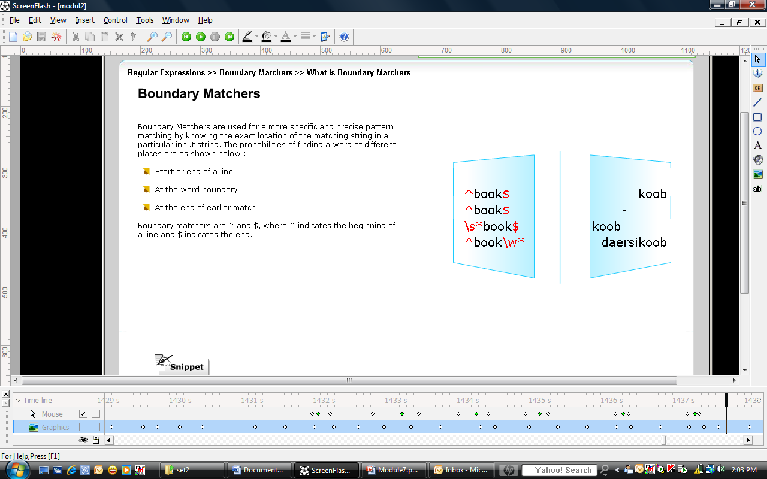

Slide 31
Boundary Matchers
^ | The beginning of a line
$ | The end of a line
\b | A word boundary
\B | A non-word boundary
\A | The beginning of the input
\G | The end of the previous match
\Z | The end of the input but for the final terminator, if any
\z | The end of the input

Slide 32

Backreferencing is a process in which a particular section of the string matching the captured group is kept in memory for future use.
To recall a particular group, you may use backslash followed by a digit indicating the number of group. This can be specified as a backreference in the regular expression.
  String regex: (\w\w)\1
  String input: papa
  Result: Found “pa” in group(1)
A Guide To Advanced Java – Module 7
Advanced Java / Session5 / <number> of 29

Slide 33

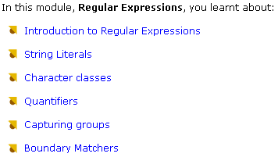

Slide 34

Mastering Regular Expressions Perl, .NET, Java, and more Jeffrey E.F. Friedl
http://java.sun.com/docs/books/tutorial/essential/regex/test_harness.html
http://www.javaworld.com/javaworld/jw-09-2007/jw-09-optimizingregex.html?page=1
http://stackoverflow.com/questions/1139171/what-is-the-difference-between-greedy-and-reluctant-quantifiers
http://w3schools.com/jsref/jsref_obj_regexp.asp
http://java.sun.com/j2se/1.5.0/docs/api/java/util/regex/Pattern.html
http://www.regular-expressions.info
Advanced Java / Session5 / <number> of 29

