Slide 1

Distributed programming in Java
Session 5 - RMI
Faculty:Nguyen Ngoc Tu

Slide 2
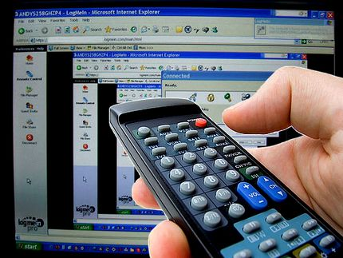
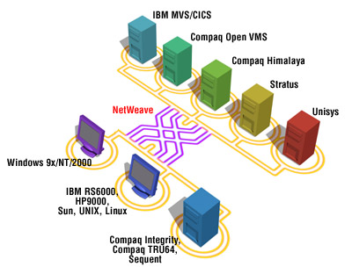
Session 5 - RMI
Distributed programming in Java

Slide 3
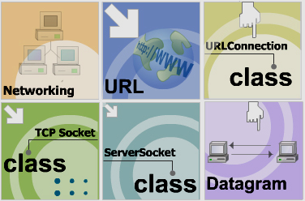
Networking

Slide 4
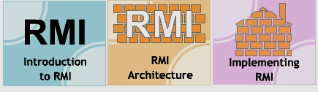
RMI

Slide 5
What is RMI?
RMI enables the programmer to create distribute Java applications, in which the methods of remote Java objects can be invoked from other Java virtual machines, possibly on different hosts.
A Java program can make a call on a remote object once it obtains a reference to the remote object, either by looking up the remote object in the naming service provided by RMI or by receiving the reference as an argument or a return value. A client can call a remote object in a server, and that server can also be a client of other remote objects.
RMI uses object serialization to marshal and unmarshal parameters.

Slide 6
Remote Method Invocation
network
Object
Client
Remote
Object
Server
method invocation
Host abc.com
Host xyz.com

Slide 7
Reverse Service Example
call(“1234567abc”)
ClientObject
ReverseService
“cba7654321”
call(true)
false
Client
Server

Slide 8
Remote Reference
Encapsulates network communication
Same interface as Remote object
Object
Client
Remote
Object
Stub
Remote
Object
f()
01101
RMI
Runtime
f()
true
10010
true
Host abc.com
Host xyz.com

Slide 9
Naming Service
Directory that associates names to remote objects (bind)
Remote
Object
A
Naming
“X”
Remote
Object
C
“Y”
Remote
Object
B
“Z”
Host xyz.com

Slide 10
Naming Service
Client use Naming Service to find a particular Server object (lookup)
Naming
Object
Client
“X”
Remote
Object
Server
lookup(“Y”)
“Y”
Remote ref.
to Server
“Z”
abc.com
Host xyz.com

Slide 11
Creating Remote object
Create an interface
Create the implementation
Compile
Create the Stub

Slide 12
Interface
public interface ReverseService extends Remote{
public String call(String s)
throws RemoteException;
public boolean call(boolean b)
throws RemoteException;
}

Slide 13
Implementation class
public class ReverseServiceImpl
extends UnicastRemoteObject
implements ReverseService {
public ReverseServiceImpl()
throws RemoteException{super();}
public String call(String a){ …code… }
public boolean call(boolean b){ …code… }
}

Slide 14
Stub
In Netbeans stub class is generated automatically
By hand: use rmic tool:
rmic ReserveServiceImpl

Slide 15
Binding (server side)
Binding means: register the object in local Naming service:
Naming.rebind(
“MyService”,
new ReverseServiceImpl());

Slide 16
Locating (client side)
Lookup operation return the reference (stub) on a remote object:
ReverseService service =
(ReverseService)Naming.lookup(
“//xyz.com/MyService”);

Slide 17
Parameters and Return Values
Remote objects – by reference
Serializable objects - by copy
Others – cannot be passed (exception)

Slide 18
Deployment
On the server host:
  Launch Naming service
rmiregistry
  Launch Server program
java Server
On the client host(s):
  Launch the client program

Slide 19
References
Java Tutorial on RMI:
http://java.sun.com/j2se/1.4/docs/guide/rmi
Book on RMI:
William Grosso “Java RMI”, O’Reilly

Slide 20


Slide 21

Java Thread Programming by Paul Hyde
http://java.sun.com/docs/books/tutorial/essential/concurrency/
http://www.javaworld.com/javaworld/jw-04-1996/jw-04-threads.html
http://www.javapassion.com/javaintro/index.html#Threading_Basics

