Slide 1
Session 4
Module 7: Networking

Slide 2
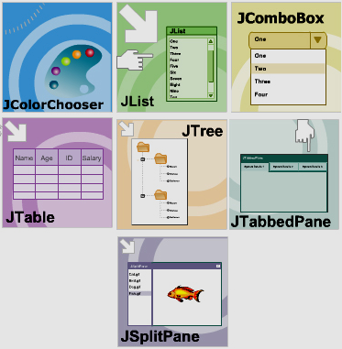
Module 5 Review

Slide 3
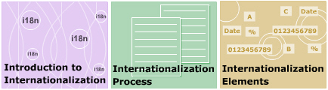
Module 6 Review

Slide 4
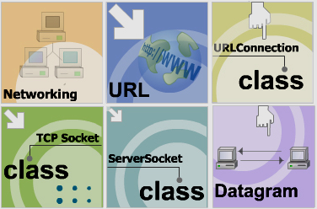
Module 7- Networking
Client/Server Demo

Slide 5
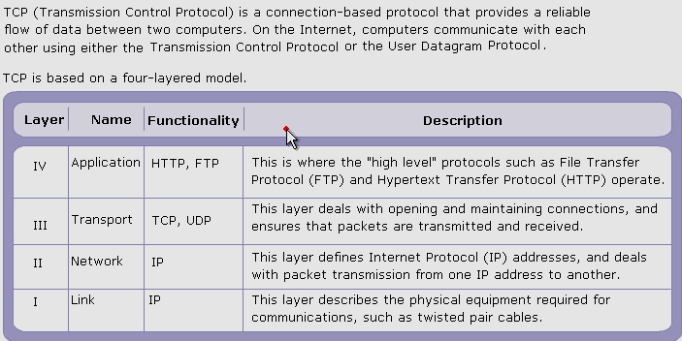
Introduction to Networking

Slide 6
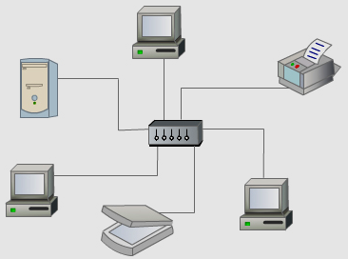
How computers communicate?
IP:
152.3.21.121
Personal computer IP:
127.0.0.1

Slide 7
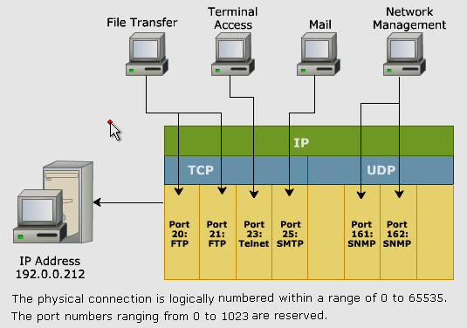
Ports

Slide 8


URL- Uniform Resource Locator
http://www.abc.com:80/users/index.html
Protocol
://
Host
:
Port
(option)
File
Class java.net.URL
Constructors

Slide 9


Class InetAddress
This class represents an Internet Protocol (IP) address.
Common used Methods of InetAddress class

Slide 10

Class URLConnection
Abstract class
Used to read content refered by URLs
Use the openConnection() method of URL class to get a
URL connection
Methods of URLConnection to read/write data from/to open connection
  getInputStream()
  getOutputStream()

Slide 11
Network Programming with
Transmission Control Protocol

Slide 12
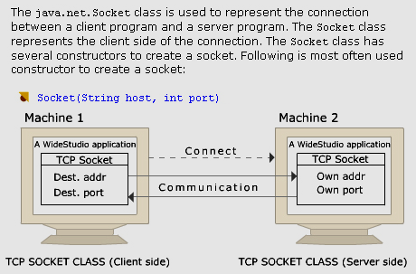
Class java.net.Socket

Slide 13
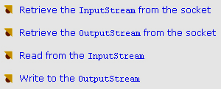
Reading from/ Writing to a Socket
Application
Socket
var1
InputStream
var2
OutputStream

Slide 14
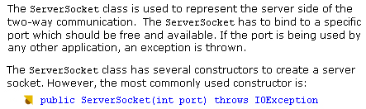
Class java.net.ServerSocket

Slide 15
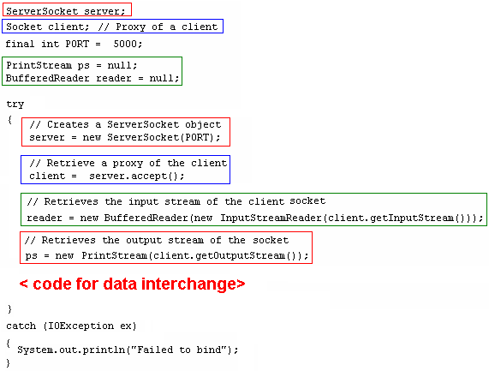
ServerSocket….

Slide 16
Network Programming with
User Datagram Protocol

Slide 17
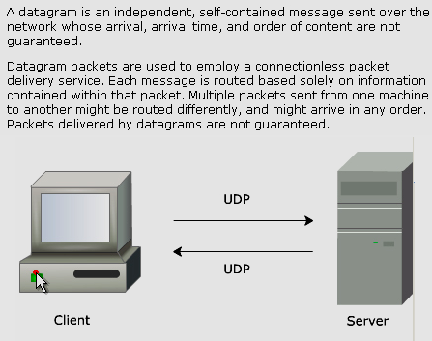
UDP and Datagram Package

Slide 18
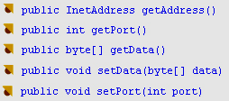
Class java.net.Datagram
Constructors:
Datagram(byte[] buffer, int length)
Datagram(byte[] buffer, int length,
InetAddress addr, int port )
Common used methods

Slide 19
class java.net.DatagramSocket
Constructors:
DatagramSocket(int port) // local lost
DatagramSocket(int port, InetAddress addr)
Common used methods
public void send( DatagramPacket p)
public void receive( DatagramPacket p)

Slide 20
Client/Server Demo(1)
TCP

Slide 21
Client/Server Demo(2)
UDP

Slide 22
Module 7 Summary

