Slide 1
Session 5
Module 8: RMI

Slide 2
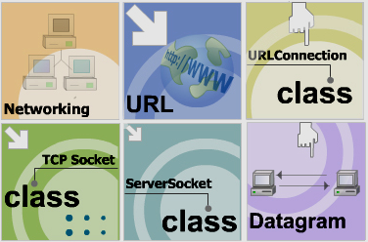
Module 7 Review

Slide 3
Module 8: Objectives
Remote Method Invocation in general
What is RMI?
RMI Architecture
RMI Working Mechanism
Steps to implement RMI
Run Server object and Client object

Slide 4

Remote Method Invocation in general
(1) file.html
Server
Search file.html, read file.html,
send content of file.html
Network
Environment
(2) file.asp
Server
Search file.asp, read file.asp,
run server code, send html result
Server
(a) if called object is not loadded, load the class,
init the object.
(b) The server object executes the called methods
(c) Sent method result to client
(2) call a method
of an object that is
running at server

Slide 5
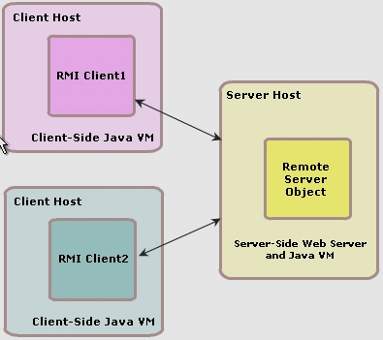
What is RMI?

Slide 6
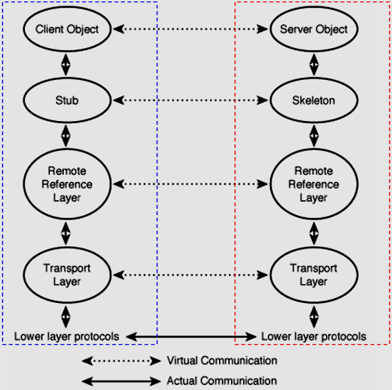
RMI Architecture

Slide 7
RMI Working Mechanism
Server class
bind
Client class
Lookup server object
Server_Stub
RMI Container
( rmiregistry.exe)
Server database
[ Name1, serverObject1]
[ Name2, serverObject2]
…
Network
Environment
Client JVM
Server JVM

Slide 8
Steps to implement RMI
Run Server object and Client object
Implementing RMI
Run RMI Application
Create Remote interface
If (rmiregistry is not called in Server class)
Run rmiregistry
Create Remote Class
implements Remote interface
Run Server class
Create Remote Stub class,
Remote Skeleton class
using rmic.exe
( From jdk 1.5,
remote skeleton is omitted)
Run Client class
Copy Remote interface,
Remote Stub class to Client
Create Client class,

Slide 9
RMI step by step

Slide 10
RMI demo

Slide 11
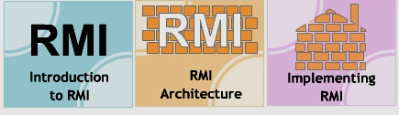
Module 8 Summary

