Slide 1
Variational Inference
Krzysztof Kolasiński, 14.11.2017

Slide 2
Content
Motivation
Linear regression y=wx+b
Variational Inference for LR
Examples in Edward

Slide 3
A motivations for studying Bayesian methods
PROS:
Bayesian framework allows for capturing model uncertainty (medicine)
Can incorporate prior knowledge
Useful when dealing with small dataset
More robust against overfitting
Possibly more robust against adversarial examples (some promising results)
CONS:
computationally more demanding,
in many applications we are forced to use approximations,
in case of deep learning problem still wore in performance than standard approach (MLE)
Can incorporate prior knowledge

Slide 4
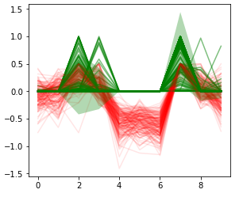
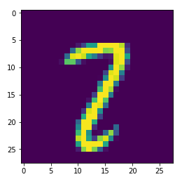
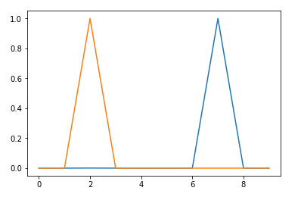
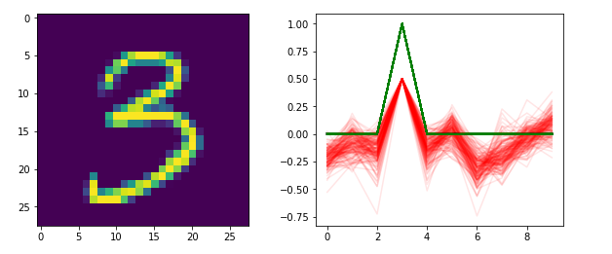
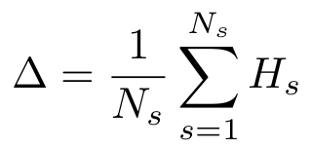

The motivation - demos
The biggest advantage of using Bayesian approach is knowledge about prediction uncertainty
We already have some experience with MCDropout
Badly classified example
Predictions of standard model. Dropout switched to test mode
Samples from permanent dropout - same model, same weights.
Correctly classified example
We captured the uncertainty by measuring the mean entropy of class probabilities over computed samples

Slide 5

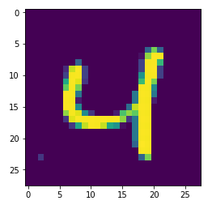
The motivation
The biggest advantage of using Bayesian approach is knowledge about prediction uncertainty
We captured the uncertainty by measuring the mean entropy of class probabilities over computed samples. With N_{s}~32.
On separate dataset (validation) we computed the “best” threshold value delta_{th} above which we categorized samples as unreadable.
The same technique was applied to find rotated objects in detection pipeline.
MCDropout improved our predictions
but at cost of longer inference time since sampling is required.

Slide 6
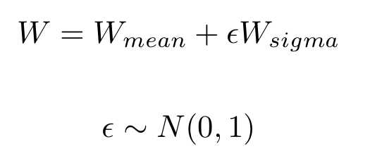
Bayesian approach as alternative for MCDropout (for us)
The biggest advantage of using Bayesian approach is knowledge about prediction uncertainty
MCDropout drops randomly activations in model,
Bayesian networks can do it by explicitly modeling models parameters as random variables
In Variational Inference we implement them using the reparametrization trick:
During the inference we sample W by sampling epsilon and then perform prediction.
The idea is to apply Bayesian inference instead of MCDropout and check if it will work better.

Slide 7
A linear regression case

Slide 8


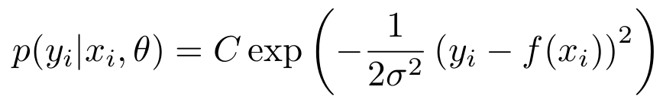
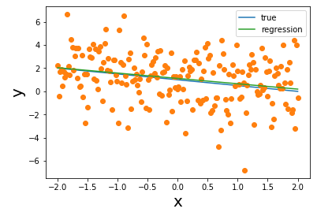


A linear regression case
We are going to solve the simplest regression problem: linear regression of form y = w * x + b
Here we assume that problem has linear dependency on x but data is corrupted by gaussian noise - epsilon
Let’s define observed data: (xi, yi), with the probability of observing data pair given by
where:

Slide 9
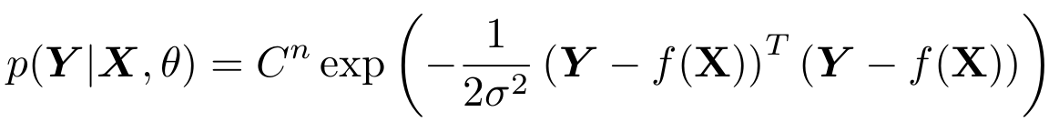
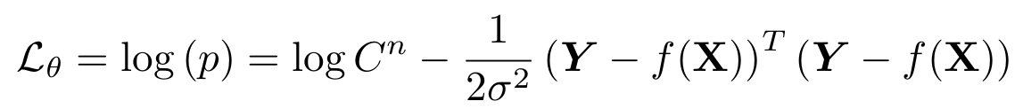
A linear regression case
The probability of observing data is given by
where:
Assuming that samples i are independent the total probability is given by:
Let’s find the MLE by maximizing the logarithm of p(Y| X)
Remember that this is equivalent to minimizing KL(p_data || p_model)

Slide 10
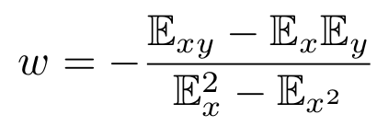

A linear regression case
The optimal parameters can be found analytically one f(x) is simple enough
For function of form f(x) we have:

Slide 11
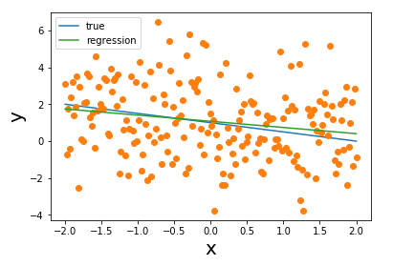
A linear regression case
We solved well known problem of linear regression
We have found optimal parameters by maximizing likelihood:

Slide 12
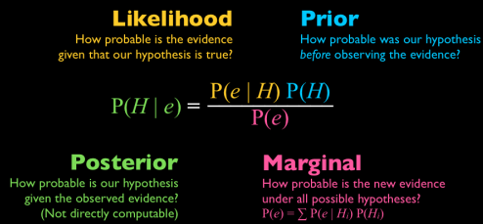
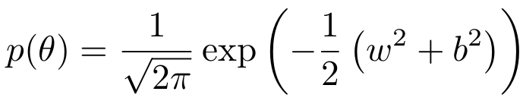
The Bayesian rule
We want to add information about uncertainty of our model
The likelihood - the probability of observing Y given X and model parameters
The prior - our best knowledge about probability distribution of model parameters. Not trainable.
The marginal - can be understand as normalization constant, similar as in softmax function, partition function etc...

Slide 13


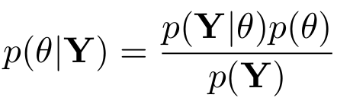
The Bayesian rule
Let’s apply BR to our problem and for the sake of clarity we omit X from following expressions:
The posterior - means the probability distribution of model parameters given data. For example what is the probability that w=0 and b=0 given data points.

Slide 14

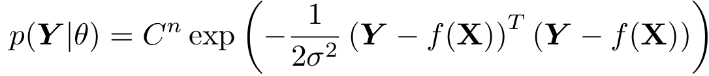
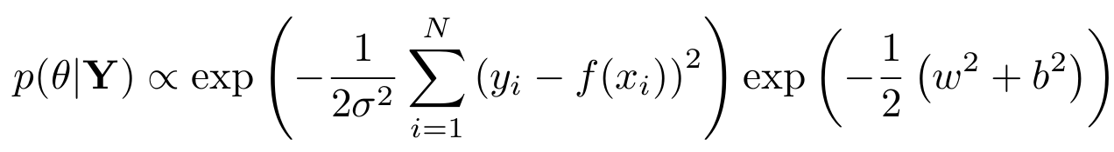
Understanding Bayesian approach
The marginal distribution normalizes the posterior. Since this is just a constant we can neglect this term for a moment:
The prior
Thus we have (neglecting constant terms)
Note, when N=0 (no data) our posterior distribution becomes the prior one.

Slide 15
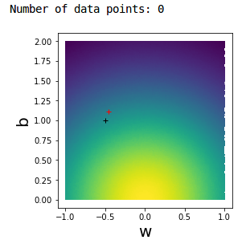
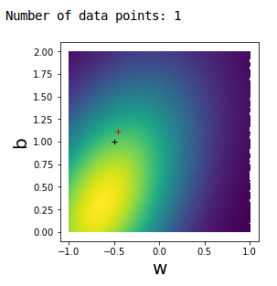
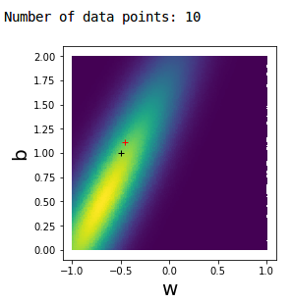
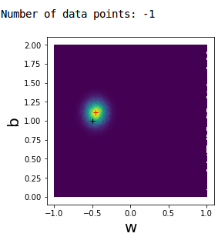
Understanding Bayesian approach - demo
The convergence of not normalized posterior in function of number of samples
We can plot p(...) as a function of two parameters w and b and changing the number of N
black cross - true values, red obtained from MLE.

Slide 16
Understanding Bayesian approach - demo
Some observations:
With more data, the posterior gets localized around true values of w and b and the impact of the prior distribution get lower and lower.
Sometimes, even if we have small number of samples, the posterior may get localized around true values. However the uncertainty will be large enough.

Slide 17
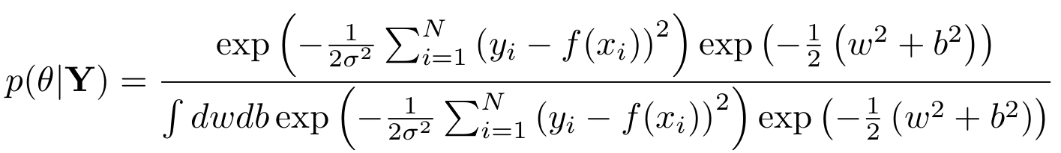

The necessity of approximations
Our problem is simple enough and we can try to compute full posterior distribution analytically.
Even for this simple problem the integral in the denominator is not the easiest one to calculate… but it can be computed.
Consider the case of multivariate linear regression problem:

Slide 18
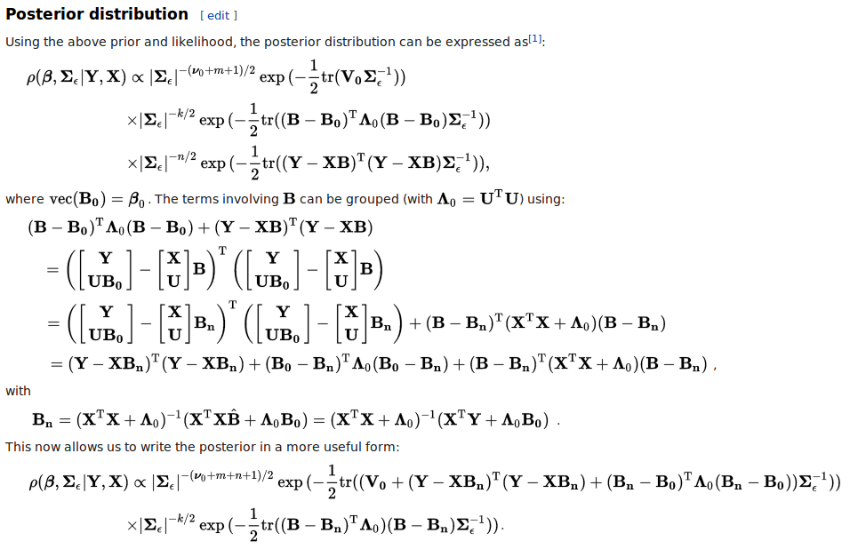
The necessity of approximations
A multivariate linear regression from wikipedia. Note the lack of normalization constant

Slide 19
The necessity of approximations
Variational Inference
The calculations of posterior become tedious even for simplest models, additionally only a small fraction of them has analytical solution e.g. it cannot be done for arbitrary deep neural networks.
Solution: we need a method which will allow us to approximate the posterior.
One of the approaches is
Which converts the problem of computing posterior as optimization problem hence we can use SGD for it.
Note: Variational means infinitesimal change in independent variable or function

Slide 20
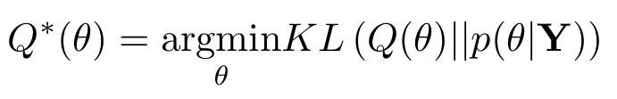
Variational Inference - derivation of the ELBO
The frequentist optimizes parameters by doing MLE
We want to find similar method which will allow us to do the SGD but with additional information about posterior distribution.
We know that computing exact posterior is not feasible in general, hence we propose a variational distribution Q
Q is an arbitrary distribution which in general is differentiable and easy to sample from

Slide 21

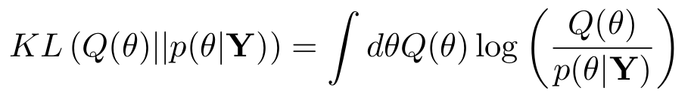
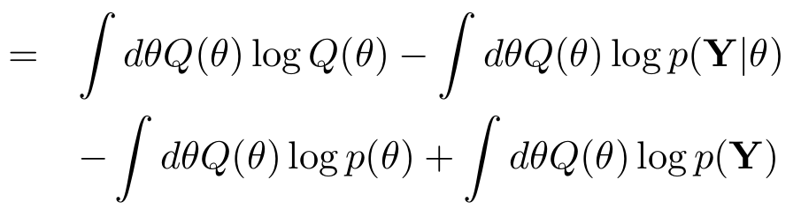
Variational Inference - derivation of the ELBO
Bayes rule
We are going to simply things in order to make our problem solvable
This can be further simplified:
-ELBO

Slide 22
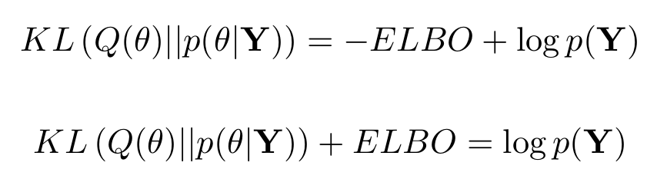

Variational Inference - derivation of the ELBO
By definition ELBO is equal to
From previous slide we have:
The evidence is const w.r.t variational parameters and KL is nonnegative, hence ELBO is a lower bound for evidence: ELBO - Evidence Lower BOund.
Solution: In order to minimize KL it is enough to maximize the second term i.e. ELBO.

Slide 23
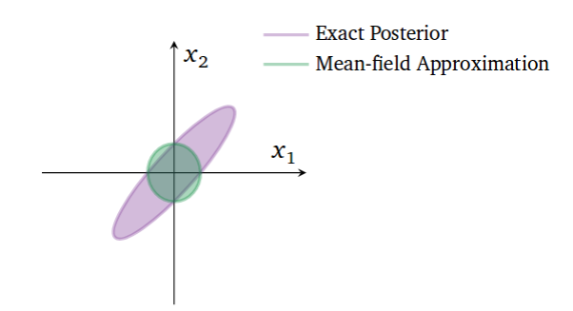
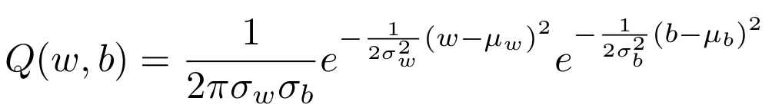
Variational Inference
We want to optimize the model parameters by maximizing ELBO
likelihood
we want to keep variational posterior close to the prior
Let’s return to our original problem: y=wx+b
The simplest possible choice for Q is to assume that all parameters are independent:
Such approximation for Q is called Mean Field Approximation

Slide 24
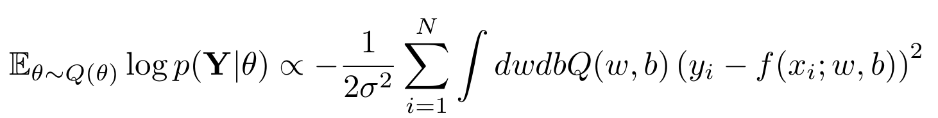
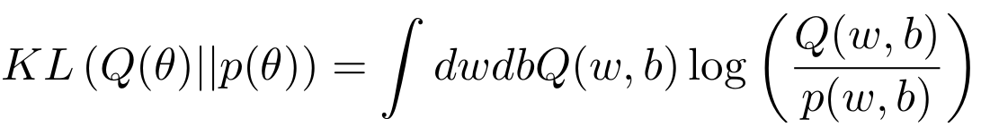
Variational Inference
We want to optimize the model parameters by maximizing ELBO
What we have so far:
variational distribution:
the likelihood:
the expectation of likelihood up to a constant term
KL divergence - note it does not depend on data

Slide 25
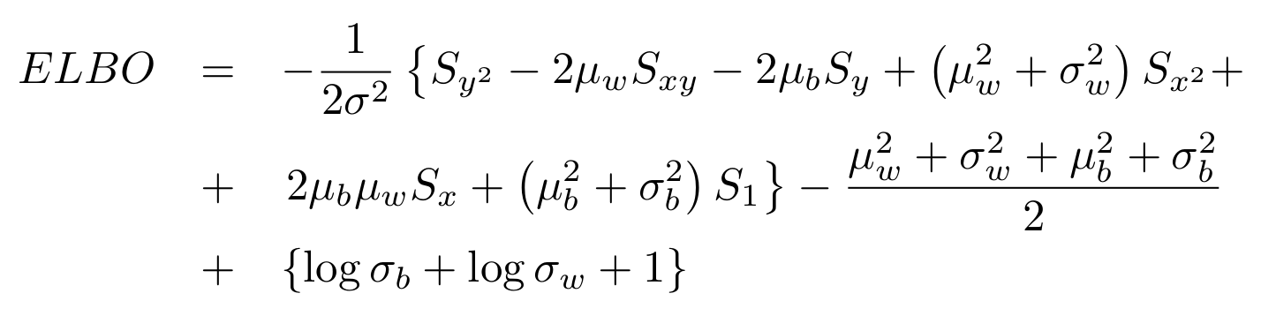
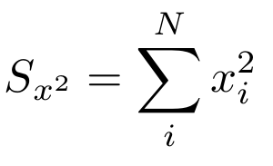
Variational Inference - exact solution
We want to optimize the model parameters by maximizing ELBO
All the integral can be computed analytically:
Where S_{P} is the sum over P:

Slide 26
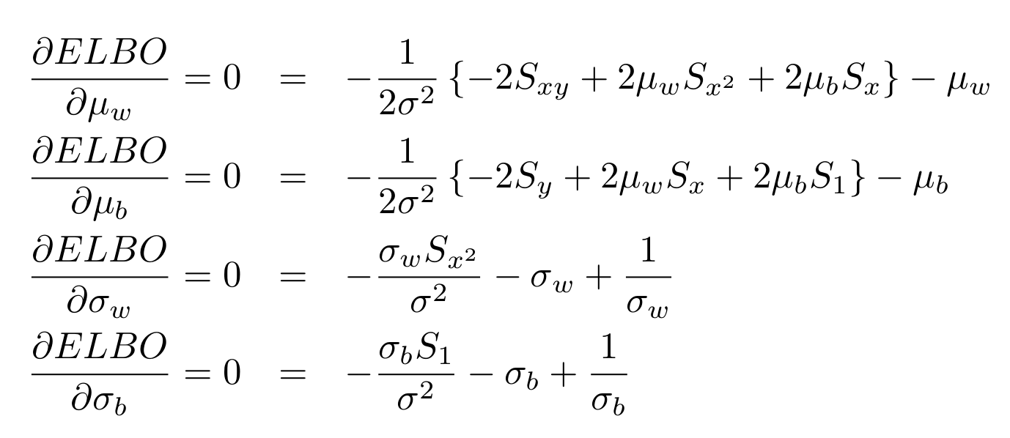

Variational Inference - exact solution - demo
We want to optimize the model parameters by maximizing ELBO
The next step is to find maximum value for ELBO by finding optimal set of parameters:
This system of equation can be easily solved for optimal:

Slide 27
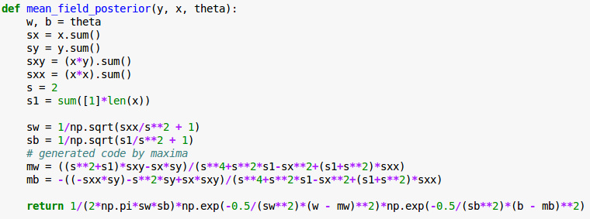
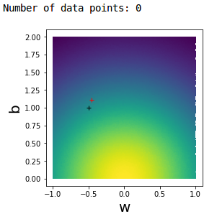
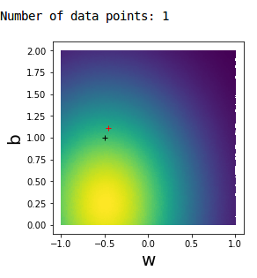
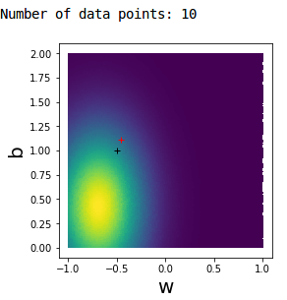
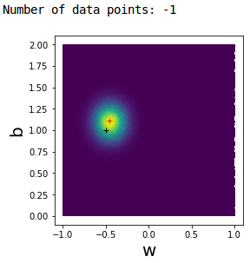
Variational Inference - exact solution - demo
The analytical solution can be compared with previous approach

Slide 28
Variational Inference - iterative approach
Usually we cannot compute integrals analytically and obtain this nice expressions for gradients:
Note that the expressions above were derived from evaluation of integrals and then by taking gradient of ELBO w.r.t approximated posterior parameters

Slide 29
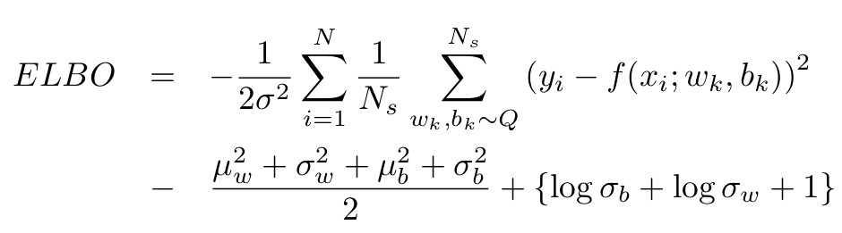
Variational Inference - iterative approach
In general we approximate ELBO by sampling from posteriors Q
If Q and p are standard distributions like gaussian, there are exact formulas for computing KL(Q||p)
Then we compute gradients of ELBO and perform parameter update using SGD

Slide 30
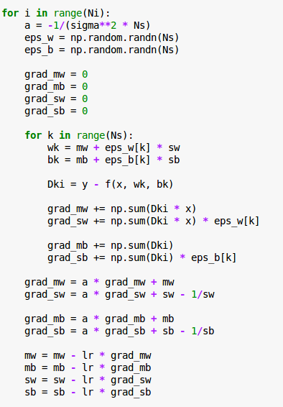
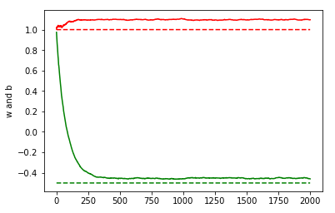
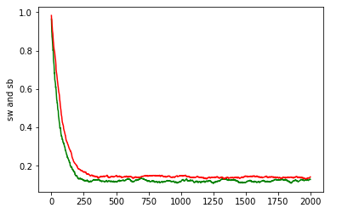
Variational Inference - iterative approach
However for certain distributions we can compute KL term
Naive implementation of gradient descent with sampling:

Slide 31
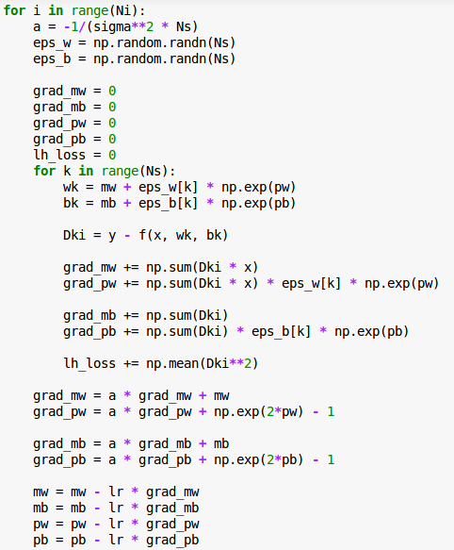

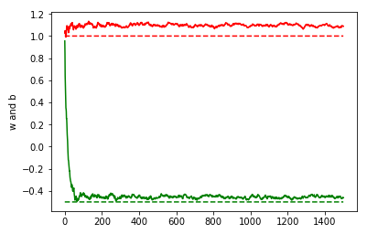
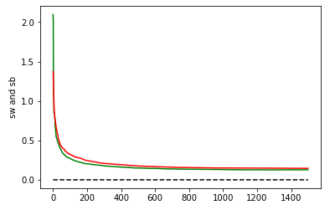
Variational Inference - iterative approach
For more stable training replace sigma with following parametrization:
This keeps sigma to be always positive.
Note that sigmas became more stable during training process

Slide 32
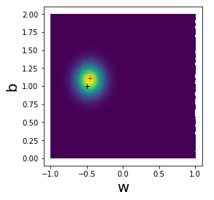
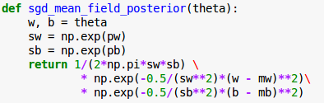
Variational Inference - comparison
Finally we can compare the results from all approaches:
Unnormalized exact posterior
Exact variational posterior
Iterative variational posterior

Slide 33
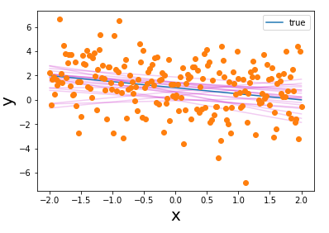

Variational Inference - sampling
After convergence we can sample our network in order to perform prediction
General approach
Define model, priors and posteriors
Train the model by optimizing ELBO, set number of MC samples
Sample model weights from trained posteriors and predict

Slide 34



Variational Inference - in Edward - demos
We want to solve the same problem with Edward library
General approach
Define model, priors and posteriors
Train the model by optimizing ELBO, set number of MC samples
http://edwardlib.org/tutorials/
Sample model weights from trained posteriors and predict

Slide 35
Questions?

Slide 36
References
https://arxiv.org/pdf/1601.00670.pdf - A review on VI
https://pl.wikipedia.org/wiki/Wnioskowanie_bayesowskie - polish naming for Bayesian statistics

Slide 37


