Slide 1

SQL Module
Mattieu Detaille
Notes:
Experience: cyber security team; innovation team (blockchain, cloud, data); freelance
Put a paper with your names on your desk
Can you introduce yourself (first name, last name, whay you are here)?

Slide 2
Primary keys
In creating tables, we choose some column names as primary keys when we want them to be a unique combination.
An id that is auto incremented
A train number with its scheduled date and time
An order id
id | Train_number | Company
1 | 203 | SNCF
2 | 405 | SNCB
Train_number | Company | Departure
203 | SNCF | 2020-02-01 12:10
405 | SNCB | 2020-02-09 15:23
Notes:
Primary keys must contain UNIQUE values, and cannot contain NULL values.
A table can have only ONE primary key; and in the table, this primary key can consist of single or multiple columns (fields).
Combination of Train_number and Company is unique : A train_number associated to a same company cannot have more than 1 departure date

Slide 3
Foreign keys
A foreign key is a column or group of columns that provides a link between data in two tables. It acts as a cross-reference between tables because it references the primary key of another table.
Train_number | Company
203 | SNCF
405 | SNCB
id | Departure | Arrival | Train_num
1 | 2020-01-02 12:10 | 2020-01-02 12:30 | 203
2 | 2020-01-02 14:15 | 2020-01-02 15:23 | 405
Notes:
Always put the primaru key in the child table
Show primary key and foreign key

Slide 4
Cascading events
The ‘ON DELETE’ and ‘ON UPDATE’ events protect relations by several ways :
Cascade : follow modification
Set null : replace the key by NULL
Set default : replace the key by the default value
Restrict : cancel modification
No action : Do not update the key
ALTER TABLE tbl_name ADD CONSTRAINT constraint_name FOREIGN KEY (key_name) REFERENCES tbl_name(attribute_name) ON UPDATE Cascade ON DELETE Restrict;
Notes:
ON DELETE : delete automatically records in child table with foreign keys referencing the primary key deleted in parent table.
ON UPDATE : update automatically foreign key in child table if corresponding primary key was updated in parent table. (bar code expansion example)

Slide 5

Normalisation rules
Since 1980s
Identifier normalisation
Each entity has an identifier
Entity normalisation
Replace entity by a relation when possible
Naming normalisation
Make names and attributes unique
Attribute normalisation – 1NF or first normalisation form
Replace multiple repetitive attribute groups by relation
Notes:
Database entity is a thing, person, place, unit, object or any item about which the data should be captured and stored in the form of tables.
Attribute: A characteristic or trait of an entity type that describes the entity, for example, the Person entity type has the Date of Birth attribute.
Clear
When seeing entity so table, think if you can split it and find a relation between the splitted elements.
Inside your database, names and attributes must be unique. Names must represent the same thing : no name for different attributes and no name for different entities. Attributes unique mean that its content do not have to be available in other attributes (address VS address number = redundancy)
Example : order, client_number, client_name, article, article_name, quantity (one name per client_number but multiple articles per client_number so new relation)

Slide 6
Relationships cardinality

Slide 7
Cardinality
Cardinalities express for a given entity occurrence, how many relationship occurrences can refer to it
Composed of two values min,max
Existing cardinality
1,1; 1,n; n,n;

Slide 8
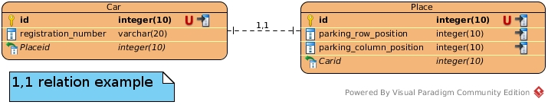
Existing relations
1,1 : The one to one relation :
Assume we manage a car parking, where each place is assigned to a car
The car is an entity (table), and the place is another entity
The car will have only one place, and the place only one car

Slide 9
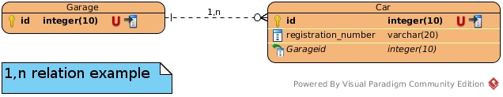
Existing relations
1,n : The one to many relation :
Assume we manage a car garage
The garage is able to have more than one car
Each car can be at only one garage at the same time

Slide 10
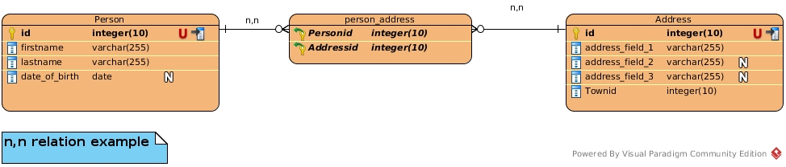
Existing relations
n,n : The many to many relation :
Assume we manage a delivery service with possibility to
have delivery address and invoice address separated.
A person can have more than one address
One address can shelter more than one person

Slide 11
ERD – Exercise 3
Model a movie database. Several actors play in a movie. A film is played by several actors. The films each have a director. Think about the attributes and relationships needed.
1. create the UML diagram of this database
2. Using PHPMyAdmin, create the tables and relationships. Use CASCADE options for the foreign key constraints.
3. Using PHPMyAdmin, add some movies, actors and directors.
4. Delete a Film actors. What happens to the other tables?

Slide 12
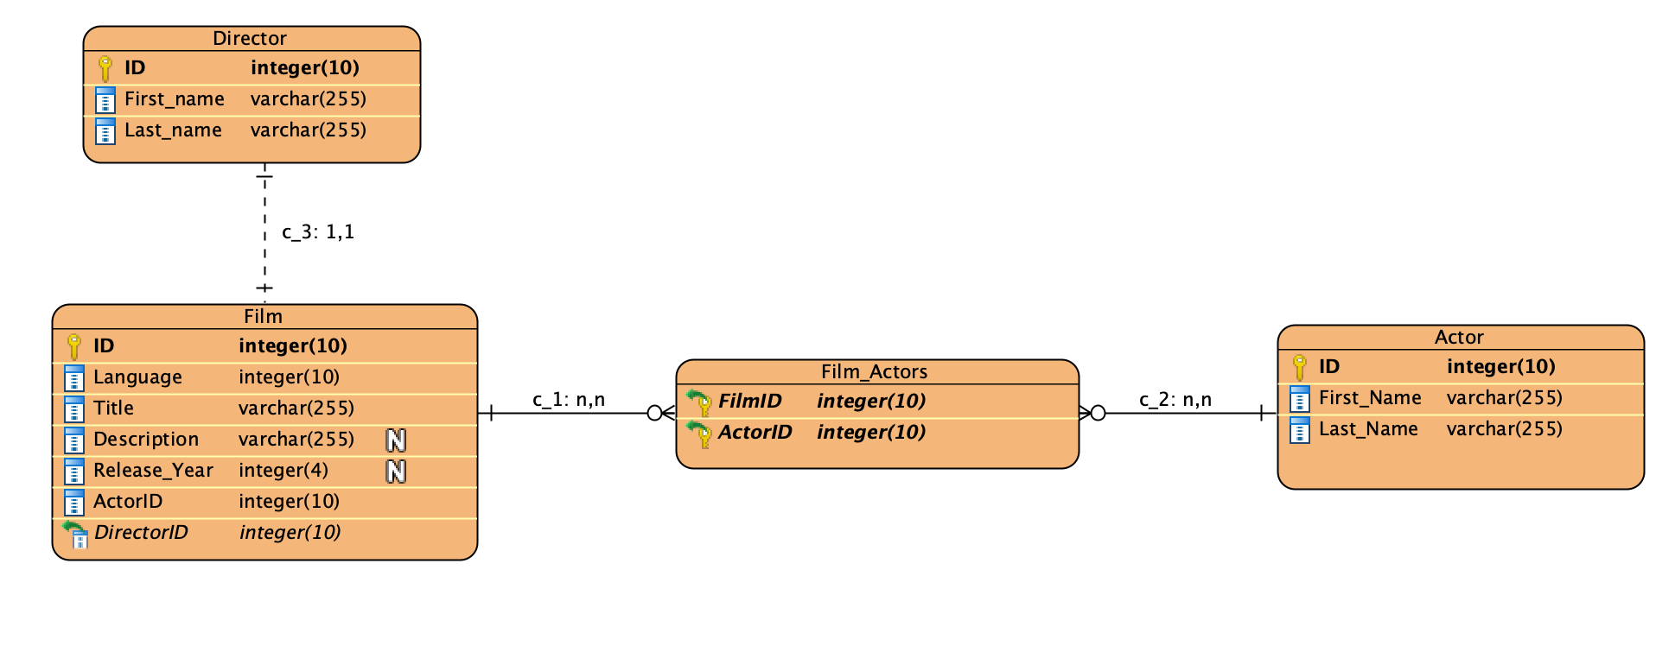
ERD – Exercise 3

Slide 13
Today Objectives
SQL read operations, aggregation operators
SUM, AVG, MAX, COUNT
GROUP BY
ORDER BY
JOIN
Database administration
NoSQL databases
Q&A

Slide 14
Setup an SQL Database environment
Install Xampp (https://www.apachefriends.org/index.html)
For Mac OS
Mount Volumes and Explore
Open file etc/extra/httpd-xampp.conf
Replace phpMyAdmin section
<Directory "/opt/lampp/phpmyadmin">
AllowOverride AuthConfig Limit
Order allow,deny
Allow from all
Require all granted
ErrorDocument 403 /error/XAMPP_FORBIDDEN.html.var
</Directory>

Slide 15
SQL Subqueries
SELECT * FROM table_name WHERE id IN (SELECT id FROM table_name WHERE info = “some info”);

Slide 16
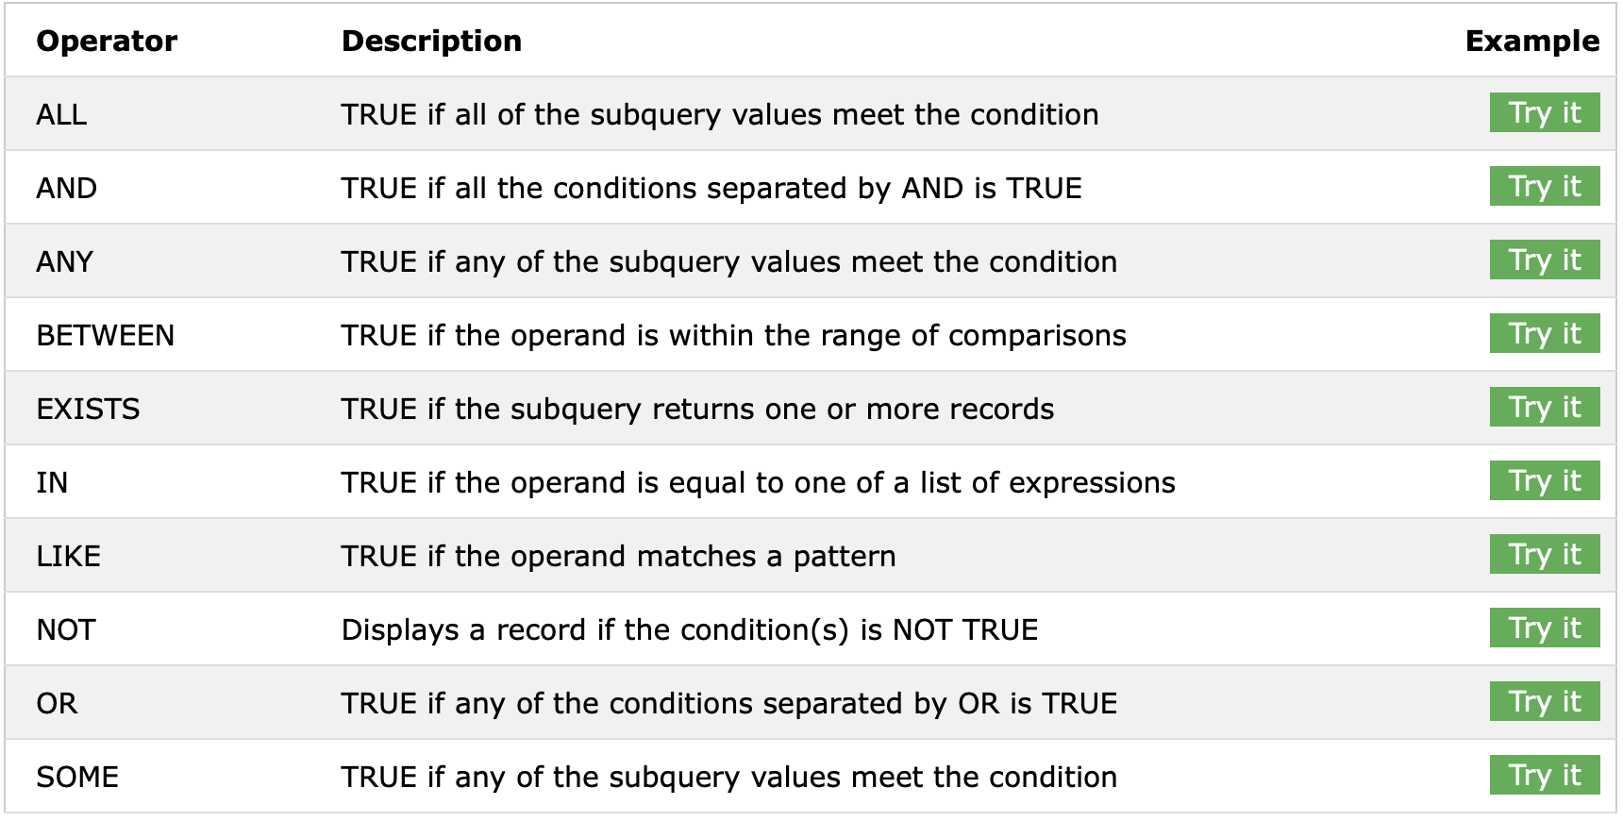
SQL logical operators
Notes:
https://www.w3schools.com/sql/sql_operators.asp

Slide 17
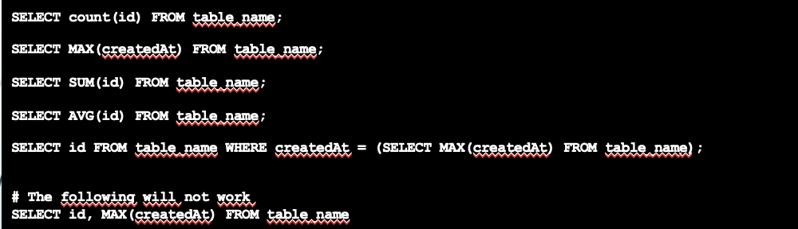
Aggregation functions
Used as function with parameter
Act on a column
DO NOT USE WITH NON-AGGREGATED COLUMNS
Notes:
Do not use with columns that cannot be aggregated in the same time as the column targeted.

Slide 18
Grouping elements in a table
SELECT [DISTINCT] select_expr [, select_expr ...]
[FROM table_references
[WHERE where_condition]]
[ORDER BY {col_name} [ASC | DESC], ...]
[GROUP BY {col_name}]
SELECT client_number, count(order_number) FROM Order GROUP BY client_number;
SELECT * FROM Order ORDER BY order_date ASC;
Notes:
The GROUP BY statement groups rows that have the same values into summary rows, like "find the number of customers in each country".
The GROUP BY statement is often used with aggregate functions (COUNT, MAX, MIN, SUM, AVG) to group the result-set by one or more columns.

Slide 19
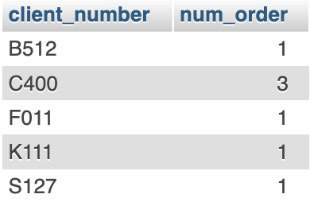
GROUP BY - example
SELECT client_number, COUNT(order_number) AS num_order FROM Order GROUP BY client_number;

Slide 20
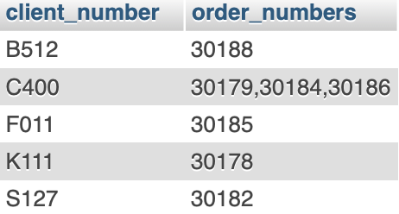
GROUP BY - example
SELECT client_number, GROUP_CONCAT(order_number) AS order_numbers FROM Order GROUP BY client_number;

Slide 21
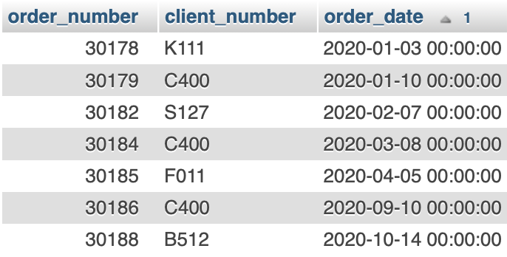
ORDER BY - example
SELECT * FROM Order ORDER BY order_date ASC;

Slide 22
Joining elements between two tables
SELECT column-names
FROM table-name1 JOIN table-name2
ON column-name1 = column-name2
WHERE condition
SELECT c.client_number, name, address, order_number FROM test.Client as c JOIN test.Order as o ON c.client_number = o.client_number WHERE c.client_number = 'C400';
Notes:
A JOIN clause is used to combine rows from two or more tables, based on a related column between them

Slide 23
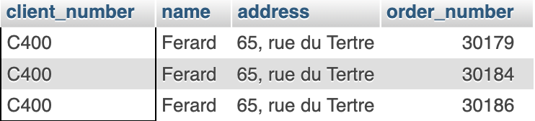
Join - example
SELECT c.client_number, name, address, order_number FROM test.Client as c JOIN test.Order as o ON c.client_number = o.client_number WHERE c.client_number = 'C400';

Slide 24
Time for exercise!

Slide 25
Queries - Exercise
Open file foreign_select_students in Queries_ex/1 directory from Git
Follow instructions
Corrections in 20-30 min.

Slide 26
Queries - Exercise
Open files select_estimates in Queries_ex/2 directory from Git
Follow instructions
Corrections in 20-30 min.

Slide 27
Queries - Exercise
Open files select_estimates_2 in Queries_ex/3 directory from Git
Follow instructions
Corrections in 20-30 min.

Slide 28
Queries - Exercise
Open files functions in Queries_ex/4 directory from Git
Follow instructions
Corrections in 20-30 min.

Slide 29
User management

Slide 30
The user management
Allow to create user
Allow to define general privileges
Allow to define per table privileges

Slide 31

With command line
CREATE USER ‘mattieu'@'localhost' IDENTIFIED BY 'password';
GRANT ALL PRIVILEGES ON test.Users TO 'mattieu'@'localhost';
GRANT ALL PRIVILEGES ON *.* TO 'admin'@'localhost';

Slide 32
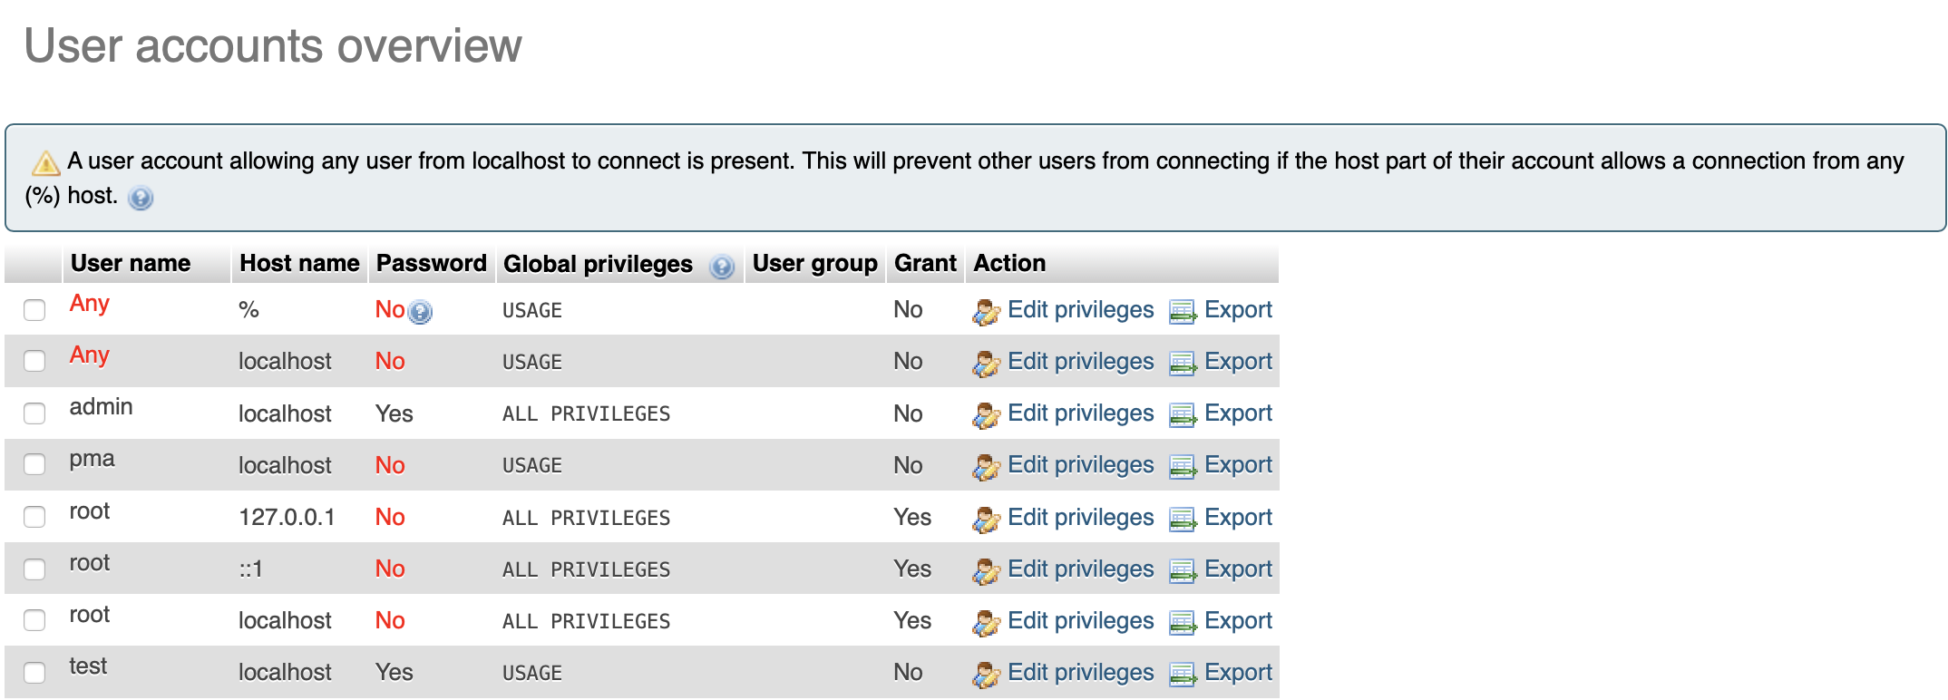
With the interface

Slide 33
Types of databases
Relational databases
Collections of data with pre-defined relationships between them.
Data organized as a set of tables with columns and rows
MySQL, PostgreSQL, MariaDB, etc.
Non-relational databases
stores data in a non-tabular form
More flexible, main difference is how they store information
NoSQL, MongoDB, Cassandra
Notes:
A relational database is a collection of data items with pre-defined relationships between them. These items are organized as a set of tables with columns and rows. Tables are used to hold information about the objects to be represented in the database.

Slide 34
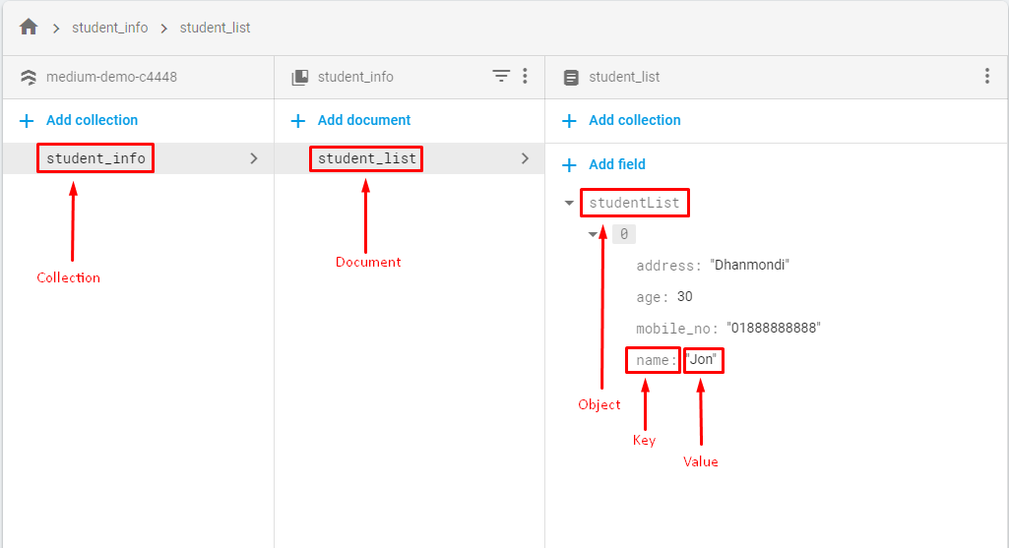
NoSQL – Document oriented
Example : Google cloud Firestore

Slide 35
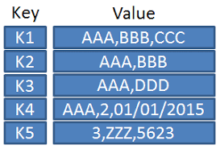
NoSQL – Key-Value oriented/Column oriented database
Example: Google cloud BigTable
Notes:
stores data tables by column rather than by row

Slide 36
ERD – Exercise 4
You are designing a parking control system. Each user has a pass allowing him to access one of the network car parks. At the end of the day, each car park sends by email a summary of the parking lots for the day: http://pastebin.com/mxCwqW5V
Design the diagram for this model, allowing for insertion of parking systems, of a summary like in the provided link as well as some customers.
Using PhpMyAdmin, create the tables and relationships. Use CASCADE options for the foreign key constraints.
Using PhpMyAdmin, insert some parking systems, some customers as well as some summary.
Query the summary of a specific user.

Slide 37
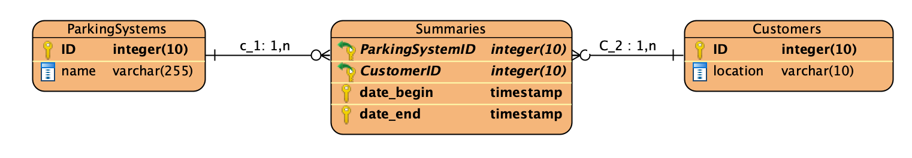
ERD – Exercise 4

Slide 38
More exercises
https://www.w3schools.com/sql/exercise.asp

Slide 39

At the end

