Slide 1

SQL Module
Mattieu Detaille
Notes:
Experience: cyber security team; innovation team (blockchain, cloud, data); freelance
Put a paper with your names on your desk
Can you introduce yourself (first name, last name, whay you are here)?

Slide 2
Create a database
CREATE {DATABASE | SCHEMA} [IF NOT EXISTS] db_name
[create_specification] ...
create_specification:
[DEFAULT] CHARACTER SET [=] charset_name
| [DEFAULT] COLLATE [=] collation_name
CREATE DATABASE test;
CREATE DATABASE test DEFAULT CHARACTER SET utf8 COLLATE = utf8_bin;
Notes:
Database and schema : the same, schema was brought up in a later version of the language SQL.

Slide 3
Create a table
CREATE TABLE tbl_name (create_definition,...)
create_definition: col_name column_definition
column_definition:
data_type [NOT NULL | NULL] [DEFAULT default_value]
[AUTO_INCREMENT] [[PRIMARY] KEY] [COMMENT 'string']
data_type:
TINYINT[(length)] [UNSIGNED] [ZEROFILL]
| INT[(length)] [UNSIGNED] [ZEROFILL]
| DOUBLE[(length,decimals)] [UNSIGNED] [ZEROFILL]
| FLOAT[(length,decimals)] [UNSIGNED] [ZEROFILL]
| DATETIME[(fsp)]
| VARCHAR(length) [CHARACTER SET charset_name] [COLLATE collation_name]
CREATE TABLE test (
id INT UNSIGNED PRIMARY KEY AUTO_INCREMENT,
information VARCHAR(10) NOT NULL
);
Notes:
Not NULL – no values mandatory
Unsigned : zero or positive numbers
Zerofill : put zero values in front of values to display it correctly
Tinyint : 0-255

Slide 4
Insert element into a table
INSERT [INTO] tbl_name[(col_name [, col_name] ...)]
{VALUES | VALUE} (value_list) [, (value_list)] ...
INSERT INTO Train_destination(Train_number, Destination) VALUES (123, ‘Paris’);
INSERT INTO Train_destination(Train_number, Destination) VALUES (123, ‘Paris’), (124, ‘Amsterdam’);

Slide 5
Update rows
UPDATE table_reference
SET assignment_list
[WHERE where_condition]
UPDATE Train_destination SET Destination = “Paris” WHERE Train_number = “203”;
Train_number | Destination
203 | Nice
405 | Brussels
Train_number | Destination
203 | Paris
405 | Brussels

Slide 6
The WHERE clause
WHERE condition [({AND | OR} condition)...]
UPDATE Train_destination SET Destination = “Paris” WHERE Train_number = “203” OR Train_number = “405” ;
Train_number | Destination
203 | Nice
405 | Brussels
Train_number | Destination
203 | Paris
405 | Paris

Slide 7
Time for exercise!

Slide 8

Update in table Train_destination
Train_number | Destination
203 | Nice
405 | Brussels
Update destination of train number 203 to San Francisco
Update Train_number of train number 405 to 406
Notes:
UPDATE Train_schedule SET Destination = “San Francisco” WHERE Train_number = “203”;
UPDATE Train_schedule SET Train_number = “406” WHERE Train_number = “405”;

Slide 9
Update table Train_schedule
Train_number | Company | Week_day | Scheduled
203 | SNCF | Monday | 12:10
405 | SNCB | Tuesday | 15:23
406 | SNCB | Wednesday | 12:12
Update company of train number 203 to SNCB
Update scheduled time of train number 405 to 15:30
Update scheduled time of train with company SNCB and Week day of Tuesday to 15:30
Update company of train having a week day of Tuesday or Wednesday to SNCF
Notes:
UPDATE Train_schedule SET Company = “SNCB” WHERE Train_number = “203”;
UPDATE Train_schedule SET Scheduled = “15:30” WHERE Train_number = “405”;
UPDATE Train_schedule SET Scheduled = “15:30” WHERE Company = “SNCB” AND Week_day = “Tuesday”;
UPDATE Train_schedule SET company = “SNCF” WHERE Week_day = “Tuesday” AND Week_day = “Wednesday”;

Slide 10
Delete rows
DELETE FROM tbl_name
[WHERE where_condition]
DELETE FROM Train_destination WHERE Train_number = “203”;
Train_number | Destination
203 | Nice
405 | Brussels
Train_number | Destination
405 | Brussels

Slide 11
Time for exercise!

Slide 12

Delete from table Train_schedule
Train_number | Company | Week_day | Scheduled
203 | SNCF | Monday | 12:10
405 | SNCB | Tuesday | 15:23
406 | SNCB | Wednesday | 12:12
Delete row with train number 203
Delete row with company of SNCF or SNCB
Delete row scheduled for Monday at 12:10
Notes:
DELETE FROM Train_schedule WHERE Train_number = “203”;
DELETE FROM Train_schedule WHERE Company = “SNCF” OR Company = “SNCB”;
DELETE FROM Train_schedule WHERE Week_day = “Monday” AND Scheduled = “12:10”;

Slide 13
Select elements in a table
SELECT select_expr [, select_expr ...]
[FROM table_references
[WHERE where_condition]]
SELECT * FROM test;
SELECT id,information FROM test WHERE id=’1’;

Slide 14
DROP a table
DROP TABLE table_name;
DROP TABLE test;

Slide 15
DROP a database
DROP DATABASE db_name;
DROP DATABASE test;

Slide 16
Table Columns & Types
Numeric
Integer (INT)
Small decimal numbers (FLOAT)
Big decimal numbers (DOUBLE)
Character String
Small String (CHAR) - 0 to 255 characters
Big String (VARCHAR) – 0 to 65535 characters
Date & Time
Date (DATE) → YYYY-MM-DD
Time (TIME) → hh:mm:ss
Date & Time (DATETIME) → YYYY-MM-DD hh:mm:ss
Timestamp
ENUM – allows to store a list of value choice
Boolean – True or False
Notes:
INT Signed range is from -2147483648 to 2147483647. Unsigned range is from 0 to 4294967295.
FLOAT (0 to 24 digits including after comma)
DOUBLE (25 to 53 digits including after comma)
A timestamp. TIMESTAMP values are stored as the number of seconds since the Unix epoch ('1970-01-01 00:00:00' UTC).
ENUM('Low', 'Medium', 'High')

Slide 17
Today Objectives
Model a database
Create a database according to a specific problem
Primary keys
Foreign keys
Entity Relationship diagram (UML)
A lot of exercises!

Slide 18
Setup an SQL Database environment
Install Xampp (https://www.apachefriends.org/index.html)
For Mac OS
Mount Volumes and Explore
Open file etc/extra/httpd-xampp.conf
Replace phpMyAdmin section
<Directory "/opt/lampp/phpmyadmin">
AllowOverride AuthConfig Limit
Order allow,deny
Allow from all
Require all granted
ErrorDocument 403 /error/XAMPP_FORBIDDEN.html.var
</Directory>

Slide 19
More exercises
Name | Age | Gender
Yoad | 900 | M
Darth Maul |  | M
Notes:
Create and insert all those information in the following tables

Slide 20
Xampp – Interface demo

Slide 21
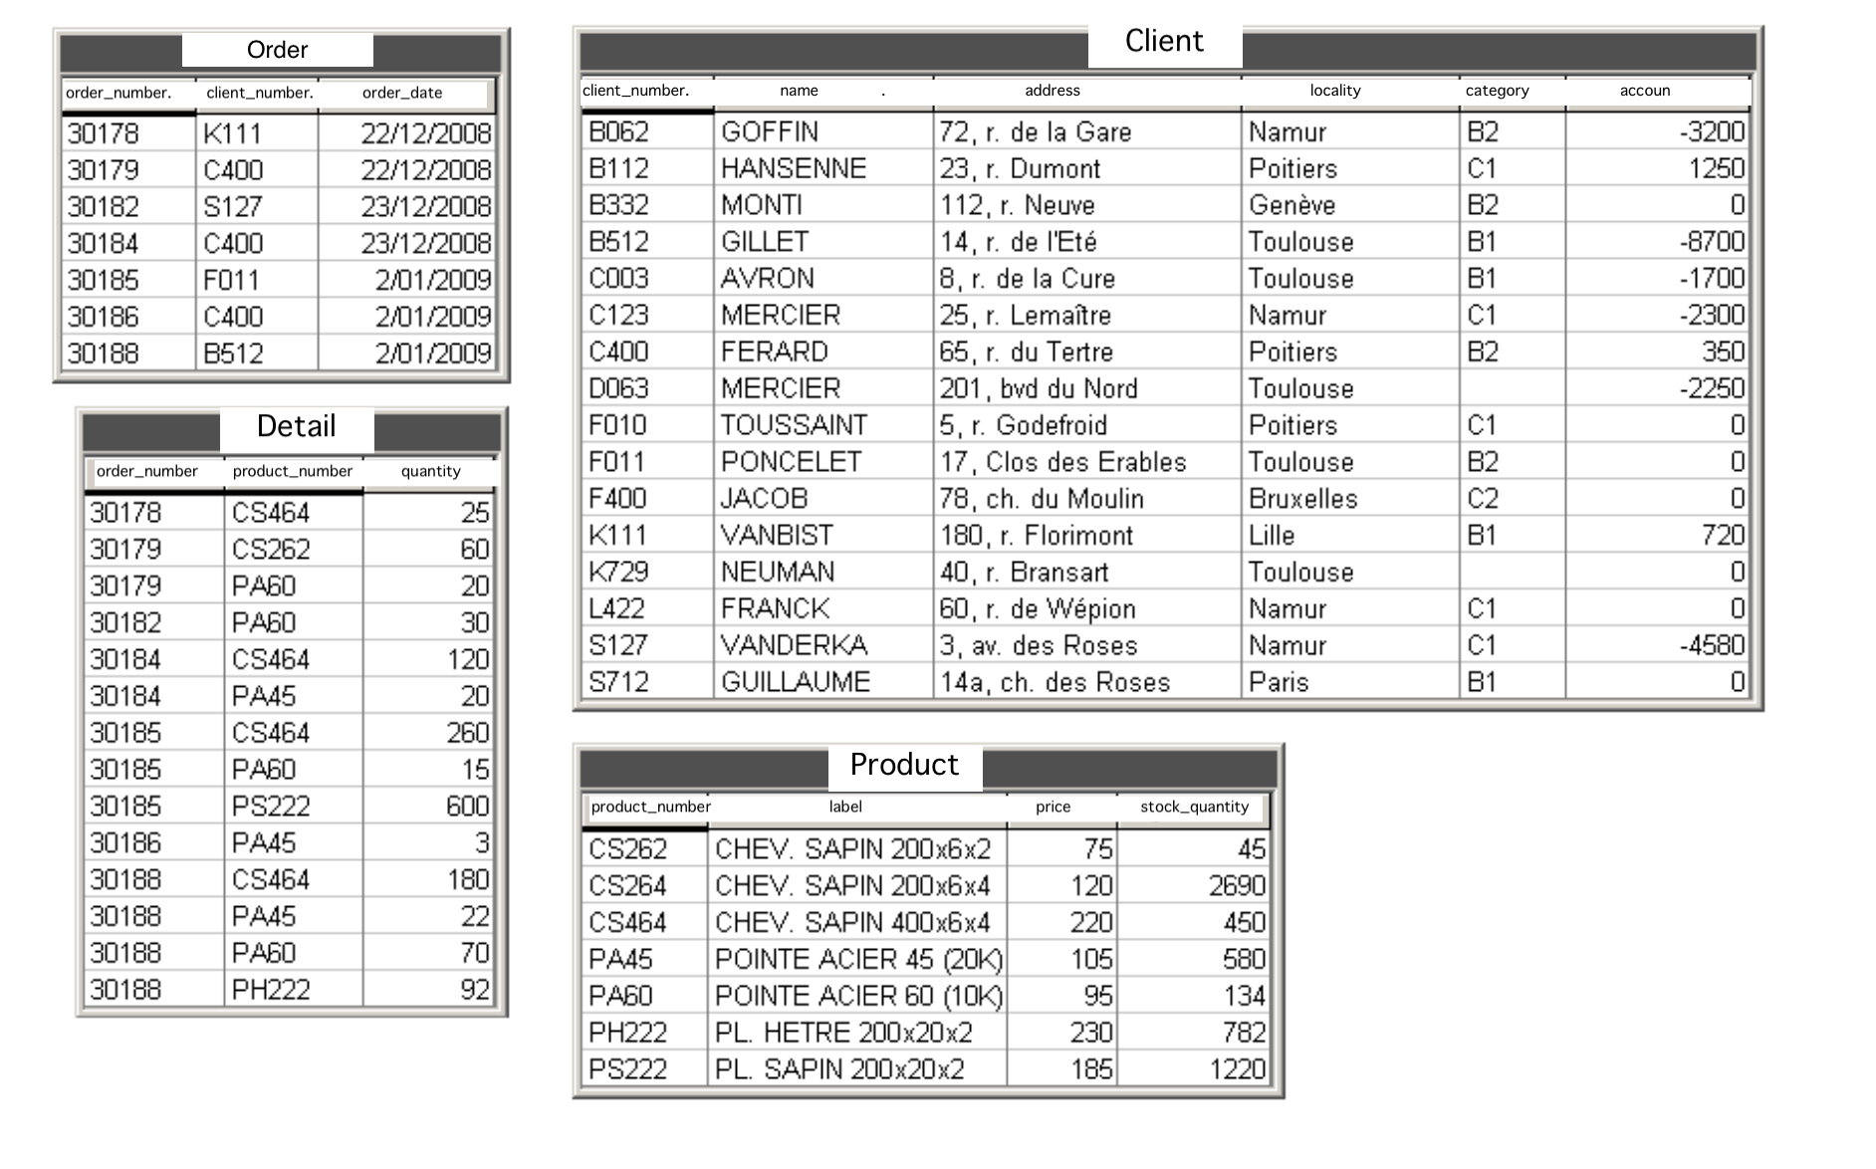
More exercises
Notes:
Create and insert all those information in the following tables
Try to insert C123 a a a a 42 in client. What happens?
Give all info from clients that lives in Namur
Give all the information about customers who live in Lille and who have a positive or zero balance.
What are the names and addresses of category C1 customers?
In what year were the orders made? (you will probably need the function strftime (format, date))
What is the total price of the available stock for each product?
What is the total price of the available stock, all products combined
https://www.hackerrank.com/

Slide 22
More exercises
Try to insert C123 a a a a 42 in client. What happens?
Give all info from clients that lives in Namur
Give all the information about customers who live in Lille and who have a positive or zero balance.
What are the names and addresses of category C1 customers?
In what year were the orders made? (you will probably need the function strftime (format, date))
What is the total price of the available stock for each product?
What is the total price of the available stock, all products combined
https://www.hackerrank.com/
Notes:
Insert in Customer ('C123', 'a', 'a', 'a', 'a', 42) What is the result ? Why ? ---> primary key on the first column, nothing is added because a row with C123 as key already existeds
SELECT * FROM Client WHERE locality = 'Namur’
SELECT * FROM Client WHERE locality = 'Lille' AND compte >= 0
SELECT nom,adresse FROM Client WHERE cat = 'C1’
SELECT order_number, DATE_FORMAT(order_date, '%Y') FROM test.Order;
SELECT product_number , price*stock_quantity FROM Product
SELECT sum(price*stock_quantity) FROM Product

Slide 23
Model a relational database

Slide 24
Primary keys
In creating tables, we choose some column names as primary keys when we want them to be a unique combination.
An id that is auto incremented
A train number with its scheduled date and time
An order id
id | Train_number | Company
1 | 203 | SNCF
2 | 405 | SNCB
Train_number | Company | Departure
203 | SNCF | 2020-02-01 12:10
405 | SNCB | 2020-02-09 15:23
Notes:
Primary keys must contain UNIQUE values, and cannot contain NULL values.
A table can have only ONE primary key; and in the table, this primary key can consist of single or multiple columns (fields).
Combination of Train_number and Company is unique : A train_number associated to a same company cannot have more than 1 departure date

Slide 25
Primary key - examples
id | Train_number | Company
1 | 203 | SNCF
2 | 405 | SNCB
CREATE TABLE Trains (id INT NOT NULL PRIMARY KEY AUTO_INCREMENT, Train_number INT NOT NULL, Company VARCHAR(10));
CREATE TABLE Train_schedule (Train_number INT NOT NULL, Company VARCHAR(10), Departure DATETIME, PRIMARY KEY(Train_number, Departure);

Slide 26
Primary key - examples
Train_number | Company | Departure
203 | SNCF | 2020-02-01 12:10
405 | SNCB | 2020-02-09 15:23
CREATE TABLE Train_schedule (Train_number INT NOT NULL, Company VARCHAR(10), Departure DATETIME, PRIMARY KEY(Train_number, Company));

Slide 27
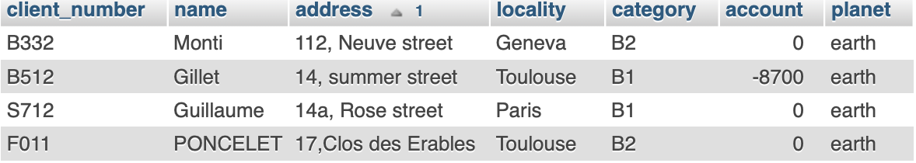
What would be the primary key in here?
Notes:
Client_number cause two people having the same name can live in the same place but the client_number has to be unique.

Slide 28
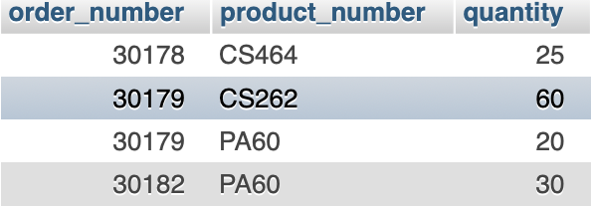
What would be the primary key in here?
Notes:
Order_number, product_number because we want to have all same products quantity in same line

Slide 29
Foreign keys
A foreign key is a column or group of columns that provides a link between data in two tables. It acts as a cross-reference between tables because it references the primary key of another table.
Train_number | Company
203 | SNCF
405 | SNCB
id | Departure | Arrival | Train_num
1 | 2020-01-02 12:10 | 2020-01-02 12:30 | 203
2 | 2020-01-02 14:15 | 2020-01-02 15:23 | 405
Notes:
Always put the primaru key in the child table
Show primary key and foreign key

Slide 30
Foreign keys
Train_number | Company
203 | SNCF
405 | SNCB
CREATE TABLE Train_info (Train_number INT NOT NULL PRIMARY KEY, Company VARCHAR(10));

Slide 31
Foreign keys
id | Departure | Arrival | Train_num
1 | 2020-01-02 12:10 | 2020-01-02 12:30 | 203
2 | 2020-01-02 14:15 | 2020-01-02 15:23 | 405
CREATE TABLE Trains_schedule (id INT NOT NULL PRIMARY KEY AUTO_INCREMENT, DEPARTURE DATETIME, ARRIVAL DATETIME, Train_num INT NOT NULL, CONSTRAINT `c_1` FOREIGN KEY (Train_num) REFERENCES Train_info(Train_number));

Slide 32
Foreign keys
id | Departure | Arrival | Train_num
1 | 2020-01-02 12:10 | 2020-01-02 12:30 | 203
2 | 2020-01-02 14:15 | 2020-01-02 15:23 | 405
CREATE TABLE Trains_schedule (id INT NOT NULL PRIMARY KEY AUTO_INCREMENT, DEPARTURE DATETIME, ARRIVAL DATETIME, Train_num INT NOT NULL);
ALTER TABLE Trains_schedule ADD CONSTRAINT `c_1` FOREIGN KEY (Train_num) REFERENCES Train_info(Train_number);
Notes:
OR

Slide 33
Cascading events
The ‘ON DELETE’ and ‘ON UPDATE’ events protect relations by several ways :
Cascade : follow modification
Set null : replace the key by NULL
Set default : replace the key by the default value
Restrict : cancel modification
No action : Do not update the key
ALTER TABLE tbl_name ADD CONSTRAINT constraint_name FOREIGN KEY (key_name) REFERENCES tbl_name(attribute_name) ON UPDATE Cascade ON DELETE Restrict;
Notes:
ON DELETE : delete automatically records in child table with foreign keys referencing the primary key deleted in parent table.
ON UPDATE : update automatically foreign key in child table if corresponding primary key was updated in parent table. (bar code expansion example)

Slide 34

SQL and relationship
SQL (Structured Query Language) is a domain-specific language used in programming and designed for managing data held in a relational database management system (RDBMS)
SQL designed for relation
Allow to define a relation between tables/entities

Slide 35

Introduction to MERISE
Since 1980s
Conceptualisation paradigm
Define normalisation rules
Adopted as a best practice
Notes:
Database normalization is the process of structuring a relational database in order to reduce data redundancy and improve data integrity.
Normalization means organizing the columns (attributes) and tables (relations) of a database to ensure that their dependencies are properly enforced by database integrity constraints.
Normalization is the process of organizing data in a database. This includes creating tables and establishing relationships between those tables according to rules designed both to protect the data and to make the database more flexible by eliminating redundancy and inconsistent dependency.
Best practice in order to design proper relational databases

Slide 36
Normalization rules
Since 1980s
Identifier normalization
Each entity has an identifier
Entity normalization
Replace entity by a relation when possible
Naming normalization
Make names and attributes unique
Attribute normalization – 1NF or first normalization form
Replace multiple repetitive attribute groups by relation
Notes:
Database entity is a thing, person, place, unit, object or any item about which the data should be captured and stored in the form of tables.
Attribute: A characteristic or trait of an entity type that describes the entity, for example, the Person entity type has the Date of Birth attribute.
Clear
When seeing entity so table, think if you can split it and find a relation between the splitted elements.
Inside your database, names and attributes must be unique. Names must represent the same thing : no name for different attributes and no name for different entities. Attributes unique mean that its content do not have to be available in other attributes (address VS address number = redundancy)

Slide 37
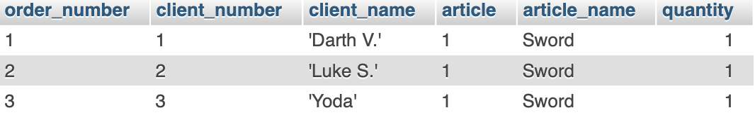
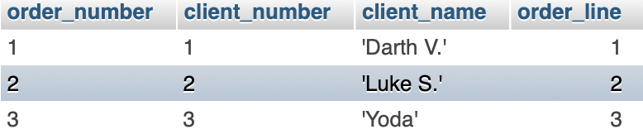
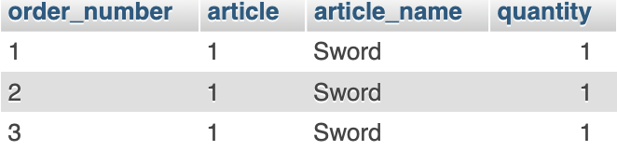
Normalization - example
Notes:
Example : order, client_number, client_name, article, article_name, quantity (one name per client_number but multiple articles per client_number so new relation)

Slide 38
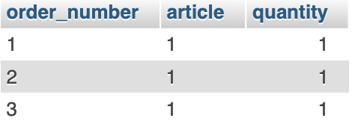

Normalization - example

Slide 39
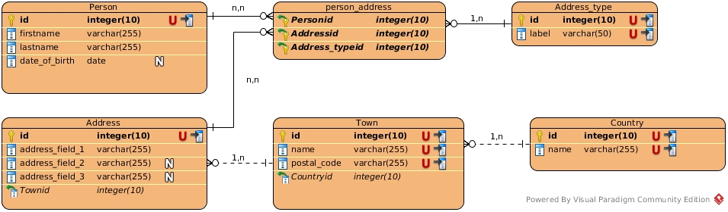
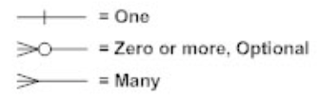
Entity Relationship diagram
Notes:
An entity relationship diagram (ERD) shows the relationships of entity sets stored in a database. An entity in this context is an object, a component of data. An entity set is a collection of similar entities. These entities can have attributes that define its properties.
By defining the entities, their attributes, and showing the relationships between them, an ER diagram illustrates the logical structure of databases.
ER diagrams are used to sketch out the design of a database.
Cardinality – sense of the relationship
Box = entity = table
Properties = Attributes of table
Null
Primary key
Foreign key

Slide 40
Relationships cardinality

Slide 41
Cardinality
Cardinalities express for a given entity occurrence, how many relationship occurrences can refer to it
Composed of two values min,max
Existing cardinality
1,1; 1,n; n,n;

Slide 42
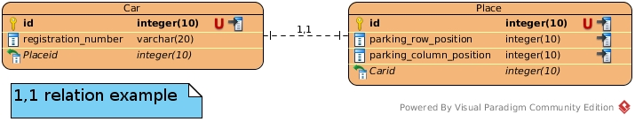
Existing relations
1,1 : The one to one relation :
Assume we manage a car parking, where each place is assigned to a car
The car is an entity (table), and the place is another entity
The car will have only one place, and the place only one car

Slide 43
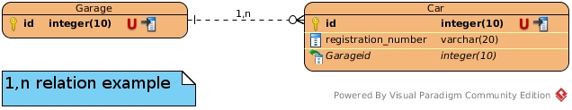
Existing relations
1,n : The one to many relation :
Assume we manage a car garage
The garage is able to have more than one car
Each car can be at only one garage at the same time

Slide 44
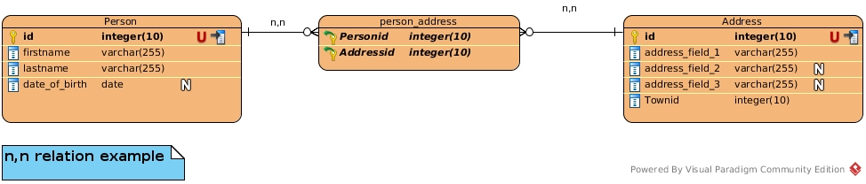
Existing relations
n,n : The many to many relation :
Assume we manage a delivery service with possibility to
have delivery address and invoice address separated.
A person can have more than one address
One address can shelter more than one person

Slide 45
Complete design example

Slide 46
ERD – Exercise 1
We want to create a website where users can ask questions.
The necessary fields for table Users: email, last_connection (date and time) and Questions: title, content
Add the foreign key to the correct table (hint: always in the child table). Use CASCADE options for the foreign key constraints.
Design the UML diagram of this relationship
Using PHPMyAdmin, create the tables and relationships. Use CASCADE options for the foreign key constraints.
Using PHPMyAdmin, insert some users and questions.
Delete a user. What is the effect on the question tables?

Slide 47
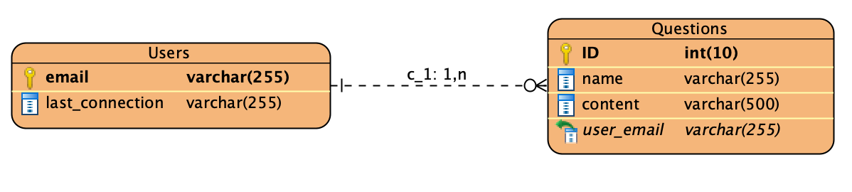
ERD – Example 1

Slide 48
ERD – Exercise 2
Design a database that can be used by a library website. An author may write several books.Each book is arranged in a shelf according to the type of work: 'Science-Fiction', 'References', 'Novels’ ... We will have 3 tables, for books, shelves and authors.
1. create the UML diagram of this database
2. Using PHPMyAdmin, create the tables and relationships. Use RESTRICT options for the foreign key constraints.
3. Using PHPMyAdmin, add some books, authors and departments.
4. Delete a shelve. What happens?

Slide 49
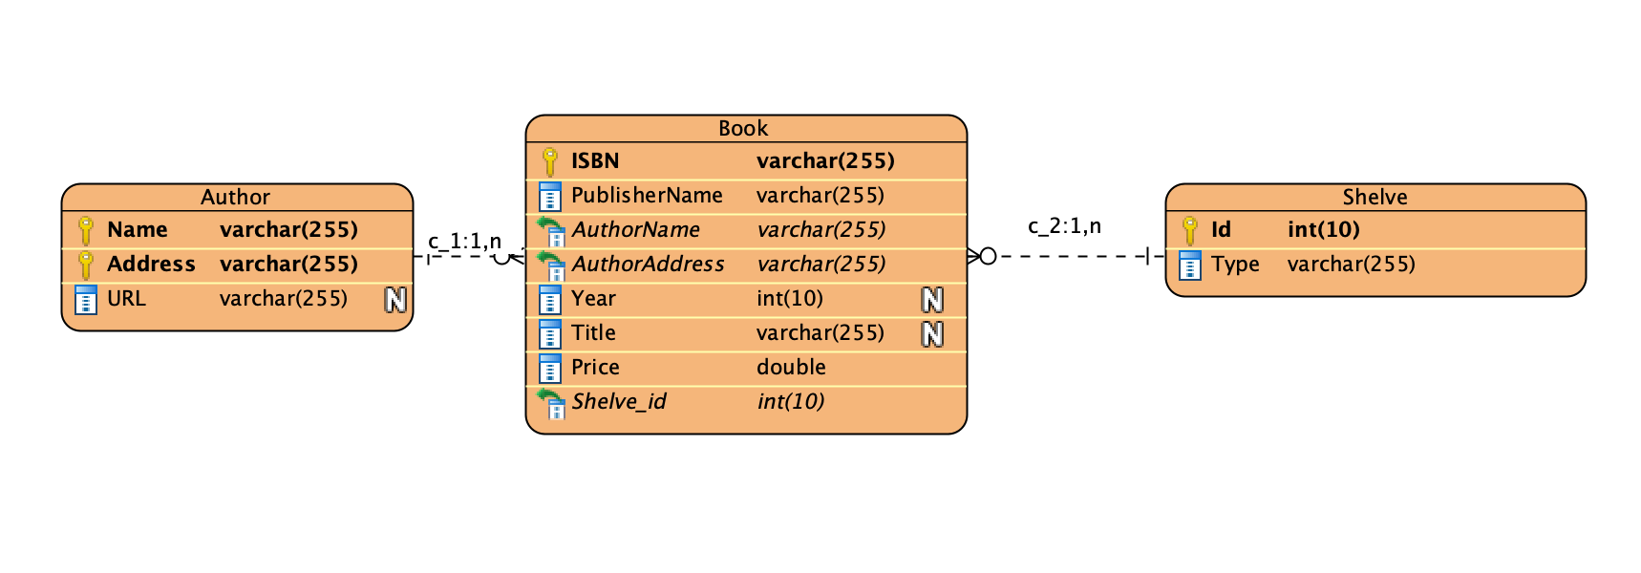
ERD – Exercise 2

Slide 50
ERD – Exercise 3
Model a movie database. Several actors play in a movie. A film is played by several actors. The films each have a director. Think about the attributes and relationships needed.
1. create the UML diagram of this database
2. Using PHPMyAdmin, create the tables and relationships. Use CASCADE options for the foreign key constraints.
3. Using PHPMyAdmin, add some movies, actors and directors.
4. Delete a Film actors. What happens to the other tables?
5. Delete a movie. What happens?

Slide 51
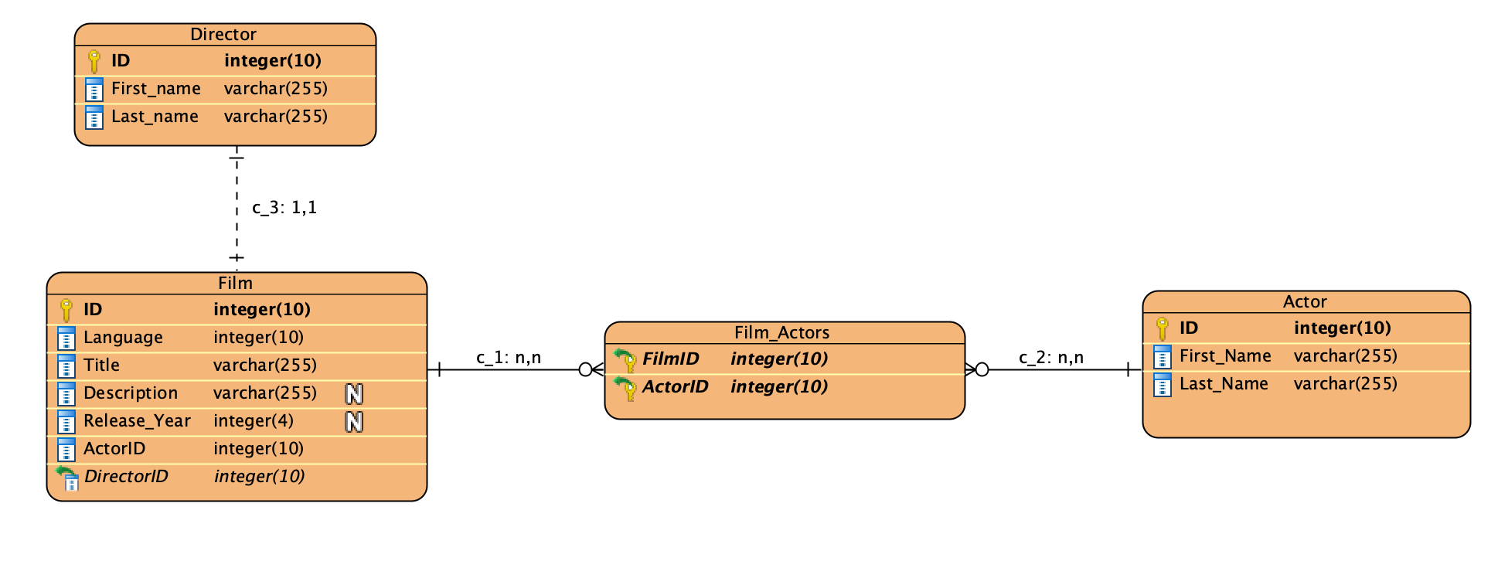
ERD – Exercise 3

Slide 52
ERD – Exercise 4
You are designing a parking control system. Each user has a pass allowing him to access one of the network car parks. At the end of the day, each car park sends by email a summary of the parking lots for the day: http://pastebin.com/mxCwqW5V
Design the diagram for this model, allowing for insertion of parking systems, of a summary like in the provided link as well as some customers.
Using PhpMyAdmin, create the tables and relationships. Use CASCADE options for the foreign key constraints.
Using PhpMyAdmin, insert some parking systems, some customers as well as some summary.
Query the summary of a specific user.

Slide 53
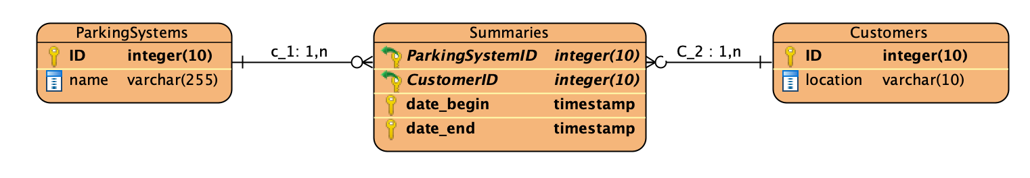
ERD – Exercise 4

