Slide 1

SQL Module
Mattieu Detaille
Notes:
Experience: cyber security team; innovation team (blockchain, cloud, data); freelance
Put a paper with your names on your desk
Can you introduce yourself (first name, last name, whay you are here)?

Slide 2
Module Objectives
Database
Database management system
Model a database based on a defined problem
Use and query a database
SQL
PhpMyAdmin - MariaDB
Xampp
Optimize and administrate a database
Import/Export data

Slide 3
Today Objectives
Understand what is a Database
Understand what is a Database management system
Create a database according to a problem
Insert information in a database
Use and query a database
SQL
PhpMyAdmin - MariaDB
Xampp

Slide 4
What is a database? Have you ever used any?
What’s your experience with them?
Notes:
Every time you go on a website, pretty sure there is one behind
Small ones for small services like reservation system in a restaurant
Imagine now the database needed for Facebook, Amazon? Store and process huge amount of data

Slide 5
What is a database?
A database is used to store some data
Any organized collection of data
Some examples
T.V. guide
Airline reservation system
Files on computers and hard drives

Slide 6
Data - Information
Data
Unprocessed information - from sensors for instance
Information
Information that has been organized in a coherent and meaningful way
Data → Information → Knowledge

Slide 7
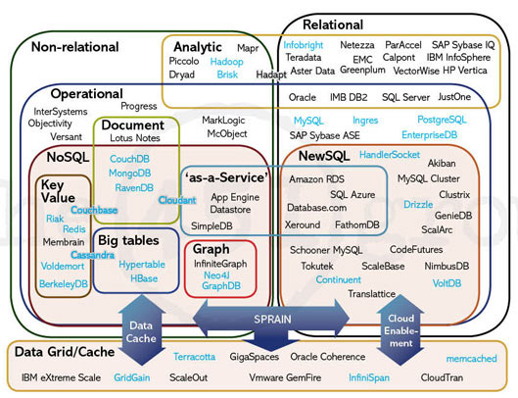

Slide 8
Why do we use a database and not a program simply combined with a file?

Slide 9
What’s wrong with files?
Tight coupling between programs and physical data organization
One changes? the other too!
The “model” of data is hardcoded
What if the program is lost?
Hard to manage concurrent updates & failures
What if data is simultaneously used by many users? – What if the computer gets unplugged?

Slide 10
What is a Database Management System (DBMS)?
Database system = Software system that supports the definition of a database
Database management system = Software system designed to store, manage and facilitate access to databases
Purpose: Data ➔ Information ➔ Knowledge ➔ Action
Notes:
A database management system (DBMS) such as Access, FileMaker, Lotus Notes, Oracle or SQL Server which provides you with the software tools you need to organize that data in a flexible manner. It includes tools to add, modify or delete data from the database, ask questions (or queries) about the data stored in the database and produce reports summarizing selected contents

Slide 11





Existing SQL DBMS
IBM DB2
Oracle
MySQL
Microsoft SQL Server
Notes:
MySQL is the one we will use
MariaDB = high avilability and failover

Slide 12
Why use a DBMS?
Data independence and efficient access
Reduced application development time
Data integrity and security
Concurrent access, recovery from crashes

Slide 13
Types of databases
Relational databases
Collections of data with pre-defined relationships between them.
Data organized as a set of tables with columns and rows
MySQL, PostgreSQL, MariaDB, etc.
Non-relational databases
stores data in a non-tabular form
More flexible, main difference is how they store information
NoSQL, MongoDB, Cassandra
Notes:
A relational database is a collection of data items with pre-defined relationships between them. These items are organized as a set of tables with columns and rows. Tables are used to hold information about the objects to be represented in the database.

Slide 14
In this class, we will focus on a RELATIONAL database :
MariaDB – Evolution of MySQL

Slide 15
Relational database representation
SQL databases are represented with tables
Databases have several tables or entities
Tables have rows and columns
Train_number | Company | Departure
203 | SNCF | 2020-02-01 12:10
405 | SNCB | 2020-02-09 15:23
Column name or Field
First row
Table
Second row
Train_number | Origin | Destination
203 | Paris | Nice
405 | Luxembourg | Brussels
Column
Notes:
Draw database-tables representation on the board
A relational database is a collection of data items with pre-defined relationships between them. These items are organized as a set of tables with columns and rows. Tables are used to hold information about the objects to be represented in the database.
Entity : Train-schedule; Train-location
Relation : schedule-location of the train

Slide 16
SQL Basics – CRUD operations

Slide 17
CRUD operations
CREATE
Read
Update
Delete

Slide 18
Creating and deleting a database

Slide 19
Create a database
CREATE {DATABASE | SCHEMA} [IF NOT EXISTS] db_name
[create_specification] ...
create_specification:
[DEFAULT] CHARACTER SET [=] charset_name
| [DEFAULT] COLLATE [=] collation_name
CREATE DATABASE test;
CREATE DATABASE test DEFAULT CHARACTER SET utf8 COLLATE = utf8_bin;
Notes:
Database and schema : the same, schema was brought up in a later version of the language SQL.

Slide 20
Select a database
USE db_name;
USE test;

Slide 21
Drop a database
DROP DATABASE db_name;
DROP DATABASE test;

Slide 22
Creating tables in a database

Slide 23
Table Columns & Types
Numeric
Integer (INT)
Small decimal numbers (FLOAT)
Big decimal numbers (DOUBLE)
Character String
Small String (CHAR) - 0 to 255 characters
Big String (VARCHAR) – 0 to 65535 characters
Date & Time
Date (DATE) → YYYY-MM-DD
Time (TIME) → hh:mm:ss
Date & Time (DATETIME) → YYYY-MM-DD hh:mm:ss
Timestamp
ENUM – allows to store a list of value choice
Boolean – True or False
Notes:
INT Signed range is from -2147483648 to 2147483647. Unsigned range is from 0 to 4294967295.
FLOAT (0 to 24 digits including after comma)
DOUBLE (25 to 53 digits including after comma)
A timestamp. TIMESTAMP values are stored as the number of seconds since the Unix epoch ('1970-01-01 00:00:00' UTC).
ENUM('Low', 'Medium', 'High')

Slide 24
Create a table
CREATE TABLE tbl_name (create_definition,...)
create_definition: col_name column_definition
column_definition:
data_type [NOT NULL | NULL] [DEFAULT default_value]
[AUTO_INCREMENT] [[PRIMARY] KEY] [COMMENT 'string']
data_type:
TINYINT[(length)] [UNSIGNED] [ZEROFILL]
| INT[(length)] [UNSIGNED] [ZEROFILL]
| DOUBLE[(length,decimals)] [UNSIGNED] [ZEROFILL]
| FLOAT[(length,decimals)] [UNSIGNED] [ZEROFILL]
| DATETIME[(fsp)]
| VARCHAR(length) [CHARACTER SET charset_name] [COLLATE collation_name]
CREATE TABLE test (
id INT UNSIGNED PRIMARY KEY AUTO_INCREMENT,
information VARCHAR(10) NOT NULL
);
Notes:
Not NULL – no values mandatory
Unsigned : zero or positive numbers
Zerofill : put zero values in front of values to display it correctly
Tinyint : 0-255

Slide 25
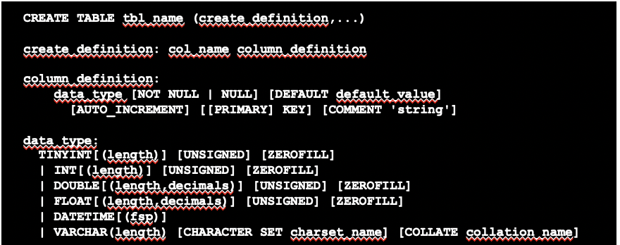
Create table Train_destination
Train_number | Destination
123 | Paris
Notes:
CREATE TABLE Train_destination (Train_number INT NOT NULL, Destination VARCHAR(10) NOT NULL)

Slide 26
Create table Train_schedule
Train_number | Company | Week_day | Scheduled
203 | SNCF | Monday | 12:10
405 | SNCB | Tuesday | 15:23
Notes:
CREATE TABLE Train_schedule (Train_number INT NOT NULL, Company VARCHAR(10) NOT NULL, Week_day VARCHAR(10) NOT NULL, Scheduled TIME)

Slide 27
Insert rows in a table of a specific database

Slide 28
Insert element into a table
INSERT [INTO] tbl_name[(col_name [, col_name] ...)]
{VALUES | VALUE} (value_list) [, (value_list)] ...
INSERT INTO Train_destination(Train_number, Destination) VALUES (123, ‘Paris’);
INSERT INTO Train_destination(Train_number, Destination) VALUES (123, ‘Paris’), (124, ‘Amsterdam’);

Slide 29
Insert in table Train_destination
Train_number | Destination
203 | Nice
405 | Brussels
Notes:
INSERT INTO Train_destination(Train_number, Destination) VALUES (203, ‘Nice’);
INSERT INTO Train_destinatio(Train_number, Destination) VALUES (405, ‘Brussels’);

Slide 30
Insert in table Train_schedule
Train_number | Company | Week_day | Scheduled
203 | SNCF | Monday | 12:10
405 | SNCB | Tuesday | 15:23
Notes:
INSERT INTO Train_schedule(Train_number, Company, Week_day, Scheduled) VALUES (203, ‘SNCF’,’Monday’,’12:10’);
INSERT INTO Train_schedule(Train_number, Company, Week_day, Scheduled) VALUES (405, ‘SNCB’,Tuesday’,’15:23’);

Slide 31
Time for exercise!

Slide 32
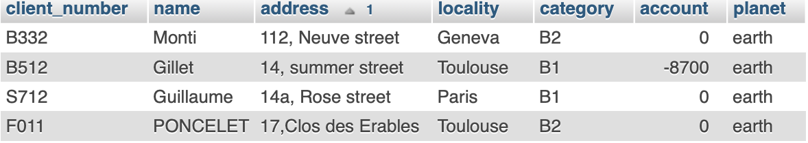
Client table – Create and insert
Notes:
CREATE TABLE Client (
`client_number` varchar(4) DEFAULT NULL,
`name` varchar(9) DEFAULT NULL,
`address` varchar(21) DEFAULT NULL,
`locality` varchar(9) DEFAULT NULL,
`category` varchar(2) DEFAULT NULL,
`account` mediumint(9) DEFAULT NULL,
`planet` varchar(8) DEFAULT NULL
);
INSERT INTO `Clients` VALUES ('B062','skywalker','72, south street','San Francisco','B2',-3200,'Tatooine’);

Slide 33
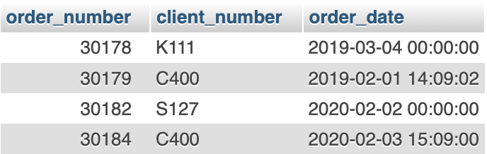
Order table – Create and insert
Notes:
CREATE TABLE Order (
`order_number` mediumint(9) DEFAULT NULL,
`client_number` varchar(4) DEFAULT NULL,
`order_date` datetime DEFAULT NULL
);
INSERT INTO `Orders` VALUES (30178,'K111','2019-03-04’);

Slide 34
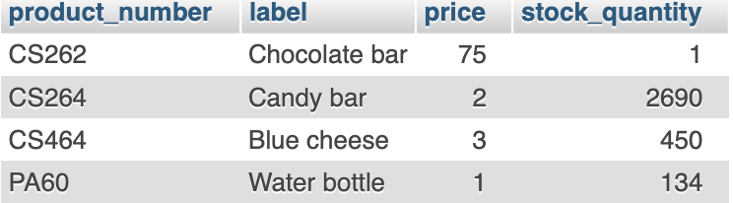
Product table – Create and insert
Notes:
CREATE TABLE Product (
`product_number` varchar(5) DEFAULT NULL,
`label` varchar(21) DEFAULT NULL,
`price` smallint(6) DEFAULT NULL,
`stock_quantity` smallint(6) DEFAULT NULL
);
INSERT INTO `Product` VALUES ('CS262','Chocolate bar',75,1);

Slide 35
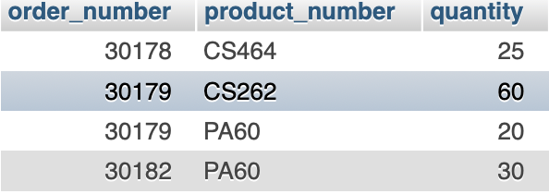
Detail – Create and insert
Notes:
CREATE TABLE Detail (
`order_number` mediumint(9) DEFAULT NULL,
`product_number` varchar(5) DEFAULT NULL,
`quantity` smallint(6) DEFAULT NULL
);
INSERT INTO `Detail` VALUES (30178,'CS464',25);

Slide 36
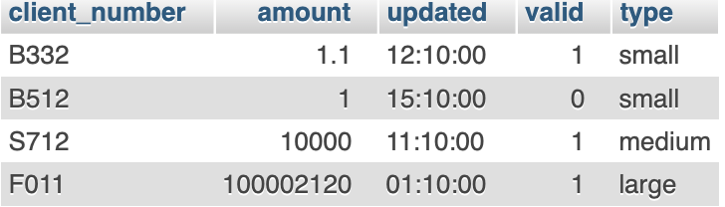
Bank_account table – Create and insert
Type is ENUM type with possibilities small, medium, large
Notes:
CREATE TABLE Bank_accounts (client_number VARCHAR(10), amount DOUBLE, updated TIME, valid BOOLEAN, type ENUM('small', 'medium', 'large’));
INSERT INTO Bank_accounts(client_number, amount, type, updated, valid) VALUES ('B332', 100.0, 'small', '12:10', TRUE);

Slide 37
Update rows in a table of a specific database

Slide 38
Update rows
UPDATE table_reference
SET assignment_list
[WHERE where_condition]
UPDATE Train_destination SET Destination = “Paris” WHERE Train_number = “203”;
Train_number | Destination
203 | Nice
405 | Brussels
Train_number | Destination
203 | Paris
405 | Brussels

Slide 39
The WHERE clause
WHERE condition [({AND | OR} condition)...]
UPDATE Train_destination SET Destination = “Paris” WHERE Train_number = “203” OR Train_number = “405” ;
Train_number | Destination
203 | Nice
405 | Brussels
Train_number | Destination
203 | Paris
405 | Paris

Slide 40
The WHERE clause
WHERE condition [({AND | OR} condition)...]
UPDATE Train_destination SET Destination = “Paris” WHERE Train_number = “203” AND Destination = “Nice” ;
Train_number | Destination
203 | Nice
405 | Brussels
Train_number | Destination
203 | Paris
405 | Brussels

Slide 41
Time for exercise!

Slide 42

Update in table Train_destination
Train_number | Destination
203 | Nice
405 | Brussels
Update destination of train number 203 to San Francisco
Update Train_number of train number 405 to 406
Notes:
UPDATE Train_schedule SET Destination = “San Francisco” WHERE Train_number = “203”;
UPDATE Train_schedule SET Train_number = “406” WHERE Train_number = “405”;

Slide 43
Update table Train_schedule
Train_number | Company | Week_day | Scheduled
203 | SNCF | Monday | 12:10
405 | SNCB | Tuesday | 15:23
406 | SNCB | Wednesday | 12:12
Update company of train number 203 to SNCB
Update scheduled time of train number 405 to 15:30
Update scheduled time of train with company SNCB and Week day of Tuesday to 15:30
Update company of train having a week day of Tuesday or Wednesday to SNCF
Notes:
UPDATE Train_schedule SET Company = “SNCB” WHERE Train_number = “203”;
UPDATE Train_schedule SET Scheduled = “15:30” WHERE Train_number = “405”;
UPDATE Train_schedule SET Scheduled = “15:30” WHERE Company = “SNCB” AND Week_day = “Tuesday”;
UPDATE Train_schedule SET company = “SNCF” WHERE Week_day = “Tuesday” AND Week_day = “Wednesday”;

Slide 44
DELETE rows in a table of a specific database

Slide 45
Delete rows
DELETE FROM tbl_name
[WHERE where_condition]
DELETE FROM Train_destination WHERE Train_number = “203”;
Train_number | Destination
203 | Nice
405 | Brussels
Train_number | Destination
405 | Brussels

Slide 46
Time for exercise!

Slide 47

Delete from table Train_schedule
Train_number | Company | Week_day | Scheduled
203 | SNCF | Monday | 12:10
405 | SNCB | Tuesday | 15:23
406 | SNCB | Wednesday | 12:12
Delete row with train number 203
Delete row with company of SNCF or SNCB
Delete row scheduled for Monday at 12:10
Notes:
DELETE FROM Train_schedule WHERE Train_number = “203”;
DELETE FROM Train_schedule WHERE Company = “SNCF” OR Company = “SNCB”;
DELETE FROM Train_schedule WHERE Week_day = “Monday” AND Scheduled = “12:10”;

Slide 48
DELETE a table of a specific database

Slide 49
DROP a table
DROP TABLE table_name;
DROP TABLE test;

Slide 50
Read rows in a table of a specific database

Slide 51
Select elements in a table
SELECT select_expr [, select_expr ...]
[FROM table_references
[WHERE where_condition]]
SELECT * FROM test;
SELECT id,information FROM test WHERE id=’1’;

Slide 52

Select in table Train_destination
Train_number | Destination
203 | Nice
405 | Brussels
Train_number | Destination
203 | Nice
SELECT * FROM Train_destination WHERE Train_number = “203”
SELECT Train_number, Destination FROM Train_destination
WHERE Train_number = “203”

Slide 53
Select in table Train_schedule
Train_number | Company | Week_day | Scheduled
203 | SNCF | Monday | 12:10
405 | SNCB | Tuesday | 15:23
Train_number | Company | Week_day | Scheduled
203 | SNCF | Monday | 12:10
Notes:
SELECT * FROM Train_schedule WHERE Train_number = “203”;

Slide 54
Time for exercise!

Slide 55
Client table – SELECT
SELECT client B332
SELECT client with locality Toulouse
SELECT client with category B1
SELECT client with account < 0
SELECT client with locality Toulouse and category B1
SELECT client with locality Geneva or Toulouse

Slide 56
Order table – SELECT
SELECT order with order_number 30178
SELECT order client_number K111
SELECT order with order_date before 4th March 2019
SELECT order with order_date after 4th January 2019
SELECT order with order_date equal to 3rd February 2020

Slide 57
Product table – SELECT
SELECT product with product_number PA60
SELECT product with price > 450
SELECT product with stock_quantity >= 130
SELECT product with price < 134 and stock_quantity > 70
SELECT product with price = 75 or stock_quantity = 450

Slide 58
Bank_account table – SELECT
SELECT small client account
SELECT client account with amount < 1000
SELECT client accout updated later than 3 PM
SELECT small account updated before 1 PM
SELECT small account updated later than 3 PM

Slide 59
Time for real exercise!

Slide 60
Setup an SQL Database environment
Install Xampp (https://www.apachefriends.org/index.html)
For Mac OS
Mount Volumes and Explore
Open file etc/extra/httpd-xampp.conf
Replace phpMyAdmin section
<Directory "/opt/lampp/phpmyadmin">
AllowOverride AuthConfig Limit
Order allow,deny
Allow from all
Require all granted
ErrorDocument 403 /error/XAMPP_FORBIDDEN.html.var
</Directory>

Slide 61
Xampp - Demo
Notes:
CREATE DATABASE test;
CREATE TABLE test_table (id INT, information VARCHAR(10));
DELETE TABLE test_table;
DROP TABLE test_table;
DROP DATABASE test;

Slide 62
More exercises
Name | Age | Gender
Yoad | 900 | M
Darth Maul |  | M
Notes:
Create and insert all those information in the following tables

Slide 63
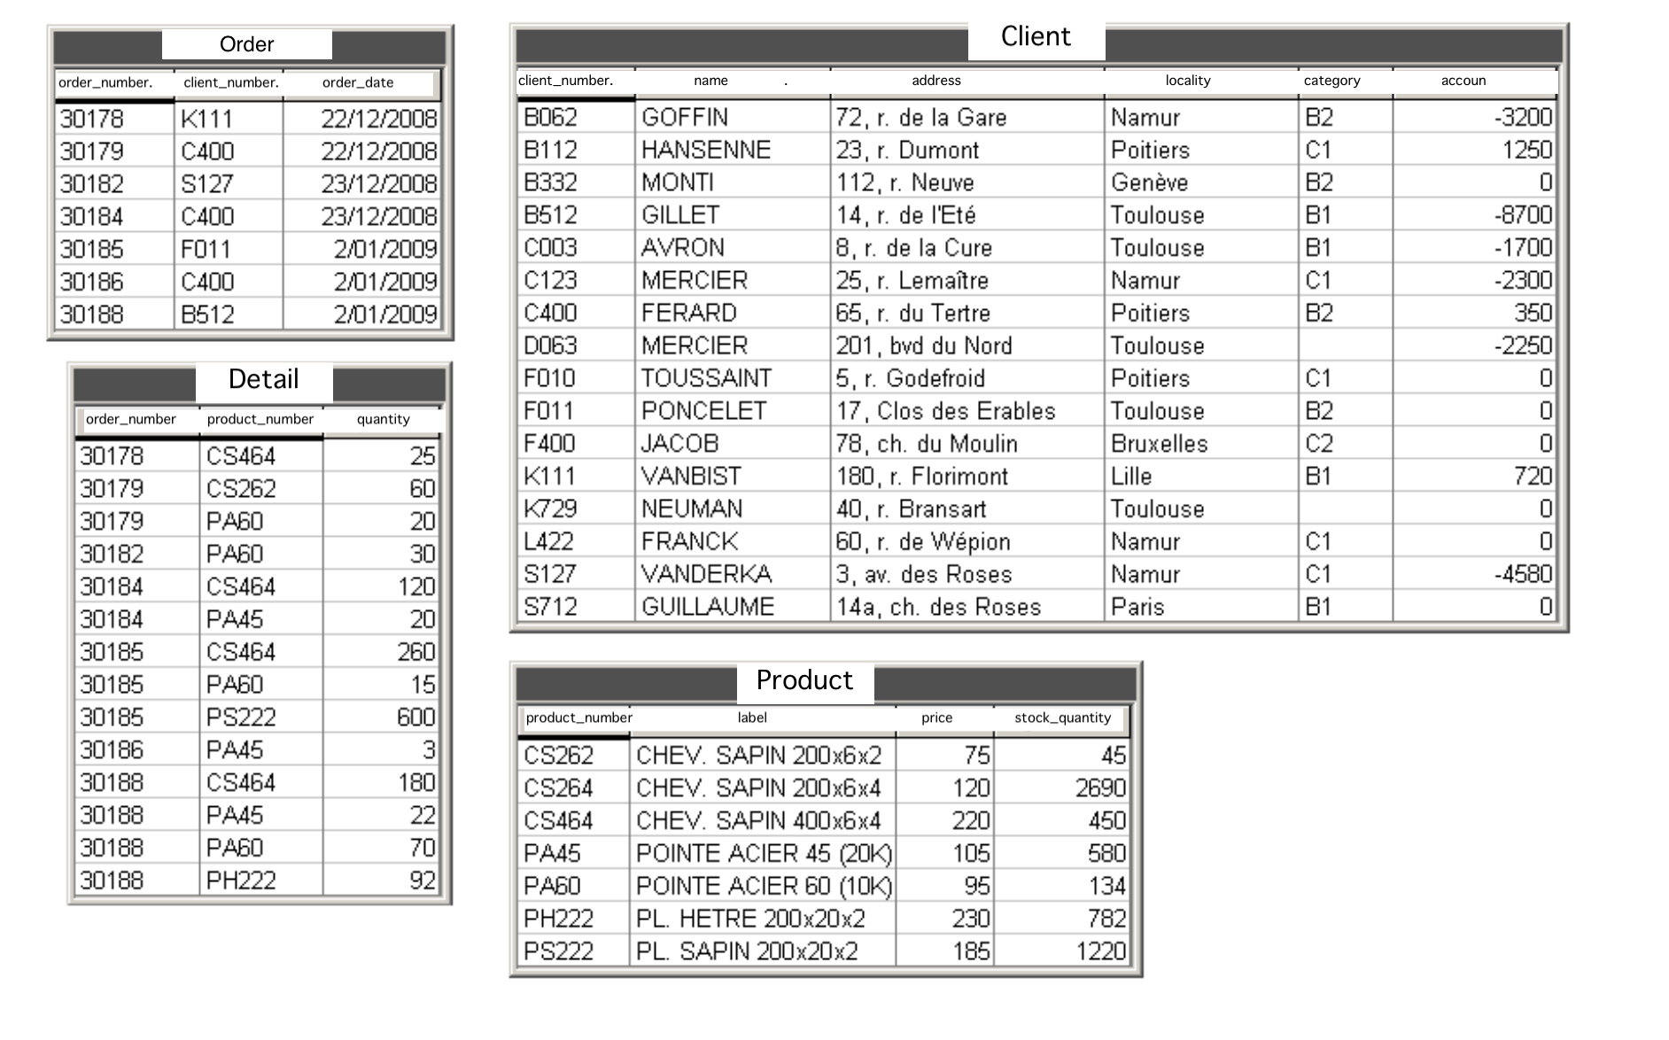
More exercises
Notes:
Create and insert all those information in the following tables
Try to insert C123 a a a a 42 in client. What happens?
Give all info from clients that lives in Namur
Give all the information about customers who live in Lille and who have a positive or zero balance.
What are the names and addresses of category C1 customers?
In what year were the orders made? (you will probably need the function strftime (format, date))
What is the total price of the available stock for each product?
What is the total price of the available stock, all products combined

Slide 64
More exercises
Create and insert all those information in the following tables
Try to insert C123 a a a a 42 in client. What happens?
Give all info from clients that lives in Namur
Give all the information about customers who live in Lille and who have a positive or zero balance.
What are the names and addresses of category C1 customers?
In what year were the orders made? (you will probably need the function strftime (format, date))
What is the total price of the available stock for each product?
What is the total price of the available stock, all products combined

Slide 65
Website for SQL challenges
https://www.hackerrank.com/

