Slide 1
Objects in GridDyn
GridDyn Documents
Philip Top

Slide 2
Outline
Brief look at how the solver interacts with Griddyn
Solve Process
Callback functions
Objects in Griddyn
Interface in GridCoreObjects
Inteface in GridPrimary
GridSecondary and GridSubModel
Specific Objects
gridBus
gridLink
gridRelay
gridArea
gridLoad
gridDynGenerator

Slide 3
Execution Flow: powerflow
makeReady()
Power Balance Loop
Measure
Flow adjustment Loop
Adjust Gen Levels
Guess
Solve*
Check/adjust*
* Now we Get a little deeper
Do Final stuff

Slide 4
Execution Flow: dynamic calculation
Calculation Initial conditions
While time<timeStop
Find next event time
While time<next Event Time
Solve
Check for roots
* Now we Get a little deeper
Deal with any issues: reset if necessary*
Save state to objects
Deal with events: reset if necessary*
finalize
* Will get into more detail in later weeks

Slide 5
The solve Call
Call into the solverInterface solve function
Does some flag translation and calls a solver library
Ida and Kinsol are the main solver libraries,
Also interfaces to CVODE and ARKODE
Simple Gauss-Seidel solver as alternative
possibly boost::odeint later for an alternative so Griddyn can function without Sundials (not that I think it will function well, just want it to function)
SolverInterface objects have callback helper functions that call into the Griddyn simulation

Slide 6
The solve Call (for powerflow)
GridDynSimulation
SolverInteface
Sundials
KLU
Powerflow
solve
Kinsol
ResidualFunction
Function
Evaluation
Residual*
Jacobian
Jacobian
Evaluation
JacobianElement*
* Object function calls

Slide 7
The solve Call (for DAE)
GridDynSimulation
SolverInterface
Sundials
KLU
dyanmicDAE
solve
IDA
ResidualFunction
Residual*
Function
Evaluation
JacobianFunction
JacobianElements*
Jacobian
Evaluation
rootFindingFunction
rootTest*
Root
Evaluation
* Object function calls

Slide 8
gridCoreObject Interface
Model Parameter Interface
set, get, setTime, setOwner
setFlag, getFlag
Object interaction
add/remove, addsp
find, getSubObject, findSubObject
Messaging/ updates
updateA, updateB
log, alert, enable, disable
getParameterString, getString
clone
Bold is not fully implemented in all objects
Notes:
Addsp is for smart pointers to objects—targetted primarily at objects which are operating in multiple contexts, not used very often yet

Slide 9
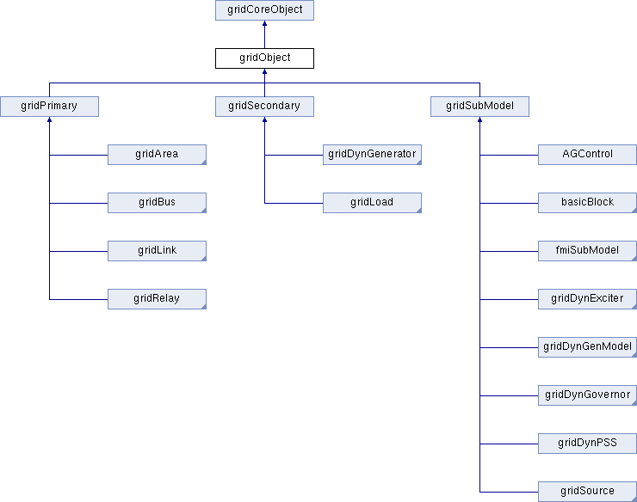
Code: GridObject

Slide 10
Grid Object Interface
State size and indexing
setOffset, setOffsets, setRootOffset, setParamOffset,setDiffOffset, setAlgOffset,
Solution information
getState, setState, guess
Object management
IsArmed*, isConnected,
Statesize*,algsize*,diffsize*, voltageStateCount*, angleStateCount*, jacSize*, rootSize*, paramSize*,
isLoaded*, loadSize, loadSizesSub*
setupPFlowFlags*, setupDynFlags*, updateFlags
getVariableType, getTols, getConstraints
getStateNames
*Not virtual

Slide 11
Grid Primary Interface
Initialization
pFlowInitializeA*, pFlowInitializeB*
Model calculations
preEx, jacobianElements, residual, derivative, algebraicUpdate, postEx, reset, timestep
Output
getOutput, getOutputs, getOutputLoc, getDoutDt,
getBus, getLink, getArea, getRelay
rootTest, rootTrigger, rootCheck,
pFlowObjectInitializeA, pFlowObjectInitializeB
dynInitializeA*, dynInitializeB*
dynObjectInitializeA, dynObjectInitializeB
powerFlowAdjust, pFlowCheck, reset, computePower
*Not virtual

Slide 12
GridPrimary Notes
GridPrimary are top level simulation objects
Areas
Wide area controls
Object Containers
Simulation distribution
Root Simulation object is special type of object
Buses
System nodes
Container for loads and generators
Compute voltage and angle
Links
Connect nodes together (or areas)
Primary model of a transmission line
But many other possibilities
Relays
Sensors and actuators for the grid
Can sense from one object and act on another
Can act as containers for other primary objects and other objects

Slide 13
GridSecondary, and GridSubModel
Very similar to gridPrimary in interface
GridSecondary
Additional Outputs related to real and reactive power
Additional Outputs related to available adjustments in power levels
GridSubModel
Only one set of Initialization functions-object holding it is expected to manage when it gets initialized
getInputSize, getOutputSize
Both
outputPartialDerivatives –useful if the output is not a specific state
ioPartialDerivatives --useful if the output is not a specific state
findIndex

Slide 14
Closer look at a function Call
Input arguments (not present for gridPrimary IO data is a resizable vector class (std::vector or boost small vector)
virtual void residual(
const IOdata & args,
const stateData *sD,
double resid[],
const solverMode & sMode);
Current state information (state, derivatives if applicable, time, id, and some other information
Storage location of calculation results
Requested method of computation and index of where to find the index information
any approximations
types of states
dynamic mode

Slide 15
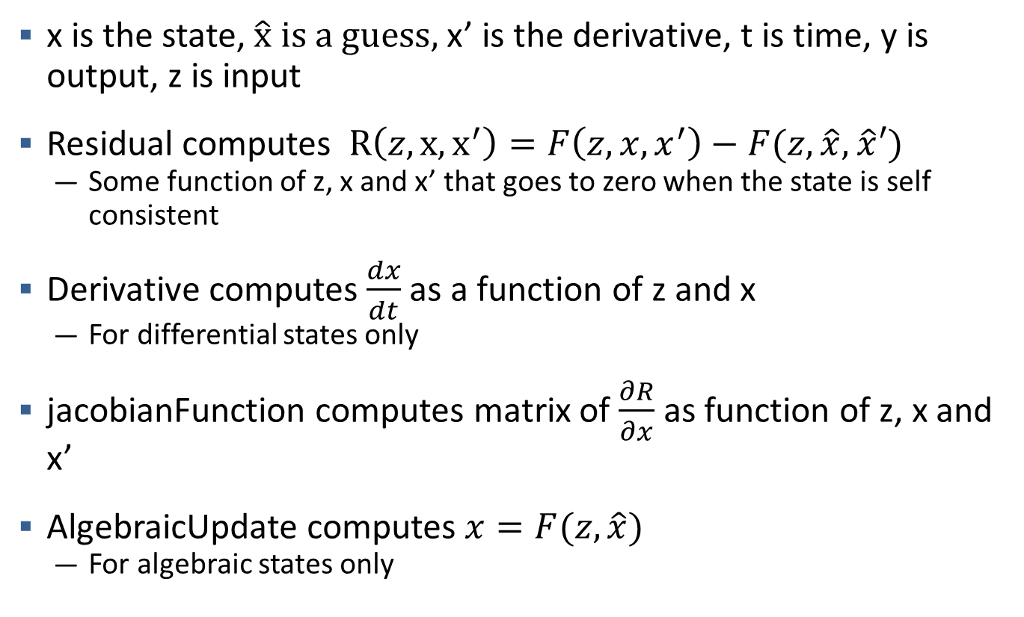
The Calculation Functions
x is the state, $\hat{x} is a guess,$x’ is the derivative, t is time, y is output, z is input
Residual computes $R\left(z,x,x^{′}\right)=F\left(z,x,x^{′}\right)−F(z,\hat{x},$ $\hat{x}′)$
Some function of z, x and x’ that goes to zero when the state is self consistent
Derivative computes $\frac{dx}{dt}$ as a function of z and x
For differential states only
jacobianFunction computes matrix of $\frac{∂R}{∂x}$ as function of z, x and x’
AlgebraicUpdate computes $x=F(z,\hat{x})$
For algebraic states only

Slide 16
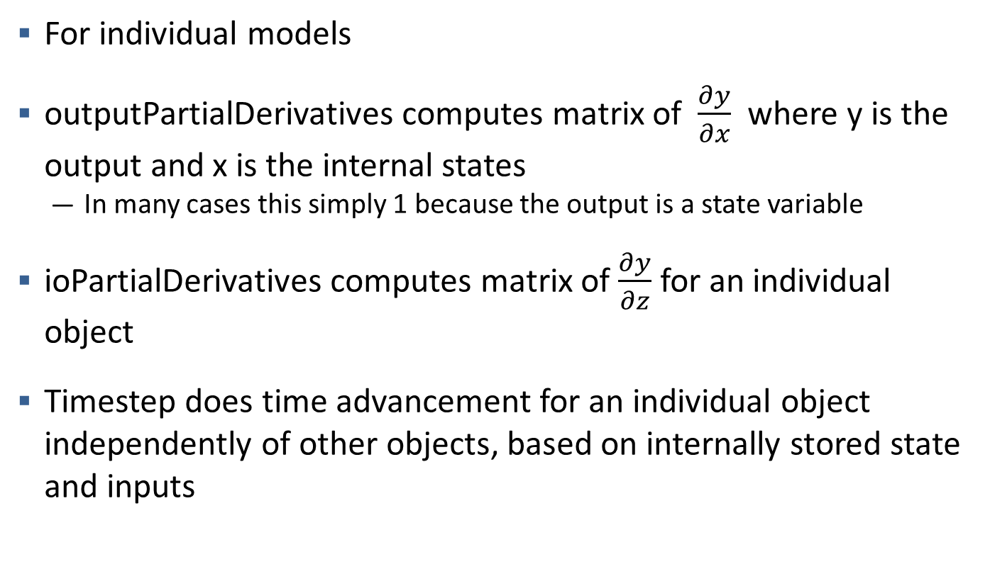
Calculation Functions
For individual models
outputPartialDerivatives computes matrix of $\frac{∂y}{∂x}$ where y is the output and x is the internal states
In many cases this simply 1 because the output is a state variable
ioPartialDerivatives computes matrix of $\frac{∂y}{∂z}$ for an individual object
Timestep does time advancement for an individual object independently of other objects, based on internally stored state and inputs

Slide 17
Bus object
Voltage and angle states
Different modes to fix one or more of the states (PQ, PV, Slack, and afix)
gridBus
gridLinks
Link 1
Link 2
gridLoads
gridDynGenerators
.
.
.
Load 1
Gen 1
Link N
Load 2
Gen 2
.
.
.
.
.
.
Load N
Gen N

Slide 18


Bus Object
$$R\left(v\right)=\sum{LoadQ+\sum{GenQ+\sum{LinkQ}}}$$
$$R\left(θ\right)=\sum{LoadP+\sum{GenP+\sum{LinkP}}}$$
For dynamic computations busses also calculate bus frequency as a filtered and scaled derivative of the angle
Generalized from typical power flow calculations
The individual objects do the calculations of real and reactive power
Busses just do the sums
This allows expansion of loads, gens and links beyond the typical power system models in power flow and dynamic computations
The only assumptions buses make about the nature of generators, loads and links is that they are functions of voltage, angle, and frequency. The lack of assumptions on the form of that functions gives GridDyn enormous flexibility in defining and adding models

Slide 19
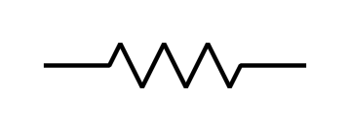
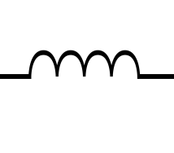
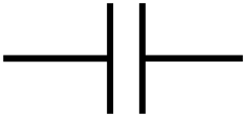

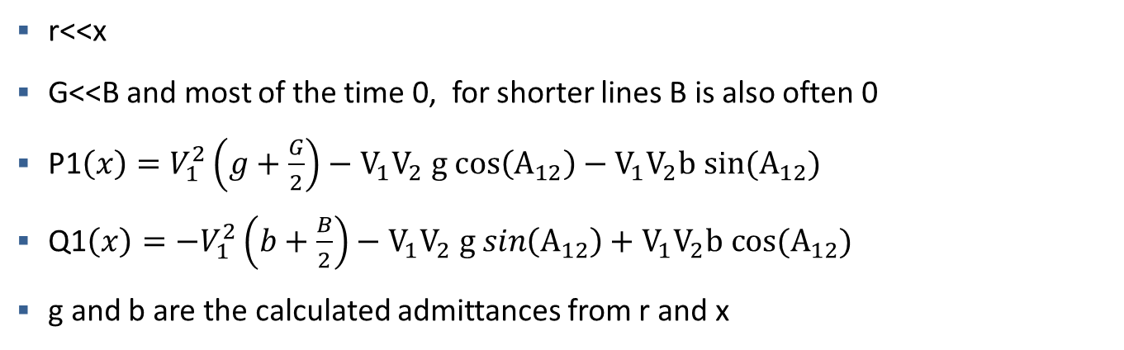
Link Object
Bus 1
r
x
Bus 2
jB/2
G/2
G/2
jB/2
r<<x
G<<B and most of the time 0, for shorter lines B is also often 0
P1$\left(x\right)=V_{1}^{2}\left(g+\frac{G}{2}\right)−V_{1}V_{2} g cos\left(A_{12}\right)−V_{1}V_{2}b sin(A_{12})$
Q1$\left(x\right)={−V}_{1}^{2}\left(b+\frac{B}{2}\right)−V_{1}V_{2} g sin\left(A_{12}\right)+V_{1}V_{2}b cos(A_{12})$
g and b are the calculated admittances from r and x

Slide 20
GridRelay
Read data from Source objects(s) check conditions(continuously or at sampled intervals)
If condition(s) are met for a certain period of time trigger actions on sink object(s)
Condition 1
Delays
Condition to Action Matrix
Action 1
Condition 2
Action 2
.
.
.
.
.
.
Condition N
Action N
Source Object
Sink Object

Slide 21
GridRelay
Sensors build on the relay class and include a chain of control blocks for modeling sensing systems
Includes a communicator for interrelay interaction or communication with external controls or monitoring systems
Actions can be triggered off of 1 or more conditions
Implemented relays include
Fuses
Breakers
Impedance based zonal relays
Differential relays
Load relays (voltage and frequency)
Gen relays (voltage and frequency)
Thermal models for transformers
Lifespan modules for transformer
Bus relay

Slide 22
GridRelay
Further expansion will allows nearly arbitrary models to be executed inside GridDyn allowing generic FMU’s , generic state space models, and flexible interfaces to other simulators and model types
This is in development

Slide 23
GridArea
Container for other primary objects
Wide area control schemes such as AGC (work in progress)
Output functions for computing results across the entire area
Object management functions

Slide 24
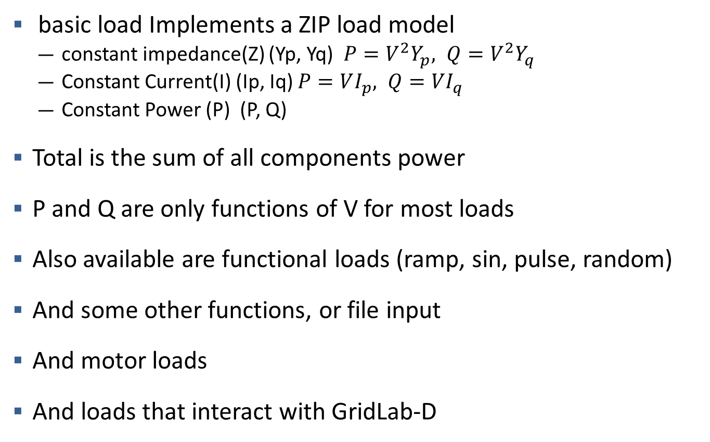
GridLoad
basic load Implements a ZIP load model
constant impedance(Z) (Yp, Yq) $P=V^{2}Y_{p}, Q=V^{2}Y_{q}$
Constant Current(I) (Ip, Iq) $P=VI_{p}, Q=VI_{q}$
Constant Power (P) (P, Q)
Total is the sum of all components power
P and Q are only functions of V for most loads
Also available are functional loads (ramp, sin, pulse, random)
And some other functions, or file input
And motor loads
And loads that interact with GridLab-D

Slide 25
GridDynGenerator
GridDynGenerator
Vtarget
V
Exciter
Eq
GenModel
x
P,Q
A
PSS
Pset
r
f
Governor
Vs
P mech
w

Slide 26
GridDynGenerator
All components are submodels
Not all need to be present, Generators work with any or all types of components
None of the components needs to know the internals of the other components, these submodels are the primary source of differential equations in power system models
Pset can be manipulated by AGC, and generator schedules
Vtarget can be manipulated by Wide area voltage controllers

Slide 27
Other objects
Blocks --submodels which implement control system block
Working on control system submodel which could implment arbritrary arrangements of blocks
Gain, delay, deadband, function, pid, control, transferfunction, derivative, integral, and others available
Sources –basically signal generators into GridDyn
Schedulers– objects which control the scheduled power of things in Griddyn (generators, ties, loads)
Manage generator ramps
Coordinate AGC, reserve, and normal scheduled power
Communicate via communicators

