Slide 1
New reserve model

Slide 2
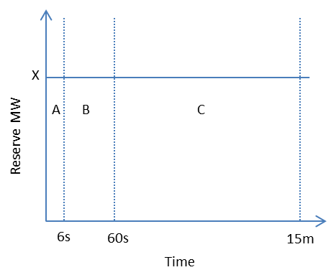
Comments on original design
SPD would calculate X as normal (binding risk) and procure reserve from providers with new offer form that ensures:
∑Reserve offers in timeframe A ≥ mX (where m = 0.5 or another fraction representing an allowance for ramping)
∑Reserve offers in timeframe B ≥ X
∑Reserve offers in timeframe C ≥ X
Price of reserve = ∑Shadow prices from constraints 1-3
At least the first of these constraints would be adjusted by the NFR
The binding risks for different reserve classes (6s, 60s and 15mins) can be from different risk classes.
The amount of reserve provided by a risk setting generator can be different for each reserve class.
These issues make it very complicated to model risk as above proposal.

Slide 3
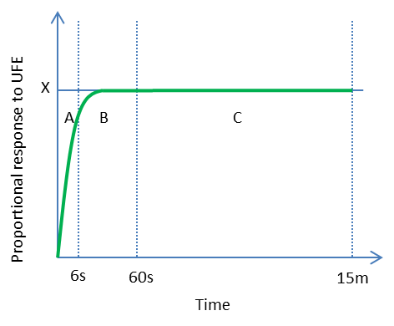
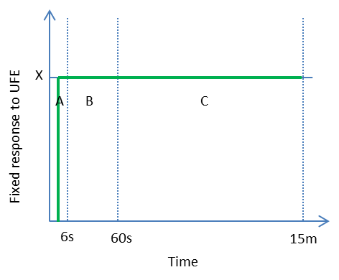
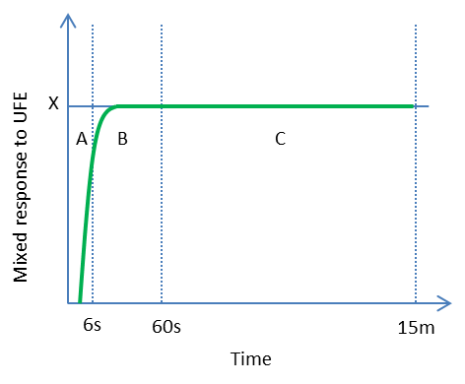
Comments on original design
Example of proportional response
Example of fixed response
Example of mixed response
Reserve offer would contain five values:
X quantity (MW)
Y price ($/MWh)
Fraction of area A under curve (eg 0.42, 0.55 and 0.25)
Fraction of area B under curve (eg 0.93, 1.00 and 0.93)
Fraction of area C under curve (eg 1.00, 1.00 and 1.00)
There is one set of reserve offer from each offer.
The quantity of provided reserve class will be defined by the fraction of the area A, B or C (reserve class factors) and the cleared quantity of reserve.

Slide 4
SPD formulation design summary
One extra class of reserve (15 min) is added into the system.
All risk and NMIR equations stay the same and are also applied for new reserve class.
Since there is one set of reserve from each offer, all the current reserve equations are modified to remove to reserve class set.
A new reserve equation is required to calculate the effective quantity for each reserve class from a cleared reserve offer.
Pricing for each reserve class remains the same.
The effective pricing at each offer will be a sum product of reserve class prices and reserve class factors

Slide 5
Example of reserve offer
Offer block | Max (MW) | Price ($/MWh) | PLSR proportion | 6s factor | 60s factor | 15 min factor
1 | 20 | 0.01 | 50% | 0.7 | 0.95 | 1
2 | 15 | 10.00 | 100% | 0.7 | 0.95 | 1
3 | 10 | 100.00 | 150% | 0.7 | 0.95 | 1
PLSR proportion only applied for partial loaded spinning reserve.
Effective reserve class factor (6s, 60s and 15 min) can be different for different offer blocks.

Slide 6
Advantages of new reserve model
Only one set of reserve offer.
Reserve pricing for each provider is dependent on reserve quality (reserve class effectiveness)

Slide 7
Foreseeable challenges
Change of reserve offer structure/parameters may put more cost onto system operators and participants’ IT system.
RMT need to be modified to accommodate new reserve class and calculate NFR.
Reserve pricing is more complex.

Slide 8
Appendix
Fundamental sets and indices
Item | Definition
Generation Offers | A generation offer is represented by an element of the set OFFERS and is indexed by g
Reserve Offers | A reserve offer from a generator or interruptible load provider is represented by an element of the set RESERVEOFFERS and is indexed by r. Reserve offers are not class-specific. One reserve offer can provide for different reserve classes based on reserve class effective factors of the reserve offer.
Reserve Classes | A reserve class is represented by an element of the set RESERVECLASSES and is indexed by c. RESERVECLASSES = {Fast, Sustained, Lasting} or {6s, 60s , 15 min}
Reserve Types | A reserve type is represented by an element of the set RESERVETYPES and is indexed by element s. RESERVETYPES = {PLSR, TWD, IL}
Risk Classes | A risk class is represented by an element of the set RISKCLASSES and indexed by rc.
Derived sets
Item | Definition
OFFERS_{i} | is the set of all generation offers belonging to island i.
RESERVEOFFERS_{i} | is the set of all reserve offers in island i.

Slide 9
Parameters Appendix (Cont.)
Item | Definition
ReserveOfferBlocks_{r} | The number of blocks in reserve offer r ∈ RESERVEOFFERS
ReserveOfferProportion_{r, j} | The incremental MW percentage of the j^{th} block of offer r ∈ RESERVEOFFERS_{PLSR}.
ReserveOfferMaximum_{r, j} | The maximum MW reserve available from the j th block of the reserve offer r.
ReserveGenerationMaximum_{g} | The maximum MW generation and reserve capability associated with generation offer g ∈ OFFERS
ReserveClassFactor_{r, j,c} (New) | Effective factor of each block j of reserve offer r for reserve class c.
Variables
Item | Definition
GENERATION_{g} | The scheduled part of MW generation corresponding to offer g.
RESERVE_{r} | The reserve scheduled corresponding to reserve offer r ∈ RESERVEOFFERS
RESERVEBLOCK_{r,j} | The reserve scheduled corresponding to j^{th}block of the reserve offer r.
RESERVECLASSMW_{r,c} (New ) | The effective factor of the reserve scheduled corresponding reserve offer r for reserve class c
ISLANDRISK_{i,c,rc} | The MW risk for island i∈ISLANDS, reserve class c∈RESERVECLASSES and risk class rc∈ RISKCLASSES. The variable is unrestricted.

Slide 10
SPD risk equations/constraints Appendix (Cont.)
Equation 3.4.1.1 to 3.4.1.10 remain same as status quo with reserve class has extra element LIR (for 15 minutes reserve).
SPD reserve sharing equations/constraints
Equation 3.4.2.1 to 3.4.2.31 remain same as status quo with reserve class has extra element LIR (for 15 minutes reserve).
SPD reserve requirement and availability constraints
Equation 3.4.2.1 to 3.4.2.31 remain same as status quo with reserve class has extra element LIR (for 15 minutes reserve).

Slide 11
SPD reserve equations/constraints Appendix (Cont.)

