Slide 1
A* CCG Parsing with a Supertag and Dependency Factored Model
Masashi Yoshikawa and Hiroshi Noji and Yuji Matsumoto
Graduate School of Information and Science
Nara Institute of Science and Technology
ACL 2017

Slide 2
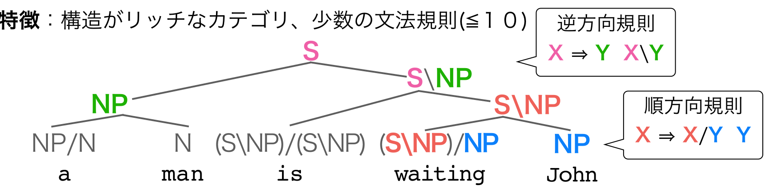
CCG
结构丰富的类别、少数语法规则

Slide 3
A* 搜索
A*算法是一种启发式搜索算法，启发式搜索就是在状态空间中的搜索对每一个搜索的位置进行评估，得到最好的位置，再从这个位置进行搜索直到目标。这样可以省略大量无谓的搜索路径，提高了效率。
f = g + h
f - 节点从初始状态到目标状态的估价函数
g - 初始状态到当前状态的实际代价
h - 当前状态到结束状态的预估代价
A* 搜索保证能找到最优解：
h < 实际代价：搜索的点数多，搜索范围大，效率低，但能得到最优解。
h > 实际代价：搜索的点数少，搜索范围小，效率高，但不能保证得到最优解。

Slide 4
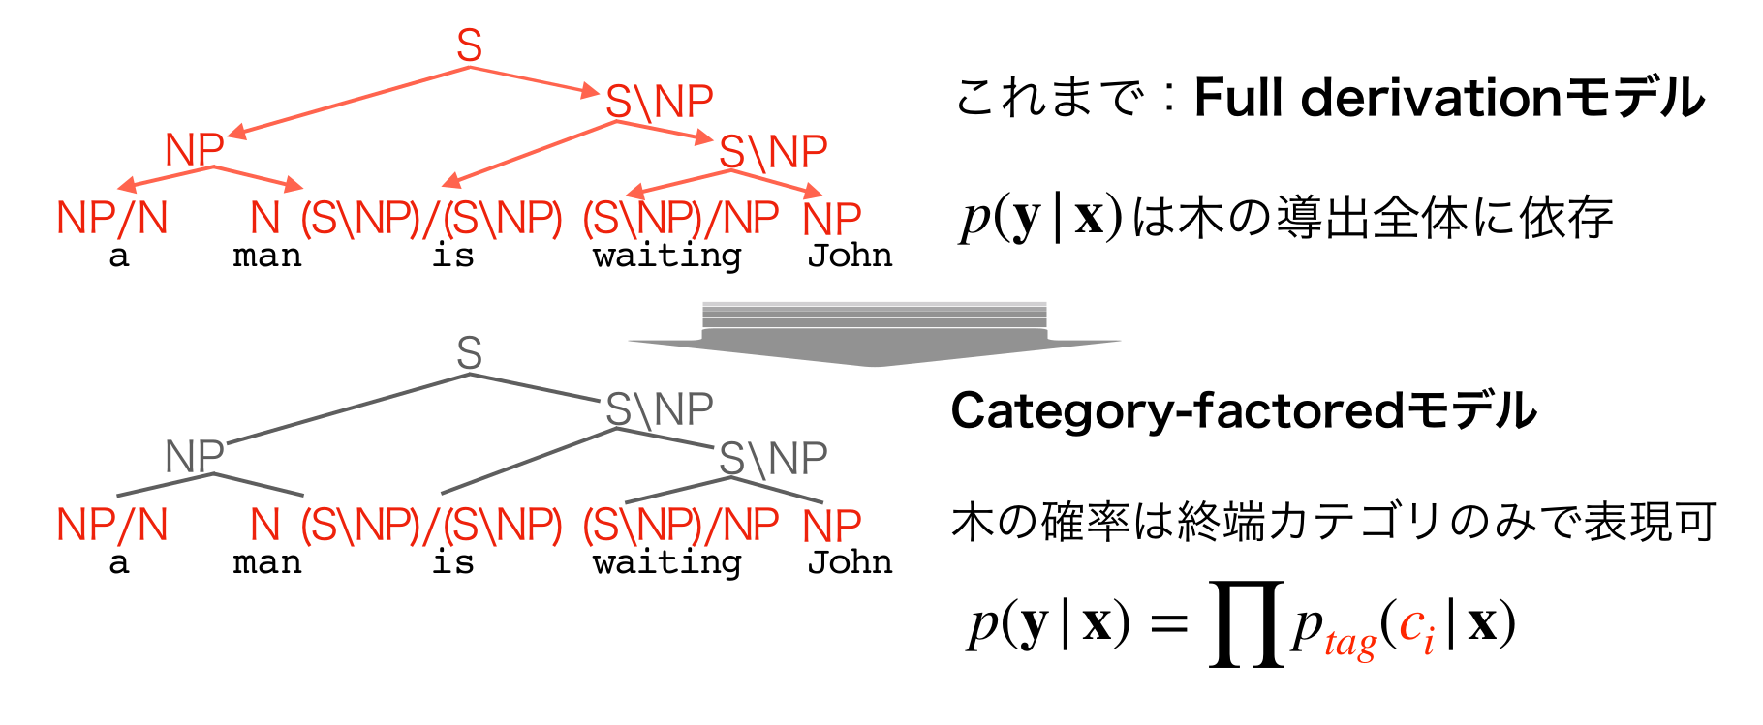
现有的parsing方法(Lewis+, 2014)
完整推导
为给定句子完整推导的概率
模型

Slide 5
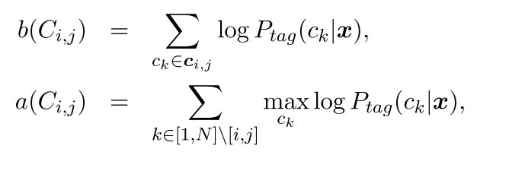
现有的parsing方法(Lewis+, 2014)
为什么这样是可行的：
对于所有单词的类别概率P_{tag}(c|x)可事先计算→多句并行处理
容易追求外侧概率(=到终点的成本)→扩展到A*解析
实现方式：
f = g + h
f - 节点从初始状态到目标状态的估价函数
g - 初始状态到当前状态的实际代价
h - 当前状态到结束状态的预估代价

Slide 6
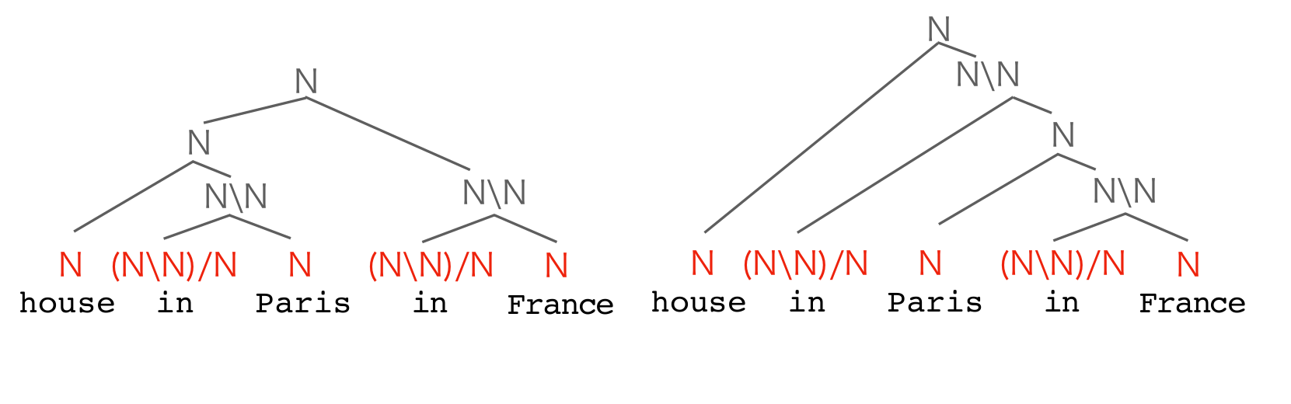
现有的parsing方法(Lewis+, 2014)
同样的范畴序列可能对应不同的树

Slide 7
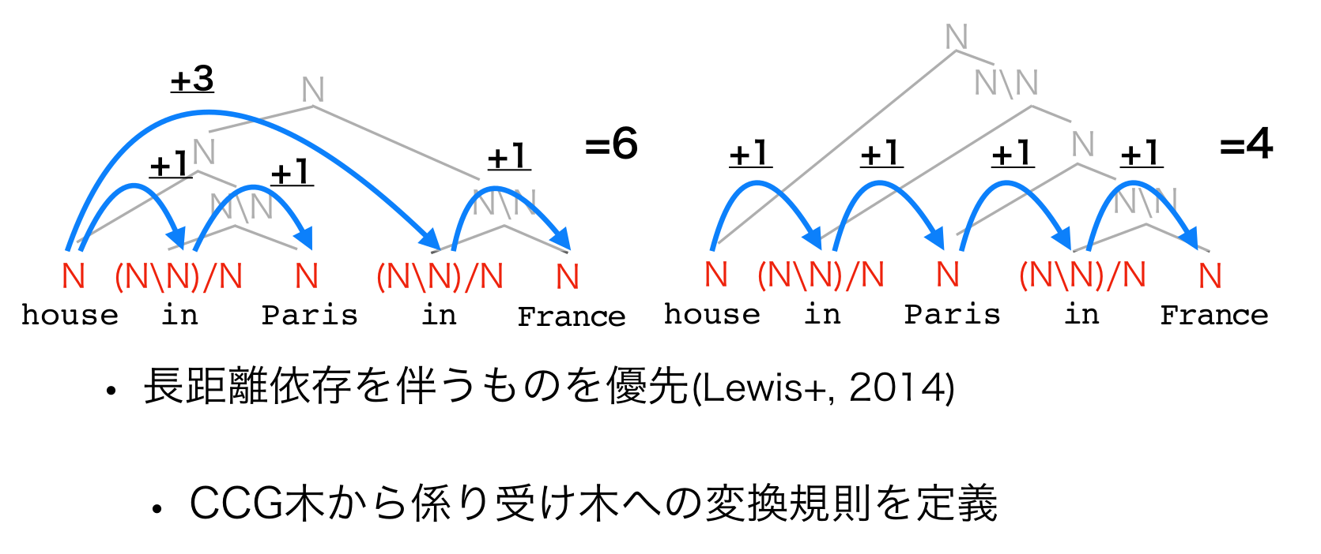
现有的parsing方法(Lewis+, 2014)
优先考虑长距离依赖

Slide 8
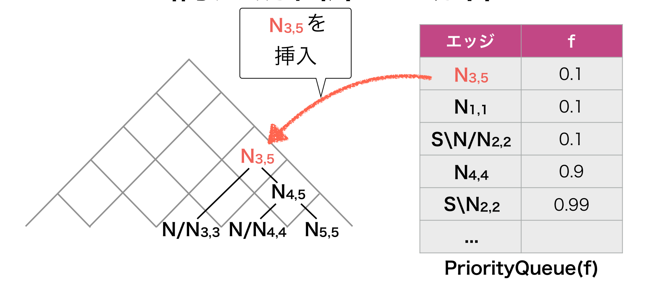
A* CCG Parsing

Slide 9
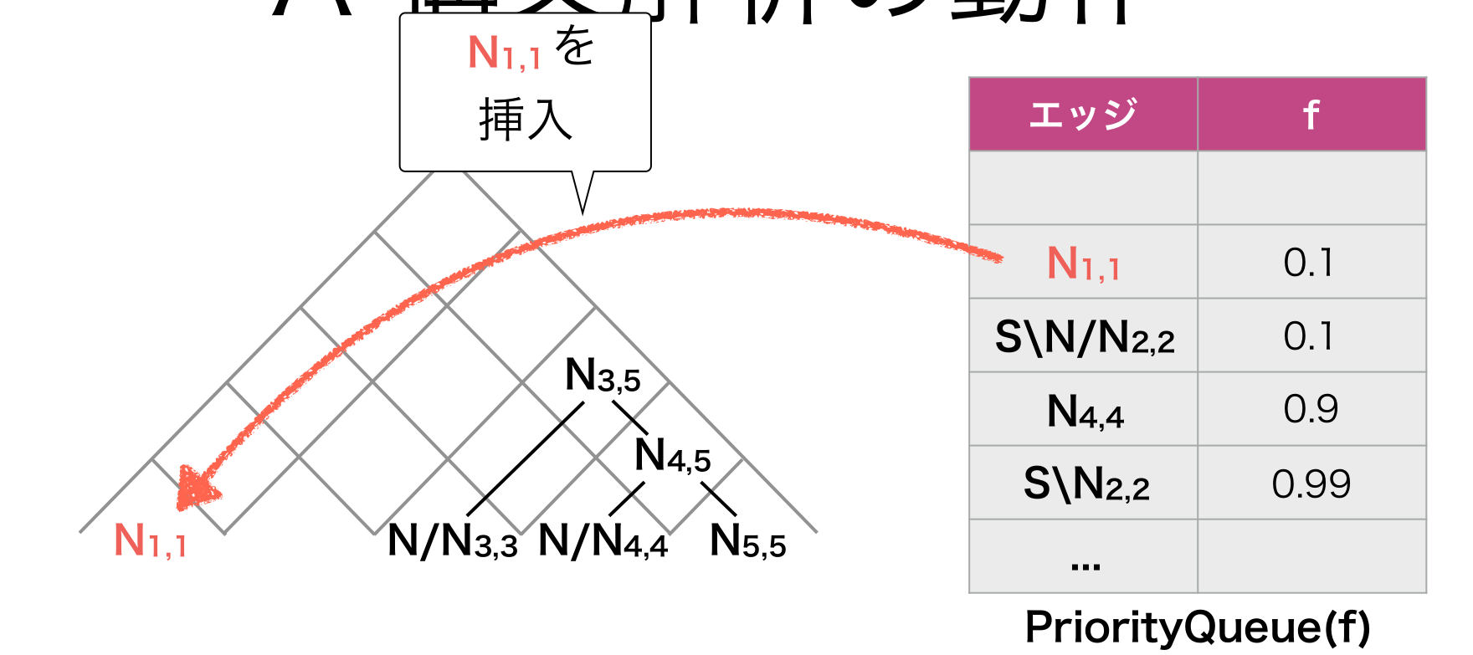
A* CCG Parsing

Slide 10
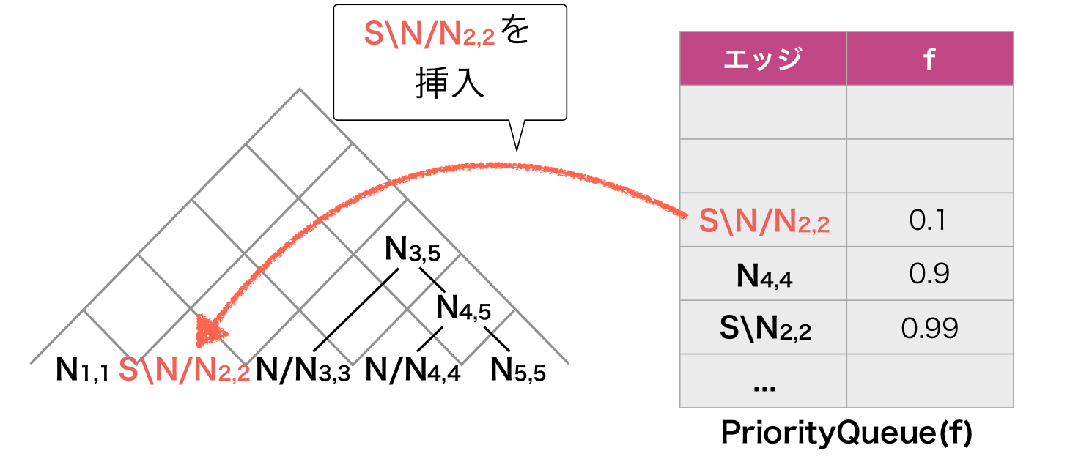
A* CCG Parsing

Slide 11
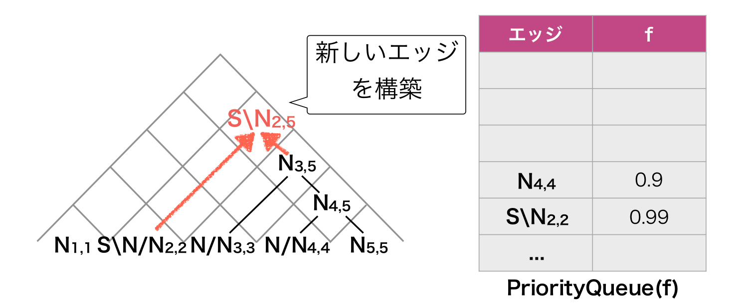
A* CCG Parsing

Slide 12
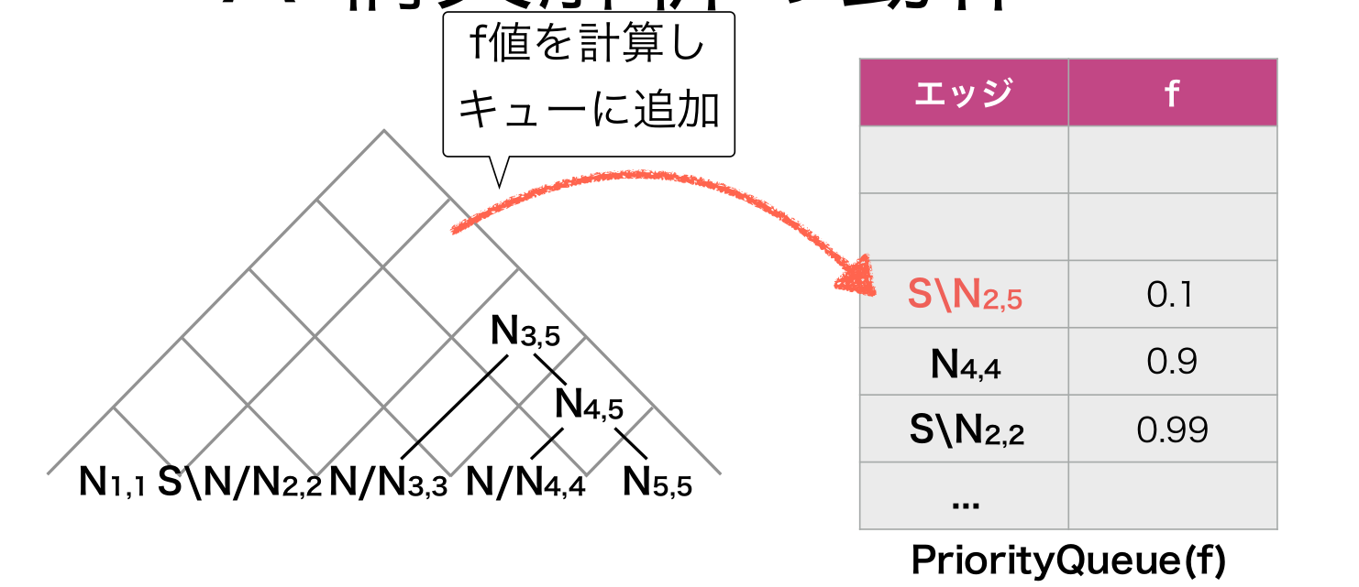
A* CCG Parsing

Slide 13
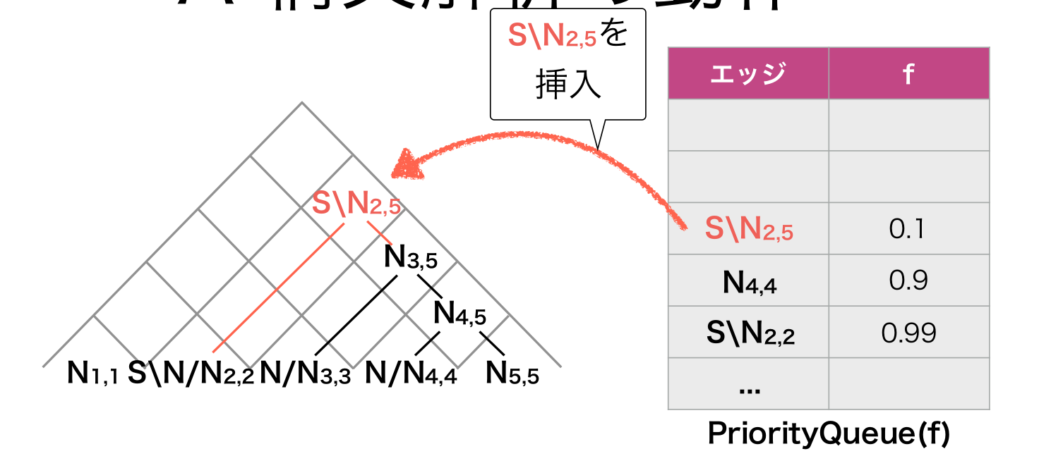
A* CCG Parsing

Slide 14
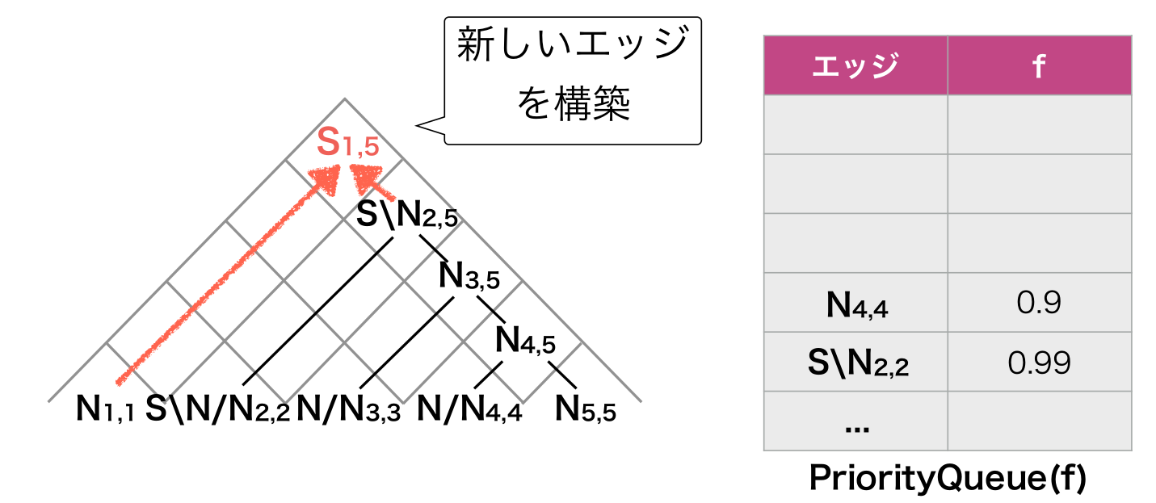
A* CCG Parsing

Slide 15
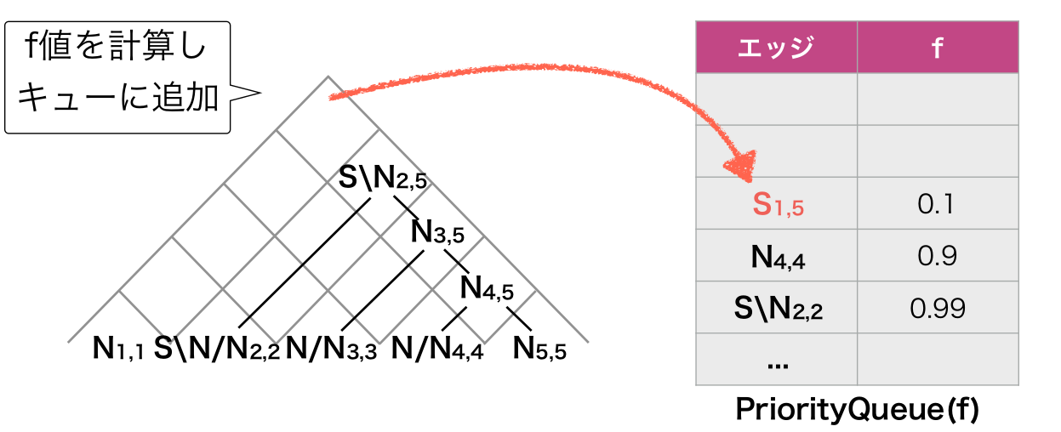
A* CCG Parsing

Slide 16
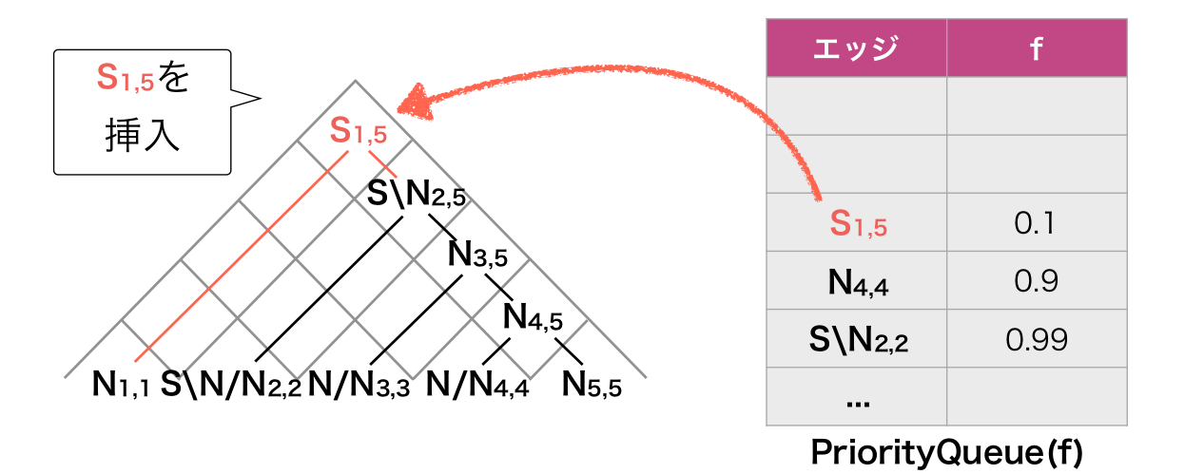
A* CCG Parsing

Slide 17
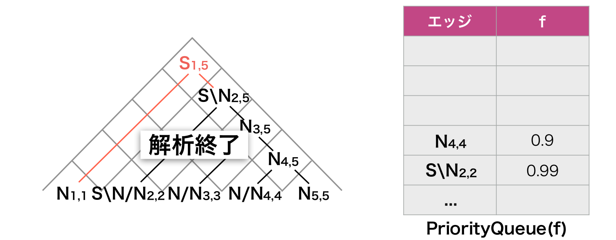
A* CCG Parsing

Slide 18
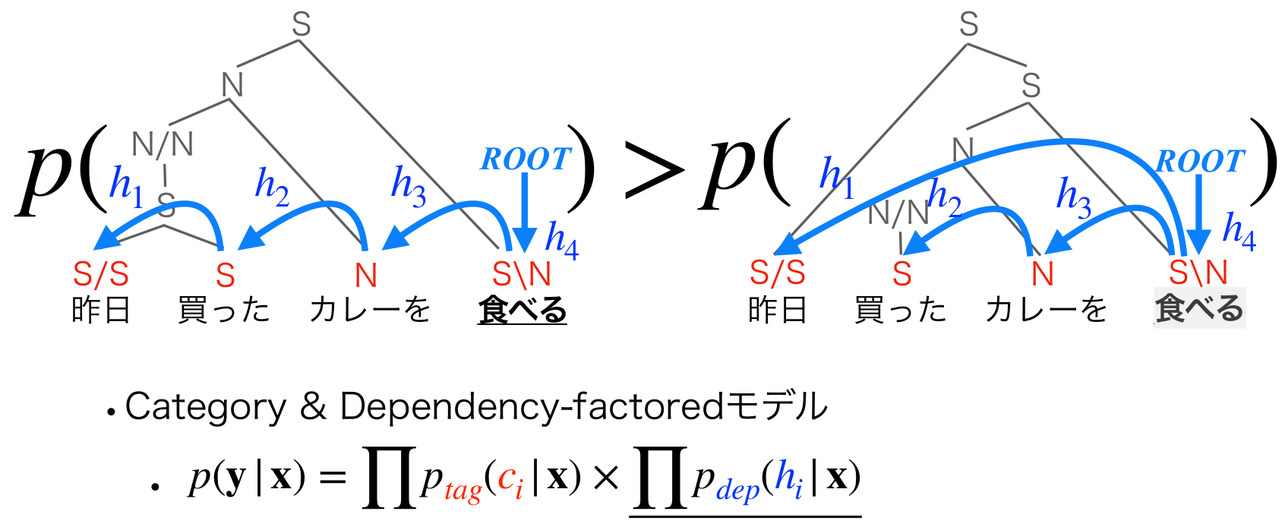
本文的工作
模型

Slide 19
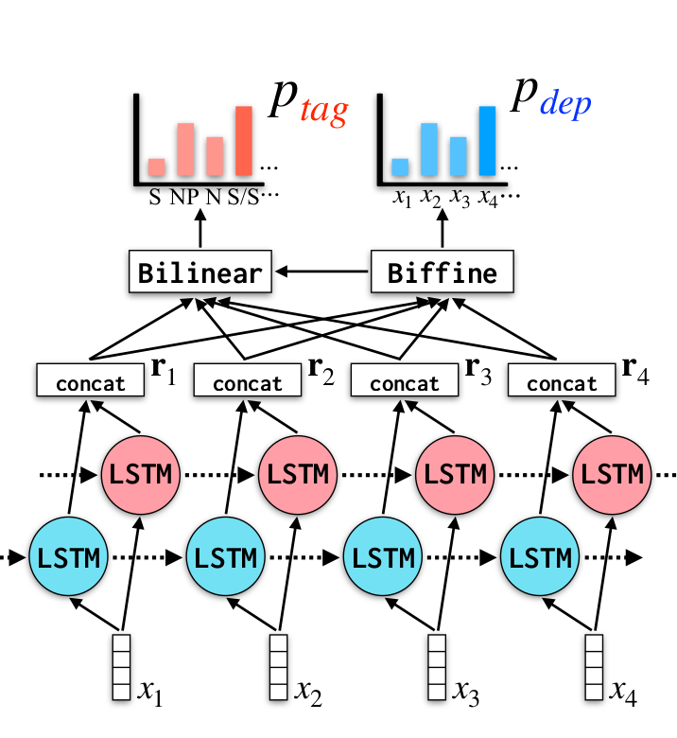
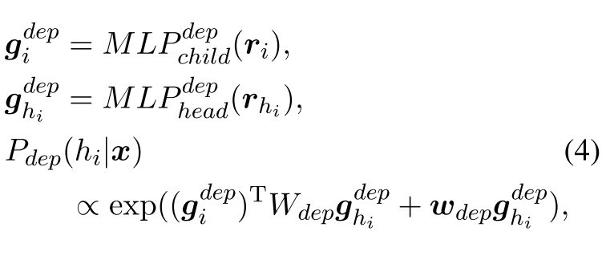
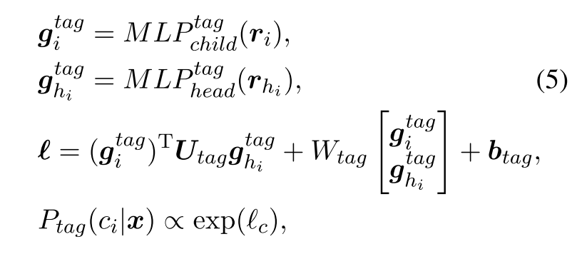
本文的工作
Biffine
Bilinear

Slide 20
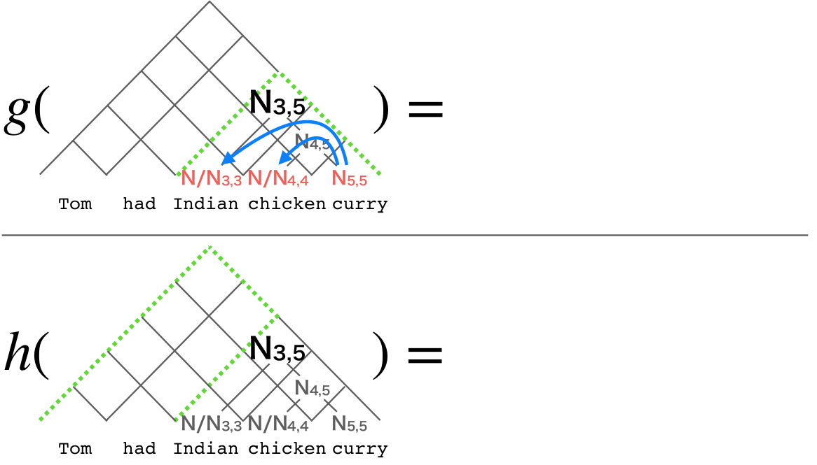
本文的工作

Slide 21
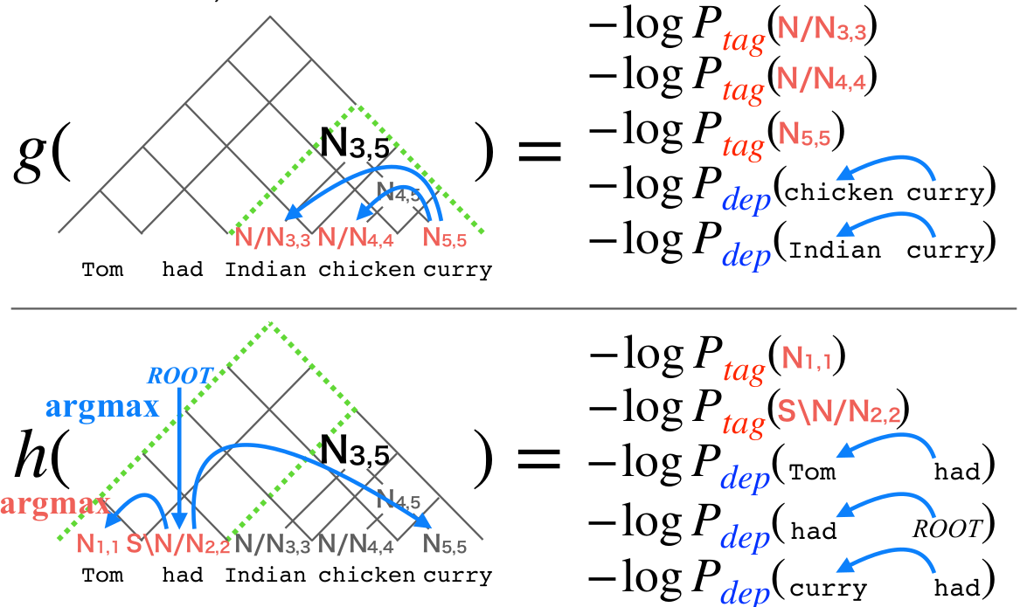
本文的工作

Slide 22
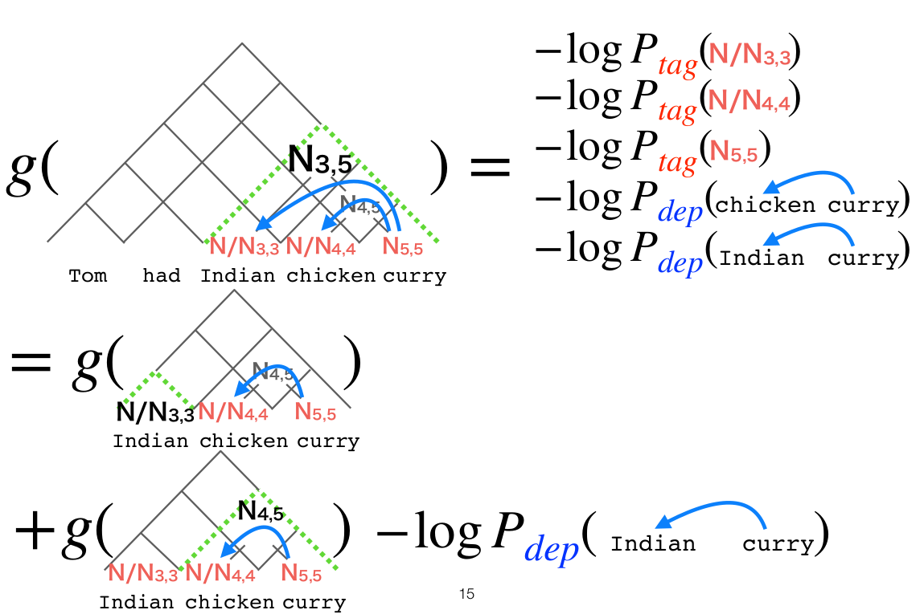
本文的工作

Slide 23
CCG to Dependency Conversion
LEWISRULE
For forward application, take left argument as head, unless it matches X/X or X/(X\Y)
For the backward rules, take right argument as head, unless it matches X\X or X\(X/Y)
...
HEADFINAL
SOV languages, always select the right argument as the head
HEADFIRST
SVO languages, always select the left argument as the head

Slide 24
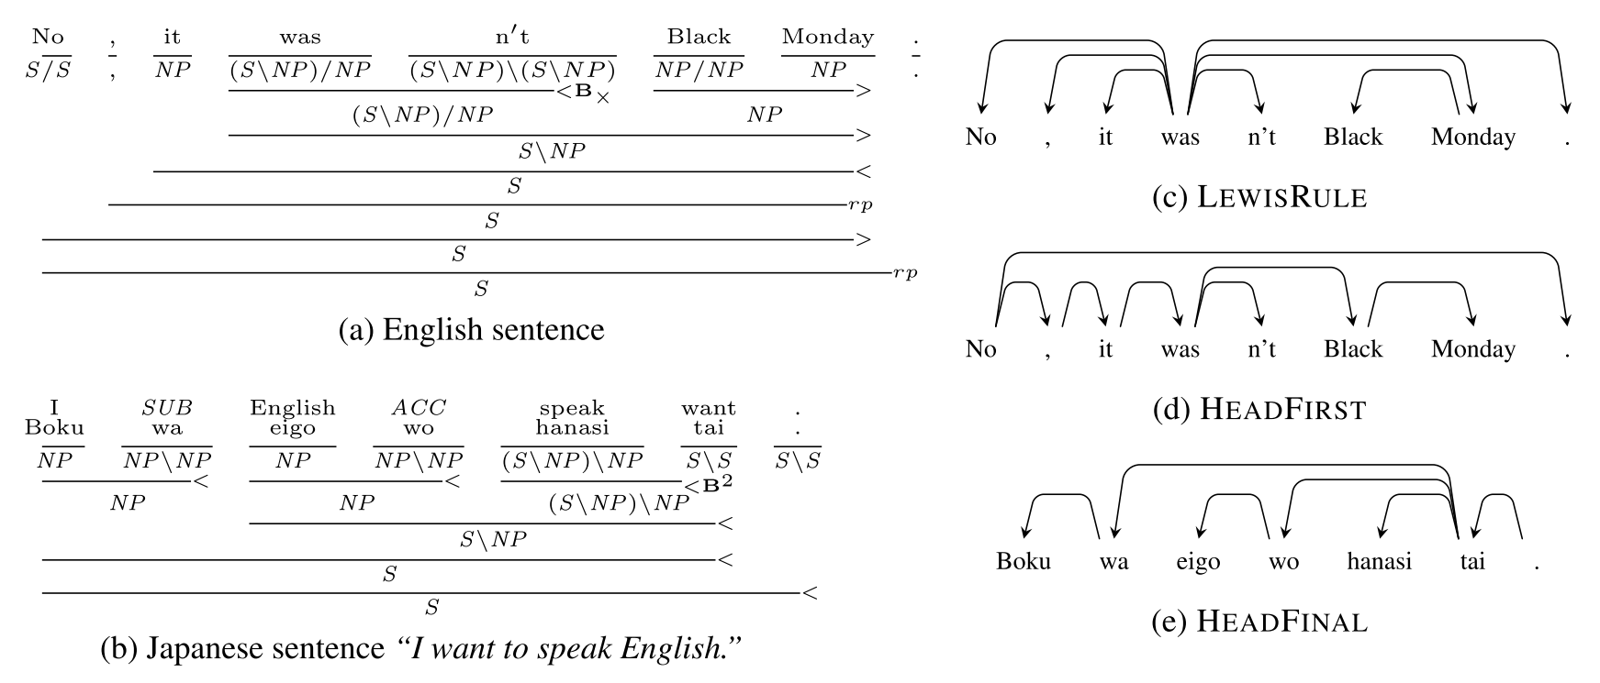
CCG to Dependency Conversion

Slide 25
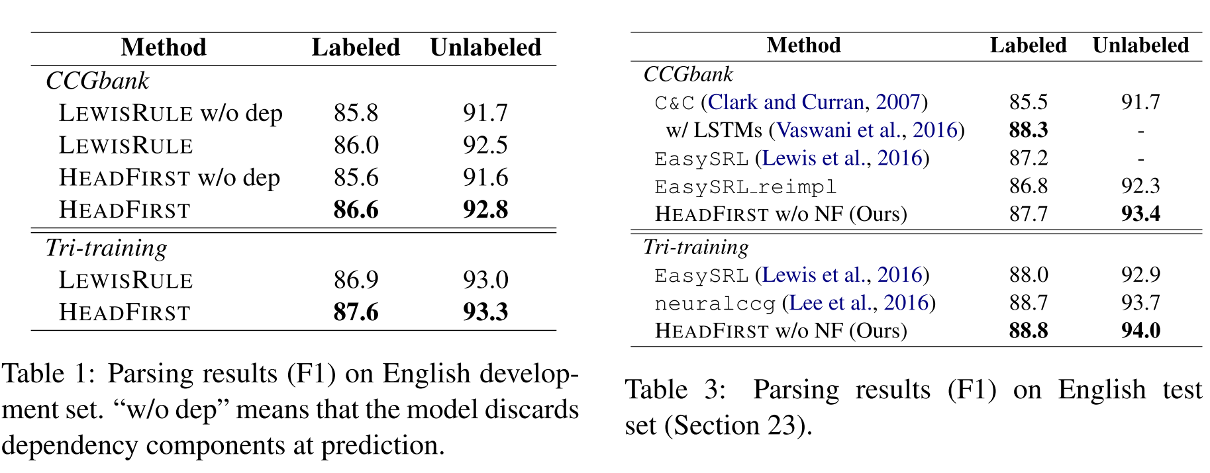
实验

Slide 26



Automatic Generation of
High Quality CCGbanks for Parser Domain Adaptation
Masashi Yoshikawa, Hiroshi Noji, Koji Mineshima, Daisuke Bekki
Nara Institute of Science and Technology
Artificial Intelligence Research Center AIST
Ochanomizu University
ACL@Florence July 29th 2019
Notes:
とらんぷ記号

Slide 27


An Issue on Supervised Syntactic Parsing
Performance heavily depends on training data (out-of-domain problem)
Ex) Biomedical texts: too many unseen technical terms
Human annotation of CCG trees is costly
Knowledge on CCG grammar
Rigid grammar rules do not allow annotation errors (→)
S
NP
NP/N N S\N
A man hikes
“Using recombinant HBxAg protein, we found HBxAg-specific stimulation of peripheral blood mononuclear cells in patients with acute hepatitis B virus infection (6 of 6) and chronic hepatitis B virus infection (6 of 17) but not in healthy individuals.”
Notes:
As widely known in the literature, supervised syntactic parsers suffer from performance drop when they are applied to texts from new domains.
For example, when parsing a text from biomedical domain, usually it contains a lot of technical terms which the parser has never seen before.
The straightforward solution to this issue is to label sentences in the target domain with a correct parse tree.
But this is highly costly in the case of CCG, mainly due to two reasons.
Firstly, the CCG grammar is demanding of linguistic knowledge, and it is difficult to train an annotator for this grammar.
Second, the strict nature of the grammar does not allow errors in annotation.
Simple annotation errors like this example, turns the annotated tree just unusable because of the violation of the grammar.
The CCG grammar states that categories N and NP here must be identical to be able to combine.

Slide 28

Approaches to Domain Adaptation
Supertagging is easier to adapt (Rimell and Clark, 2008, Lewis et al., 2016)
Recent parsers require full annotation (e.g. Lee et al., 2016, Yoshikawa et al., 2017)
Difficult to inject knowledge on coordination and PP-attachment
(Contextualized) word embeddings (Peters et al., 2017, Devlin et al., 2019)
ELMo works really well for const. parsing! (Peters et al., 2018)
Can be combined with our method
Our approach: automatic generation of CCGbanks for new domains utilizing cheaper dependency resources
dep. trebank
new
CCGbank
Convert
Fine-tune
CCG parser
Notes:
Previous studies in domain adaptation of CCG parsing have focused on supertagging, which is a CCG version of the part-of-speech tagging.
But it has some issues, especially it is not simply applicable to recent parsers.
Word embeddings or their contextualized versions are very useful for domain adaptation, and there actually is previous work that showed ELMo is very effective for domain adaptation of constituency parsing.
These methods are orthogonal to our method in this work, and we can combine them to achieve even better performance.
In this work, we propose a totally new approach to this issue: automatic generation of CCGbanks, i.e. CCG treebanks for new domain.
This approach is agnostic on any parser architecture, and experimentally we show its effectiveness in various settings.
Next we go into the details of our method.

Slide 29
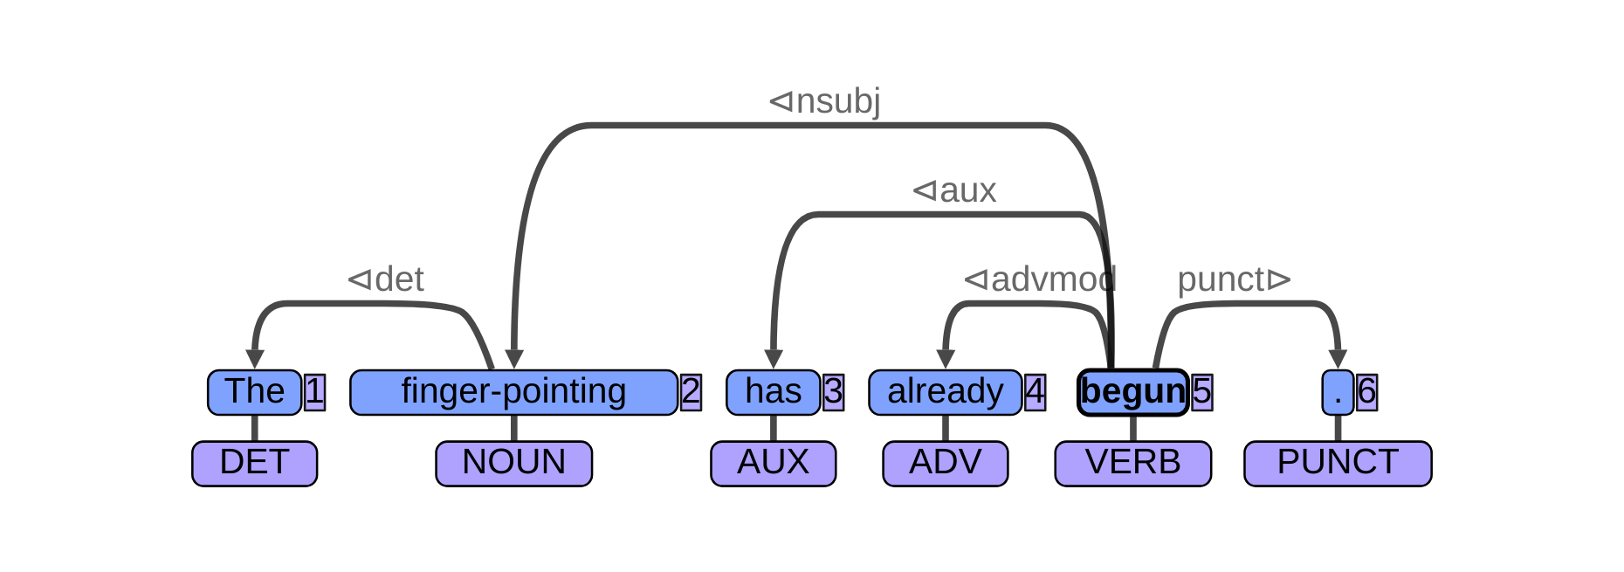
Automatic Generation of CCGbanks from Dep. Corpora
Approach：Learn a converter from depenedency tree to CCG tree
Use learned converter to obtain new CCGbanks from dep. corpora
Dependency Tree：
Many existing resources (e.g. UD)
Annotation is much easier
Genia
Switch-
board
UD
Web
. . .
Biomed. texts
Conversation
Web
Will our solution be successful?
Parsing (sentence to tree)：OOV problem occurs if input is words
Conversion (tree to tree)：tree structures are common across domains?
High quality CCG trees can be obtained for new domains
Notes:
In this approach, first, we learn a mapping function from a dependency tree to a CCG tree, using some deep neural networks. Then, we use the trained converter to convert an existing dependency-based treebank to a CCGbank.
Since there are plenty of dependency-based resources and, dependency tree is much easier to train an annotator for, we can assume we have a dependency treebank in the target domain.
The key observation in this work is the commonality of syntactic structure across various domains.
Parsing suffers from problems such as out-of-vocabulary problem, because its input is words, whose distribution follows well-known zipf law.
Meanwhile, when the input is syntactic tree, it becomes more likely that the converter has seen similar structures before, even when the target domain is different from the one of the converter’s training data.
As such we can expect to obtain high quality CCG trees using our method, even for new target domains.

Slide 30
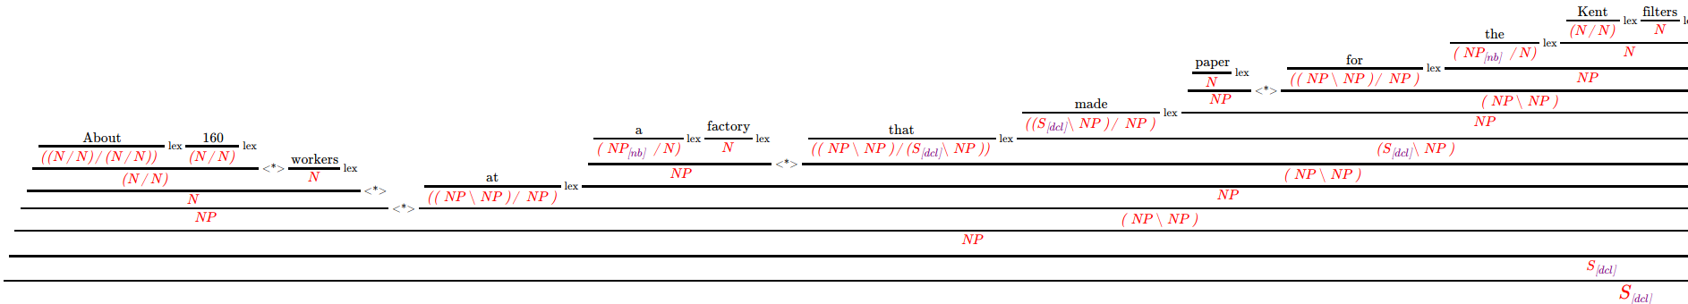
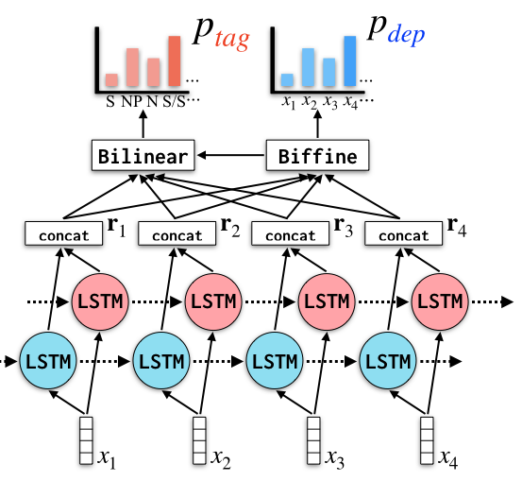
Our converter is based on a CCG parsing method
Our previous work: depccg (Yoshikawa et al., 2017)
A CCG tree is decomposed into supertags and dependencies
Capturing non-local dependencies through the strict grammar
A* parsing (like CKY) to search the most probable CCG tree
“About 160 work- ers at a factory that made paper for the Kent filters were exposed to asbestos in the 1950s .”
LSTM-based scoring &
A* shortest path algorithm
CCG tree
Sentence
Notes:
Our dependency-to-CCG converter is based on our previous CCG parsing method, so I will briefly introduce about it.
In our previous work, we proposed a CCG parsing model, where the probability of a CCG tree is decomposed into local factors of supertags and dependency relations.
This is very aggressive decomposition of tree probability, but non-local dependencies among substructures are captured through the adoption of the strict CCG grammar.
We combined this formulation of tree probability and LSTM-based scoring function, and use CKY-style A*-parsing to obtain the most probable CCG tree.

Slide 31

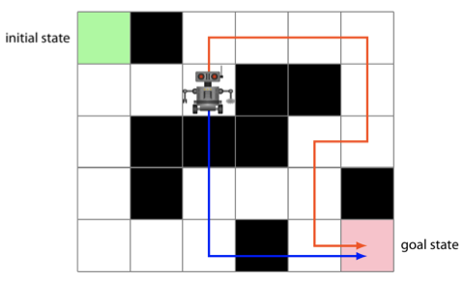
Dependency-to-CCG Conversion Model
CCG parser: maps word vectors to CCG tree
Converter: learns to map vector encoding of dep. tree z to CCG tree
Dependency Encoder: Bidirectional TreeLSTM (Miwa et al., 2016)
: Guarantee of most probable grammatically valid tree output
government
S
mark
det
nsubj
...
reported
NP
S\NP
the government reported that ...
the
i
NP/N N (S\NP)/S S
Dependency tree
that
...
Vector encodings
Bidir. TreeLSTM
(Miwa el al.,2016)
the government reported that ...
Decoder based on depccg
CCG tree
Notes:
In this work, we extend the parsing method into the dependency-to-CCG conversion model.
Since a CCG parser can be thought of as a mapping from word vectors of input sentence to a CCG tree,
we can simply replace the input vectors by one based on the vector encodings of a dependency tree.
To obtain the vector encodings, we use bidirectional treeLSTM by Miwa et al. in this work.
The converter is conceptually simple, but it has advantages that the output tree is always most probable one, and it is also guaranteed to be grammatically valid.

Slide 32
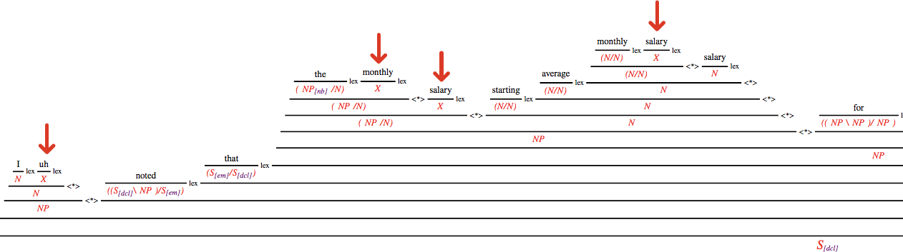
2nd : Constrained Decoding
Our method is fully automated CCGbank generation
(But, ) we want to control the generation using external resources
Ex) Disease dictionary may be used to always map disease names to NP
With our decoder, such a controlled decoding is possible
Below: Gold disfluencies are marked ‘X’ in converting Switchboard corpus
“… I uh noted that the monthly salary starting average monthly salary salary for engineers …”
Notes:
We have another advantage in this approach.
Our method is fully automated method of CCGbank generation, however, in some cases, we want to control the forms of output trees by using external resources.
For example, a dictionary on disease names can be used to always map disease names in a sentence to the NP category.
As we use chart-based parsing algorithm, it is possible to perform such a controlled decoding, by simply controlling the search space of the parsing algorithm.
In the example below this slide, we applied constrained decoding when converting the Switchboard corpus, which is a corpus of telephone conversation.
This sentence by a speaker contains lots of disfluencies, and we want to handle these disfluencies differently in the succeeding semantic composition.
We used our method and disfluency annotations in the corpus, and we successfully marked all the occurrences of disfluencies with special category X.

Slide 33
Summary of Our Method
Train the converter
government
S
mark
det
nsubj
...
reported
NP
S\NP
the government reported that ...
the
i
NP/N N (S\NP)/S S
Dependency tree
that
...
Vector encodings
the government reported that ...
Bidir. TreeLSTM
(Miwa el al.,2016)
Decoder based on depccg
CCG tree
2. Use it to obtain new CCG labeled data
The parser is now robust to biomed. texts!
nmod
...
amod
case
Circadian rhythm in glucocorticoid ...
Trained
Converter
Genia
CCGbank
Genia
dep. trebank
Fine-tune
depccg
Notes:
Here is the summary of our method.
First we train a converter that maps a dependency tree to a CCG tree.
Then, we use the trained converter to map an existing dependency corpus to obtain a new CCG treebank, which is then used to fine-tune an off-the-shelf CCG parser.
Next, we evaluate the effectiveness of our approach in experiments.

Slide 34
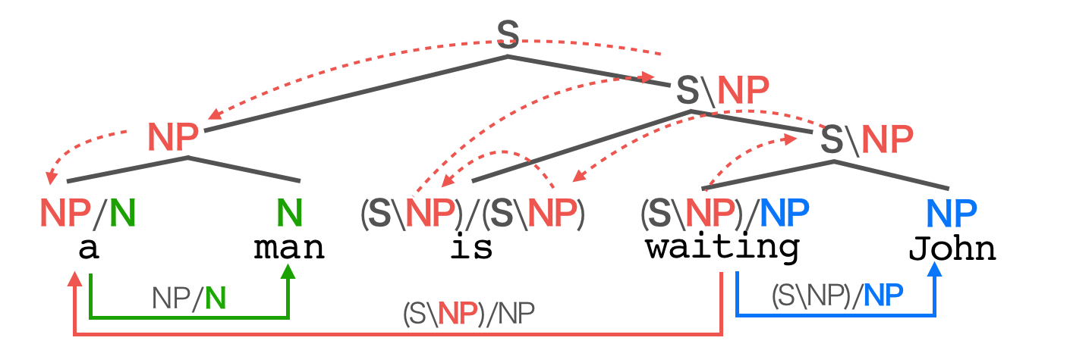
Experiments
Baseline CCG parser: depccg (Yoshikawa et al., 2017)
Input dependency tree is based on UD v1
Converter is trained on PTB and CCGbank (WSJ02-21)
PTB is mapped to Universal Dependencies v1 trees using Stanford Converter
Evaluation is in terms of (un)labeled F1 of pred-arg edges
CCG tree:
Pred-arg edges:
Notes:
In the experiments, we applied our method to a CCG parser depccg on various settings.
We trained our converter using Penn treebank and CCGbank.
In this work, all the dependency trees are based on Universal Dependencies version one, and when using constituency-based treebank, we apply Stanford Converter to obtain UD trees.
We use standard CCG parsing evaluation metric, which calculates the number of correctly predicted predicate-argument edges.
The actual evaluation script is complicated, but intuitively the score is based on these edges obtainable from a CCG tree.

Slide 35
Can our method really generate high quality CCGbanks?
Converter’s performance on gold WSJ23 dep. trees
Upper bound on conversion quality (in-domain setting)
Scores per syntactic phenomenon
 | depccg +ELMo | Converter
PP-attachment
(NP\NP)/NP | 90.62 | 97.46
((S\NP)\(S\NP))/NP | 81.15 | 88.63
Relative clause (subject/object extracted)
(NP\NP)/(S[dcl]\NP) | 93.44 | 98.71
(NP\NP)/(S[dcl]/NP) | 90.48 | 93.02
Input | Method | Unlabeled F1 | Labeled F1
Sentence | depccg | 94.0 | 88.8
 | + ELMo | 94.98 | 90.51
Dep. tree | Converter | 96.48 | 92.68
Hugely outperforms the best-performing depccg+ELMo model
Notes:
First, we test our hypothesis: Using the converter, can we really obtain high quality CCGbanks?
To evaluate this, we applied the learned converter to the test part of WSJ, for which both gold dependency and CCG trees are available.
Because the inputs are from the same domain as the training one, this can be seen evaluating the upper bound of the conversion quality.
On the left table, I show the F1 scores of the converter, compared to depccg and and its extension using ELMo.
We observe that the converter hugely outperforms these CCG parsers.
This implies the effectiveness of our approach of obtaining CCGbanks from dependency-based resources.
We also evaluated the converter in terms of syntactic phenomena.
Actually it is also hugely better at handling difficult constructions such as pp-attachment and relative clauses, compared to depccg+ELMo baseline.

Slide 36
Experiment 1: Speech Conversation
Switchboard corpus (Godfrey et al., 1992): Train/Test = 59,029/7,681
Treebank on transcription texts of telephone conversation
Evaluation: standard CCG evaluation (using 100 sentences annotated by me)
Challenges: Broken expression, lengthy sentences with embeddings
F値
74.32
76.19
77.54
the only problem i see with term limitations is that i think that the bureaucracy in our government as is with most governments is just so complex that there is a learning curve and that you ca n’t just send someone off to washington and expect his first day to be an effective congress precision
Notes:
Next, we conducted domain adaptation experiments.
We conducted experiments on four different domains in the paper, but due to time constraints, I will introduce only two from them.
The first experiment is on speech conversation, using the Switchboard corpus, which is a treebank on transcribed texts of telephone conversation.
Using the converter, we converted the train part of around 60 thousand trees to CCG ones.
For the evaluation, we randomly extract 100 sentences from the test part, and I manually annotated gold CCG trees.
The challenges in handling this dataset are informal expressions, such as saying 'cause', instead of 'because'.
And the dataset contains rather lengthy sentences with many embeddings.

Slide 37
Experiment 1: Speech Conversation
Method\Score | Unlabeled F1 | Labeled F1
depccg | 90.68 | 82.46
ELMo | 93.23 | 86.46
Ours | 95.63 | 92.65
Additive contributions of ELMo and the proposed method
Error cases after the domain adaptation
Only common errors remains such as PP-attachment, predicate argument structure, etc.
F値
74.32
76.19
77.54
Notes:
The results on this dataset is as follows, where we evaluate the effects of both ELMo and the proposed method.
They contribute to the performance additively, and we see huge performance gain in terms of both metrics compared to the baseline.
We analyzed error cases of the parser after the domain adaptation. We observe only those errors common in syntactic parsing, involving PP-attachment and the misrecognition of predicate argument structures, etc.
Our method successfully reduced errors characteristic to this domain.

Slide 38
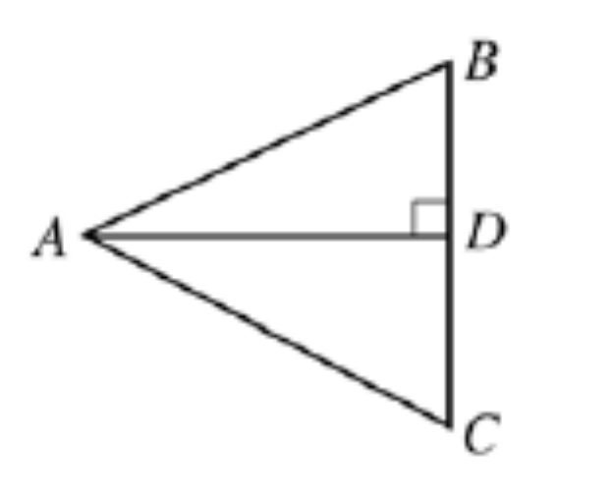
Experiment 2：Math problems
Parsing experiment on geometry problems
Manually annotate dependency (Train) and CCG (Test) trees
The same dataset as domain adaptation of const. parsing (Joshi et al., 2018)
60 sentences for train/test sets (Seo et al., 2015)
Challenges：Math-specific expressions (esp. symbols), limited amount of training data
“In triangle ABC above, the bisector of angle BAC is perpendicular to BC at point D. If AB = 6 and BD = 3,
what is the measure of angle BAC?”
(1): 15, (2): 30, (3): 45, (4): 60, (5): 75
Notes:
In the second experiment, we conduct domain adaptation to math problems on geometry.
We use the same dataset as the previous work on domain adaptation of constituency parsing.
I annotated the dataset, by assigning both dependency and CCG trees to train and test parts respectively. Both sets contain 60 sentences.
The challenges in this setting are expressions specific to math, especially symbols, and the limited amount of training data.

Slide 39
Experiment 2: Results on math problems
Method\Score | Unlabeled F1 | Labeled F1
depccg | 88.49 | 66.15
ELMo | 89.32 | 70.74
Ours | 95.83 | 80.53
Both ELMo and ours hugely contribute to the performance
Especially huge gain in labeled metric
Notes:
This is the result on math problems. In accordance with the previous result, both ELMo and our method contribute to the performance additively.
Again, we observed huge gains, and especially in terms of the labeled metric.

Slide 40
Experiment 3: Biomedical Paper (GENIA)
Existing CCG benchmark of biomed. Texts (Rimell et al., 2008)
Convert GENIA corpus (Tateisi et al., 2005); 4,432 sentences
Successfully map all biomed. terms to NP using constrained decoding
Challenge: handling rare technical terms
“Using recombinant HBxAg protein, we found HBxAg-specific stimulation of peripheral blood mononuclear cells in patients with acute hepatitis B virus infection (6 of 6) and chronic hepatitis B virus infection (6 of 17) but not in healthy individuals.”
ELMo contributes in handling unk words
Method\Score | Prec. | Rec. | F1
depccg | 83.11 | 82.63 | 82.87
ELMo | 85.87 | 85.34 | 85.61
Genia1000 | 85.45 | 84.49 | 84.97
Ours | 86.90 | 86.14 | 86.52
Genia1000:
Partially labeled data by (Rimell et al., 2008)

Slide 41
Experiment 4: Question sentences
Existing CCG benchmark on question sentences (Rimell et al., 2008)
Convert QuestionBank (Judge et al., 2006); 3,622 sentences
Challenge: constructions not occurring in newswire texts
How much vitamin C should you take in a day ?
What year was Desmond Mpilo Tutu awarded the Nobel Peace Prize ?
Method\Score | Prec. | Rec. | F1
depccg + Questions | 90.42 | 90.15 | 90.29
ELMo | 90.55 | 89.86 | 90.21
Ours | 90.27 | 89.97 | 90.12
Questions：
Partially labeled data by (Rimell et al., 2008)
Limited effect of both ELMo and proposed method
⇒Parsing errors occur in places not relevant to question constructions

Slide 42
Summary & Future Work
Automatic CCGbank construction using cheaper dependency corpora
Experiments on biomedical texts, questions, speech conversation, and math problems
Remarkable improvements on speech conversation and math problems
Future Work (CCG-based applications)
Inference systems on math problems, biomedical texts, conversation, etc.
Codes & datasets: https://github.com/masashi-y/depccg
$ pip install numpy cython depccg
Notes:
here is the summary of the talk.
we proposed a new domain adaptation method based on automatic construction of CCG treebanks using cheaper dependency corpora.
We conducted experiments on four different domains including biomedical texts, question sentences, speech conversation and math problems, and I introduced the results on latter two domains, on which we observed remarkable performance improvements.
The codes and datasets will be available from this link, and the parser is also available from pip.
Thank you for listening.

