Slide 1

AAAI2018

Slide 2
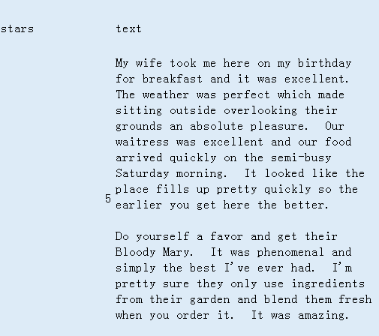
Problem
The task aims to infer the overall sentiment intensity (e.g. 1-5 stars on the review site Yelp) of review documents written by users for products.

Slide 3
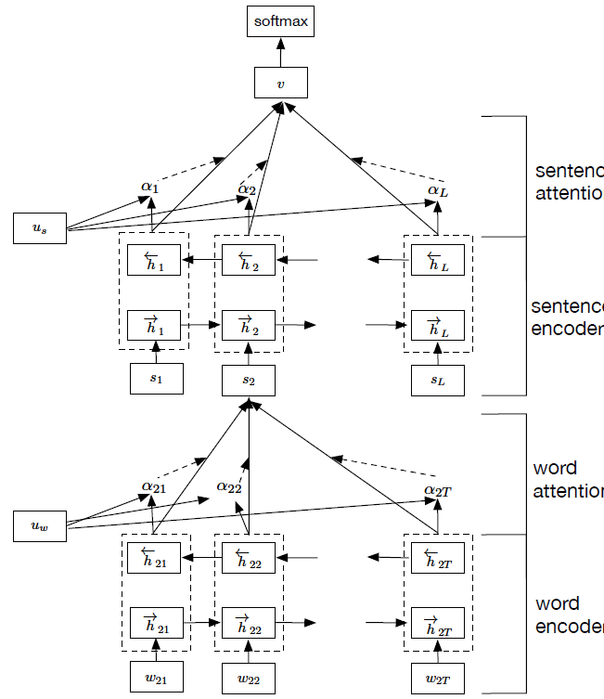
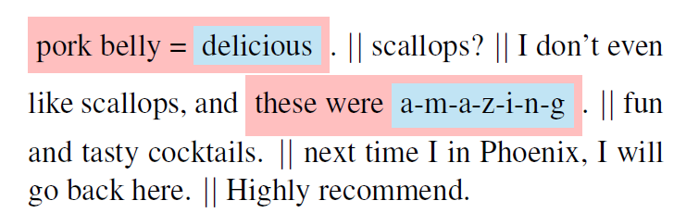
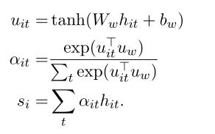
Previous method
(i) it has a hierarchical structure that mirrors the hierarchical structure of documents
(ii) it has two levels of attention mechanisms applied at the word and sentence-level.

Slide 4
Previous method
Four discoveries:
1.user-sentiment consistency
2.product-sentiment consistency
3.user-text consistency
4.product-text consistency

Slide 5
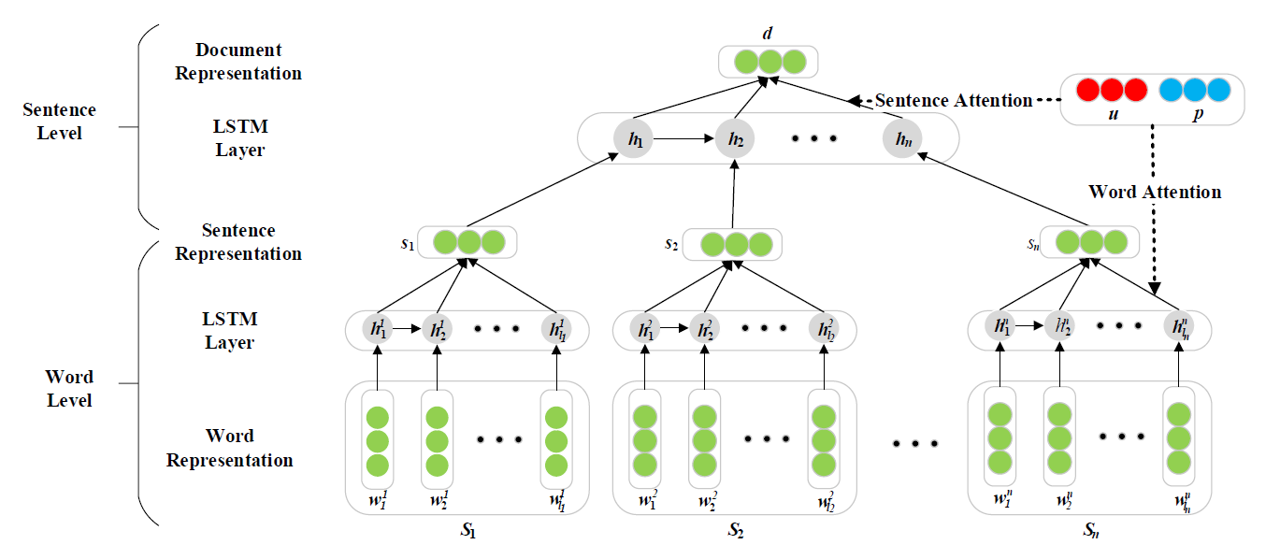
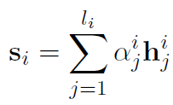
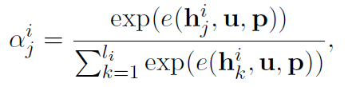
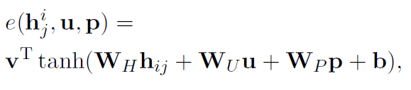
Previous method
(i) propose a hierarchical neural network which incorporates user and product information via word and sentence level attentions.

Slide 6
Motivation
Some words or sentences show strong user’s preference, and some others tend to indicate product’s characteristic. The two kinds of information play different roles in determining the sentiment label of a review.
the bar area is definitely good and i love the modern contemporary style.

Slide 7
Main idea
1.encoding user and product information respectively into two hierarchical networks to generate two individual text representations with user attention or product attention
2.design a combined strategy to make most use of the two representations for training and final prediction

Slide 8
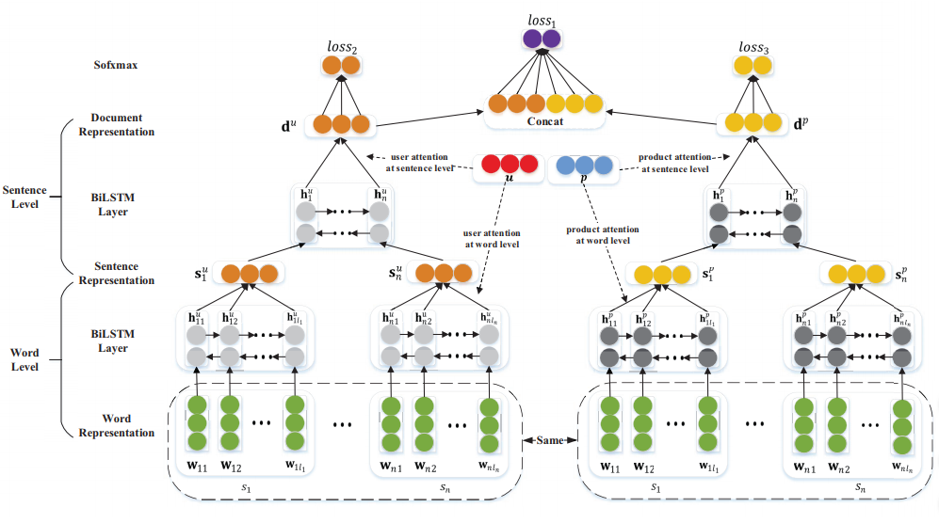
Architecture

Slide 9



Computation of sentence representation

Slide 10








Loss

Slide 11
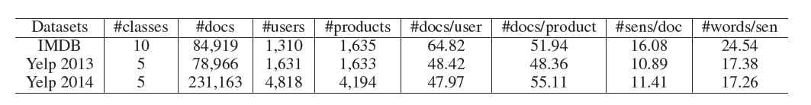
Experiment

Slide 12
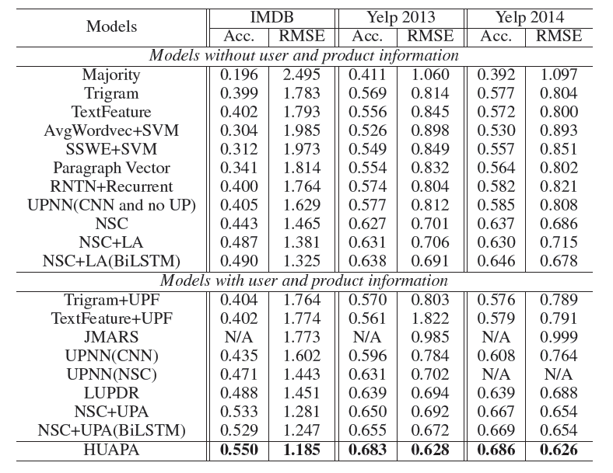
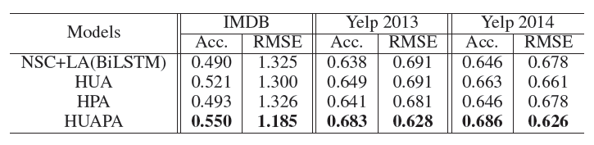
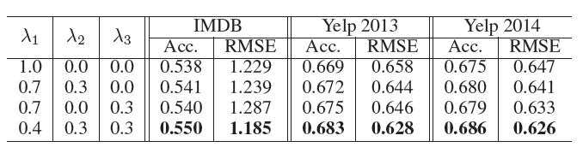

Slide 13
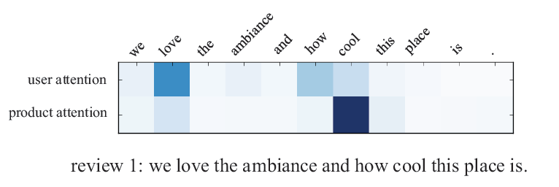
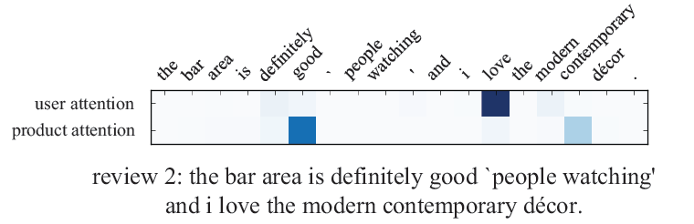
Attention Weight Visualization

Slide 14
Conclusion
The paper proposes a novel framework incorporating user and product information for sentiment classification.

Slide 15
Thanks!

