Slide 1



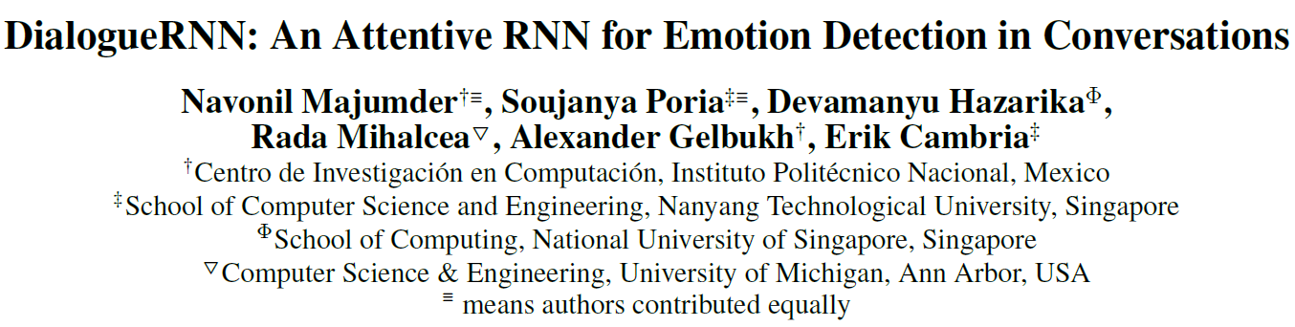
Copyright © 2019, Association for the Advancement of Artificial Intelligence (www.aaai.org).
霍沛

Slide 2

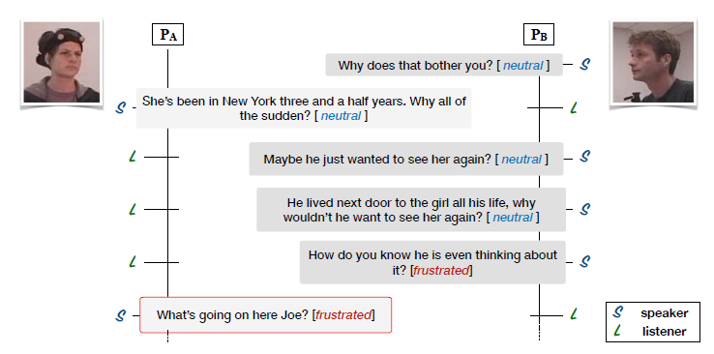
Intention：
Emotion detection in conversations
happy,
sad,
neutral,
angry,
excited,
frustrated
Emotion label
Based on the assumption that there are three major aspects
relevant to the emotion in a conversation:
speaker,
context of preceding utterances
the emotion of the preceding utterances

Slide 3




utterance representation:
Textual Feature Extraction：
CNN model
How do you know he is even thinking about it ?
Filters of size3,4,5 each have 50 feature-maps
Max pooling
Fully connected

Slide 4




Global State (Global GRU)
Size：
Notes:
全局状态的设定，主要是为了捕获整体上下文的一种信息，这种整体的信息包括当前的语句以及说话人的情感状态

Slide 5

Party State
These states are representative of the speakers’ state in the conversation, relevant to emotion classification.
These state vectors are initialized with null vectors
for all the participants
Speaker Update:
Listener Update:
Notes:
考虑到讲话的人通常是根据上文来组织当前的回复，

Slide 6

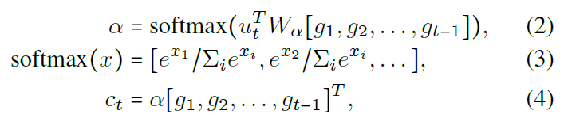




To
compute context
Notes:
In
Eq. (2), we calculate attention scores over the previous
global states representative of the previous utterances. This
assigns higher attention scores to the utterances emotionally
relevant to ut.

Slide 7





Two listener state update mechanisms:
1
2

Slide 8
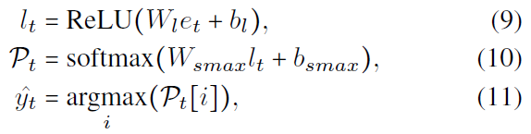
Emotion Representation (Emotion GRU)
To utterance
Emotion Classification

Slide 9
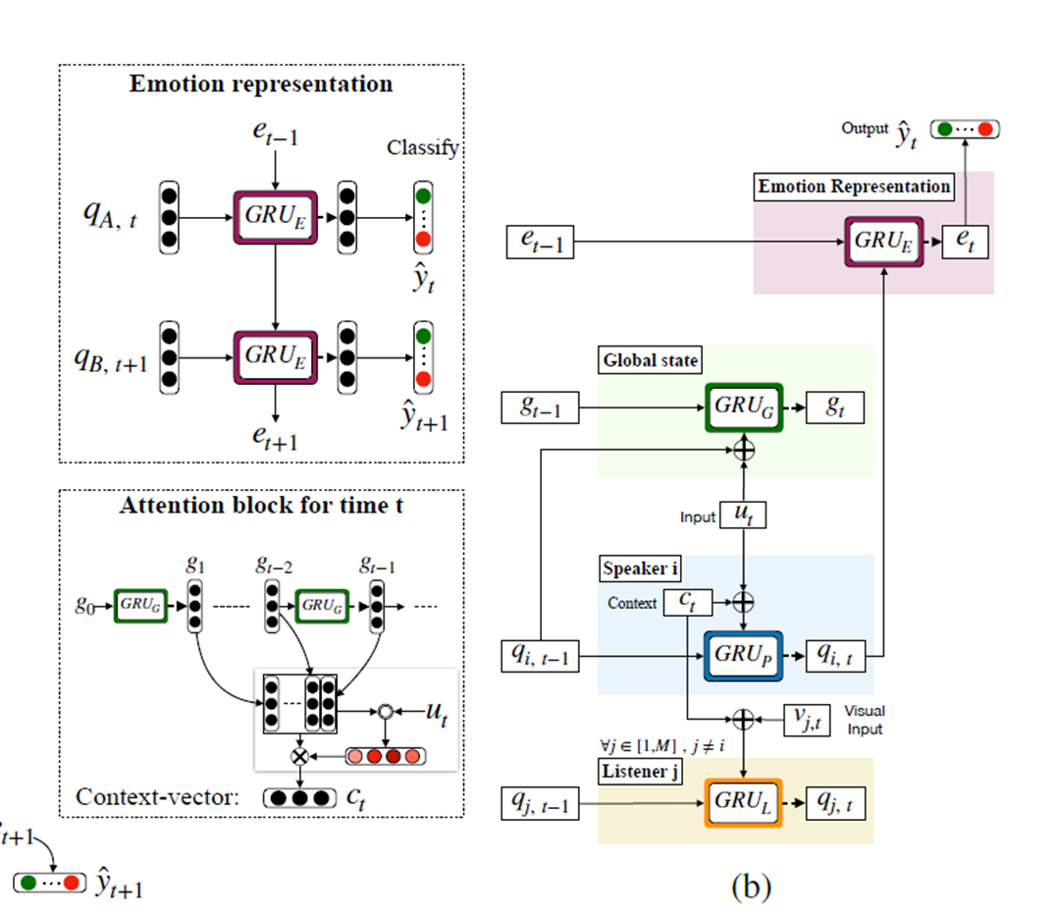
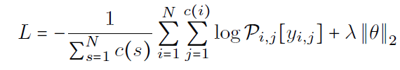



Loss function：
is the number of samples/dialogues
is the number of utterances in dialogue i

Slide 10
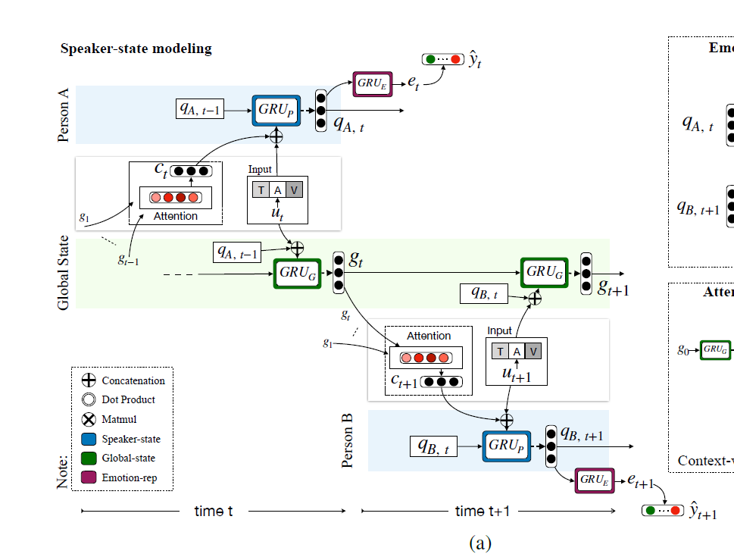


Slide 11

DialogueRNN Variants
DialogueRNN + Listener State Update (DialogueRNNl)
Bidirectional DialogueRNN (BiDialogueRNN)
DialogueRNN + attention (DialogueRNN+Att):
Bidirectional DialogueRNN + Emotional attention (BiDialogueRNN+Att)

Slide 12
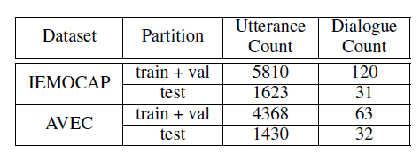
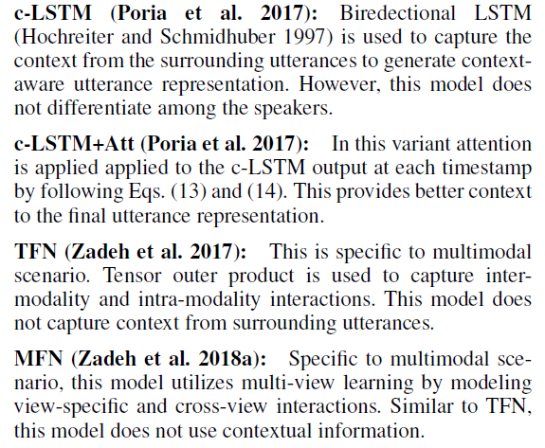
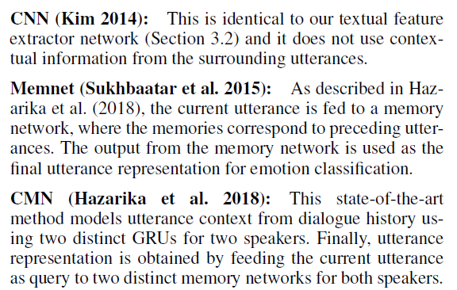
Datasets
Baselines and State of the Art

Slide 13
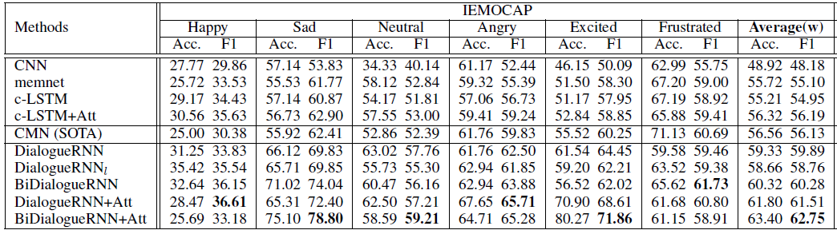
Results

Slide 14
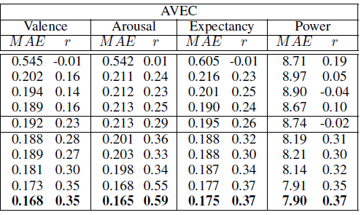
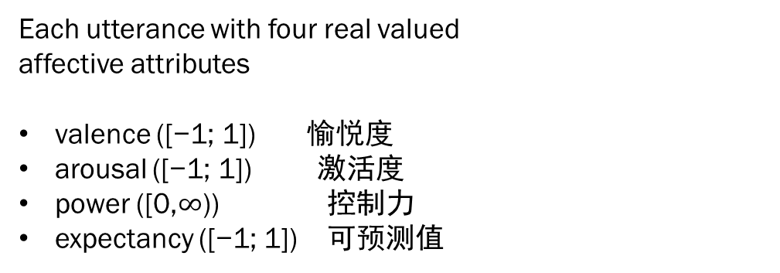
Results
MAE = Mean Absolute Error,
r =Pearson correlation coefficient
Each utterance with four real valued
affective attributes
valence ([−1; 1]) 愉悦度
arousal ([−1; 1]) 激活度
power ([0,$∞$)) 控制力
expectancy ([−1; 1]) 可预测值
*AVEC : Audio/Visual Emotion Challenge
Notes:
The first dimension can be interpreted as an evaluation-pleasantness dimension. Appraisals of intrinsic pleasantness and goal conduciveness, as well as action tendencies of approach versus avoidance or moving against, characterize this dimension.
The second dimension is an activation-arousal dimension. It is mainly characterized by sympathetic arousal, such as rapid heartbeat and readiness for action. It opposes emotions such as stress, anger, and anxiety to disappointment, contentment, and compassion.
The third dimension is characterized by appraisals of control, leading to feelings of power or weakness; interpersonal dominance or submission, including impulses to act or refrain
from action; changes in the rate and volume of speech; and parasympathetic symptoms
On this dimension, emotions such as pride, anger, and contempt are opposed to sadness, shame, and despair
The last dimension is characterized by appraisals of novelty and unpredictability (and behaviors such as jaw dropping, eyebrow raising, and spontaneous exclamations), as compared with appraisals of expectedness or familiarity. Obviously, surprise is distinguished from all other emotions on this dimension. However, meaningful differentiations emerge among these other
emotions as well; for example, fear is distinguished from stress and disgust from contempt
第一个维度可以解释为评估 - 愉悦度维度。内在愉悦和目标有利性的评估，以及接近与避免或反对的行动倾向，是这个维度的特征。
第二个维度是激活 - 唤醒维度。其主要特征是交感神经兴奋，例如心跳加速和行动准备。它反对压力，愤怒和焦虑等情绪，失望，满足和同情。
第三个维度的特点是对控制的评价，导致权力或弱点的感觉;人际支配或提交，包括行动或克制的冲动
从行动;言论率和言论量的变化;和副交感神经症状
在这个方面，诸如骄傲，愤怒和蔑视之类的情绪与悲伤，羞耻和绝望相对立
最后一个维度的特点是对新颖性和不可预测性（以及下巴，眉毛抬起和自发感叹等行为）的评价。显然，在这个方面，惊喜与所有其他情绪不同。然而，这些其他方面出现了有意义的差异
情绪也是如此;例如，恐惧与压力和蔑视的厌恶区别开来

Slide 15
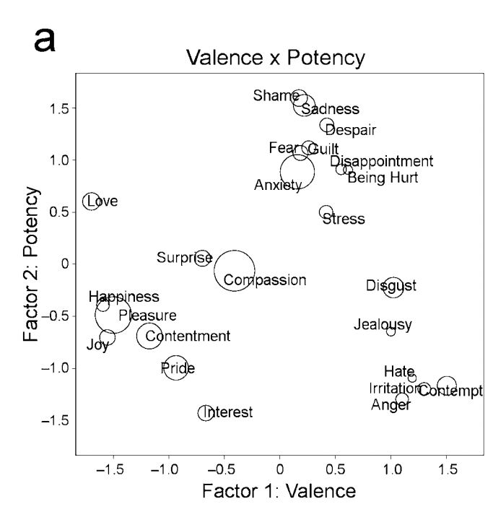
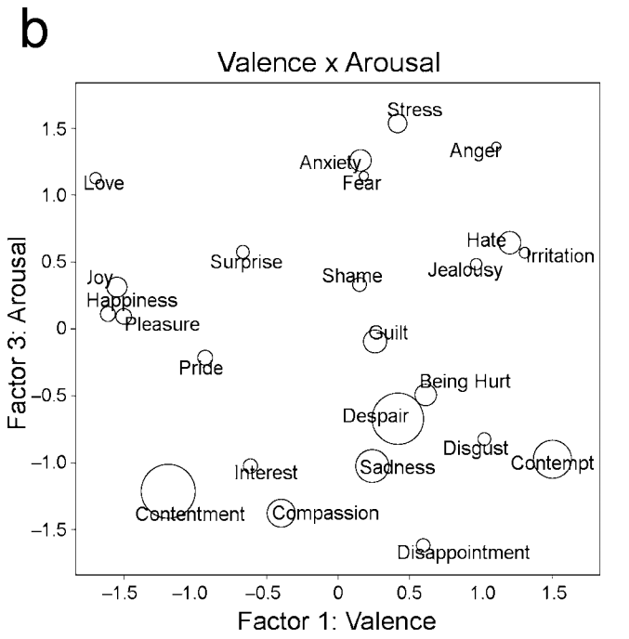

Slide 16
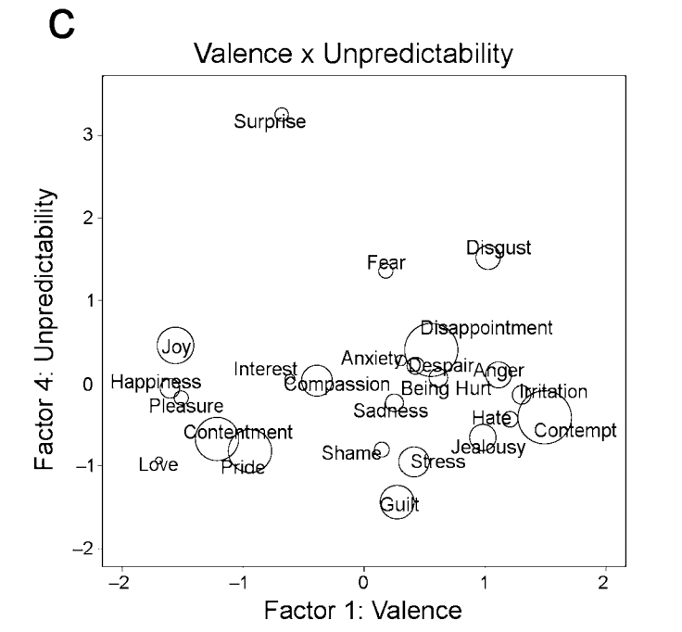
https://citeseerx.ist.psu.edu/viewdoc/download?doi=10.1.1.1031.3706&rep=rep1&type=pdf

Slide 17
THANKS

