Slide 1
Gated Self-Matching Networks for Reading Comprehension and Question Answering
Wenhui Wang, Nan Yang, Furu Wei, Baobao Chang, Ming Zhou
盛艺暄
2017-11-08

Slide 2
Datasets
The Stanford Question Answering Dataset (SQuAD)
Each of the answers is a segment of text from the passage.
In meteorology, precipitation is any product of the condensation of atmospheric water vapor that falls under gravity. The main forms of precipitation include drizzle, rain, sleet, snow, graupel and hail... Precipitation forms as smaller droplets coalesce via collision with other rain drops or ice crystals within a cloud. Short, intense periods of rain in scattered locations are called “showers”.
What causes precipitation to fall?
gravity
What is another main form of precipitation besides drizzle, rain, snow, sleet and hail?
graupel
Where do water droplets collide with ice crystals to form precipitation?
within a cloud

Slide 3
We first match the question and passage with gated attention-based recurrent networks to obtain the question-aware passage representation.
Then we propose a self-matching attention mechanism to refine the representation by matching the passage against itself, which effectively encodes information from the whole passage.
We finally employ the pointer networks to locate the positions of answers from the passages.

Slide 4
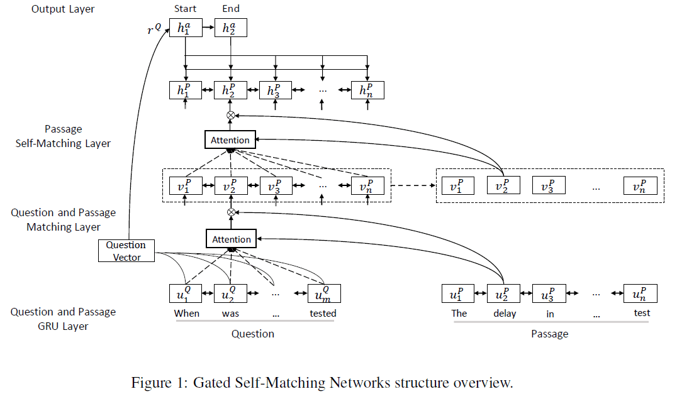
r-net
Output
Layer
Self-Matching Attention
Gated Attention-based Recurrent
Networks
Question and Passage Encoder

Slide 5
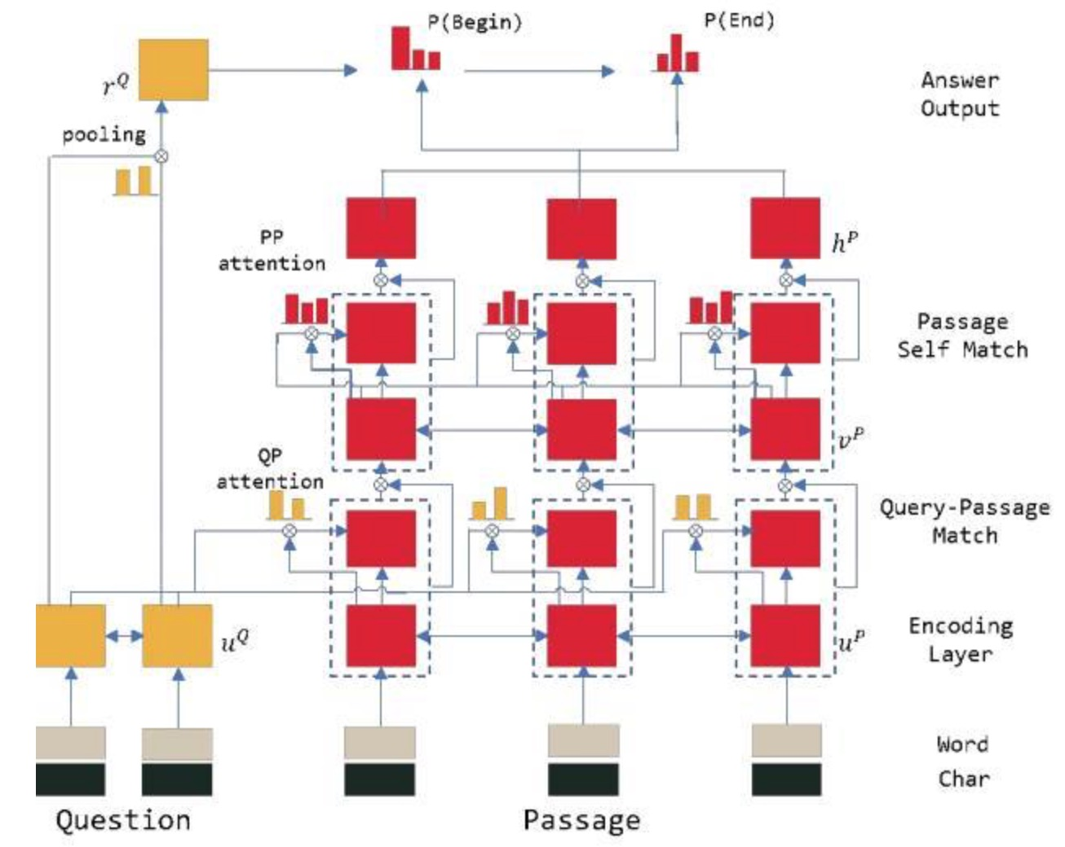
r-net
Output
Layer
Self-Matching Attention
Gated Attention-based Recurrent
Networks
Question and Passage Encoder

Slide 6
Question and passage Encoder
question word-level character-level embeddings
passage word-level character-level embeddings
new representation and of all words
in the question and passage respectively.

Slide 7
r-net
Output
Layer
Self-Matching Attention
Gated Attention-based Recurrent
Networks
Question and Passage Encoder

Slide 8

Gated Attention-based Recurrent Networks
Given question and passage representation and
[2015 CoRR] Tim Rocktaschel, Edward Grefenstette, Karl Moritz Hermann, Tom´as Kocisk´y, and Phil Blunsom. Reasoning about entailment with neural attention.
generating sentence-pair representation , via soft-alignment of words in the
question and passage as follows:
where is an attention pooling vector of the whole question

Slide 9
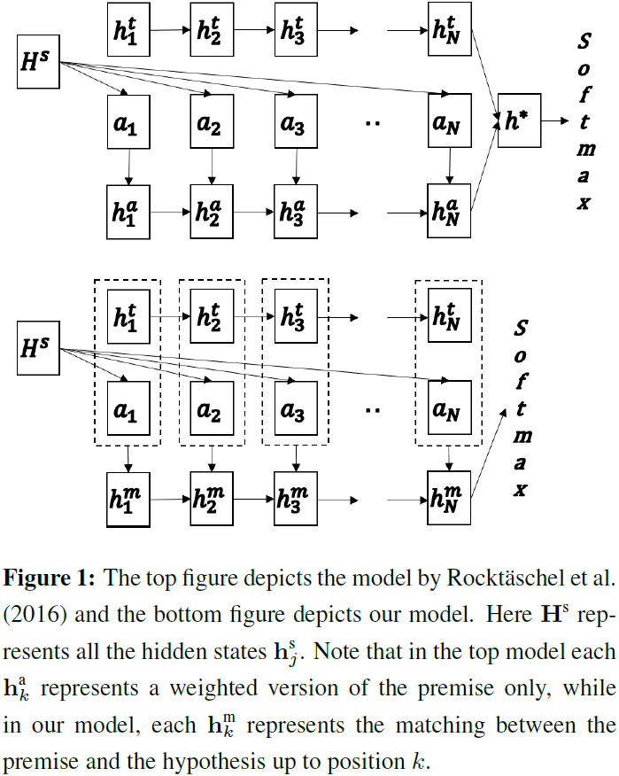
Gated Attention-based Recurrent Networks
hypothesis
[2015 CoRR] Tim Rocktaschel, Edward Grefenstette, Karl Moritz Hermann, Tom´as Kocisk´y, and Phil Blunsom.
Reasoning about entailment with neural attention.
premise
[2016NAACL] ShuohangWang and Jing Jiang. Learning natural language inference with LSTM.
treating the question as a premise
the passage as a hypothesis.

Slide 10
Gated Attention-based Recurrent Networks
To determine the importance of passage parts and attend to the ones relevant to the question, we add another gate to the input of RNN:
is utilized in subsequent calculations instead of
such representation has very limited knowledge of context.

Slide 11
r-net
Output
Layer
Self-Matching Attention
Gated Attention-based Recurrent
Networks
Question and Passage Encoder

Slide 12
Self-Matching Attention
Since the context can be long, and distant parts of text may rely on each other to fully understand the content.
directly matching the question-aware passage representation against itself
where is an attention-pooling vector of the whole passage
An additional gate as in gated attention-based recurrent networks is applied to to adaptively control the input of RNN

Slide 13
r-net
Output
Layer
Self-Matching Attention
Gated Attention-based Recurrent
Networks
Question and Passage Encoder

Slide 14
Output Layer
we use pointer networks (Vinyals et al., 2015) to predict the start and end position of the answer.
we use an attention-pooling over the question representation to generate the initial
hidden vector for the pointer network.

Slide 15
Output Layer
Given the passage representation
represents the last hidden state of the answer recurrent network (pointer network).
The input of the answer recurrent network is the attention-pooling vector based on current predicted probability :

Slide 16
Implementation Details
1.use the tokenizer from Stanford CoreNLP to preprocess each passage and question.
2.The Gated Recurrent Unit (Cho et al., 2014) variant of LSTM is used throughout our model.
3.For word embedding, we use pretrained case-sensitive GloVe embeddings2 (Pennington et al., 2014) for both questions and passages, and it is fixed during training; We use zero vectors to represent all out-of-vocab words.
4.We utilize 1 layer of bi-directional GRU to compute character-level embeddings and 3 layers of bi-directional GRU to encode questions and passages, the gated attention-based recurrent network for question and passage matching is also encoded bidirectionally in our experiment.

Slide 17
Implementation Details
5.The hidden vector length is set to 75 for all layers. The hidden size used to compute attention scores is also 75.
6.We also apply dropout (Srivastava et al., 2014) between layers with a dropout rate of 0.2.
7.The model is optimized with AdaDelta (Zeiler, 2012) with an initial learning rate of 1.
8.The ρ and ε used in AdaDelta are 0.95 and respectively.

Slide 18
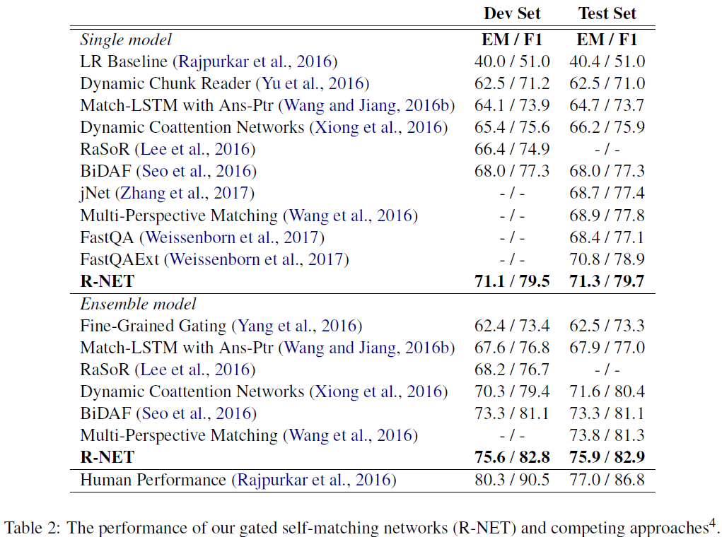
Main Results

Slide 19
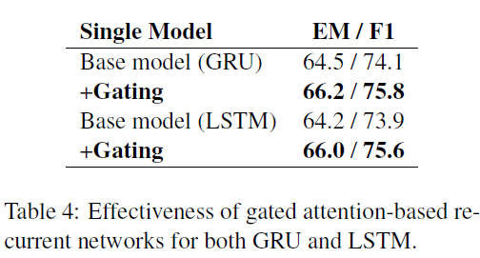
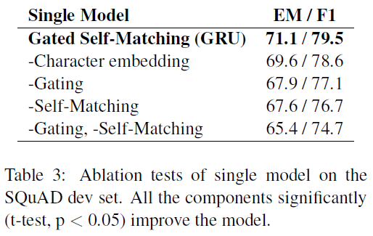
Main Results

Slide 20
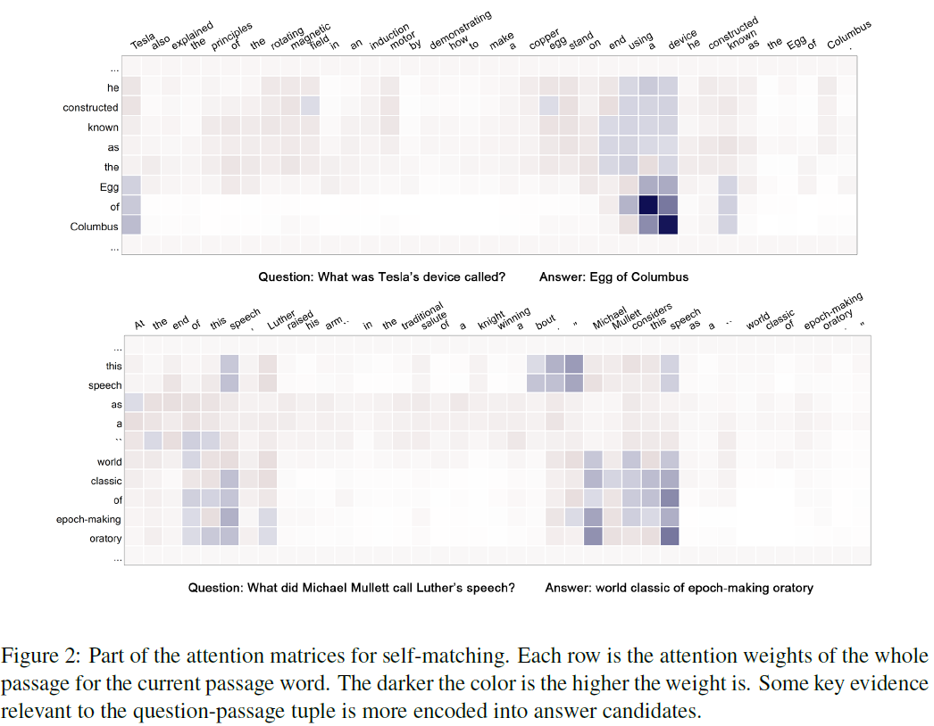
Main Results

Slide 21
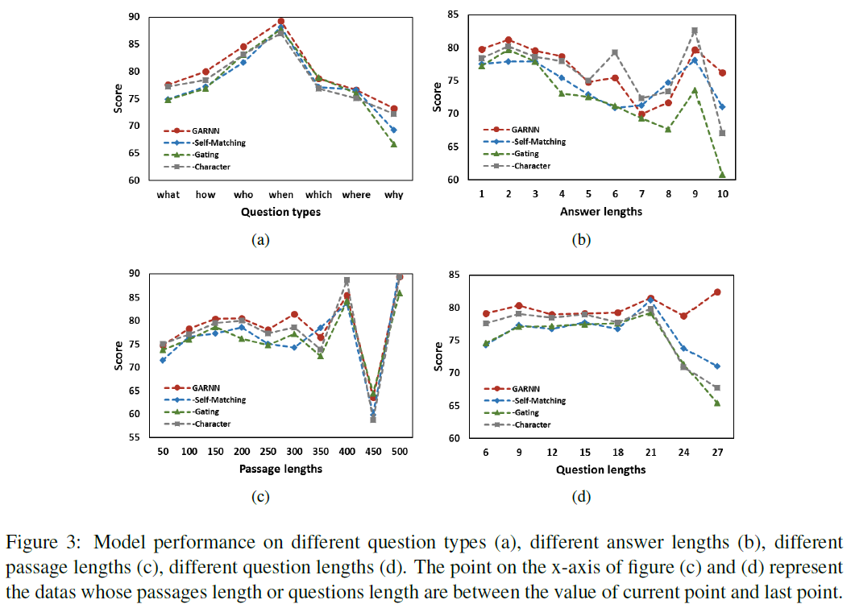
Main Results

Slide 22
thanks

