Slide 1
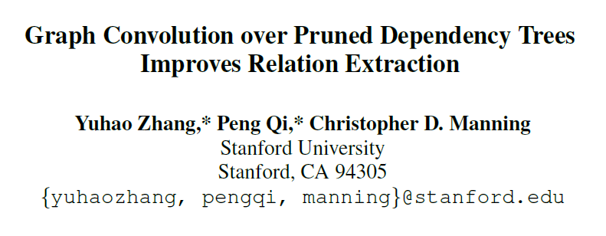
EMNLP2018

Slide 2
Motivation
Models making use of dependency parses of the input sentences, or dependency-based models, have proven to be very effective in relation extraction, because they capture long-range syntactic relations that are obscure from the surface form alone (e.g., when long clauses or complex scoping are present).

Slide 3
Previous method(Neural)
1. Performing bottom-up or top-down computation along the parse tree or the subtree below the lowest common ancestor(LCA) of the entities.
2. Reducing the parse tree to the shortest dependency path between the entities.

Slide 4
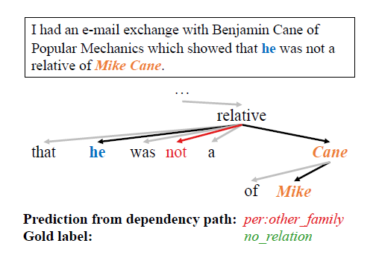
Drawbacks
1. Difficult to parallelize, time costing.
2.

Slide 5
Main idea
1. Encoding Relations with Graph convolutional networks(GCN).
2. Contextualized GCN
3. Incorporating Off-path Information with Path-centric Pruning

Slide 6
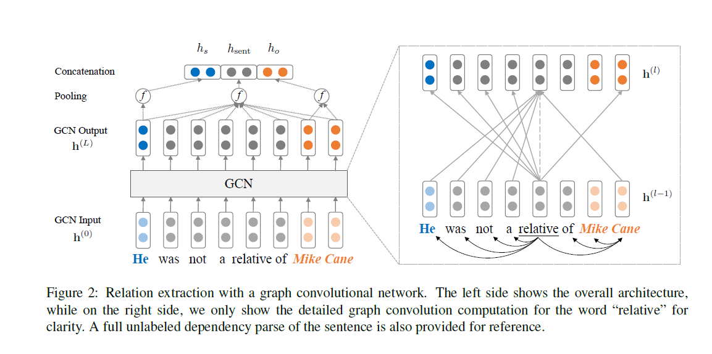
Architecture

Slide 7

Graph Convolutional Networks over Dependency Trees
Matrix A where Aij = 1 if there is an edge going from node i to node j.
W is a linear transformation
b a bias term
σ is nonlinear function

Slide 8

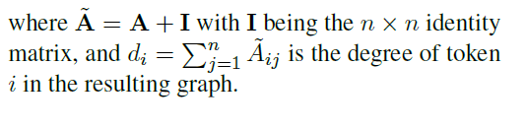
Graph Convolutional Networks over Dependency Trees
Problems：
Lead to node representations with drastically different magnitudes, since the degree of a token varies a lot.

Slide 9
Contextualized GCN
1 The input word vectors do not contain contextual information about word order or disambiguation.
2 The GCN highly depends on a correct parse tree to extract crucial information from the sentence (especially when pruning is performed), while existing parsing algorithms produce imperfect trees in many cases.
3 The input word vectors are first fed into a bi-directional long
short-term memory (LSTM) network to generate contextualized representations

Slide 10
Incorporating Off-path Information with Path-centric Pruning
1. removing tokens outside this scope(lowest common ancestor (LCA) subtree.) helps relation extraction by eliminating irrelevant information from the sentence.
2. pruning too aggressively (e.g., keeping only the dependency path) could lead to loss of crucial information and conversely hurt robustness.

Slide 11
path-centric pruning
K = 0 corresponds to pruning the tree down to the path
K = 1 keeps all nodes that are directly attached to the path （Best practical）
K = ∞ retains the entire LCA subtree.

Slide 12
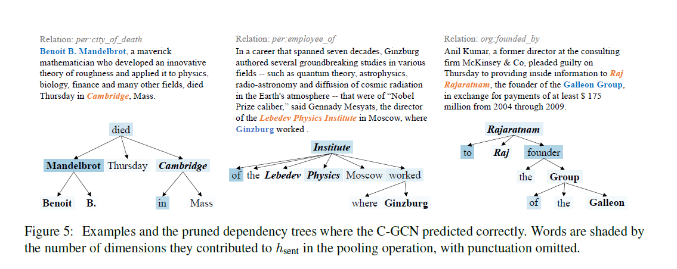
Examples

Slide 13
Experiment: data
1) TACRED contains over 106k mention pairs drawn from the yearly TAC KBP4 challenge. It represents 41 relation types and a special no relation class when the mention pair does not have a relation between them within these categories.
2) SemEval 2010 Task 8: The SemEval dataset is widely used in recent work, but is significantly smaller with 8,000 examples for training and 2,717 for testing. It contains 19 relation classes over untyped mention pairs: 9 directed relations and a special Otherclass.

Slide 14
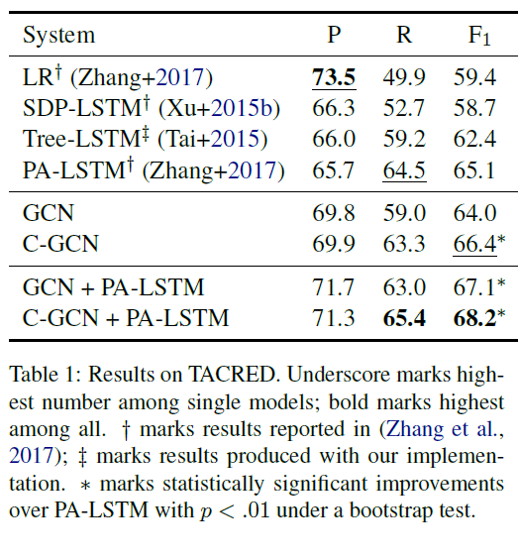
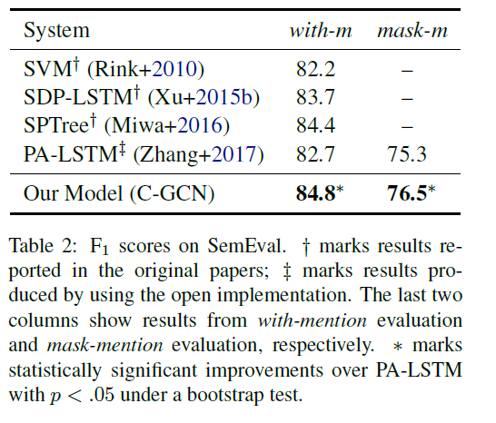

Slide 15
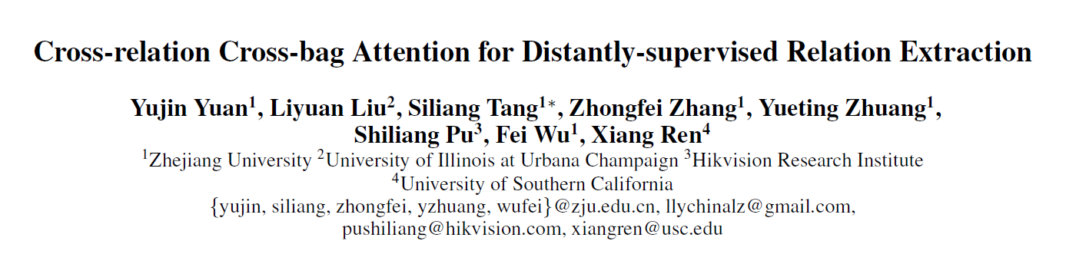
AAAI 2019

Slide 16
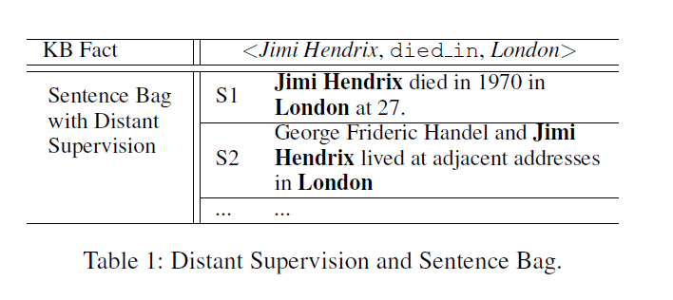
Multi-instance.
Sentence-level Selective attention
ATT generates the attention weight for each relation type independently and overlooked their correlation.
“By identifying S2 as a high-quality sentence for live_in, we are also able to recognize it as a low-quality sentence for die_in.”

Slide 17
Ideas
1. Based on this intuition, we propose a novel attention mechanism, Cross-relation Attention, which generates the attention weight after examining their relatednesses to all relation types.
2. Relaxing the constraint that one training instance only contains one entity pair. Specifically, proposing the Cross-bag Attention to combine different sentence bags, refer the combined structure as superbag, and set superbag as the training instance instead of sentence bag.

Slide 18
Cross-relation Cross-bag Selective Attention (C²SA)
1. Our approach takes into account the interplay between multiple
relations.
2. Our approach assesses the quality of the bag feature and reduces the impact of bag-level noisy label problem while the existing selective attention in the literature fails when processing a completely incorrect bag.

Slide 19
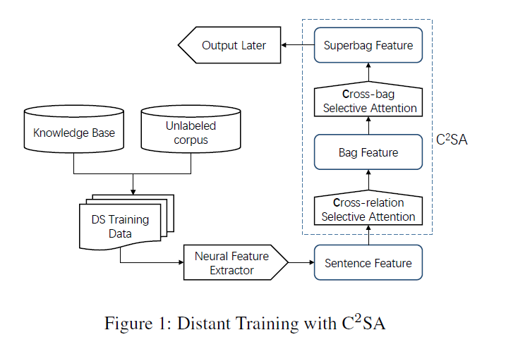

Slide 20
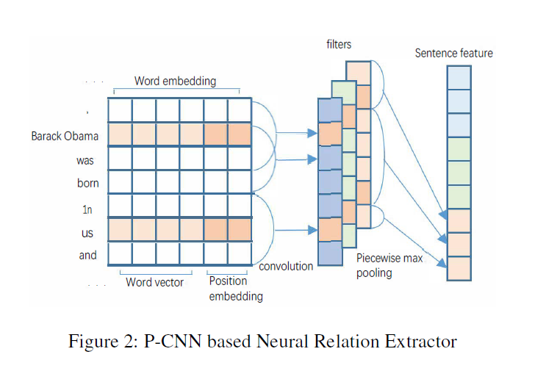
Relation Extractor

Slide 21
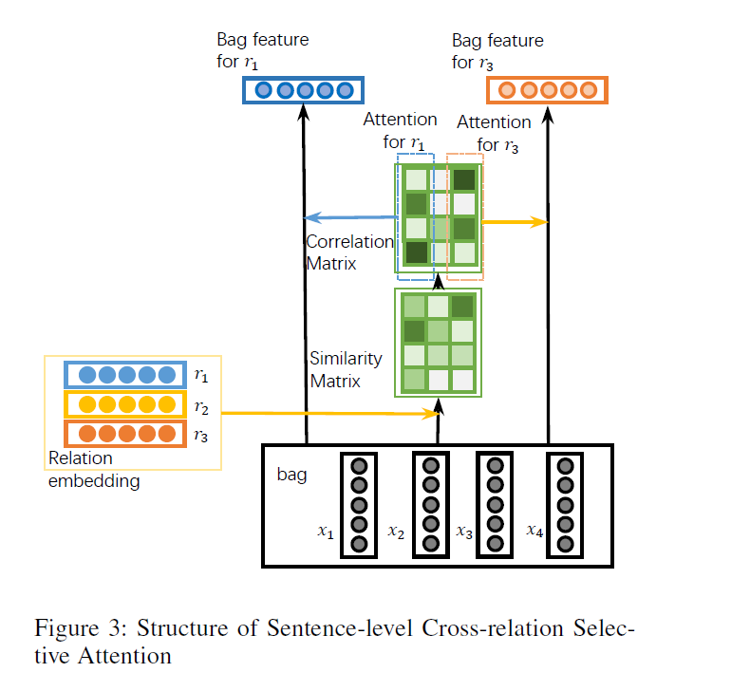
Cross-relation Cross-bag Selective Attention

Slide 22
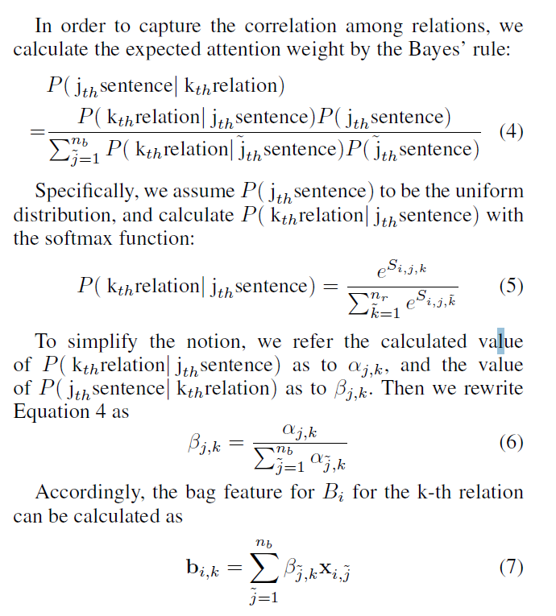

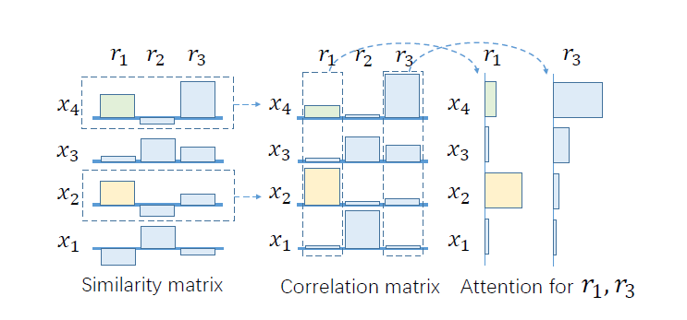
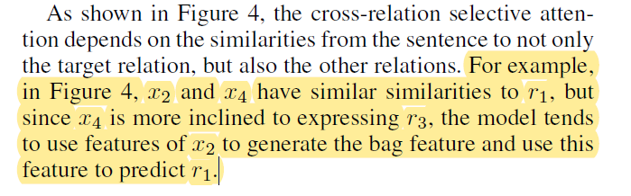
Cross-relation Selective Attention
Similarity between the sentence and the relation:

Slide 23
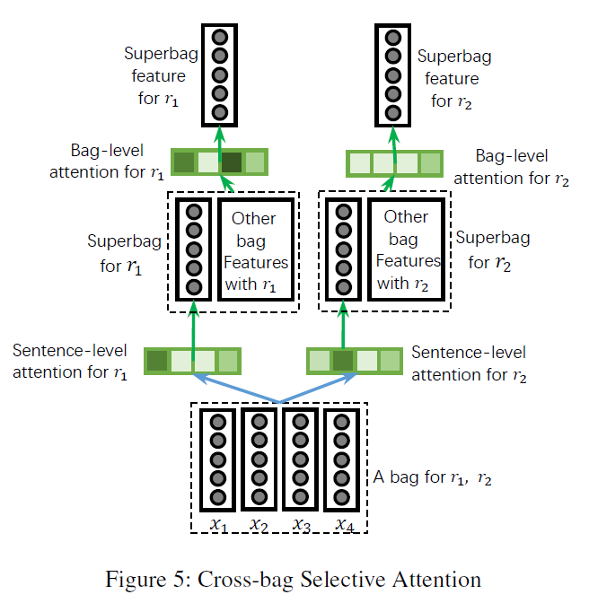
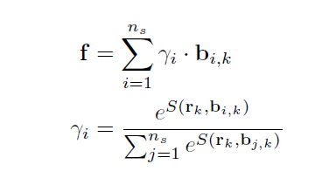
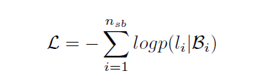
Cross-bag Selective Attention

Slide 24
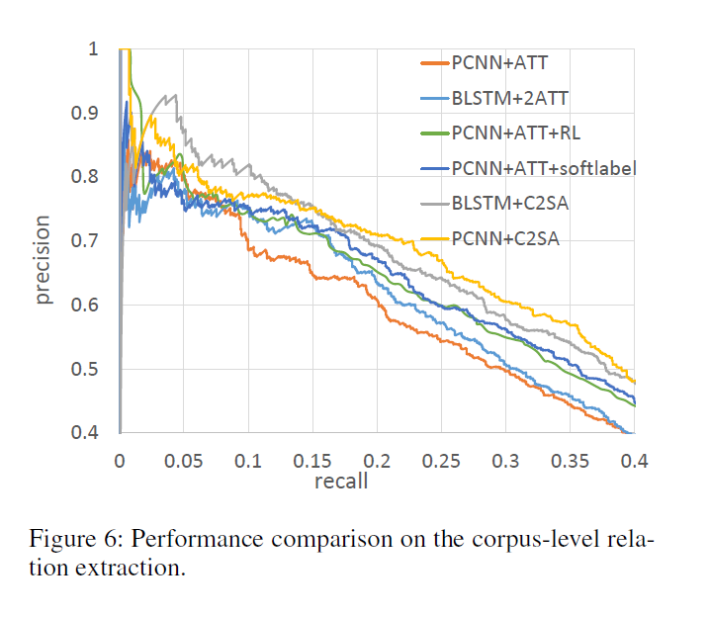
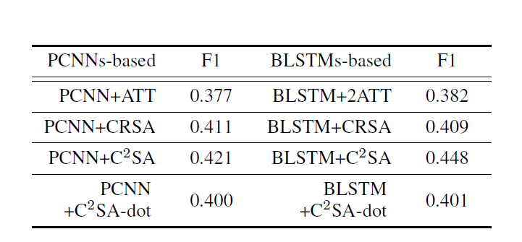
Result on NYT

Slide 25
Comparison on the Sentence-level Task
“For the sentence-level evaluation, we adopt the dataset used in the existing literature (Hoffmann et al.2011). It contains 395 sentences with human annotations.
Compared with the test set for the corpus-level task, this
set is small in size.“

Slide 26
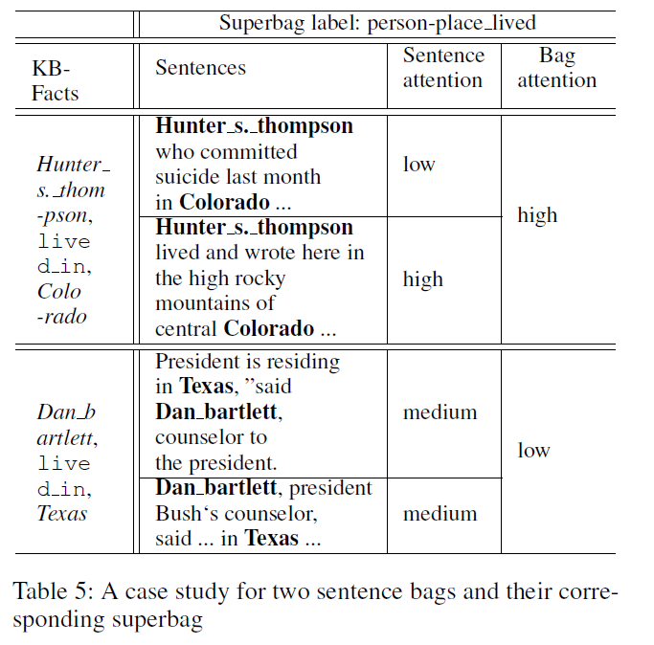
Case study

