Slide 1
论文分享
51184506058
胡佳颖

Slide 2
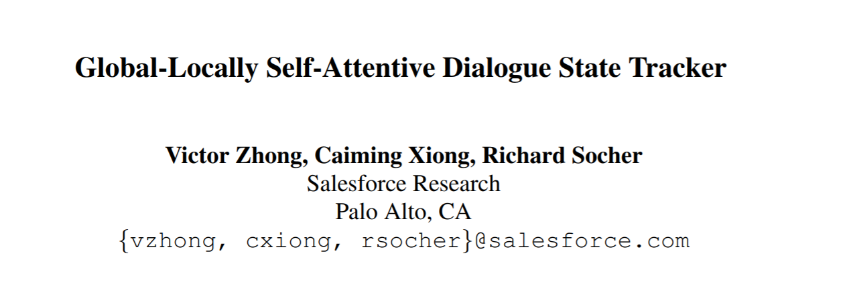

Slide 3
Background
Task-oriented dialogue system
help users accomplish tasks ranging from meeting scheduling to vacation planning(Amazon Echo, Apple Siri and Microsoft Cortana)
Five components in the task-completion dialogue:
Language understanding module
State tracker
Policy manager
Datebase
Natural language Generator

Slide 4
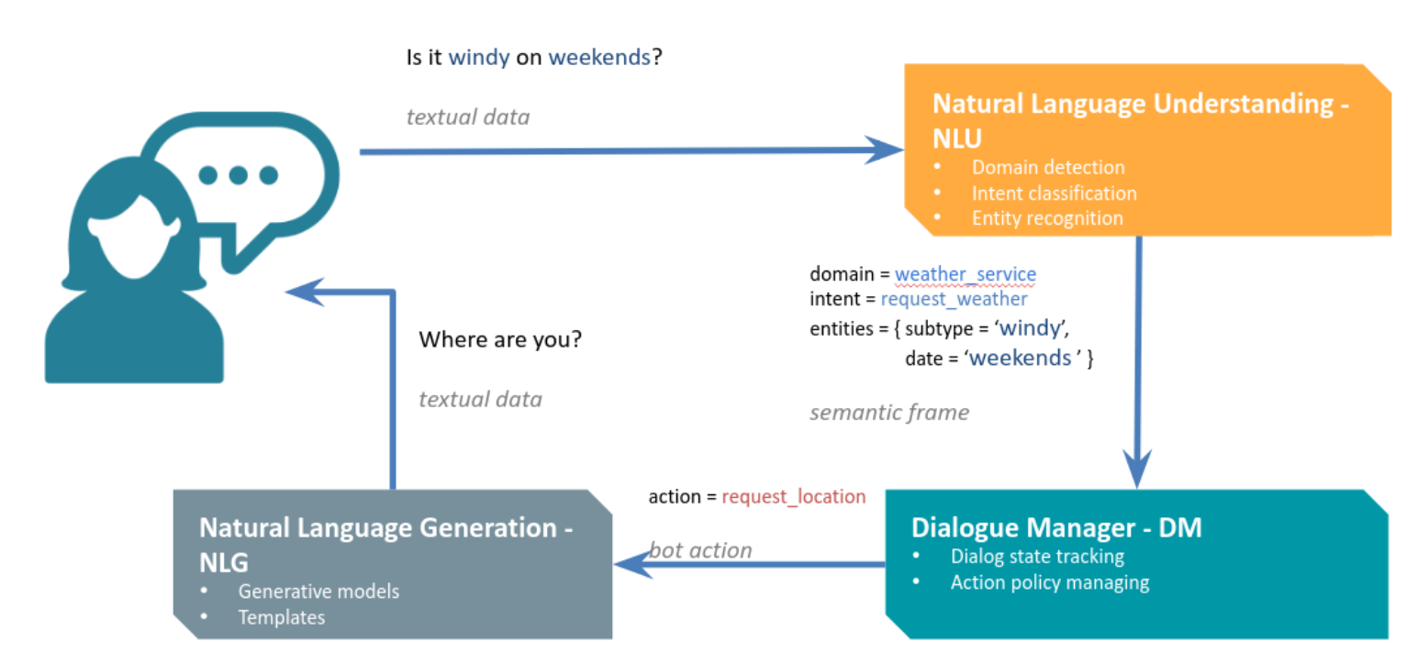

Slide 5
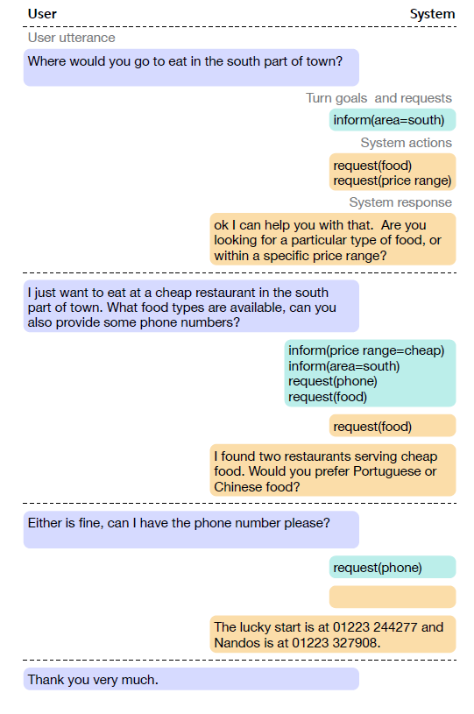
State tracker
A key problem in DST that is not addressed
by existing methods is the extraction of rare slot-
value pairs that compose the state during each
turn.

Slide 6
Global-Locally Self-Attentive Dialogue State Tracker
GLAD decomposes the multi-label state prediction problem into a collection of binary prediction problems by using a distinct estimator for each slot-value pair that make up the state.

Slide 7
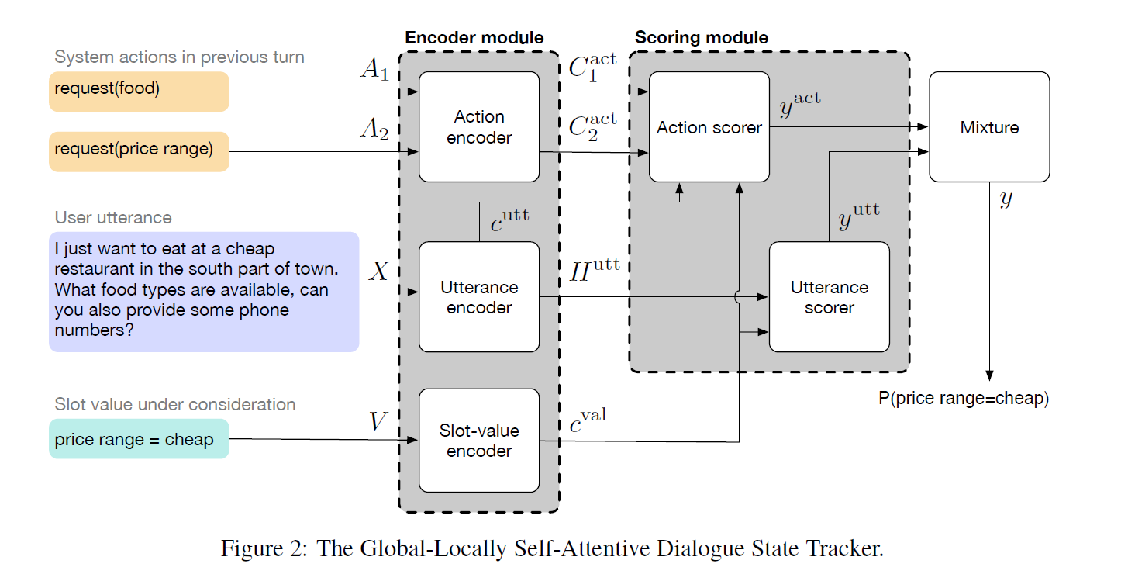

Slide 8
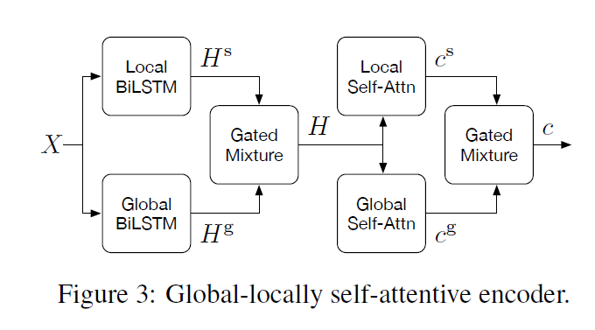
Encoding module
Global module: sharing parameters between
each slot
Local module: learning slot-specific features

Slide 9
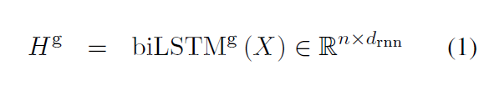



Slide 10
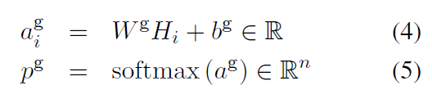
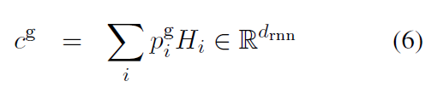

Slide 11
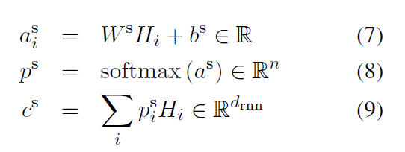


Slide 12

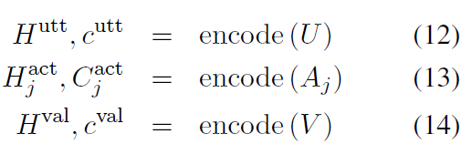

Slide 13
Scoring module
The first source of contribution is the user utterance, in which the user directly states the goals and requests.
“how about a French restaurant in the centre of town?”, after the system asked “how may I help you?”

Slide 14
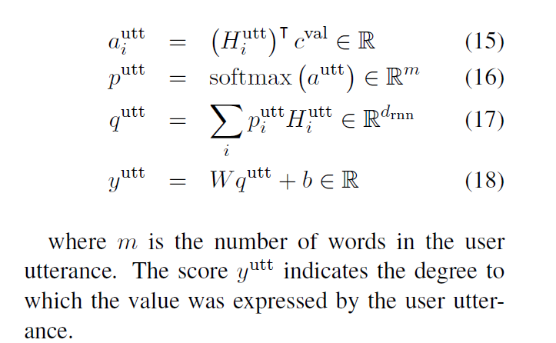

Slide 15
Scoring module
The second source of contribution is the previous system actions.
the user saying “yes”, after the system asked “would you like a restaurant in the centre of town?”

Slide 16
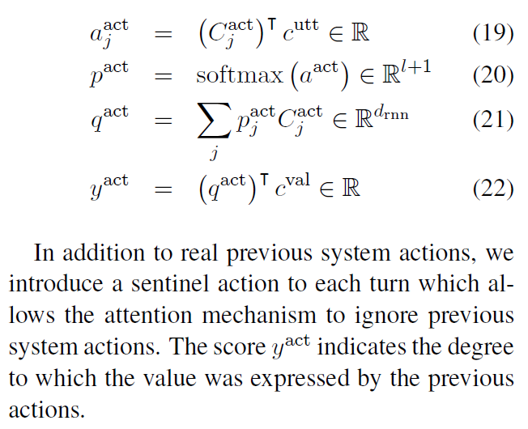

Slide 17
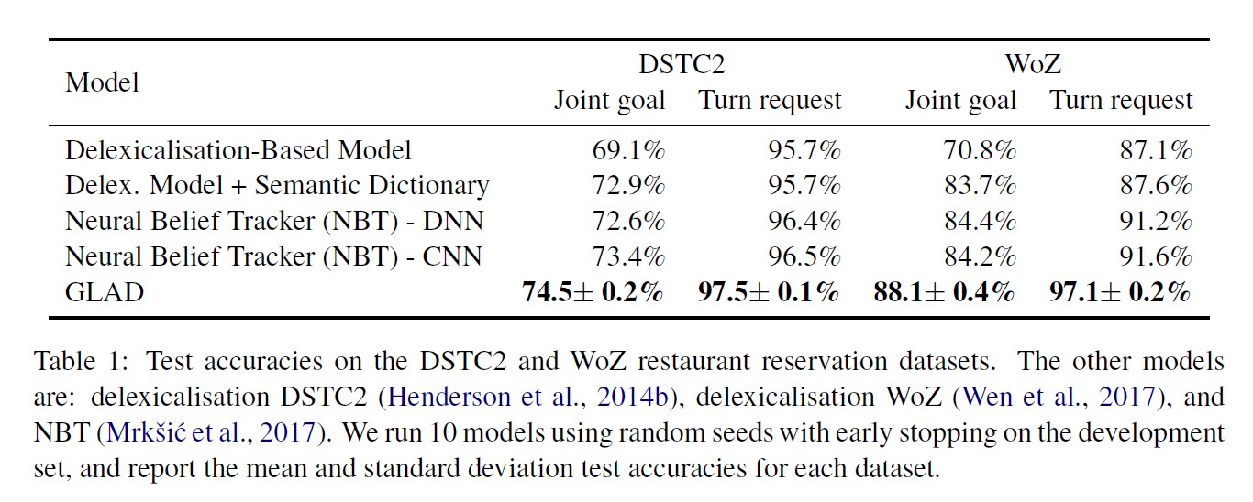
Experiment

Slide 18
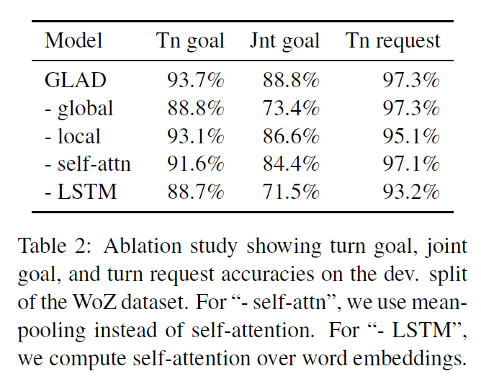
Experiment

Slide 19
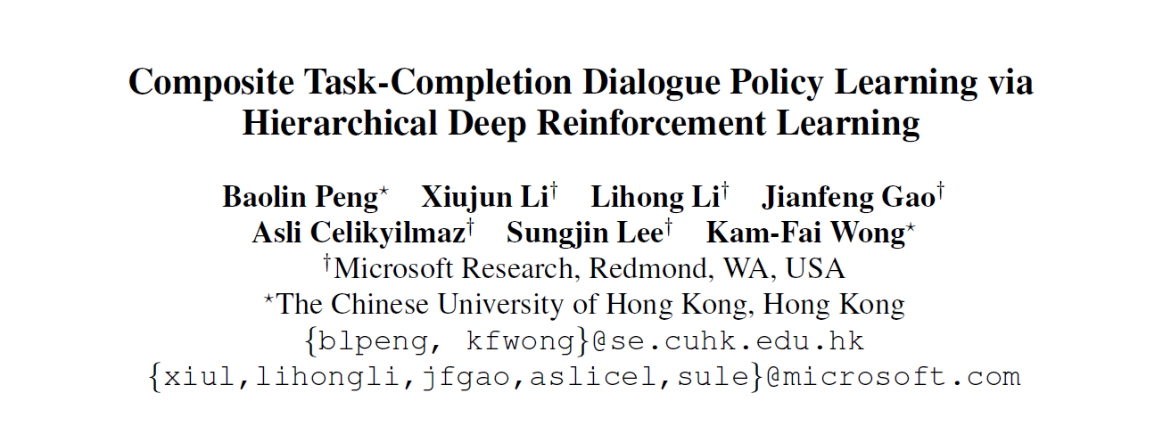

Slide 20
Dialogue manager
A top-level dialogue policy that selects among subtasks or options
A low-level dialogue policy that selects primitive actions to complete the subtask given by the top-level policy
A global state tracker that helps ensure all cross-subtask constraints be satisfied

Slide 21
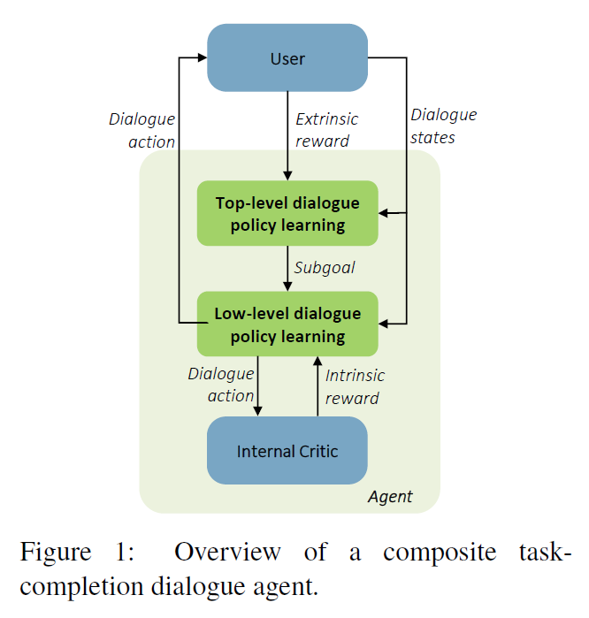

Slide 22
Extrinsic reward
At the end of each dialogue, the agent receives a positive reward of 2*max_turn (max_turn = 60 in our experiments) for success
or a negative reward of –max_turn for failure.
At each turn, the agent receives a reward of -1 so that shorter dialogue sessions are encouraged.

Slide 23
Intrinsic reward
An evaluation module (internal critic) gives intrinsic reward signals, indicating how likely a particular subtask is completed based on its current state generated by the global state tracker.
When a subgoal terminates, the agent receives a positive intrinsic reward of 2L/K if a subgoal is completed successfully, or a negative intrinsic reward of -1 otherwise; for each turn, the agent receives an intrinsic reward -1 to encourage shorter dialogues.

Slide 24



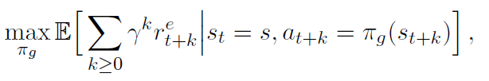
Hierarchical Policy Learning-target
optimize the low-level policy
optimize the high-level policy

Slide 25
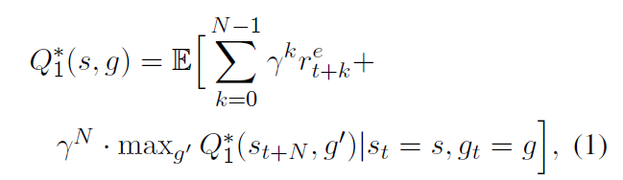
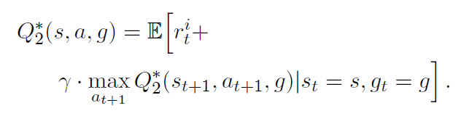
Hierarchical Policy Learning-Q function
the top-level dialogue policy estimates the optimal Q-function that satisfies the following:
the low-level dialogue policy estimates the Q-function that satisfies the following:

Slide 26
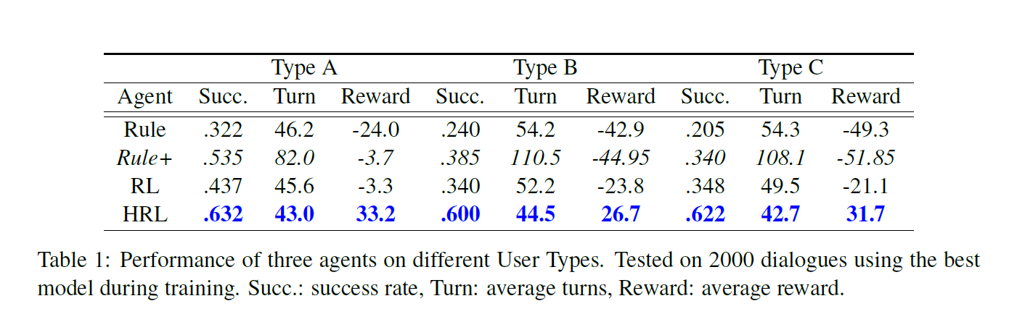
Evaluation

