Slide 1
GAN and WGAN

Slide 2
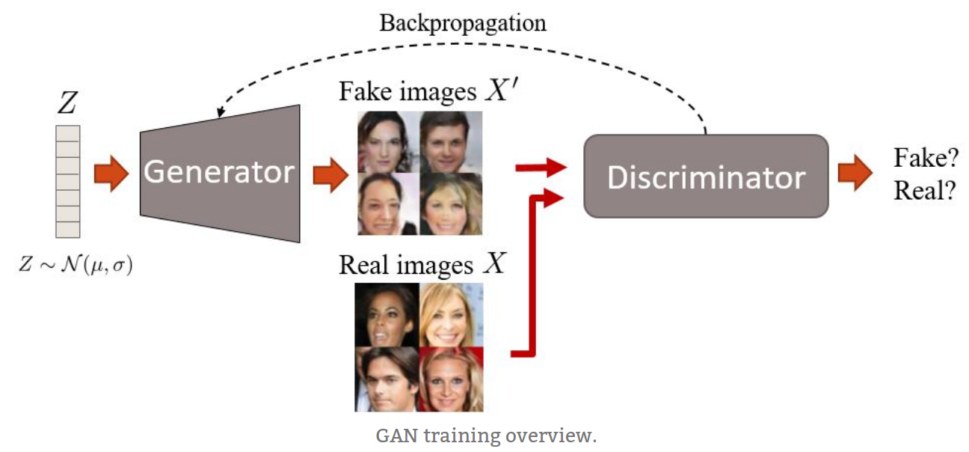

Slide 3
Improve the discriminator to discriminate the synthetic images from ones
Update the generator to generate more realistic image

Slide 4
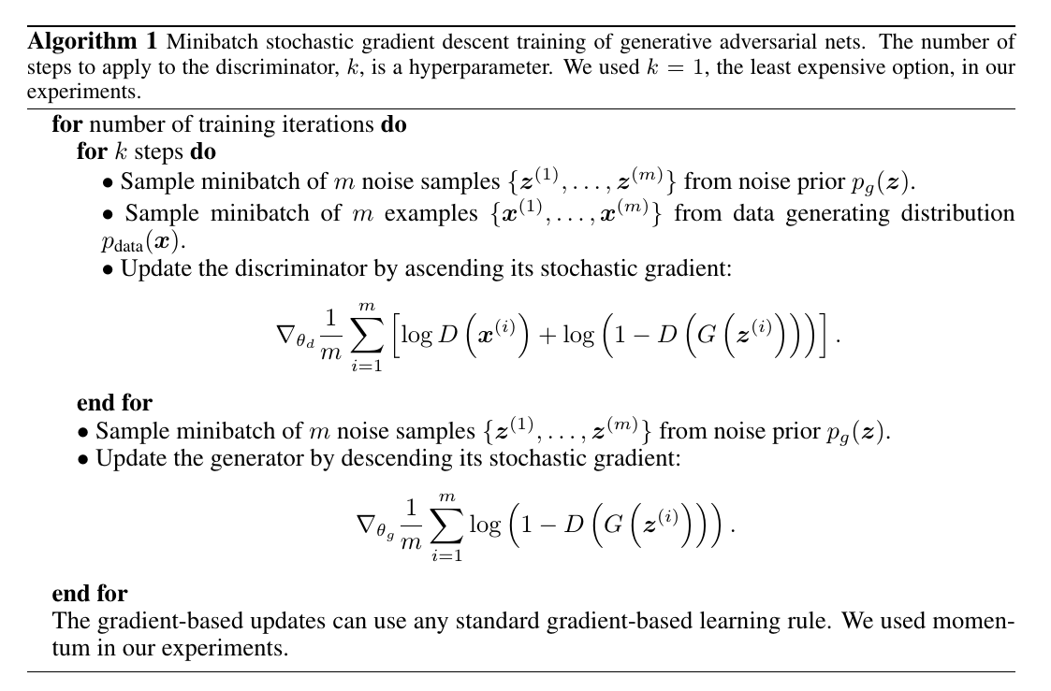

Slide 5
WGAN
Remove sigmoid of the discriminator's last layer
Remove log of the loss both discriminator and generator
Weight clip
Don't use momentum-based optimizier

Slide 6

Value Function

Slide 7
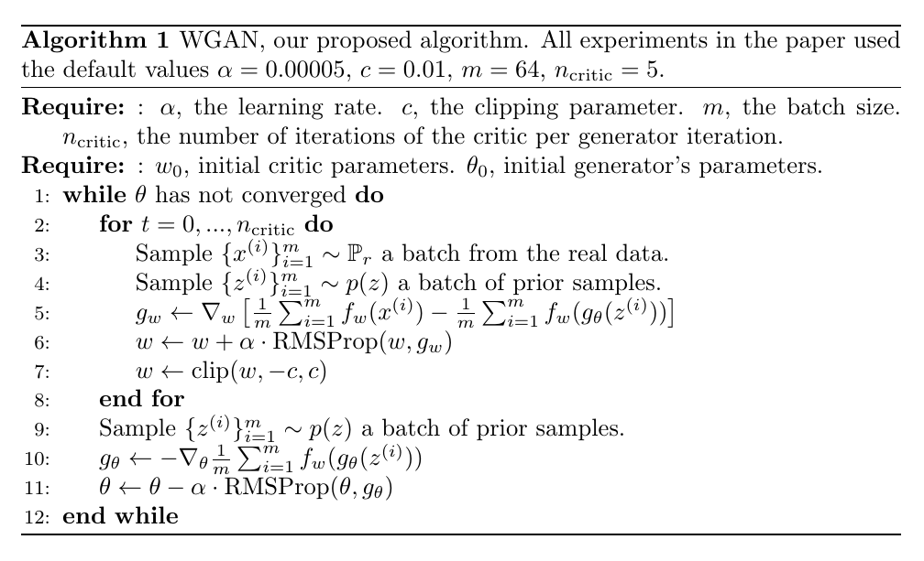

Slide 8
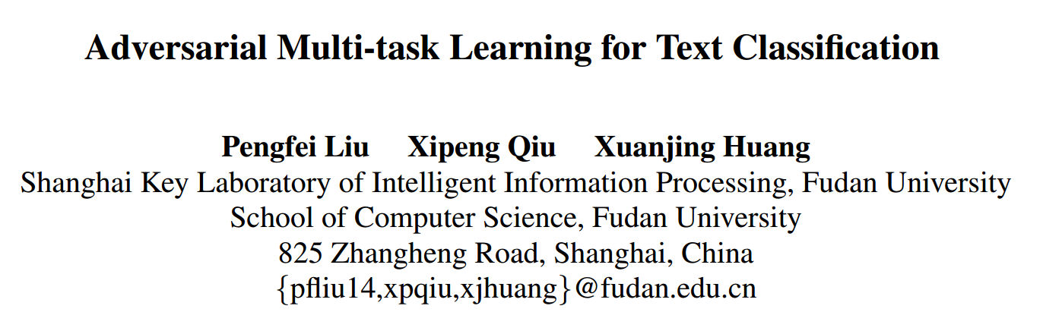

Slide 9
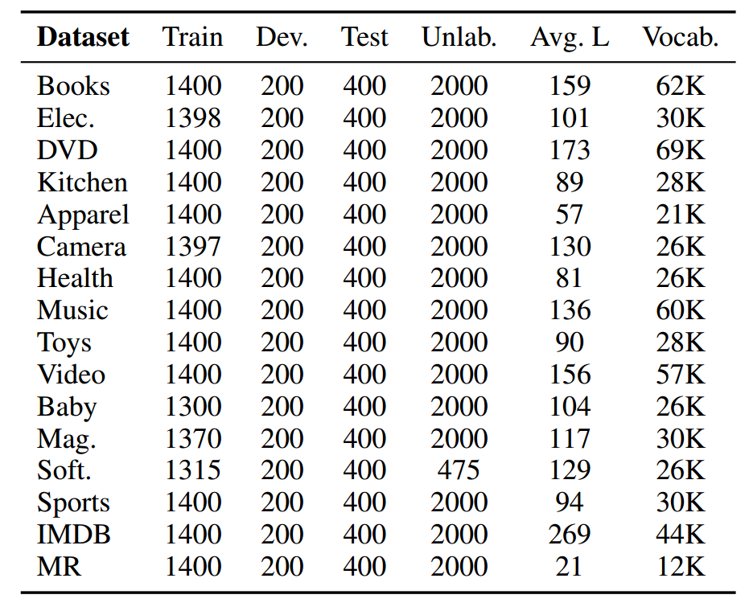
Task Description
Input: a sentence
Output: positive or negative
Multi-task(Multi-domain)

Slide 10
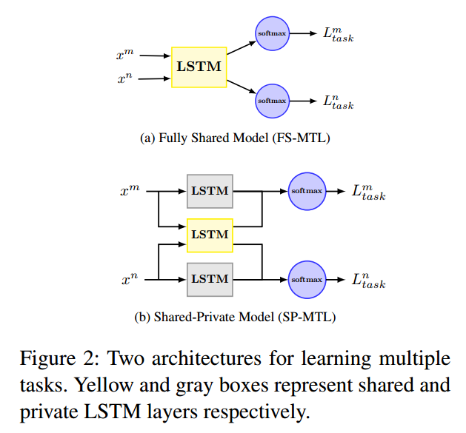

Slide 11
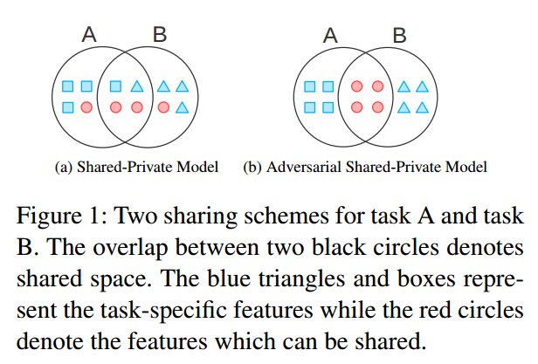
The infantile cart is simple and easy to use.
This kind of humour is infantile and boring.

Slide 12
Motivation
adversarial training: ensure that the shared feature space
simply contains common and task-invariant information
orthogonality constraints: eliminate redundant features
from the private and shared spaces
a transferable feature is one for which an algorithm cannot
learn to identifythe domain of origin of the input observation

Slide 13
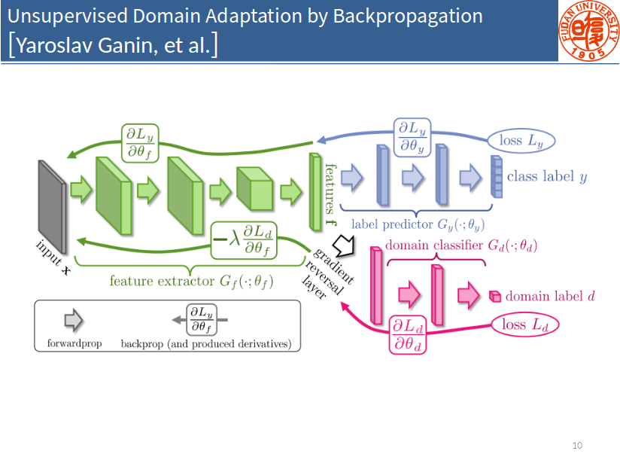

Slide 14
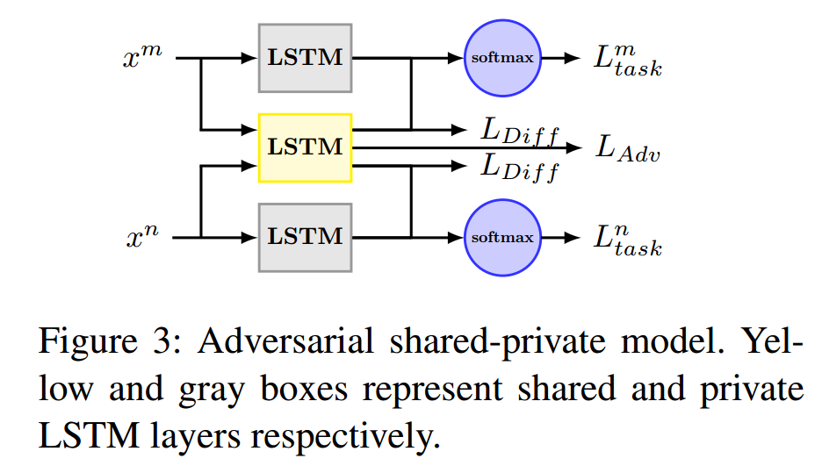

Slide 15
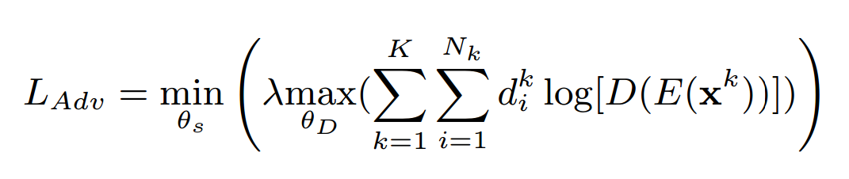
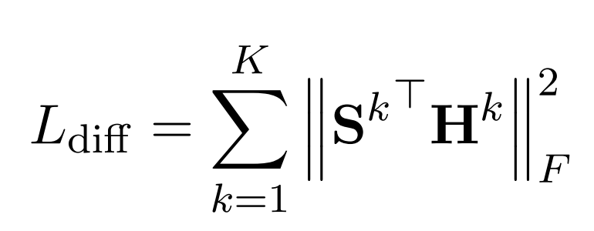

Slide 16
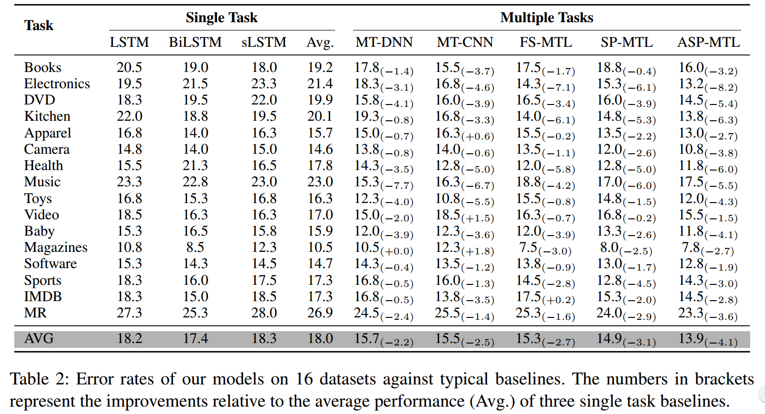

Slide 17
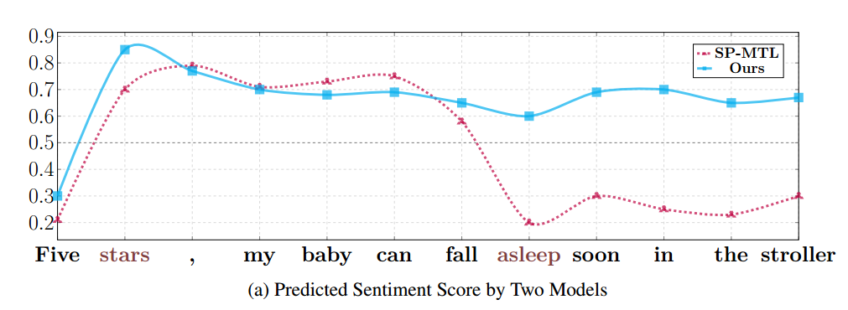

Slide 18
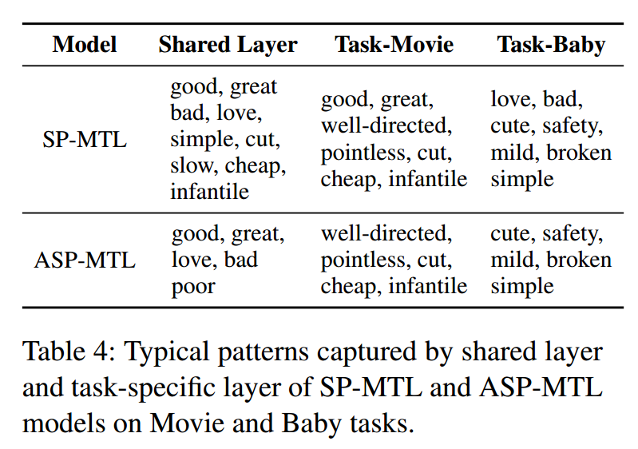

Slide 19
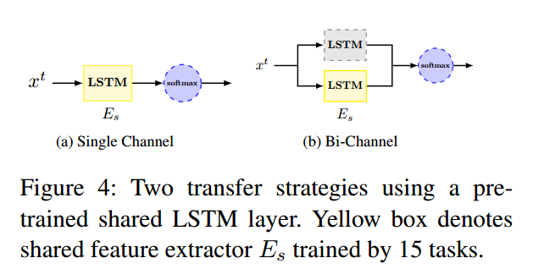
/home/zhi/Documents/antnlp/WGAN/15.png

Slide 20
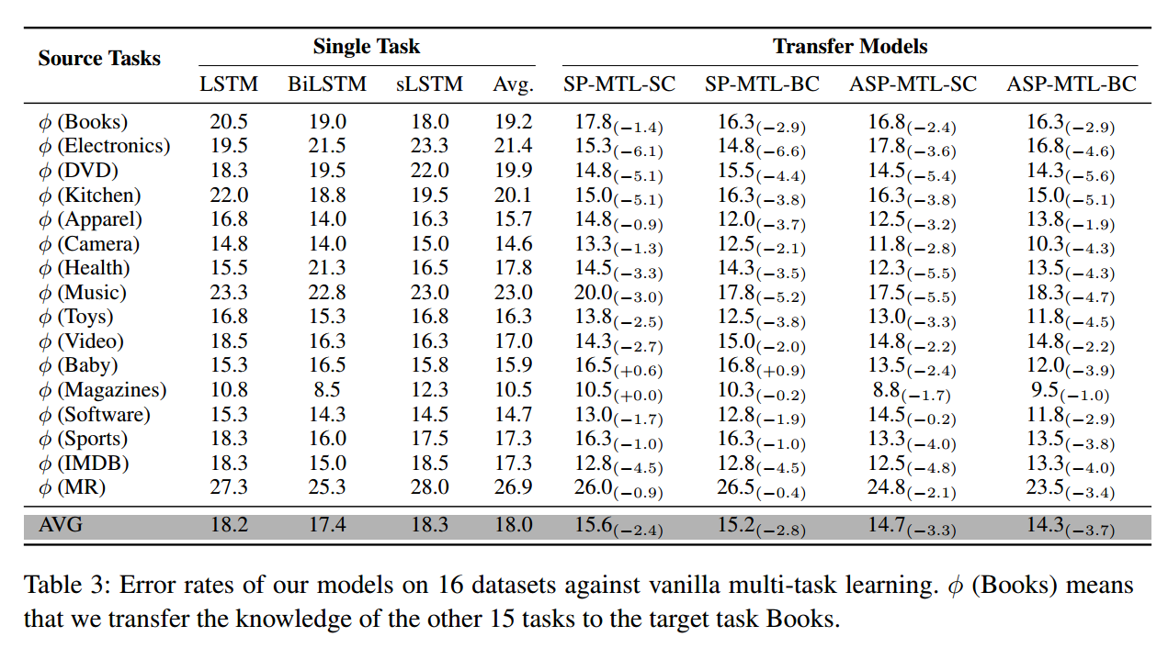

Slide 21
Conclusions
Adversarial multi-task learning framework
The task-specific and task-invariant features are learned non-redundantly

