Slide 1
member：
M
Optimization
Toolbox
atlab
INTRODUCTION
方利翔、吴鑫杰、屠嘉骏、胡明贵

Slide 2
01
What is Optimization tool
Introduction
02
Why do we need Optimization tool
How do we use Optimization tool
03
04
An example

Slide 3
What is Optimization tool
01

Slide 4

What is Optimization Toolbox
Optimization Toolbox is a kind of toolbox to extract the best solution from multiple solutions.
（1）可求解无约束条件非线性极小值；
（2）可求解约束条件下非线性极小值，包括目标逼近问题、极大、极小值 问题和半无限极小值问题；
（3）可求解二次规划和线性规划问题；
（4）可求解非线性最小二乘逼近和曲线拟合；
（5）可求解非线性系统的方程；
（6）可求解约束条件下的线性最小二乘优化；
（7）可求解复杂结构的大规模优化问题。

Slide 5
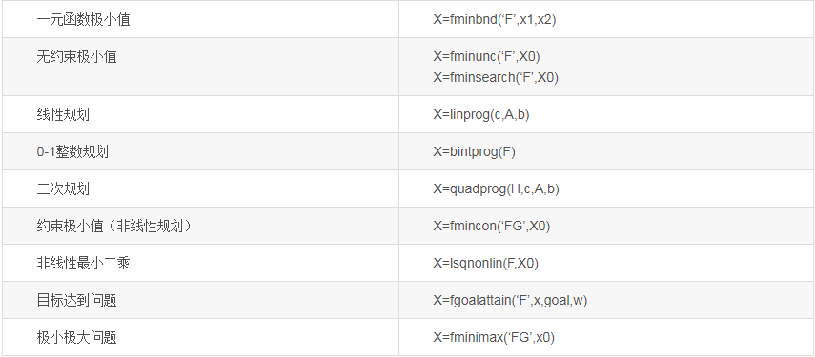
Some common function

Slide 6
Why do we need Optimization tool
02

Slide 7
Why do we need Optimization tool
偷懒
It can help us to do much calulation which we dislike to.

Slide 8
How do we use Optimization tool
03

Slide 9
How do we use Optimization tool
This toolbox would be used with two steps which like to put the elephant in the ice box.
（1）Establish the mathematical models which we need；
（2）Mathematical solution；

Slide 10
How do we use Optimization tool
This toolbox just be used by two steps which like to put the elephant in the ice box.
命令行输入:optimtool;
OR
Start->Toolboxes->Optimization->Optimization tool(optimtool)

Slide 11
How do we use Optimization tool

Slide 12
How do we use Optimization tool

Slide 13
举个栗子
04

Slide 14
An example
ASK：Money in P2P should not exceed 25%，money in fixed deposit should more than
the sum of the money in P2P and fund. So how much interest I can get a year?

Slide 15
An example
First: Establish the mathematical models which we need；
x1+x2+x3 = 1
x1<= 0.3
x3-x1-x2<=0
0.4<=x3
x1<=0.25
f=0.2*x1 + 0.1*x2 + 0.05*x3
Sencod:Mathematical solution

Slide 16
An example

Slide 17
An example

Slide 18
An example 4

Slide 19
An example 4

Slide 20
THANKS
M
atlab

