Slide 1
MATLAB
Image Processing Toolbox

Slide 2
1
Image reading
PART

Slide 3
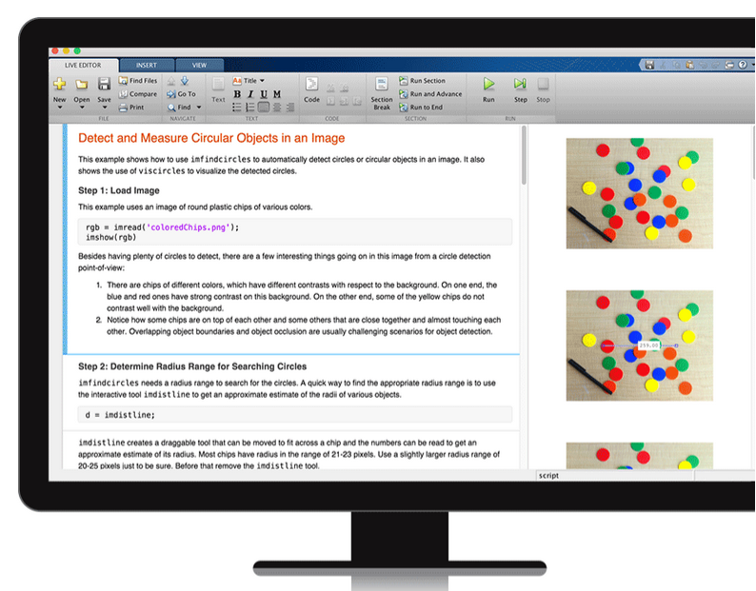
1 Image reading
The image processing toolbox is composed of a series of functions that support image processing operations. We need to complete the reading of the graphic image file between the operations on the image.
Note: Since MATLAB only supports four types of images (Indexed image, Gray image , Binary Image, RGB image), when processing other image files, it is necessary to perform pre-conversion.

Slide 4
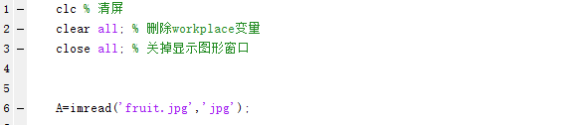

1 Image reading
The function Imread can complete the reading of the image. The basic syntax is as follows:
general: A=imread(filename,fmt)
Index image: [X,map]=imread(filename,fmt)

Slide 5
2
Image display
PART

Slide 6
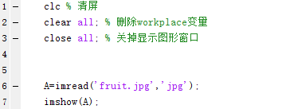
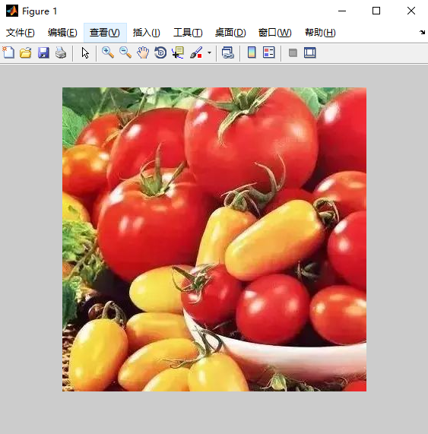
Image display 2
The image display function Imshow is used as follows:
Indexed image:
imshow(X,map)
Gray image:
imshow(I)
imshow(I,n)
imshow(I,[low,high])
Binary Image:
imshow(BW)
RGB image:
imshow(RGB)

Slide 7
Image display 2
Here are some commonly used functions that display multiple image files.
Create a new image window
figure,imshow
Function: Create a new image window to display a new image, so that a new image is obtained without the original image being overwritten.
Multi-image display
Montage(I)
Montage(D,map)
Function: It can be used to display all image files in a certain format under a file to form a matrix and display it in an image frame.
Sub-picture display
Subplot(m,n,k),imshow
Function: draw and display the kth subgraph of m rows and n columns.

Slide 8
3
Image writing
PART

Slide 9
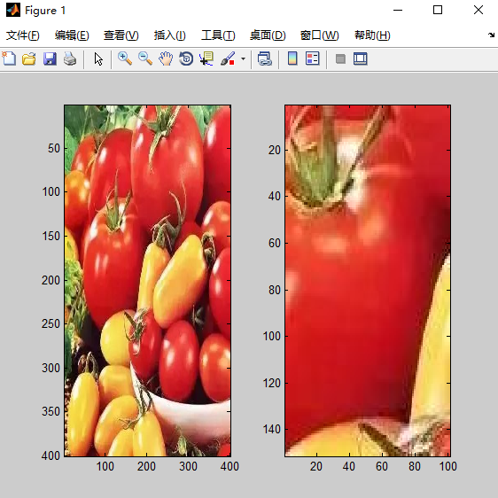
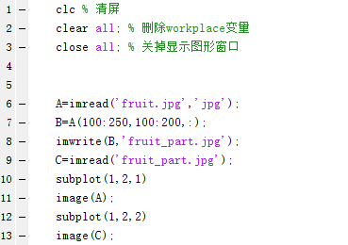
3 Image writing
The function Imwrite can complete the writing of the image.
The basic syntax is as follows:
general: imwrite(A,filename,fmt)
Index image: imwrite(X,map,filename,fmt)

Slide 10
4
An example
PART

Slide 11
An example 4
Color-based image segmentation
When actually processing an image, it is often necessary to segment the image. This example uses Matlab to implement color-based image segmentation.
Color-based image segmentation is simple to implement, the algorithm is simple, and has good real-time performance.
The knowledge points involved in this example are as follows:
1, RGB to YCBCR color space conversion.
2. Binarize the image with the threshold of each channel.
3. Morphological treatment: corrosion, expansion, and hole filling.
4. Connected area extraction.

Slide 12
An example 4
请输入你的标题

Slide 13
THANKS

