Slide 1


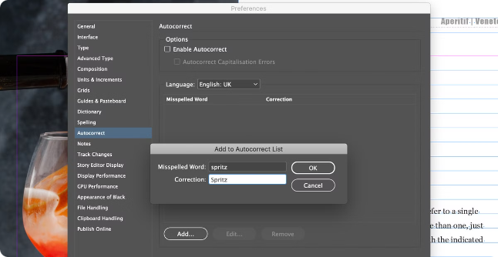
Spelling and Grammar Check App
This application offers an intuitive interface for users to check and correct spelling and grammar errors in plain text and DOCX files.

Slide 2
Introduction
The goal of this project is to develop a user-friendly tool that can help users improve their writing by identifying and suggesting corrections for common spelling and grammar mistakes.
Accuracy
User-Friendliness
Efficiency
The application aims to achieve high accuracy in identifying and suggesting corrections for spelling and grammar errors.
The interface should be intuitive and easy to use, even for users who are not familiar with grammar and spelling rules.
The application should be able to process text quickly and efficiently, providing users with results in a timely manner.

Slide 3
Application Overview
The application will consist of two main components: a text editor for input and a results pane displaying identified errors and suggested corrections.
Text Editor
Results Pane
The text editor will allow users to input plain text or upload DOCX files.
The results pane will highlight identified errors in the text and provide suggested corrections, including synonyms and grammar improvements.

Slide 4
Class Structure and Methods
The application will be structured using a class-based approach, with separate classes for handling text processing, error detection, and suggestion generation.
1
TextProcessor Class
2
ErrorDetector Class
3
SuggestionGenerator Class
This class will handle loading and cleaning text from various sources, including plain text input and DOCX files.
This class will utilize NLP libraries to identify potential spelling and grammar errors in the input text.
This class will generate suggestions for correcting identified errors, leveraging dictionaries, grammar rules, and NLP techniques.

Slide 5
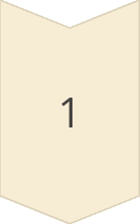
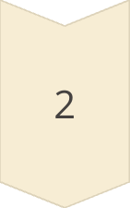
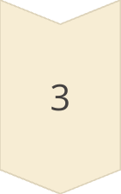
Streamlit Application Components
Streamlit will be used as the framework for building the user interface, enabling rapid development and deployment of the application.
Input Component
A text area or file upload component for users to input their text.
Processing Component
A backend component that handles text processing, error detection, and suggestion generation.
Output Component
A display component that shows the processed text with highlighted errors and suggested corrections.

Slide 6
Detailed Functionality Walkthrough
Upon inputting text or uploading a DOCX file, the application will initiate a sequence of steps to process the text, detect errors, and generate suggestions.
Text Preprocessing
1
The text is cleaned and formatted for analysis.
2
Error Detection
The application identifies potential spelling and grammar errors using NLP techniques.
Suggestion Generation
3
Based on the identified errors, the application generates relevant corrections and suggestions.
4
Output Display
The processed text with highlighted errors and suggestions is displayed in the results pane.

Slide 7




Challenges and Considerations
Developing a robust spelling and grammar check application requires careful consideration of various challenges and potential limitations.
Accuracy
Performance
Achieving high accuracy in identifying and suggesting corrections is crucial.
Ensuring fast and efficient processing of text, especially for large files.
User Experience
Contextual Understanding
Providing an intuitive and user-friendly interface that is easy to navigate.
Developing a system that can understand the context of the text to provide accurate suggestions.

Slide 8


Libraries Used
The application utilizes various Python libraries to provide its functionalities.
1
TextBlob
2
LanguageTool
Provides text processing and sentiment analysis capabilities.
Offers advanced grammar and spelling checking capabilities.
3
python-docx
4
Text Processing
Facilitates reading and writing DOCX files.
Includes various modules for cleaning, formatting, and analyzing text.

Slide 9
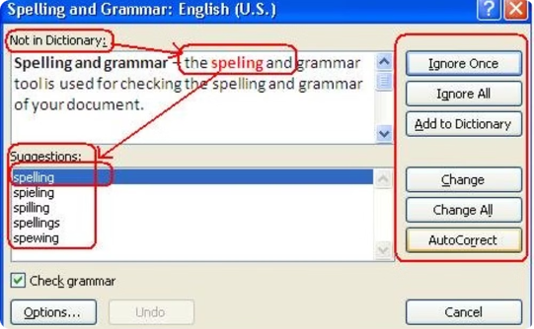
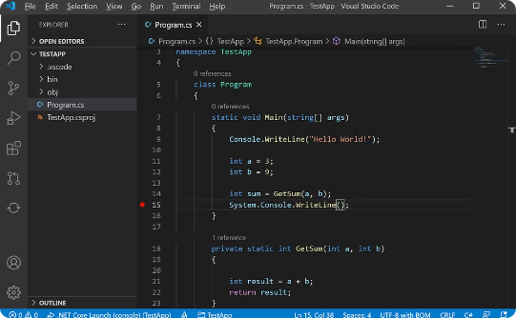

Conclusion
The spelling and grammar check application offers a valuable tool for users to improve their writing by identifying and suggesting corrections for common spelling and grammar mistakes.
User Interface
Code
Impact
The application provides an intuitive and user-friendly interface for users to interact with the features.
The application leverages Python libraries and a modular code structure for efficient functionality.
The application aims to improve user's writing by identifying and suggesting corrections for common errors.

