Slide 1

Task, Graph and Features of Anti-Money Laundering
Transaction
List screening
Rule matching
Intelligent model monitoring
Suspicious
Transactions
Anti fraud: quasi real time
Anti money laundering: T+1
Transaction information
Static information
Equipment information
Position information
Related information
Financial link information
Counterparty information
Amount of money
Single transaction, cumulative, limit
Operation time
Non working hours, midnight, holidays
Essential information
Name, ID card, phone number, home address, company name, company address
Operating IP
Number of transactions
Authentication method
Login empty code, payment password, gesture, SMS, personal insurance, UK, cloud certificate
Operating equipment
Equipment, previously used equipment, trusted equipment
Bit weight data
Bit weight resolution, number attribution operator bit weight
Terminal
Proxy IP/VPN IP, IDCIP, no backup fingerprint
Emergency contact
Co borrower
Behavioral preference
List of trusted counterparties, previously used counterparties, commonly used IPs, commonly used devices, and account signing locations
Associated bank card
Future location and account type
Related diagram information
Source of Funds
Name, reserved mobile phone, reserved ID card, account return location, signing location, account type
Capital flow
Name, account ownership, company, individual, bank /other bank
Notes:
第二部找到图上每个节点即用户的关键特征

Slide 2

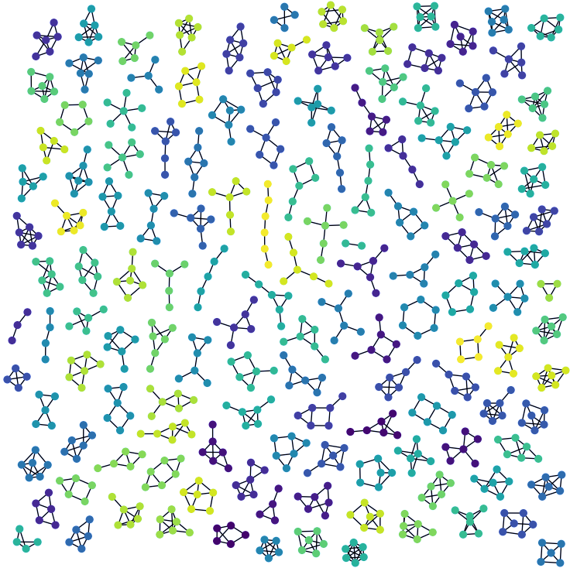




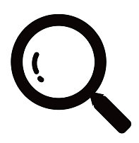
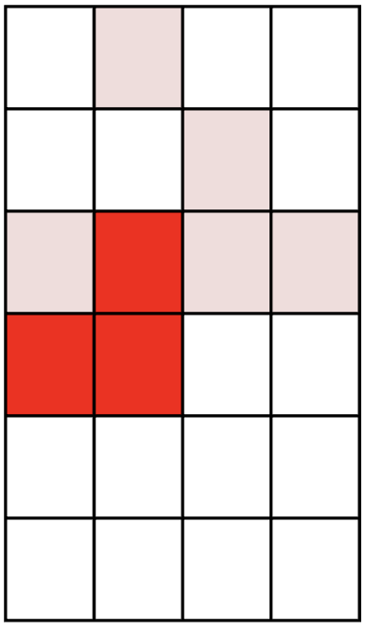
Model: Anomaly detection with Guided Diffusion Model for Graph Recovery
Partially-observed
Transaction Graph
Original Subgraph
Noised Subgraph
Guiding
Classifier
Recovered Subgraph
Inject noise
Recover with guidance
Node
Attributes
Denoising
Network
Subgraph Sampler
-
Visualize anomaly heat map
“the reconstruction error of the transaction frequency on the weekend is much larger than other benign accounts”
Explanation
Notes:
检测方法：
Firstly, the subgraph sampler extracts the most-informative neighbors of each user account and constructs an adaptive subgraph surrounding it. We can treat each subgraph as an independent training sample and solve the problem on the subgraph level.
Secondly, these subgraphs are treated as original graphs being fed into the guided diffusion module, which is intended to recover an arbitrary subgraph to an anomaly-free version.
The diffusion module injects a series of noise from a normal distribution iteratively onto the original subgraph in the forward diffusion process. Then in the reversed denoising processing, the denoising GNN network predicts the injected noise to reconstruct the graph.
In addition, a novel graph classifier is designed to guide the recovering direction towards a “healthy” subgraph by revising the predicted noise in the denoising process.
The guiding classifier ensures that only suspicious regions are changed, while the rest of the subgraph, the normal part, remains unchanged.
Eventually, in AML detecting, the reconstruction error between the original subgraph and the recovered version measures the anomaly score of each account. The divergence in node attributes can be visualized with an anomaly heat map, which provides an adequate explanation for each suspicious account, e.g., the reconstruction error of the transaction frequency on the weekend is much larger than other benign accounts.

Slide 3
Explanation: Using abnormal heat maps as interpretable methods
Number of cross-border transactions: 3m
Transaction amount: 3m
Remittance amount (converted to RMB) 3m
Local currency cash transaction amount: 3m
The number of times a single payment in local currency cash reaches 50000 or more is 3m
The number of times a single cash transaction in the local currency reaches 50000 or more, with a total of 3m
The number of transactions with a single online banking transaction exceeding 50000 is 3m
The number of times a single online banking transaction reaches 50000 or more by the payer is 3m
The counterparty is in a high-risk area with an amount of 3m
The transaction occurred in a high-risk area with a transaction amount of 3m
Payment times for a single cash amount of 100000 yuan or more: 3m
Cash receipts with a single amount of 100000 yuan or more, totaling 3m
Multiple private transfers of over 500000 yuan per transaction, with a total of 3m
The number of transactions with corporate clients' online banking exceeding 500000 in a single transaction is 3m
During the customer rating period, the number of IP logins in high-risk areas was 3m
During this period, multiple online banking transactions were conducted for different customers using the same IP address
Account characteristics
True value
Predictive value
Account within the sub chart
Abnormal feature with high reconstruction error.

