Slide 1
Landscape: Languages, Compilers, and Hardware:
cc: ← .h, .c
.i ← cpp
.s ← ccom .o ← as
.out ← ld
Languages
Source: .java
Languages
Domain Specific
Compilers & Interpreters
Analysis
lexicographical
syntaxical
semantics
Language Optimization
Machine Optimization
Translation: TAC → MIPS
Hardware
General Types: Registers / Stack
Specific CPU Controls
CLI: compilation exercise
Source: .c
javac
Source: .i
Object: .class
Assembly: .s
java
Translation Process
Object: .o
Virtual Machine
Executable: a.out
Hardware
kernel
kernel

Slide 2
Models of Computation and Communication
We need to develop a model
to reason about the problem
to reason about our solution
to reason about the problem about our solution.
Models of Communication:
OSI/ISO model (Open Systems Interconnect)
TCP/IP model
Model of Computation: (Machine <-> Language)
Turing Machine, Linear Bounded Automata, Pushdown Automata, and Finite State Automata
Sequential Circuits, and Combinational Logic
Universal Computer and Machines: Theoretical to Abstract to Physical

Slide 3
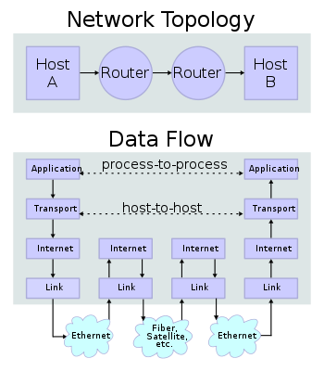

Slide 4
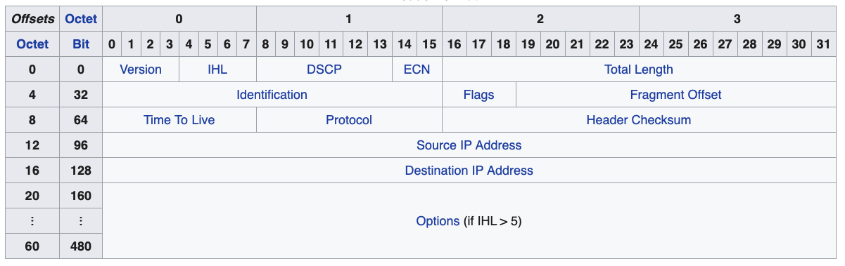
IPv4 Packet Header

Slide 5
OSI and TCP/IP Models
Layer | Name | Example Protocol | Naming | Transported | Hardware Device
7 | Application | http | url | data
6 | Presentation | ---
5 | Session | ---
4 | Transport | TCP/IP | socket | segment
3 | Network / Internet | IPv4/IPv6 | IP | packet | router
2 | Data Link / Link | Ethernet | MAC | frame | switch
1 | Physical | 802.11g | Interface | symbols | hub, bridge
Host layers
Media layers

Slide 6
The Layers Simplified
Layer 1: Physical Layer
The mechanics of sending symbols -- restricted (maybe) to one's and zero's
Layer 2: Data Link
When to start and stop an individual message between two connected location
Layer 3: Network
Sending a message from A ⇒ Z by going through B to C to D to … to Y and then finally Z
Layer 4: Transport
Transmitting/Ensuring a complete message from A to Z
Address performance issues

Slide 7
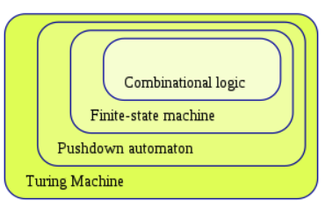
Models of Computation
Turning Machines | Recursively Enumerable | TM(Q, Σ, 𝚪, q0, 𝛅)
Linear Bounded Automata | Context Sensitive Languages | LBA(Q, Σ, 𝚪, q0, 𝛅)
Pushdown Automata | Context Free Languages | PDA(Q, Σ, 𝚪, 𝛅, q0, z0, F)
Finite State Automata | Regular Expressions | FA(Q, Σ, 𝛅, q0, F)
Sequential Circuits
Combinational Logic | Boolean Algebra

Slide 8




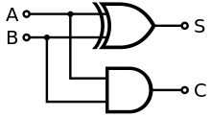
Combinational Logic
java: A || B
A | B | ⊕
False | False | False
False | True | True
True | False | True
True | True | False
Based upon Boolean Algebra
all inputs and outputs restricted to True (1) and False (0)
Operations are restricted to: AND (*) , OR (+), NOT (')
Equivalent to Digital Logic, with gates:
Can be used as a building blocks:
XOR: A ⊕ B is equivalent to (A + B) * (A' + B')
Example: Half-Adder

Slide 9
Sequential Circuits
Introduce feedback loops
Creates latch or flip-flop
a circuit with only two stable states
Example: SR Latch
S | R | Q | Output | Description
0 | 0 | Q | Q | Hold State
0 | 1 | Q | 0 | Reset / Clear
1 | 0 | Q | 1 | Set
1 | 1 | Q | X | Not allowed: Error

Slide 10
Finite State Machine
FA(Q, Σ, 𝛅, q0, F)
Q = { N, W, R, B, T } // New, Waiting (Ready), Running, Blocked, Terminated
Σ = { a, d, i, t, r, e} // admit, dispatch, interrupt, trap, resume, exit
q0 : N
F : { T }
𝛅 : Q x Σ -> Q
d
N
a
W
R
e
T
input string:
i
a
d
t
r
d
a
d
e
$
r
t
B
FA for the Process Status Diagram

Slide 11
Pushdown Automata
C -> if ( E ) S
| if ( E ) S else S
PDA(Q, Σ, 𝚪, 𝛅, q0, z0, F)
Σ : set of symbols on the input string
𝚪 : set of symbols placed on the stack
z0: set of symbols place on the stack at startup
𝛅 : Q x Σ x 𝚪-> Q x 𝚪*
input string:
control unit
$
Infinite Stack
PDA

Slide 12
Turing Machine
TM(Q, Σ, 𝚪, 𝛅, q0)
Σ : set of symbols on the input string
𝚪 : set of symbols placed on the tape
includes a blank symbol: $
𝛅 : Q x Σ x 𝚪-> Q x 𝚪 x {R, L}
control unit
input string:
$
$
$
a
$
$
$
Infinite Tape
Turing Machine

Slide 13
Linear Bounded Automata
Special Case of a Turing Machine
The tape is bounded to a defined size.
control unit
input string:
h
e
l
l
o
$
$
$
$
LBA with tape size of 8

Slide 14
Universal Computer
TM(Q, Σ, 𝚪, 𝛅, q0)
Tape: sufficiently large
A specialized control unit (aka firmware)
A specialized program placed on tape
A generic program placed on tape
Input coming from an I/O device
control unit
h
e
l
l
o
$
$
Sufficiently Large Tape
input string:
$
Universal Computer

Slide 15
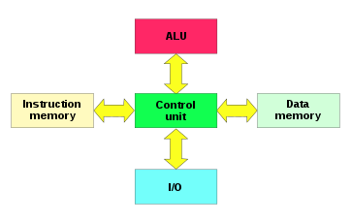
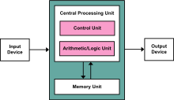
Theoretical to the Abstract
Turing Machine →
von Neumann Architecture
Harvard Architecture
Consider writing a Java program for these machines

Slide 16
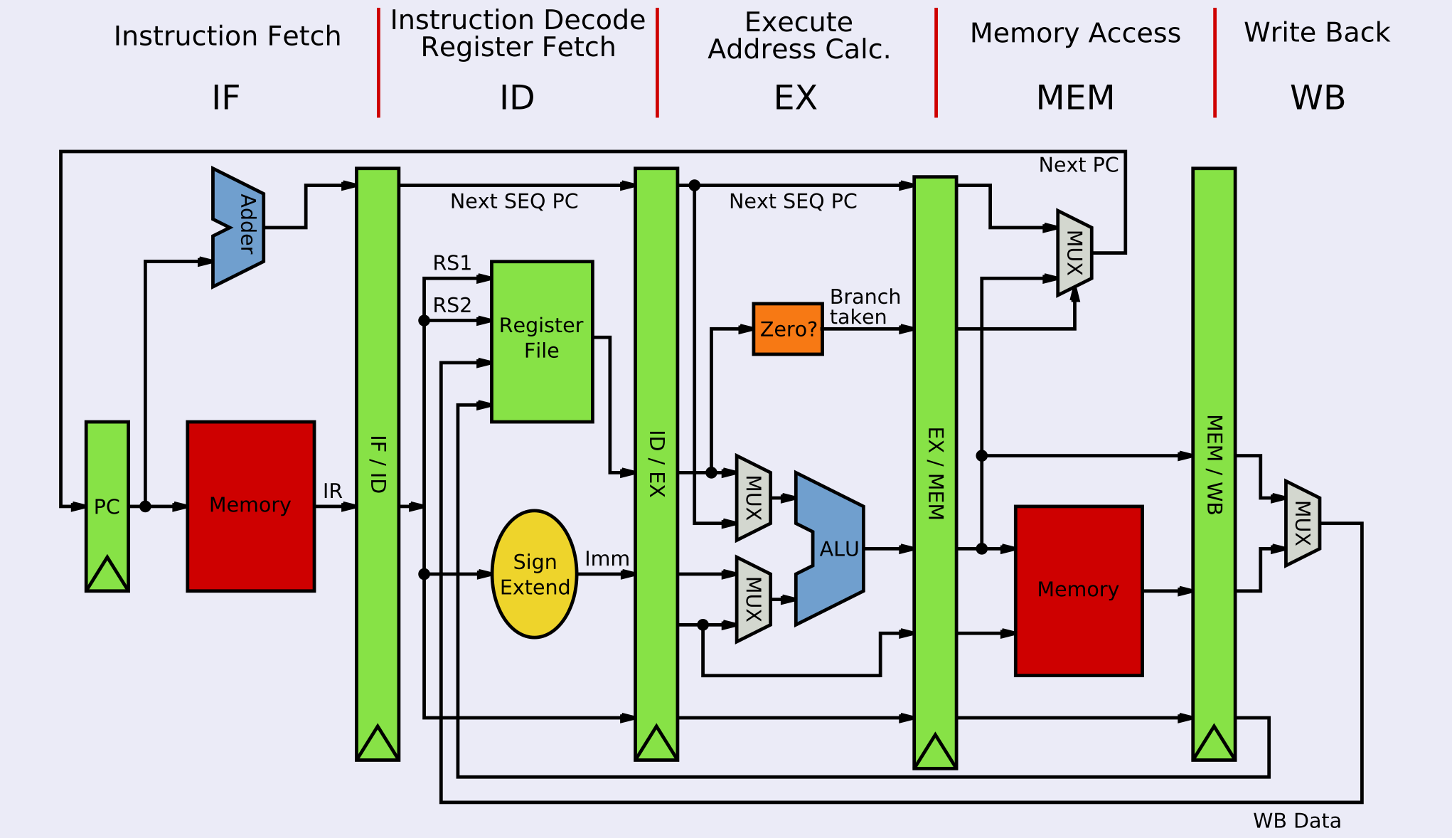
Physical Architecture: MIPS Microarchitecture

Slide 17
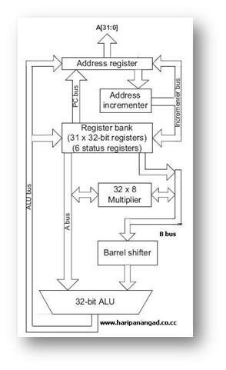
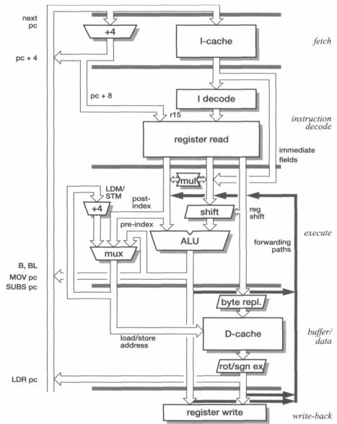
Physical Architecture: ARM (7&9) Microarchitectures

Slide 18
Physical Architectures: Examples

Slide 20
Breaking things down or building them up.
Size | Network Layer | Architecture
N | data | data
MTU | segment
64-1522 octets | frame
16 bytes |  | paragraph
32 (or 64) bits | word | word
8 bits | octet | byte
4 bits | nibble | nibble
1 bit | symbol | bit

