Slide 1
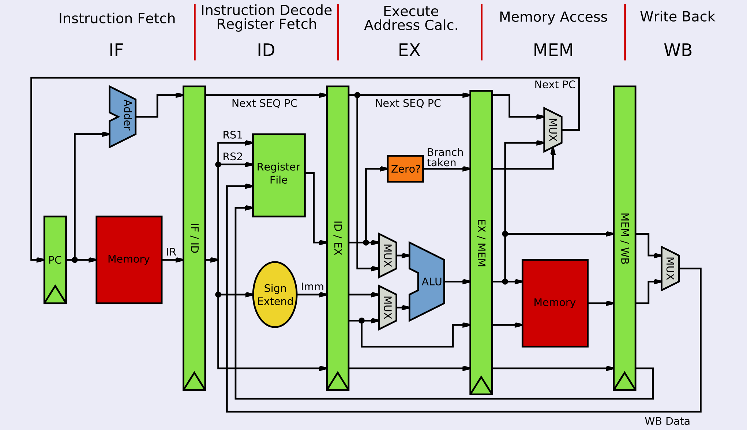
Physical Architecture: MIPS Microarchitecture

Slide 2
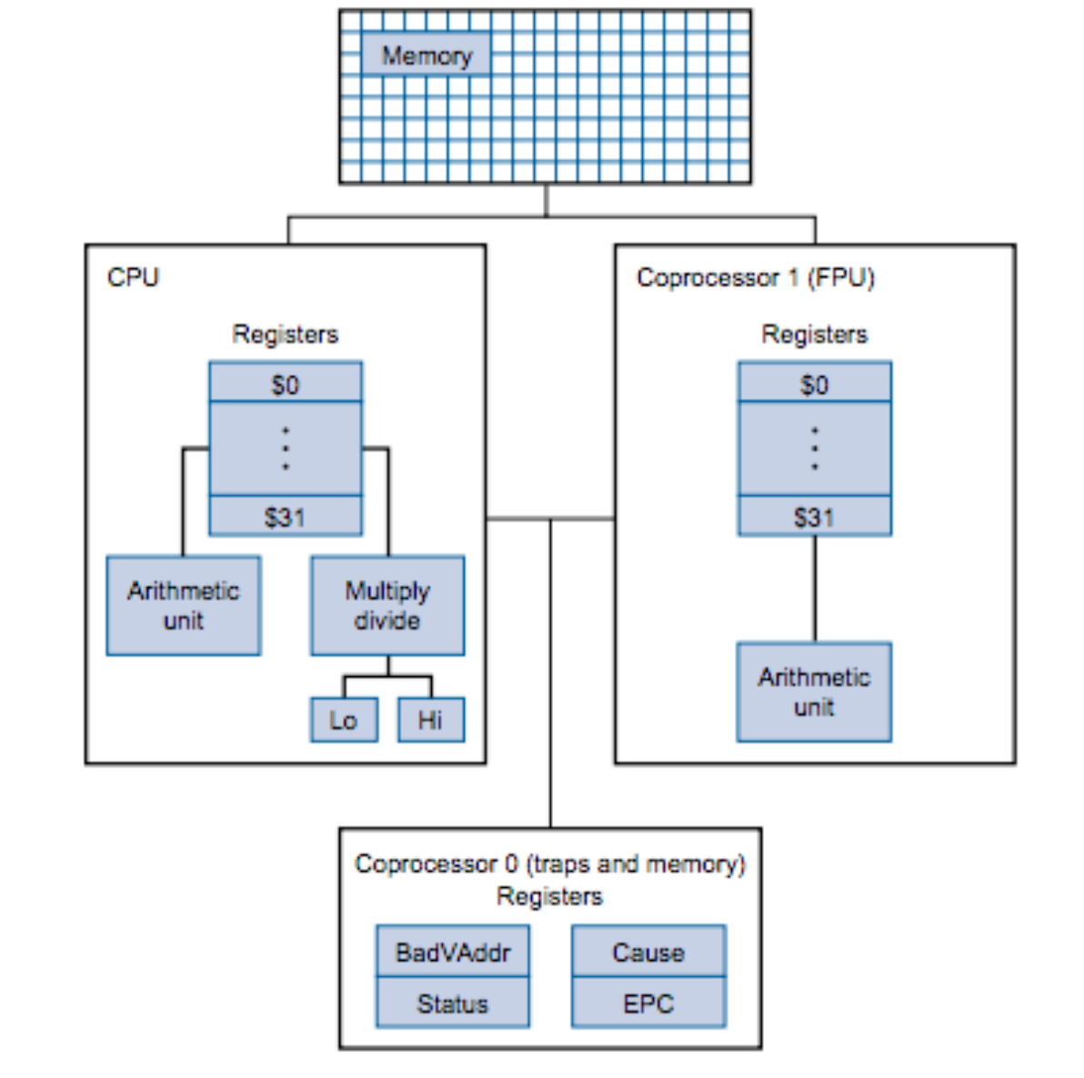
MIPS Architecture Overview
System
PC: Program Counter
IR: Instruction Register
BadVAddr: memory address where exception occurred
Status: Interrupt mask, enable bits and status when exception occurred
Cause: Type of exception
EPC: Address of instruction that caused the exception
Reserved (Don't use!)
$at: reserved for the Assembler
$k1, $k2: reserved for the Kernel
$gp: global pointer defined by the compiler
Special (Access via specific instructions)
PC: program counter
hi, lo: used double word results
(hi, lo) = val1 * val2
(hi, lo) = val1 % val2
General Purpose
32 32-bit integer registers: $0..$31
32 32-bit floating point registers: $f0..$f31

