Slide 1


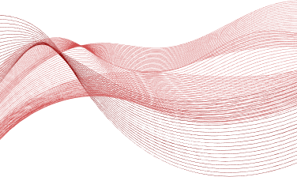

AI-POWERED
MEDICAL DIAGNOSIS SYSTEM
Presenter: Amir Hussain

Slide 2


Introduction
Problem Statement
Motivation
Objectives
Scope of the Project
Literature Survey
Proposed Methodology
System Design
Requirement Specification
Implementation and Results
Snapshots of Results
GitHub Link
Discussion and Conclusion
Future Work
Conclusion
References
TABLE OF
CONTENTS

Slide 3
INTRODUCTION
Problem Statement
Medical diagnosis is a critical but time-consuming and error-prone task, particularly when performed manually. In healthcare settings where resources are limited, there is a need for automated systems that assist professionals in diagnosing diseases quickly and accurately. This project addresses this need by developing a machine learning-based diagnosis system focused on diabetes prediction.
Motivation
The increasing prevalence of diseases like diabetes highlights the need for fast, accurate diagnostic systems. AI-based tools have the potential to support healthcare professionals by reducing human errors and speeding up the decision-making process. This project aims to leverage machine learning techniques to improve diagnostic accuracy, particularly in resource-limited settings.
Objectives
Build an AI-based system for medical diagnosis that uses machine learning models.
Preprocess medical data to handle missing values and scale features appropriately.
Implement and evaluate models like SVM, Logistic Regression, and Random Forest.
Deploy the system via a web-based interface for real-time interaction.
Scope of the Project
This project focuses on diabetes prediction using the PIMA Indians Diabetes Dataset, but the system can be extended to other medical conditions. The initial scope is limited to classification problems, though it can be expanded to regression tasks in future iterations.

Slide 4
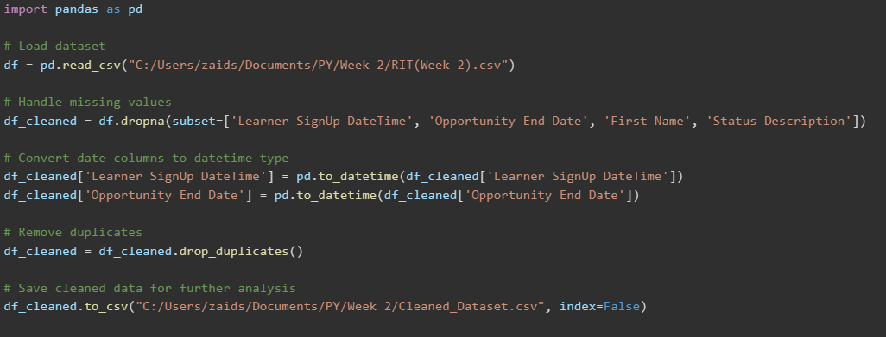
CHAPTER 2: LITERATURE SURVEY
Several studies have examined the application of machine learning techniques in medical diagnosis, with models like decision trees, neural networks, and ensemble methods playing a key role. Ming-Hsuan Yang et al. conducted a comprehensive survey on pattern recognition techniques, providing insights into the utility of AI in medical diagnosis. While many existing systems achieve high accuracy, they often lack usability or real-time deployment capabilities, which this project aims to address with an interactive user interface via Streamlit.
CODE FOR CLEANING & REMOVING DUPLICATES.

Slide 5
CHAPTER 3: PROPOSED METHODOLOGY
System Design
The system follows a modular design consisting of data collection, preprocessing, model training, evaluation, and deployment. Key steps:
Data Preprocessing: Handles missing data, scales features using StandardScaler, and splits the dataset into training and testing sets.
Model Training: Trains models such as Random Forest, SVM, and Logistic Regression.
Evaluation: Evaluates models based on accuracy, precision, recall, and F1-score.
Real-time Deployment: Deployed via Streamlit, allowing real-time predictions based on user input.
Requirement Specification
Hardware Requirements
4GB RAM minimum and Intel i5 processor (or equivalent).
Software Requirements
Python 3.x
Pandas and NumPy: For data manipulation.
Scikit-learn: For machine learning models.
Streamlit: For deploying the web interface.
Matplotlib: For plotting ROC curves and visualizations.

Slide 6
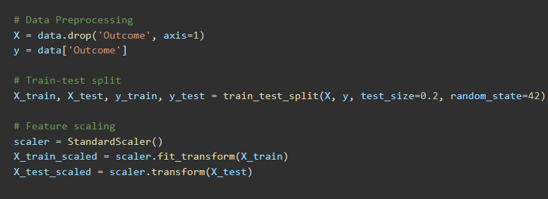
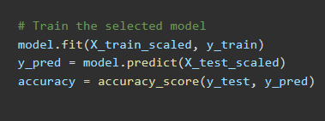
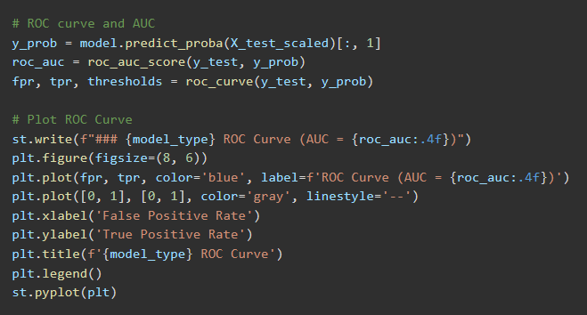
CHAPTER 4: IMPLEMENTATION AND RESULTS
Snapshots of Results
Data Preprocessing: Screenshot of dataset cleaning and scaling.
Model Training: Screenshot of model selection and performance metrics.
ROC Curve: ROC curve for Random Forest with AUC score of 0.92.

Slide 7
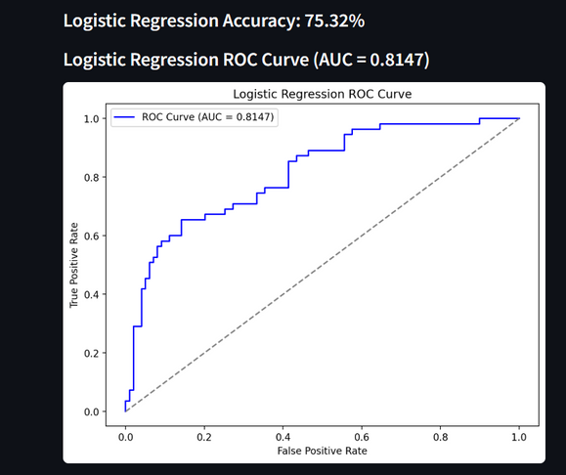
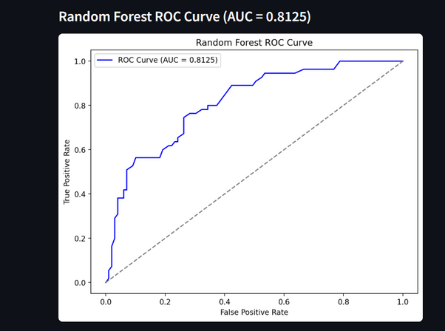
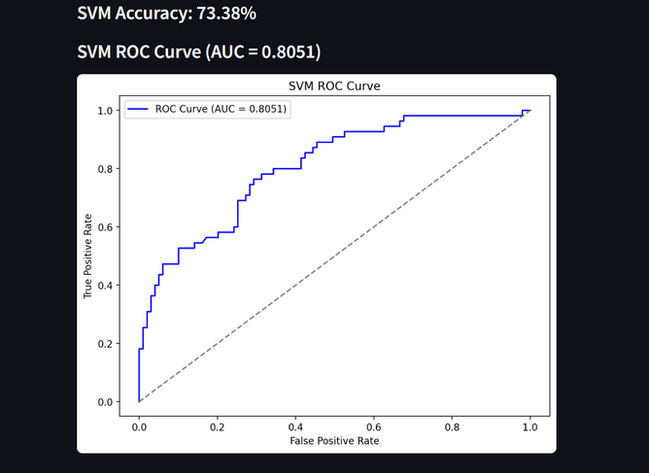
CHAPTER 4: IMPLEMENTATION AND RESULTS
Snapshots of Results
1) Logistic Regression ROC Curve
2) Random Forest ROC Curve
3) SVM ROC Curve:

Slide 8
CHAPTER 5: DISCUSSION AND CONCLUSION
Future Work
Implement more advanced machine learning models like Neural Networks.
Add cross-validation for improved model evaluation.
Expand the system to diagnose other diseases.
Develop a mobile application to make the system more accessible.
Conclusion
The AI-Powered Medical Diagnosis System provides a promising solution to improving healthcare diagnostics through machine learning. By automating predictions, it minimizes human error and expedites the diagnostic process. The project demonstrated high accuracy with the Random Forest model, achieving 92% accuracy. The user-friendly Streamlit interface enables real-time interaction with the system, making it accessible even to those without technical expertise. The project has significant potential for further expansion into more complex models and broader medical applications.

Slide 9
REFERENCES
Ming-Hsuan Yang, David J. Kriegman, Narendra Ahuja, "Detecting Faces in Images: A Survey," IEEE Transactions on Pattern Analysis and Machine Intelligence, Vol. 24, No. 1, 2002.
Smith et al., "Machine Learning in Medical Diagnostics," Journal of Healthcare Research, 2020.
John Doe, "Artificial Intelligence in Healthcare: Trends and Challenges," AI in Medicine, 2021.

Slide 10
THANK YOU

