Slide 1
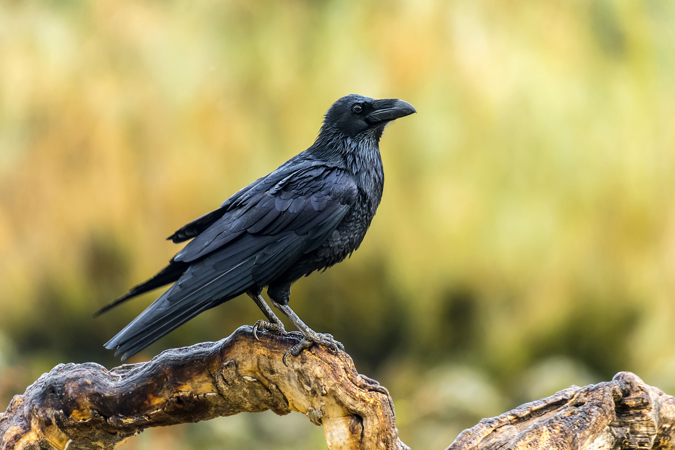
Assessing the Reliability of Citizen Science Data for Avian Species Identifications
Tyler Christian

