Slide 1

Siddaganga Institute of Technology, Tumkur-572103 (An autonomous institution affiliated to VTU, Belagavi, Approved by AICTE, New Delhi)
Department of Electronics and Telecommunication Engineering
MACHINE LEARNING ABL
“Loan Default Prediction Using Logistic Regression”
Presented by
JAYADIXITHA S P 1SI23ET019
MOHAMMED FURQAN 1SI23ET030
NAGAPRIYA K G 1SI23ET031
Submitted to
Dr. R N Sathish sir
Assistant Professor
Department of ETE
SIT, Tumkur

Slide 2
Problem Statement
• Banks provide auto loans to customers.
• Some customers default (Bad Loans).
• We must predict loan default risk using Age.
• Binary Classification Problem:
0 → Good Loan
1 → Bad Loan

Slide 3
Dataset Overview
• 15 age groups used.
• Features: Age_Mid
• Target: Bad Loan (0/1)
• Total records after expansion: 60,816
• Highly imbalanced dataset

Slide 4
Why Logistic Regression?
• Used for binary classification problems.
• Predicts probability between 0 and 1.
• Uses Sigmoid function.
• Easy to interpret using Odds Ratio.

Slide 5
Logistic Regression Formula
P(Y=1) = 1 / (1 + e^-(β0 + β1X))
• β0 → Intercept
• β1 → Coefficient (Age impact)
• Output → Probability of Bad Loan

Slide 6
Model Training Process
1. Dataset Expansion
2. Train-Test Split (70%-30%)
3. Feature Scaling
4. Logistic Regression (class_weight='balanced')
5. Model Evaluation

Slide 7
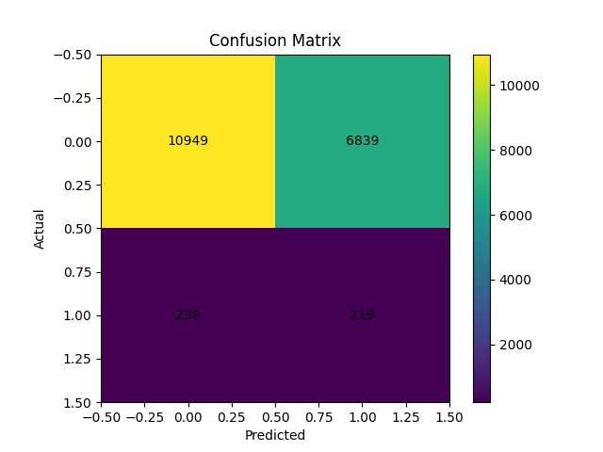
Confusion Matrix Results
True Negatives: 10949
False Positives: 6839
False Negatives: 238
True Positives: 219

Slide 8
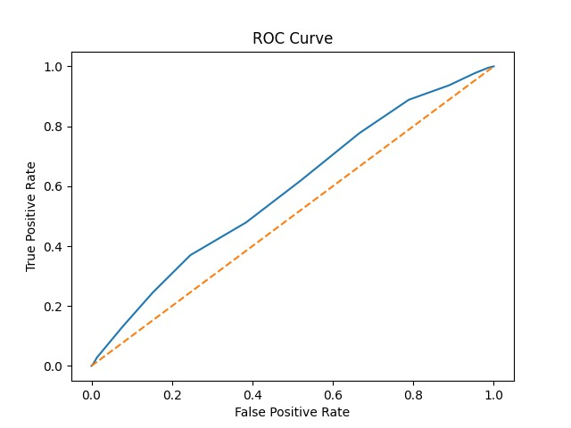
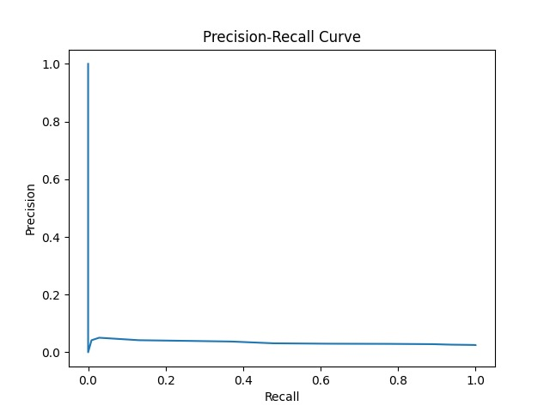
ROC & Precision-Recall Analysis
• ROC AUC = 0.58 (Moderate performance)
• Model slightly better than random guessing.
• Precision is low due to class imbalance.

Slide 9
Model Performance
Accuracy: 61%
Precision (Bad Loan): 3%
Recall (Bad Loan): 48%
F1 Score: 5.8%
AUC Score: 0.58

Slide 10
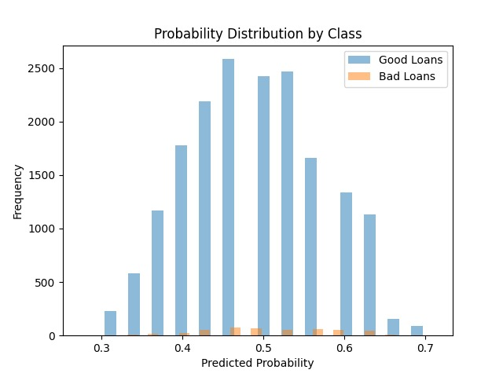
Probability Distribution by Class
• Shows distribution of predicted probabilities for Good Loans and Bad Loans.
• Good loans mostly have lower probabilities, but there is overlap between classes.

Slide 11
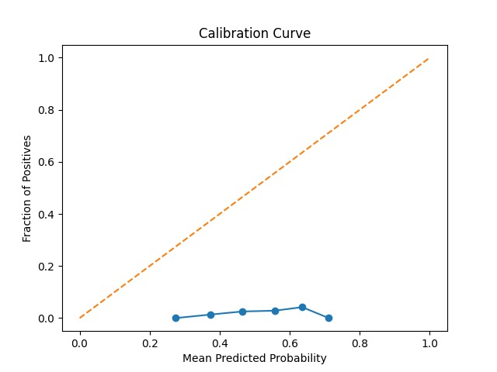
Calibration Curve
• Model probabilities are not perfectly calibrated.
• Predicted probabilities differ from actual risk.
• Indicates need for calibration improvement.

Slide 12
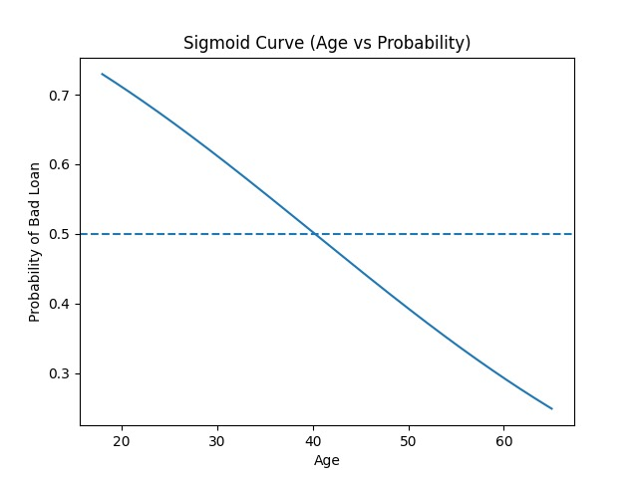
Sigmoid Curve (Age vs Risk)
• Age coefficient is negative.
• Odds Ratio = 0.71
• Increasing Age decreases bad loan risk.
• Younger customers have higher default risk.

Slide 13
Model Interpretation
Intercept (β₀ = −0.0546) represents baseline log-odds of default.
Coefficient (β₁ = −0.3395) indicates the effect of age on default probability.
Odds ratio (0.712) shows that default risk decreases as age increases.
Conclusion: Age is negatively related to loan default risk.

Slide 14
Limitations
Requires large dataset for accurate prediction.
Assumes linear relationship between predictors and logit.
Sensitive to outliers in data.
Mainly applicable to binary classification problems.
Multicollinearity between independent variables affects the model.
Cannot capture complex nonlinear relationships.

Slide 15
Future Improvements
Integration with advanced machine learning techniques.
Ability to handle large-scale and big data applications.
Use of regularization techniques like L1 and L2.
Support for multiclass classification.
Use in real-time prediction systems such as fraud detection and risk analysis.

Slide 16
Conclusion
• Logistic Regression successfully modeled loan risk.
• Age impacts loan default probability.
• Model gives interpretable business insights.
• Can help banks reduce financial risk.

