Slide 1
Hack the Future:
A Gen AI Sprint Powered by Data

Slide 2

Guidelines
The template should consist of the following and it is mandated to be used by your team for submitting your innovative ideas/solutions. Follow file naming format: Team name_Idea Name.pptx

Slide 3



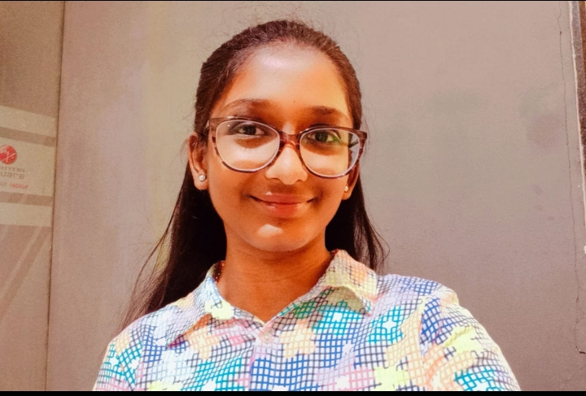
Hack the Future: A Gen AI Sprint Powered by Data
Data and AI Week
Team details
TEAM NAME: SoloSynapse
JAYADIXITHA S P

Slide 4
Entry Submission Summary
Idea Title (Provide a concise and impactful title for your idea.) | CareConnectAI
Team Name | SoloSynapse
Problem Statement | As the global population ages, ensuring the well-being of elderly individuals living independently presents a major challenge. Our system provides proactive monitoring and intelligent assistance through a collaborative multi-agent framework designed to handle health, safety, and emotional well-being.
Proposed Solution | CareConnectAI is like a thoughtful companion for elderly individuals. It keeps an eye on their health, watches out for emergencies like falls or long periods of inactivity, and sends gentle reminders for things like medications or hydration. If something seems wrong, it quickly alerts caregivers. Plus, with its conversational ability, it offers emotional support too — all thanks to its smart use of AI and a shared memory system that helps everything work together seamlessly.

Slide 5
Problem statement you are trying to address
Empowering Elderly Care with a Smart AI Companion System
Many older adults live alone and face daily challenges — from health risks and safety concerns to feelings of
isolation. Our solution is a caring, multi-agent AI system designed to support them in meaningful ways:
It keeps track of vital signs and detects emergencies like falls or long periods of inactivity.
Sends gentle reminders for medications, hydration, and upcoming appointments.
Offers simple, friendly conversations to reduce loneliness and provide emotional comfort.
Instantly alerts caregivers when something seems wrong.
Behind the scenes, all agents work together using a shared memory (SQLite) and intelligent reasoning
powered by Ollama-based LLMs — ensuring that the support feels smart, safe, and deeply human.

Slide 6
Proposed Solution Overview
Brief approach description or methodology used to tackle the problem
CareConnectAI: A Thoughtful Network of Supportive Agents
CareConnectAI brings together five smart and caring agents that work hand in hand to support elderly individuals in their daily lives:
It keeps track of vital signs using sensors and wearables.
Quickly detects falls or extended periods of inactivity to prevent emergencies.
Sends friendly, timely reminders — whether it’s for medication, hydration, or appointments.
Instantly alerts caregivers when something’s wrong, ensuring peace of mind.
And when things are calm, it can even strike up a bit of small talk to keep users company.
All these agents share one memory (SQLite) and communicate through on-premise AI models powered by Ollama — making the entire system feel intelligent, responsive, and genuinely helpful.

Slide 7
Technologies Used
List the key technologies, frameworks, and tools you utilized in your solution
Ollama (LLMs) – for reasoning, natural conversation
Python + FastAPI – agent logic & coordination
SQLite – shared structured memory
Sensor APIs – simulated or real wearable input
TTS APIs – for voice-based interaction & reminders

Slide 8
Agents' interaction design
Agent Name : | Role & Function :
Health Monitor Agent | Tracks heart rate, BP, vitals
Safety Agent | Detects falls or inactivity
Reminder Agent | Sends routine and medication alerts
Caregiver Notification | Sends alerts to family/caregivers
Social Chat Agent (opt.) | Engages elderly to reduce loneliness

Slide 9
Code structure
/eldercare_ai
├── agents/
│ ├── health_monitor.py
│ ├── safety_alert.py
│ ├── reminder.py
│ ├── caregiver_notify.py
│ └── social_chat.py
├── database/
│ └── agent_logs.db
├── services/
│ └── api.py
├── main.py
└── config.yaml

Slide 10
Conclusion
Summarize the impact and effectiveness of your solution. Reiterate how it solves the problem statement.
CareConnectAI enables safer, smarter, and more compassionate elderly care using multi-agent AI. It blends real-time sensor input with intelligent agent communication to promote independence, safety, and engagement for elderly users.

Slide 11
References/Other details
Ollama Library: https://ollama.com/library
SQLite Docs
Sensor APIs (Simulated or Open Health APIs)
Hackathon Guidelines

Slide 12
Thank You
🙌 Thank you for your attention — I look forward to showcase CareConnectAI!

