Slide 1
AIML Driven Agriculture Monitoring System
Hackathon Project: Smart Crop Health Monitoring and Automated Irrigation System

Slide 2
TEAM NAME :HackHers
TEAM MEMBRES NAME:
POORVI PRAHALAD PUROHIT
MANYA M
MEGANA T B
JAYADIXITHA S P

Slide 3
Problem Statement
Traditional crop health monitoring is slow and inefficient, leading to delayed actions and reduced yields. Our AI-driven system integrates IR sensors and machine learning to detect early signs of crop stress or disease.
IR sensors analyze light absorption to assess plant health.
Machine learning models (Logistic Regression & Random Forest) classify crops as healthy, stressed, or diseased.
Bluetooth module transmits data to a mobile app/dashboard for real-time alerts.
Automated irrigation system with a DC motor spray activates when stress is detected, ensuring proper hydration.

Slide 4
Data Source & Hardware Components
Soil Moisture Data: Extracted from WRIS dataset
- Hardware to be used: Arduino Uno, IR Sensors, Bluetooth Module, DC Motor,Motor driver
- Software: Python (pandas for data analysis)
Platform :Juptenotebook

Slide 5
🔍 Project Module Overview
Language & Tools: Python, Requests, Pandas
API Used: WeatherAPI
Total Cities Covered: 200+ Indian Cities
Output: CSV file with weather & estimated soil moisture
Use Case: Smart Irrigation, Crop Health Monitoring

Slide 6
Data Generation
Simulated weather and sensor data.
Soil Moisture: 10–60%, IR sensor: 0/1 (Healthy/Unhealthy).
Label: 1 if soil < 30 or crop unhealthy; else 0.

Slide 7
Machine Learning Model
Model: Random Forest Classifier.
Training on 300 simulated records.
12 input features including weather and sensors.
Output: 0 = No Irrigation, 1 = Irrigation Needed.

Slide 8
Arduino Integration
IR sensors detect light intensity (crop health).
Bluetooth receives city + prediction from app.
Motor runs on command (e.g., ON 10).
Auto-stop on obstacle or time.

Slide 9
🧠 Python Code Logic
1. Import required libraries (requests, pandas)
2. Define 100+ cities to fetch data for
3. Use WeatherAPI to get real-time weather data
4. Extract temperature, humidity, wind speed, etc.
5. Estimate soil moisture using a simple formula
6. Store data & export to CSV

Slide 10
💧 Soil Moisture Estimation Formula
Formula: (humidity * 0.8) - (temperature * 0.2) - (wind_speed * 0.1)
• Humidity: Major contributor (increases soil moisture)
• Temperature: Promotes evaporation (decreases moisture)
• Wind Speed: Affects evaporation (decreases moisture)
• Output capped between 0 and 100%
• Used for approximation in smart irrigation systems

Slide 11
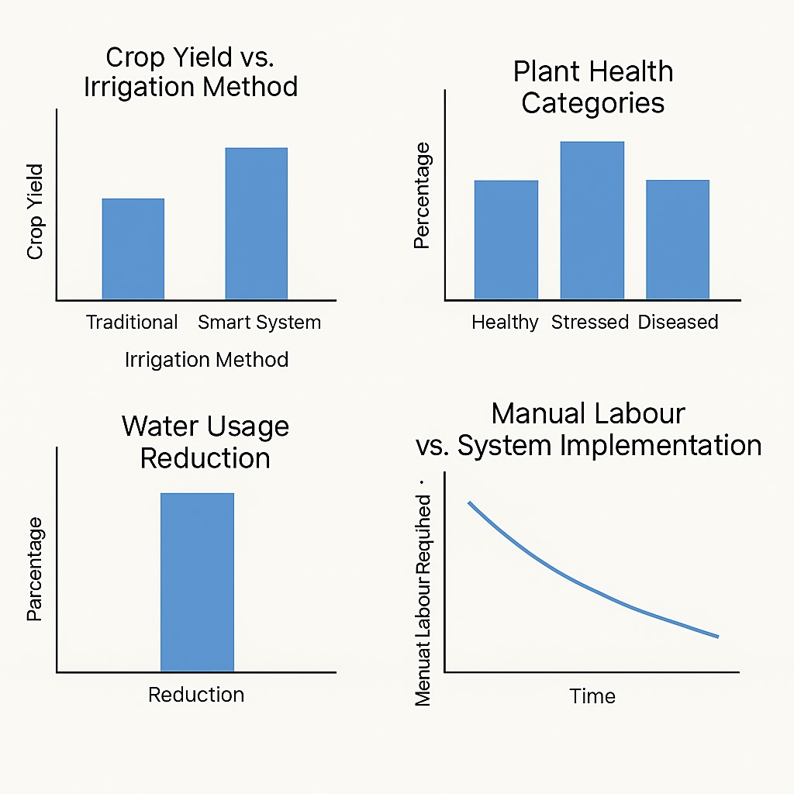
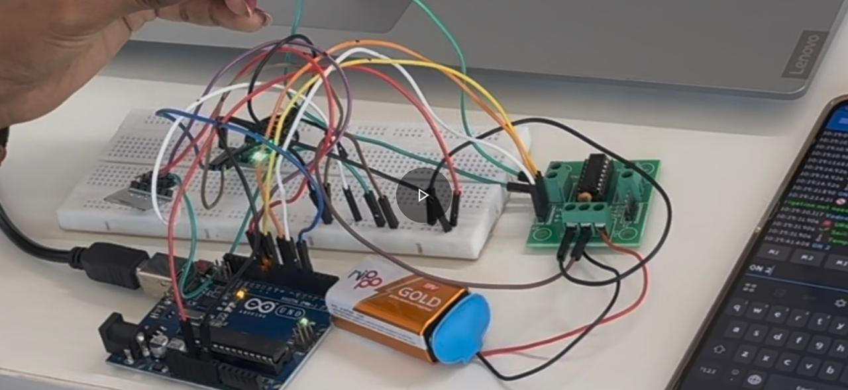
STATISTICS PROTOTYPE

Slide 12
✅ Output & Applications
• OutputExample:
City: Mumbai | Prediction: Irrigation Needed
Comment: Soil dry | Advice: Start irrigation
(Use data table in app)
• Applications:
- AI-based irrigation control
- Soil health estimation without sensors
- Weather-based crop monitoring
- Real-time farm decision support

Slide 13
IMPACT:
💧 Saves 30-40% Water
🌱 Improves Crop Health
⚡ Affordable, Scalable & Fully Automated

Slide 14
CONCLUSION
AI & IoT Integration – Utilizes AI, IoT, and sensor-based technology to modernize farming.
Real-time Monitoring – Enables real-time crop health detection for proactive decision-making.
Automated Irrigation – Reduces manual intervention through smart irrigation control.
Improved Crop Yield – Enhances productivity and ensures better crop health.
Cost-Effective & Scalable – Designed for affordability and adaptability across different farm sizes.
Sustainable Agriculture – Promotes eco-friendly and efficient farming practices.

