Slide 1



Introduction
A D PATEL INSTITUTE OF TECHNOLOGY
DEPARTMENT OF INFORMATION TECHNOLOGY
PROGRAMMING WITH JAVA(202044502)
Project Title: Aarish CRM System
Objective: A Customer Relationship Management system to manage customer records and sales.
Technology Stack: Java, Swing for UI, File Handling for Data Persistence.
GitHub: https://github.com/12302080601001/CRMSystem
Name: Aarish Bhanwadia
Enrolment No.: 12302080601001
Subject Sir: Nayan Mali

Slide 2
Project Overview
System Architecture: Based on MVC (Model-View-Controller) pattern.
Features: Add Customers, Record Sales, Generate Reports, Save and Load Data.
Modules: Customer Management, Sales Recording, Report Generation, Data Persistence.

Slide 3
Implementation Details
Inheritance and Polymorphism: Corporate and Individual customers inherit from Customer class.
Inner Classe: ReportGenerator inside CRMManager
Exception Handling: Custom CRMException class handles errors.
Threading: Synchronized methods ensure thread safety.
Collection API: HashMap used for efficient customer data storage.
File Handling: BufferedReader and BufferedWriter used for data persistence.

Slide 4
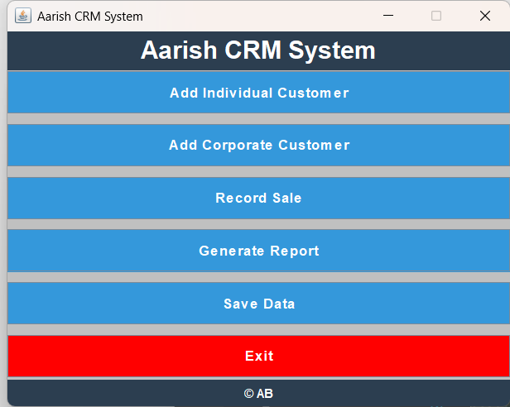
Project Demonstration

Slide 5
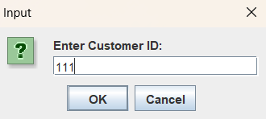
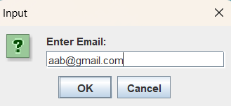
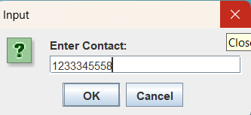
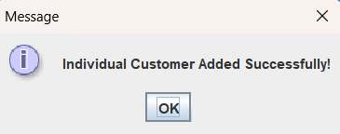
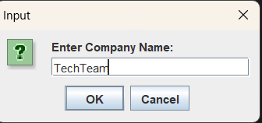
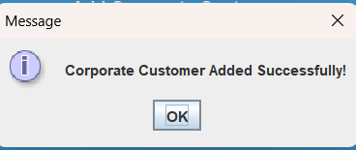
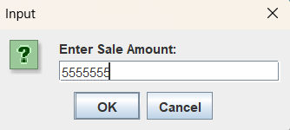
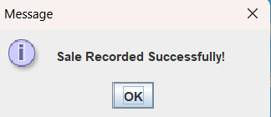
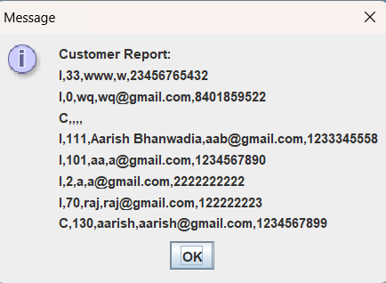

Slide 6
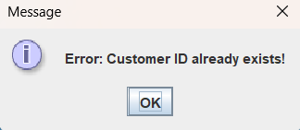
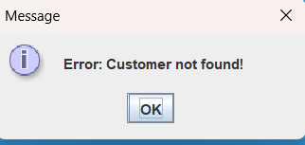
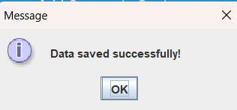
Challenges and Solutions
Development Challenges: Managing data consistency, Handling exceptions, Ensuring UI responsiveness.
Solutions Implemented: Used exception handling, synchronized methods, and efficient file handling.

Slide 7
Conclusion and Future Work
Conclusion: Successfully developed a CRM system with core functionalities.
Future Enhancements: Database integration, Advanced reporting, Cloud storage support.

