Slide 1



Enhancing Factor Models with Machine Learning-Based Fundamental Prediction:
An Approach to Mitigate Information Lag
DDA3600: Factor Investing
Senze Jia 123090223, Changshuo Li 123090256, Nuo Chen 123090029
School of Data Science
Fall 2025
1/22

Slide 2


Table of Contents
1 Introduction and Background
▶ Introduction and Background
▶ Data Source and Data Reprocessing
▶ Base Hypothesis Testing
▶ Two-stage Model
▶ Mechanism Test: Interpreting the Model’s Incremental Alpha
▶ Conclusion
▶ Q&A
2

Slide 3
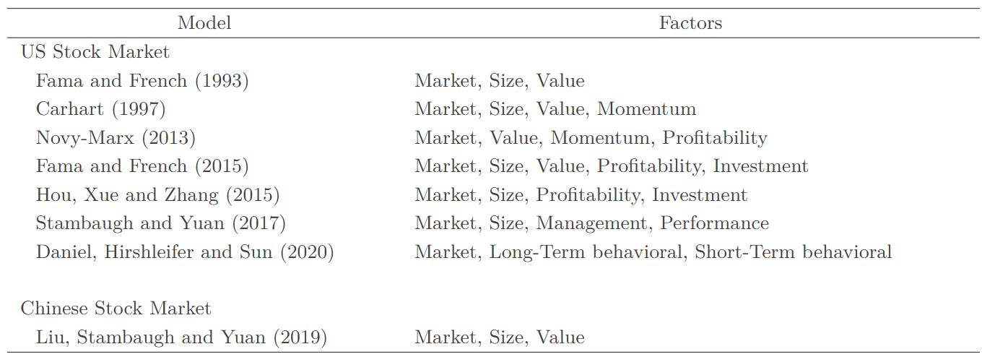
Why Fundamentals matter?
1 Introduction and Background
The relationship between firm fundamentals and cross-sectional stock returns has been a central topic in empirical asset pricing for decades.
® 2024 – 2025 Group 6 | Course Project
3
Notes:
The relationship between firm fundamentals and cross-sectional stock returns has been a central focus of empirical asset pricing for decades. Multi-factor models such as the Fama–French three- and five-factor frameworks highlight that fundamental characteristics—such as size, book-to-market, profitability, and investment—systematically explain expected returns. These models establish a link between accounting information and risk premia, suggesting that firm fundamentals contain important insights into the drivers of cross-sectional variation in returns.

Slide 4
Limitations
1 Introduction and Background
Traditional linear models rely on lagged accounting data
Reporting delays mean fundamentals at time t may be outdated at t+1
Stale information weakens factor exposures and predictive performance
Problem is worse in fast-changing environments
This limitation motivates our primary research question:
Do contemporaneous fundamentals provide stronger explanatory power for next-period returns than lagged fundamentals?
® 2024 – 2025 Group 6 | Course Project
4
Notes:
Despite these advances, traditional linear factor models rely heavily on lagged accounting information, which may not reflect a firm’s current financial condition due to reporting delays and the gradual diffusion of information into prices. This limitation becomes particularly salient in high-frequency or rapidly changing environments, where stale fundamentals may distort factor exposures or weaken predictive performance.
This limitation motivates our primary research question:
Do contemporaneous fundamentals provide stronger explanatory power for next-period returns than lagged fundamentals?

Slide 5
Objective 1: Linear Comparison
1 Introduction and Background
Compare contemporaneous vs. lagged fundamentals using linear regression
Evaluate differences in:
Goodness-of-fit (R²)
Significance of factor coefficients
H1: Contemporaneous fundamental factors exhibit significantly stronger linear correlation with contemporaneous excess returns than lagged fundamental factors.
® 2024 – 2025 Group 6 | Course Project
5
Notes:
To address this core research question, this study is structured around two sequential primary objectives.
Our first objective is empirical validation using linear regression. We hypothese H1... ... All subsequent research is based on the premise that H1 is correct.
Hence, we expect contemporaneous fundamentals to deliver higher R² and more significant coefficients.

Slide 6
Objective 2: Two-Stage Non-Linear Model
1 Introduction and Background
Construct a baseline model: predict next-period returns using current fundamentals based on MLP
Develop a two-stage MLP-based prediction framework
Stage 1: Forecast the next-period fundamental vector
Stage 2: Use forecasted fundamentals + controls to predict excess returns (same architecture as baseline)
Goal: create cleaner, forward-looking signals
® 2024 – 2025 Group 6 | Course Project
6
Notes:
“The second part of our study introduces a two-stage machine learning model.
First we forecast the next-period fundamentals, then we use these forecasts to predict returns.
This design allows us to generate more timely and informative signals. For the benchmark of comparison, we also need to use MLP to predict the next-period returns by only using current fundamentals.”

Slide 7
Why MLP?
1 Introduction and Background
1. Captures Nonlinear Relationships
Fundamentals and returns exhibit complex nonlinear interactions
MLP can model cross-factor interactions that linear models miss
Essential for handling high-dimensional characteristic sets
2. Well Suited for Two-Stage Design
Stage I: Predicting fundamentals is a stable, structured regression task
Stage II: Combining predicted fundamentals + control variables requires flexible nonlinear mapping
MLP naturally supports both tasks with the same architecture
3. Ensures Fair Comparison
Stage II uses exactly the same MLP architecture as the baseline
Any performance difference comes from better input features, not model complexity
4. Appropriate for Dataset Size
Monthly data from 2014–2023 → moderate sample size
More complex models (LSTM, Transformer) would overfit
MLP achieves the right balance between flexibility and stability
® 2024 – 2025 Group 6 | Course Project
7
Notes:
“We adopt MLP as the core architecture because it effectively captures the nonlinear interactions among firm fundamentals that linear models cannot handle.
The two-stage framework also fits naturally with MLP: predicting fundamentals is a structured regression task, while predicting returns requires flexible nonlinear combination of signals.
Moreover, Stage II uses the exact same architecture as the baseline, ensuring that any improvement comes purely from the higher-quality inputs produced by Stage I.
Given our dataset size and monthly frequency, MLP provides the optimal balance between expressiveness and out-of-sample stability.”

Slide 8
Table of Contents
2 Data Source and Data Reprocessing
▶ Introduction and Background
▶ Data Source and Data Reprocessing
▶ Base Hypothesis Testing
▶ Two-stage Model
▶ Mechanism Test: Interpreting the Model’s Incremental Alpha
▶ Conclusion
▶ Q&A
8

Slide 9
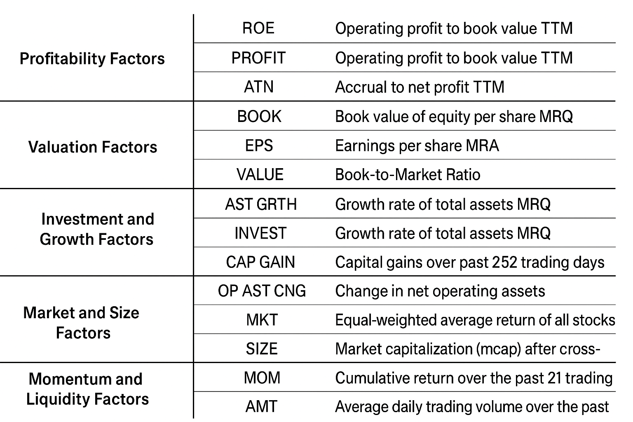
Data Source and Processing
2 Data Source and Data Reprocessing
The research utilizes a comprehensive dataset spanning from January 2014 to December 2023.
Selected characteristics are widely validated in empirical asset pricing
Cover value, profitability, investment, and accrual dimensions
Ensure the model inputs are economically meaningful and robust
® 2024 – 2025 Group 6 | Course Project
9
Notes:
The research utilizes a comprehensive dataset spanning from January 2014 to December 2023.
All variables used in the analysis are listed in the table on the left. These selected factors are widely validated in empirical asset pricing research and span key economic dimensions such as value, profitability, investment, and accruals. By relying on characteristics with well-established explanatory power, the dataset ensures that all model inputs are economically meaningful, empirically robust, and suitable for both linear and nonlinear prediction frameworks.

Slide 10
Data Source and Processing
2 Data Source and Data Reprocessing
To ensure reliable statistical analysis and stable model training, all fundamental and market-based factors undergo a series of preprocessing steps:
1. Handling Missing Values
At each time t, any missing factor value for a stock is replaced with the cross-sectional median of that factor at time t, preventing gaps that could bias estimation.
2. Cross-Sectional Standardization
Each factor is standardized within each period, ensuring comparability across time and preventing scale differences from disproportionately influencing model coefficients or neural network learning.
3.Removal of Invalid Numerical Values
Any remaining infinite or negative infinite values—typically arising from factor construction issues such as division by zero—are removed to maintain the integrity of the input data.
Together, these steps produce a clean, consistent factor panel suitable for both linear OLS regressions and nonlinear MLP-based prediction models.
® 2024 – 2025 Group 6 | Course Project
10
Notes:
To ensure our models are trained on clean and reliable data, we apply three key preprocessing steps.
First, we handle missing values by replacing them with the cross-sectional median at each time period. This prevents gaps in the data from biasing the analysis.
Second, all factors are cross-sectionally standardized each month. This puts every variable on a comparable scale and avoids situations where large-scale factors dominate model learning.
Finally, we remove any invalid or infinite values that may arise from calculations—for example, division-by-zero in Book-to-Market ratios.
Together, these steps produce a stable and consistent factor dataset that is suitable for both the linear regression tests and the neural-network-based prediction models.

Slide 11
Training Setup
2 Data Source and Data Reprocessing
Data split (2:6:2):
Pre-sample (2014–2015): tuning
In-sample (2016–2021): training
Post-sample (2022–2023): OOS evaluation
Key hyperparameters:
• Optimizer: Adam optimizer with a fixed learning rate of 0.001.
• Batch Size: 32 for stochastic gradient descent.
• Activation Function: Rectified Linear Unit (ReLU) in all hidden layers.
• Regularization: L2 weight regularization with an alpha parameter of 0.0001 is applied to prevent overfitting.
• Early Stopping: Training is monitored on a 10% validation split created from the in-sample data;
training halts if validation loss does not improve for 10 consecutive epochs.
® 2024 – 2025 Group 6 | Course Project
11
Notes:
In this slide, I summarize the training setup used for all models in the study.
To ensure a fair and robust evaluation, the dataset is divided using a 2:6:2 time split.
The pre-sample period, from 2014 to 2015, is used only for model tuning and initial validation.
The in-sample period, from 2016 to 2021, is the main training window for both the baseline model and the two-stage model.
Finally, the post-sample period, from 2022 to 2023, is reserved strictly for out-of-sample evaluation, ensuring that the testing results reflect true predictive performance rather than overfitting.
All MLP models in the study share a consistent set of key hyperparameters.
We train them using the Adam optimizer with a fixed learning rate of 0.001, and a batch size of 32.
All hidden layers use ReLU activation, and we apply L2 regularization to reduce overfitting.
In addition, we incorporate early stopping, where training halts if the validation loss does not improve for 10 epochs.
This standardized setup ensures that any performance differences between the baseline model and the two-stage model come from the model structure itself—rather than differences in training configuration.

Slide 12
Evaluation Metrics
2 Data Source and Data Reprocessing
IC Mean — accuracy in ranking
IC Std — stability of the predictive signal
ICIR (IC Mean / Std) — risk-adjusted performance
Metrics evaluated in pre-sample, in-sample, and post-sample
® 2024 – 2025 Group 6 | Course Project
12
Notes:
“We evaluate model performance using cross-sectional ICs, which measure whether the model correctly ranks stocks each month.
IC mean tells us directional accuracy, while IC standard deviation measures consistency.
Their ratio, ICIR, is the main performance indicator in quant research.”

Slide 13
Table of Contents
3 Base Hypothesis Testing
▶ Introduction and Background
▶ Data Source and Data Reprocessing
▶ Base Hypothesis Testing
▶ Two-stage Model
▶ Mechanism Test: Interpreting the Model’s Incremental Alpha
▶ Conclusion
▶ Q&A
13

Slide 14
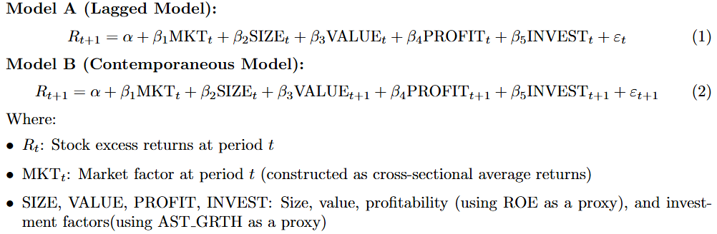
Methodology: Do Non-lagged Fundamentals Really Perform Better ?
3 Base Hypothesis Testing
H1: Contemporaneous fundamental factors exhibit significantly stronger linear correlation with contemporaneous excess returns than lagged fundamental factors.
We test the H1 by comparing the in-sample R-squared, post-sample IC mean, post-sample
ICIR and the statistical significance of size, value, profitability, and investment factors.
® 2024 – 2025 Group 6 | Course Project
4
14
Notes:
After completing the data preprocessing, we first verify Objective 1.
Recall H1.
To test this hypothesis, we design two linear regression models that are identical in structure and differ only in the timing of the fundamental inputs. Although the model resembles a multi-factor specification, the fundamental variables used here are custom proxies rather than the exact Fama–French definitions. Specifically, ROE serves as the proxy for the profitability factor, and AST_GRTH serves as the proxy for the investment factor.
Model A uses lagged fundamentals, such as ROE_t and AST_GRTH_t, while Model B uses contemporaneous fundamentals, such as ROE_{t+1} and AST_GRTH_{t+1}.
We evaluate H1 by comparing four metrics across the two models:
In-sample R-squared,
Post-sample IC mean,
Post-sample ICIR,
And the statistical significance of the value, profitability, and investment factors.
If the contemporaneous model consistently outperforms, this provides evidence that more timely fundamental information offers stronger explanatory power for cross-sectional returns, thereby supporting our hypothesis.”

Slide 15
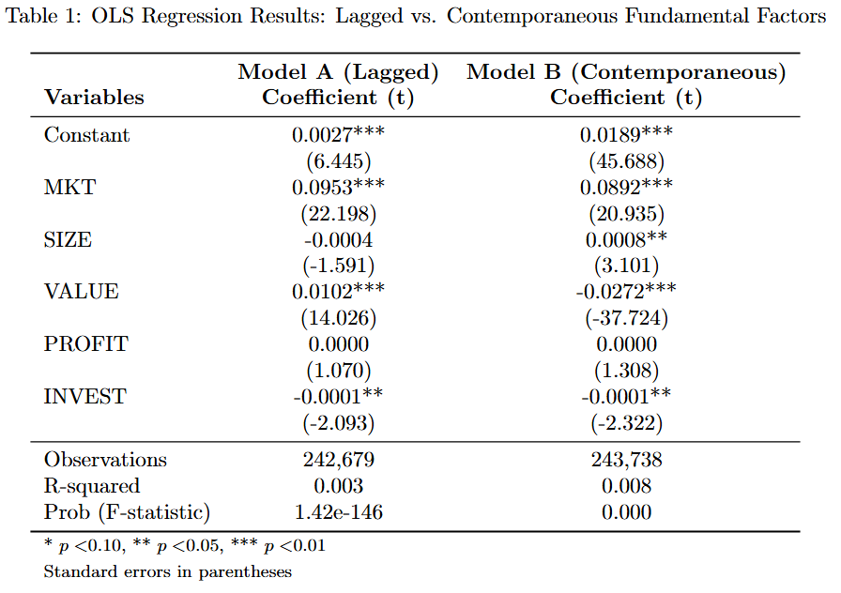
Empirical Results——Feasibility of Fundamental Prediction:
Non-lagged Fundamentals Perform Better Explain Power
3 Base Hypothesis Testing
® 2024 – 2025 Group 6 | Course Project
15
Notes:
The table shows that Model B consistently outperforms Model A, providing strong evidence in support of the hypothesis that contemporaneous fundamentals carry more timely and informative content about next-period stock returns.
From this table, we first find that Model B has a higher R-squared than model A, indicating that contemporaneous fundamentals explain a larger proportion of the variance in excess returns.
Second, the absolute values of the t-statistic for almost all factors have increased, indicating that fundamental factors become more statistically meaningful and informative once their timing is aligned with the returns they aim to explain. Particularly, the value factor switches from significantly positive to significantly negative, revealing that stale book-to-market information can distort factor interpretations, whereas updated fundamentals produce more economically consistent signals. Size becomes significant only in the contemporaneous model, and the investment factor shows stronger significance when measured contemporaneously.

Slide 16
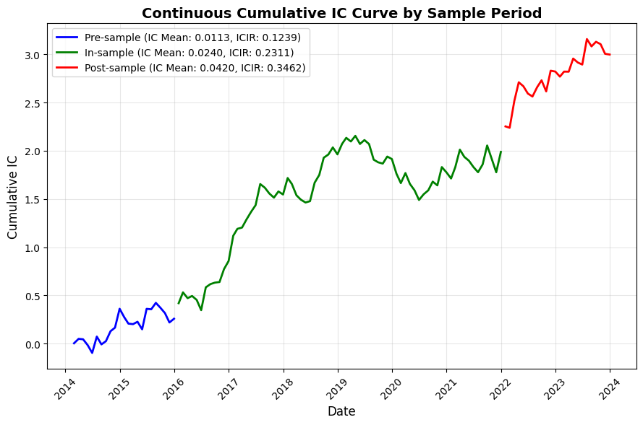
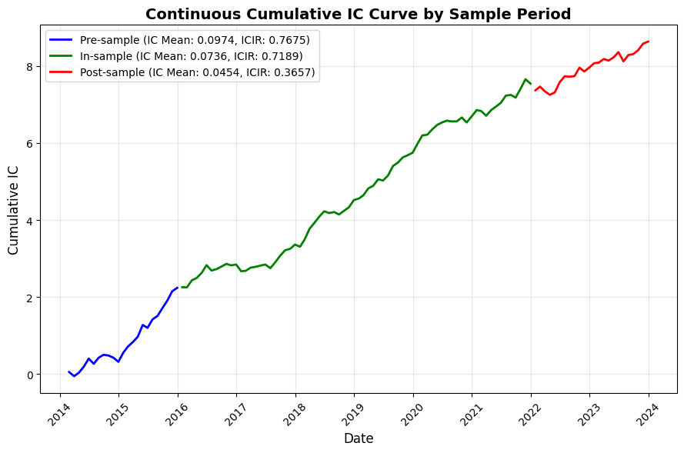
Empirical Results——Feasibility of Fundamental Prediction:
Non-lagged Fundamentals Perform Better Explain Power
3 Base Hypothesis Testing
Figure 1: Continuous Cumulative IC Curve for Model A (Lagged Model)
Figure 2: Continuous Cumulative IC Curve for Model B (Contemporaneous Model)
® 2024 – 2025 Group 6 | Course Project
16
Notes:
The in-sample Information Coefficient IR (ICIR) provides further evidence of Model B’s superiority.
the left figure is for model A, while the right one is for model B
The right model significantly outperforms the left, delivering higher, smoother, and more stable IC over time, with stronger predictive power both in- and out-of-sample.
All of the above prove the correctness of H1.

Slide 17
Table of Contents
4 Two-stage Model
▶ Introduction and Background
▶ Data Source and Data Reprocessing
▶ Base Hypothesis Testing
▶ Two-stage Model
▶ Mechanism Test: Interpreting the Model’s Incremental Alpha
▶ Conclusion
▶ Q&A
17

Slide 18
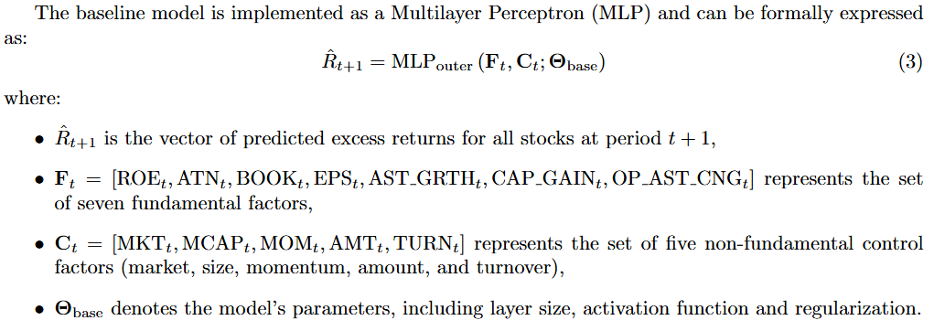
Methodology: Baseline Model
4 Two-stage Model
Baseline Model: A three-hidden-layer MLP with structure (20, 25, 20), trained for 5 epochs.
® 2024 – 2025 Group 6 | Course Project
18
Notes:
“The baseline model serves as a simple benchmark.
It directly maps all observable factors at time t to the cross-section of excess returns at time t+1.
The idea is to create a lower-bound reference point for comparison with more advanced models.
We implement this baseline using a Multilayer Perceptron.
The model takes in two types of inputs:
seven fundamental factors—such as ROE, accruals, book value, earnings, asset growth, capital gains, and operating asset changes—
and five non-fundamental control factors, including market return, size, momentum, turnover, and trading activity.
In terms of concrete architectures:
the baseline model uses a three-layer MLP with hidden units of (20, 25, 20) and is trained for 5 epochs.

Slide 19
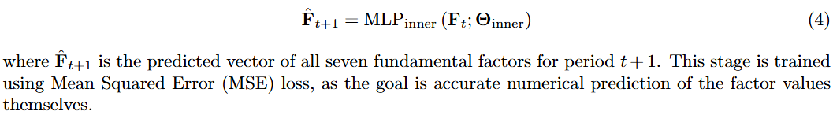
Two-Stage Model—Stage 1: Predict Future Fundamentals
4 Two-stage Model
Stage I (Inner MLP): To predict next-period fundamentals with structure (10, 20, 10)
network, trained for 4 epochs with Mean Squared Error (MSE) loss.
® 2024 – 2025 Group 6 | Course Project
19
Notes:
“In Stage I, we train a separate MLP to forecast all seven fundamental factors one month ahead.
This is a regression problem using MSE loss.
The idea is that if we can obtain a cleaner approximation of next-period fundamentals, these better inputs should improve return prediction.”
Stage I uses a smaller network with layers (10, 20, 10) to forecast fundamentals, trained with Mean Squared Error for 4 epochs.

Slide 20
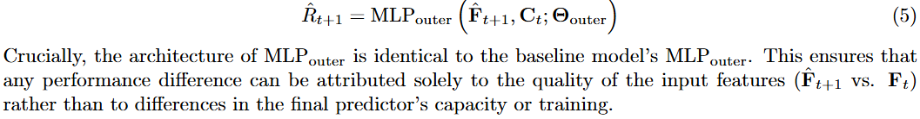
Two-Stage Model—Stage 2: Predict Returns Using Predicted Fundamentals
4 Two-stage Model
Stage II (Outer MLP): Uses an identical architecture to the Baseline model (20, 25, 20),
trained for 5 epochs. This ensures a fair comparison, isolating performance differences to the
input feature quality.
® 2024 – 2025 Group 6 | Course Project
20
Notes:
“Stage II mirrors the baseline architecture exactly.
The only change is that we feed the predicted fundamentals rather than the original lagged ones.
Because the architecture is identical, any performance improvement can be attributed to the improved input signals.”

Slide 21
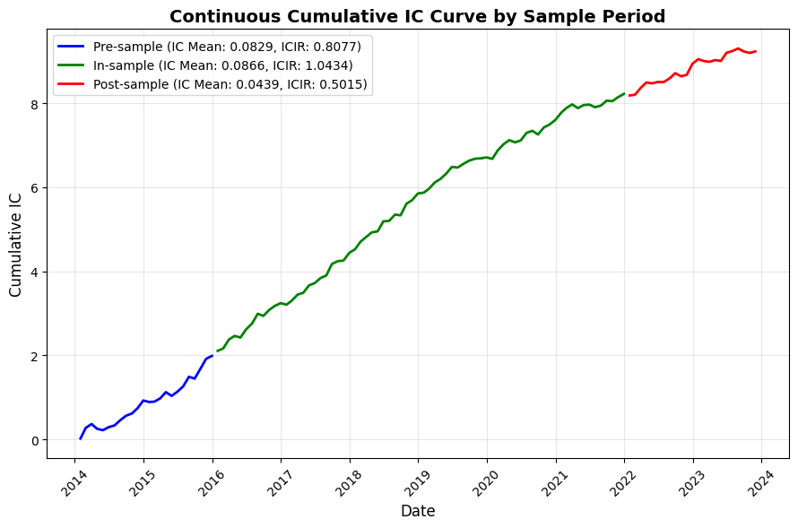
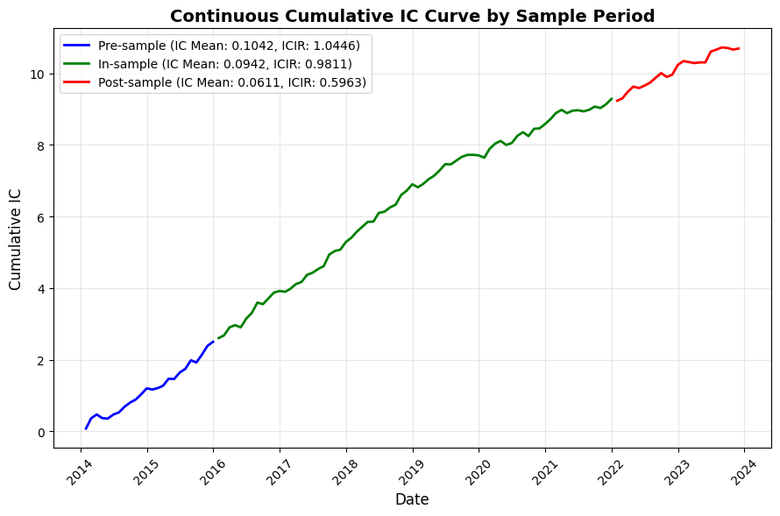
Empirical Results——Performance Comparison:
Two-stage Model Out Perform the Baseline
4 Two-stage Model
Figure 3: Continuous Cumulative IC Curve for Baseline Model
Figure 4: Continuous Cumulative IC Curve for Two-stage Model
® 2024 – 2025 Group 6 | Course Project
21
Notes:
Comparing the two cumulative IC curves, we observe that the two-stage model consistently outperforms the baseline model across all sample periods.
The two-stage framework achieves:
Higher cumulative IC levels, especially during the in-sample period where the gap becomes most pronounced.
Higher IC means and ICIRs in the pre-sample, in-sample, and post-sample windows, indicating both stronger predictive accuracy and greater stability.
Smoother and more persistent signal accumulation, demonstrating that forecasting fundamentals provides a more reliable and information-rich input for return prediction

Slide 22
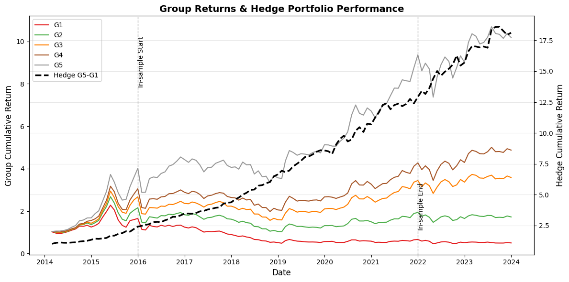
Empirical Results——Performance Comparison:
Two-stage Model Out Perform the Baseline
4 Two-stage Model
Figure 5: Group Returns & Hedge Portfolio Performance for Baseline Model
® 2024 – 2025 Group 6 | Course Project
22
Notes:
Next, I evaluate the economic performance of the two models through grouped backtesting.
For both models, stocks are sorted into five portfolios from G1 to G5 based on predicted returns, where G1 contains the lowest signals and G5 the highest.
As shown in the figures, both models produce a clean monotonic ordering—G1 through G5 separate nicely.
However, the Two-Stage model shows a much wider and more stable spread between adjacent groups, especially in the post-sample period.
This means that its predicted rankings have stronger discriminative power, capturing cross-sectional return differences more effectively.

Slide 23
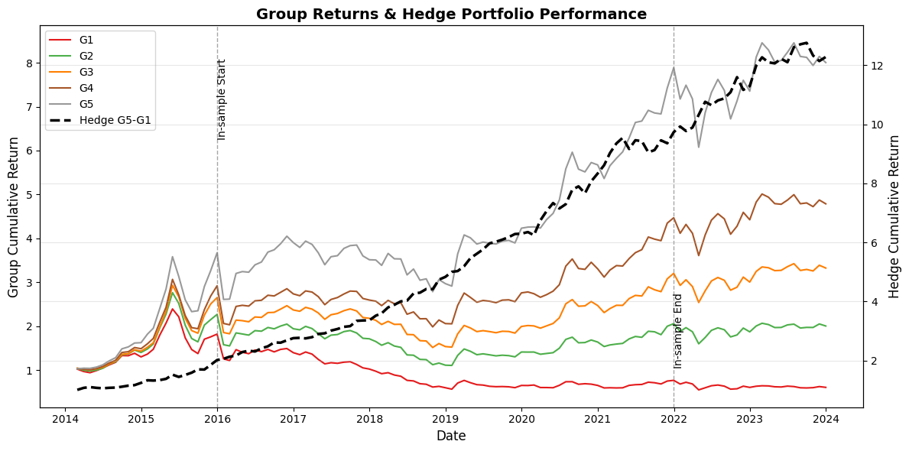
Empirical Results——Performance Comparison:
Two-stage Model Out Perform the Baseline
4 Two-stage Model
Figure 6: Group Returns & Hedge Portfolio Performance for Two-stage Model
® 2024 – 2025 Group 6 | Course Project
23

Slide 24
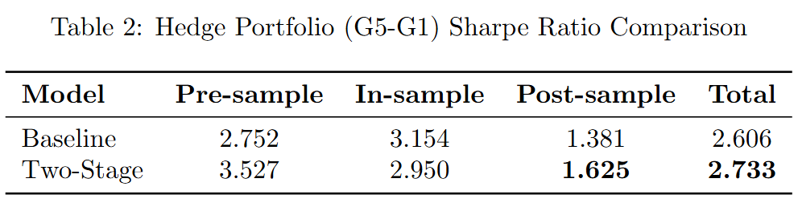
Empirical Results——Performance Comparison:
Two-stage Model Out Perform the Baseline
4 Two-stage Model
® 2024 – 2025 Group 6 | Course Project
24
Notes:
The hedge portfolio, constructed as G5 minus G1, also achieves a higher terminal cumulative return under the Two-Stage model, demonstrating stronger long-only plus short performance.
To further quantify this, the Sharpe ratio comparison in the table shows that the Two-Stage model delivers a higher post-sample Sharpe ratio than the baseline model.
This indicates better realized, risk-adjusted returns in a simulated live trading setting.
Overall, these results confirm the main takeaway:
predicting fundamentals with an MLP provides meaningful information gain, leading to better stock ranking, stronger hedge performance, and higher risk-adjusted returns compared to directly predicting return.

Slide 25
Table of Contents
5 Mechanism Test: Interpreting the Model’s Incremental Alpha
▶ Introduction and Background
▶ Data Source and Data Reprocessing
▶ Base Hypothesis Testing
▶ Two-stage Model
▶ Mechanism Test: Interpreting the Model’s Incremental Alpha
▶ Conclusion
▶ Q&A
25

Slide 26
Where does this incremental performance actually come from?
5 Mechanism Test: Interpreting the Model’s Incremental Alpha
To analyze the source of the model's incremental returns, we examine its correlation with an adjusted set of Fama-French five factors:
1. Value Factor: The average return of long-short portfolios formed on lagged Book-to-Market (BM) and lagged Earnings-per-Share (EPS), replacing HML. EPS is used instead of Earnings-to-Price as stock price is not a model input.
2. Profitability Factor: The average return of long-short portfolios formed on lagged Operating Profit-to-Book, lagged Accrual-to-Profit (ttm), and lagged Capital Gain, replacing RMW.
3. Investment Factor: The average return of long-short portfolios formed on lagged Asset Growth Rate and lagged Change in Net Operating Assets, replacing CMA.
Corresponding non-lagged versions of these three factors are also constructed.
® 2024 – 2025 Group 6 | Course Project
26
Notes:
Building on the empirical results I just presented—where the Two-Stage model shows stronger IC performance, wider return spreads, and higher post-sample Sharpe ratio—the next question is: Where does this incremental performance actually come from?
To answer this, we conduct a mechanism test to interpret the model’s alpha.
The key concern is that the Two-Stage model might simply process lagged data more efficiently, rather than truly capturing future fundamentals.
So we decompose the incremental returns by regressing them on adjusted Fama–French style factors.
Because our model uses ROE, accruals, asset growth, and capital gain, we reconstruct Value, Earning, and Growth factors using the same underlying data—both in lagged and non-lagged versions.
The regression results in Table 3 show two important findings:
Non-lagged factors explain the model’s incremental returns better, with a higher R².
Non-lagged Earning and Growth factors become statistically significant, while the lagged versions are not.
This pattern tells us that the Two-Stage model is not just reprocessing stale accounting data—it is actually learning to anticipate firms’ future profitability and growth.
In other words, the model’s improved performance is economically meaningful and interpretable: its alpha comes from predicting future fundamentals, not from overfitting lagged variables

Slide 27
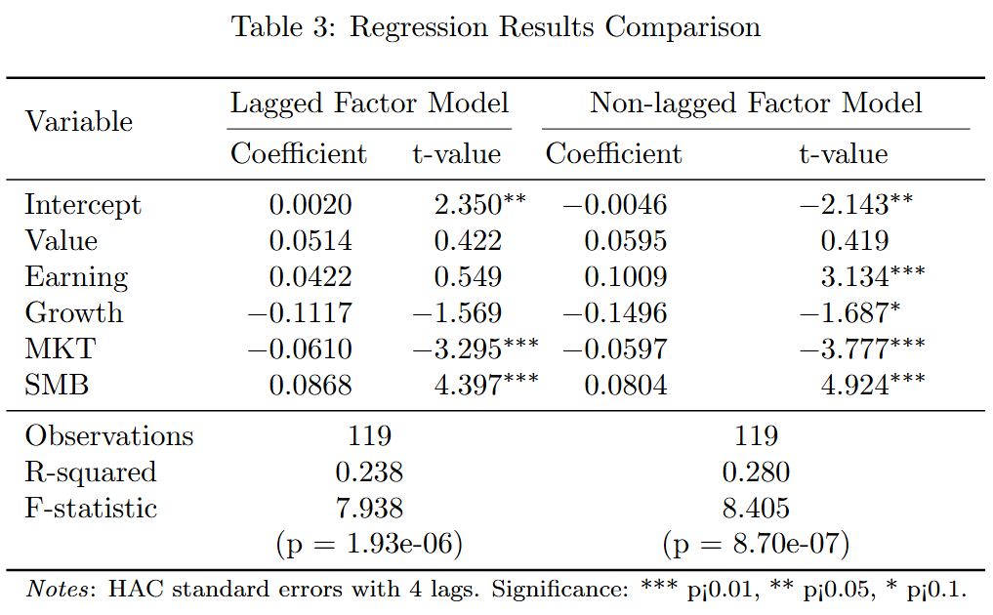
Where does this incremental performance actually come from?
5 Mechanism Test: Interpreting the Model’s Incremental Alpha
® 2024 – 2025 Group 6 | Course Project
27
Notes:
Building on the empirical results I just presented—where the Two-Stage model shows stronger IC performance, wider return spreads, and higher post-sample Sharpe ratio—the next question is: Where does this incremental performance actually come from?
To answer this, we conduct a mechanism test to interpret the model’s alpha.
The key concern is that the Two-Stage model might simply process lagged data more efficiently, rather than truly capturing future fundamentals.
So we decompose the incremental returns by regressing them on adjusted Fama–French style factors.
Because our model uses ROE, accruals, asset growth, and capital gain, we reconstruct Value, Earning, and Growth factors using the same underlying data—both in lagged and non-lagged versions.
The regression results in Table 3 show two important findings:
Non-lagged factors explain the model’s incremental returns better, with a higher R².
Non-lagged Earning and Growth factors become statistically significant, while the lagged versions are not.
This pattern tells us that the Two-Stage model is not just reprocessing stale accounting data—it is actually learning to anticipate firms’ future profitability and growth.
In other words, the model’s improved performance is economically meaningful and interpretable: its alpha comes from predicting future fundamentals, not from overfitting lagged variables

Slide 28
Table of Contents
6 Conclusion
▶ Introduction and Background
▶ Data Source and Data Reprocessing
▶ Base Hypothesis Testing
▶ Two-stage Model
▶ Mechanism Test: Interpreting the Model’s Incremental Alpha
▶ Conclusion
▶ Q&A
28

Slide 29
Key Findings
6 Conclusion
Project Objective
Address the information lag in traditional cross-sectional multi-factor models
Introduce a two-stage MLP framework that first predicts future fundamentals, then predicts returns
Main Results
Two-stage MLP consistently outperforms the contemporaneous baseline
Performance gain is economically meaningful, not just statistical
Predicted fundamentals create forward-looking signals
Model’s excess returns show stronger alignment with ex-post realized fundamentals vs. lagged ones
Evidence indicates the model implicitly anticipates future firm conditions
® 2024 – 2025 Group 6 | Course Project
29
Notes:
“Let me summarize the key findings of this project in one minute.
Our goal was to address a fundamental limitation of traditional multi-factor models: they rely on lagged accounting data, which often fails to reflect a firm’s current or future financial condition. To solve this, we introduced a two-stage MLP framework that first predicts next-period fundamentals and then uses these predicted fundamentals to forecast returns.
Empirically, the two-stage model consistently outperforms a strong baseline model. Importantly, the improvements are not just statistical. The model’s incremental returns exhibit meaningful alpha that is not explained by adjusted value, earnings, or growth factors. And the return patterns align more closely with realized future fundamentals than with lagged ones, suggesting that the model effectively anticipates future firm fundamentals.
In terms of contributions, the study offers a simple and interpretable way to modernize factor investing by incorporating forward-looking fundamentals. Practically, it shows that this approach can generate economically significant alpha even with a lightweight neural network.
There are limitations—such as the restricted set of fundamentals and the use of only MLPs—but these open clear paths for future work, including forecasting more types of fundamentals and testing more advanced architectures.
Overall, the project demonstrates that forecasting fundamentals is a powerful and intuitive extension to traditional factor models.”

Slide 30
Contributions & Implications
6 Conclusion
Methodological Contributions
Provides a simple but effective way to modernize factor models
Moves beyond lagged accounting data by integrating fundamental forecasting
Offers a transparent ML-based enhancement to traditional asset pricing
Practical Contributions
Generates significant alpha compared to direct MLP prediction
Links model performance to economic intuition:
→ Alpha arises from pricing future fundamentals early
® 2024 – 2025 Group 6 | Course Project
30

Slide 31
Limitations & Future Research
6 Conclusion
Limitations
Only a limited set of fundamentals were modeled
Architecture restricted to MLP
Mechanism analysis could be deeper
Future Directions
Forecast more types of fundamentals (e.g., cash flows, revenue, margins)
Explore advanced ML models (RNNs, Transformers, GNNs)
Conduct detailed feature-importance/attribution analysis
Test robustness across market regimes and include trading frictions
® 2024 – 2025 Group 6 | Course Project
31

Slide 32
Q&A
® 2024 – 2025 Group 6 | Course Project
32

