Slide 1
Multilevel Self-Attention Model and its Use on Medical Risk Prediction

Slide 2
What is medical risk prediction and why
Medical risk prediction is a prediction of future medical events based on historical health data.
Future disease prediction
Future medical cost prediction
Being able to detect the early onset of diseases and identify risk factors make early intervention and risk management possible

Slide 3
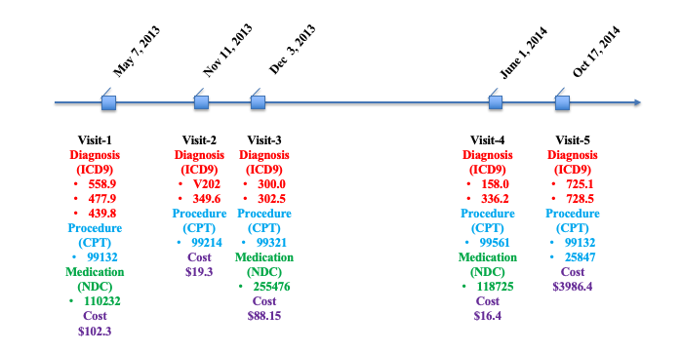
Challenges of mining claims data
Temporal (irregular)
High dimensional
Noisy

Slide 4
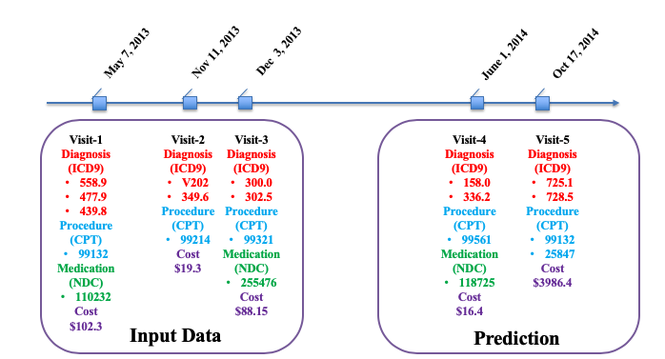
Task
Utilizing historical claims data to predict the next year information
Task-1: predict the future medical cost
Task-2: predict future disease

Slide 5
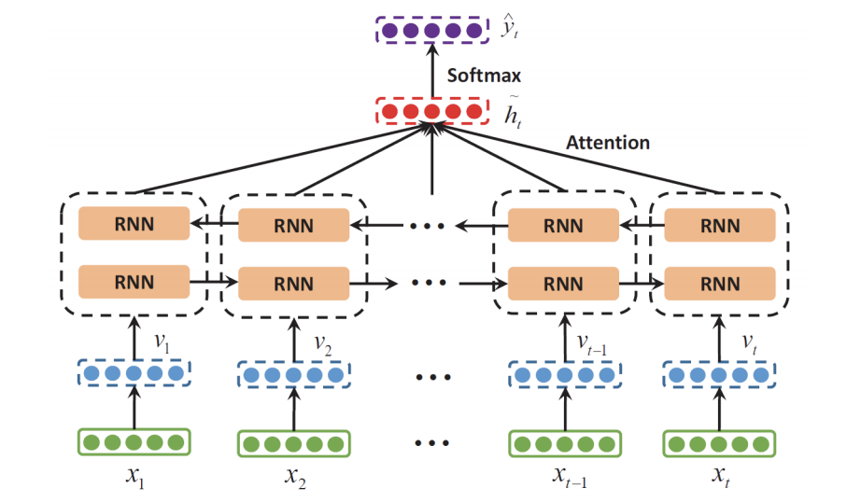
Existing Work for Task-1 (disease prediction)
B-RNN
Regular RNN-based model can’t handle irregular time intervals between visits.
Ma et al. Dipole: Diagnosis Prediction in Healthcare via Attention-based Bidirectional Recurrent Neural Networks. In KDD’17.

Slide 6
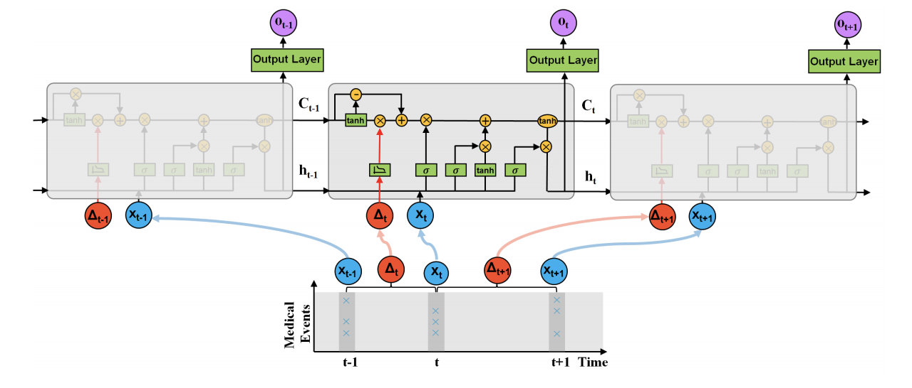
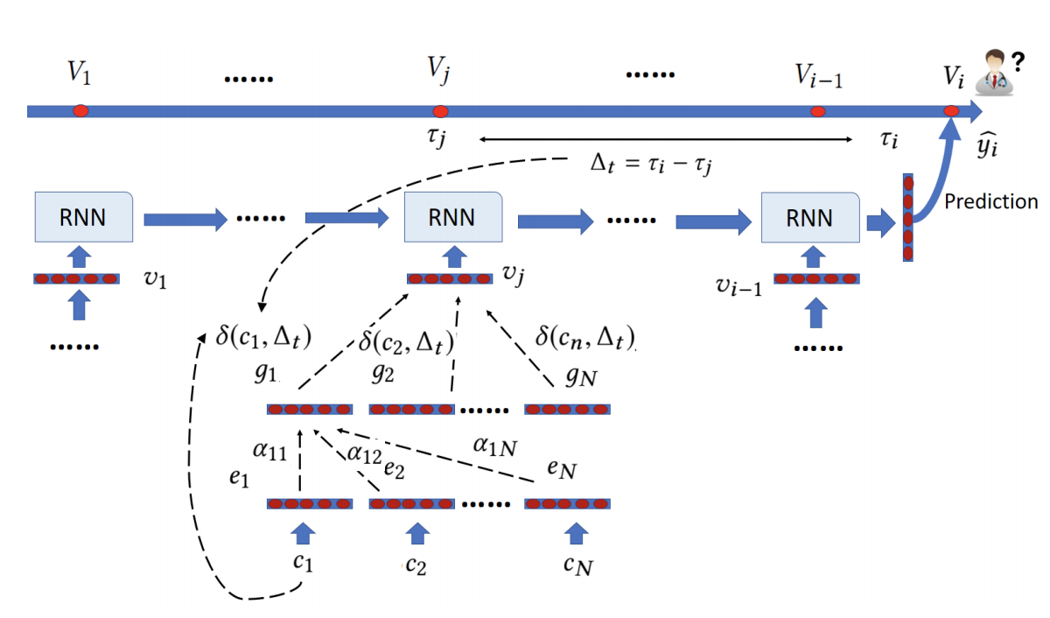
Existing Work for Task-1 (disease prediction)
T-LSTM and Time-line
Training RNN-based model requires large amount of data.
The dependency between medical codes and medical visits is not capture during training
Bai et. al. : Interpretable representation learning for healthcare via capturing disease progression through time. In KDD’18.
Baytas et. al. Patient subtyping via time-aware LSTM networks. In KDD’17.

Slide 7
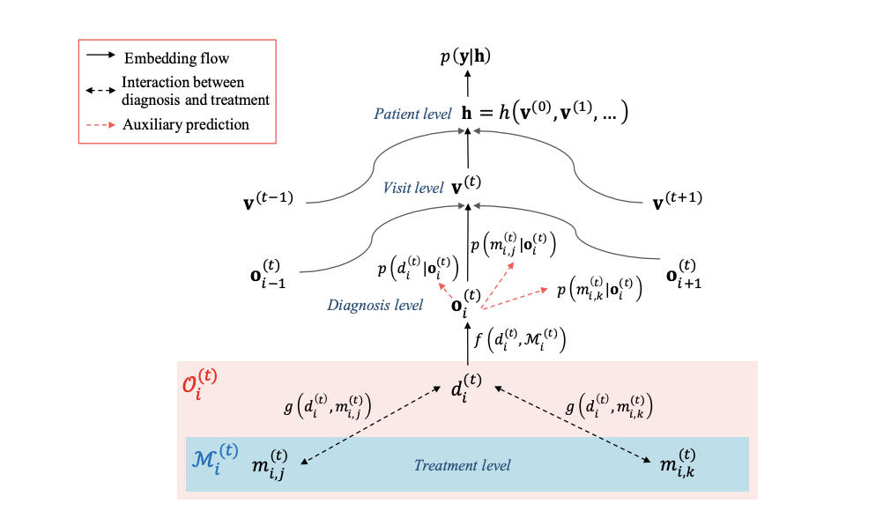
Existing Work for Task-1 (disease prediction)
MIME
Dependency is only captured when the data is structured. The relationships between medical codes is not explicitly shown in claims data.
Edward Choi, Cao Xiao, Walter Stewart, and Jimeng Sun. Mime: Multilevel medical embedding of electronic health records for predictive healthcare. In NeurIPS, pages 4552–4562, 2018
Notes:
m

Slide 8
Existing Work for Task-2 (cost prediction)
Three types:
Identify risk factor via cost prediction (i.e., chronic disease scores on cost).
Classify patients into cost bucket.
Predict actual medical cost.
Notes:
m

Slide 9
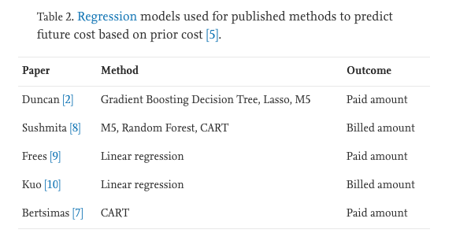
Existing Work for Task-2 (cost prediction)
Traditional machine learning methods were not able to model high dimensional non-linear relations as well as Deep learning methods
High-dimensional medical features are rarely used for predicting medical cost
Mohammad et. al. Healthcare cost prediction: Leveraging fine-grain temporal patterns. Journal of Biomedical Informatics Volume 91, March 2019, 103113
Notes:
m

Slide 10
Challenges
How to capture the dependency between medical codes/visits within medical claims (including facility claims and pharmacy claims)?
How to design a robust and stable predictive model, especially for medical cost prediction?
How to interpret the predictive result, especially for predictive medical cost?
How to move toward preventable care?

Slide 11
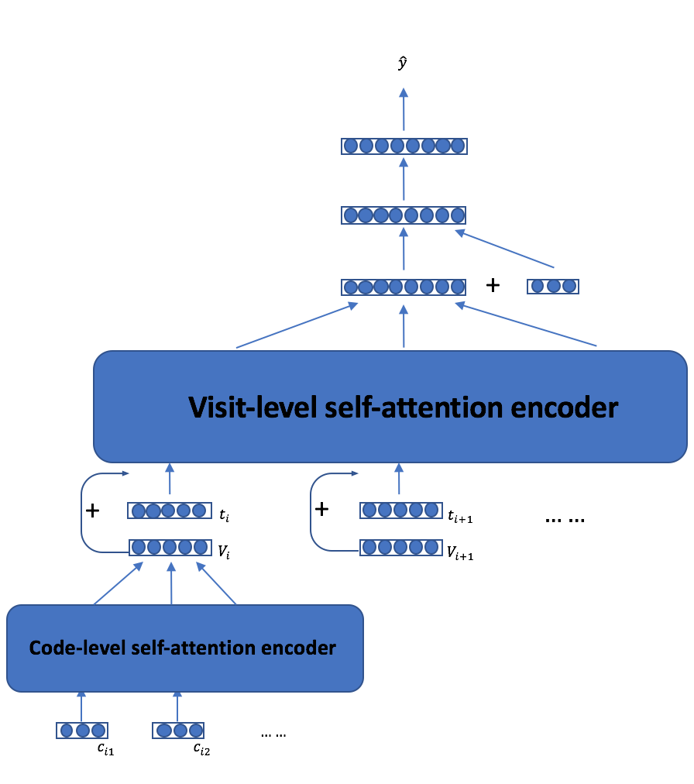
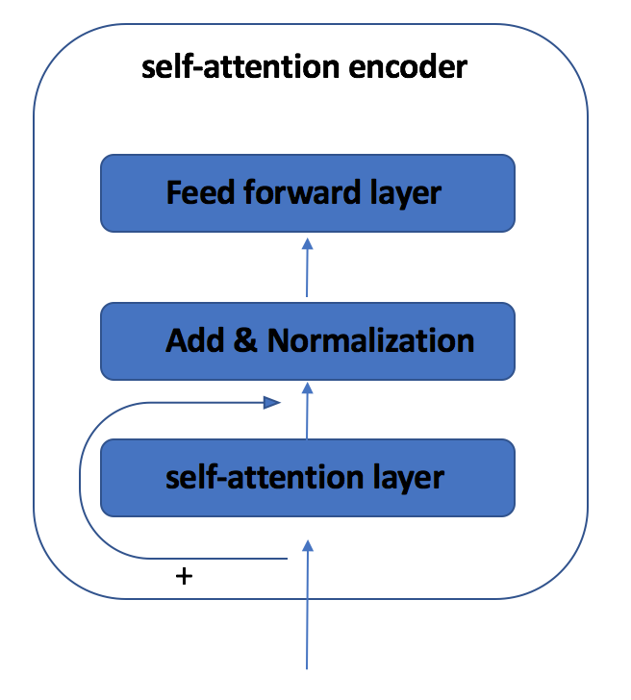
MSAM: Multilevel Self-Attention Model
The underlying relationships between medical codes/visits can be capture via code/visit-level self-attention encoder.
The irregular time gaps between medical visits can be handle by time-embedding.

Slide 12
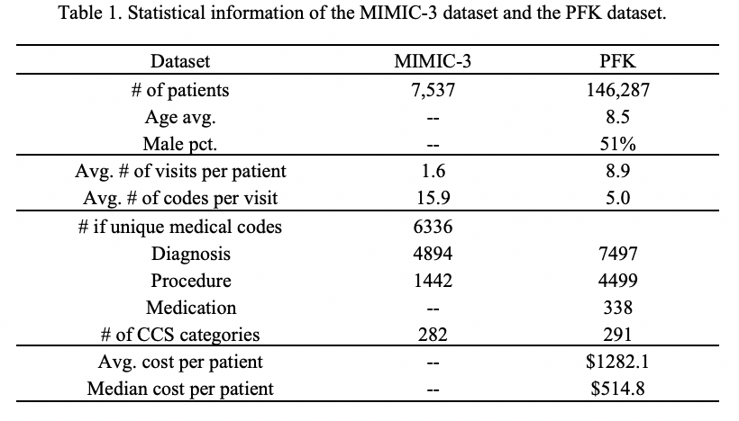
Dataset and evaluation metric
Dataset:
Evaluation Metric
Disease prediction: recall@k.
Cost prediction: MAE.
Predicted cost distribution plot.
High cost patient selection.
Case Study for self-attention weights.

Slide 13
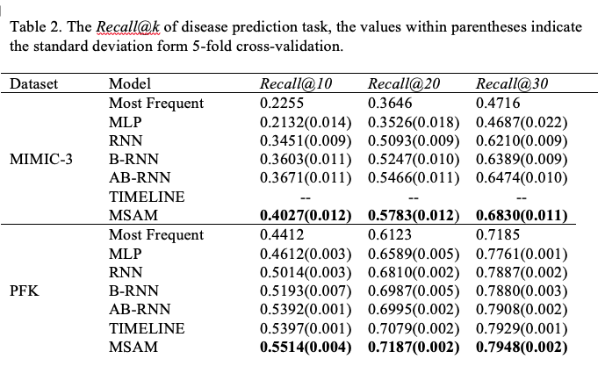
Performance Evaluation: Disease Prediction
The performance of MSAM outperformed all baseline models.
The proposed MSAM achieves robust results on different dataset with different split seed.
Capture underlying implicit dependency between medical codes and between medical visits and improve the model performance.

Slide 14
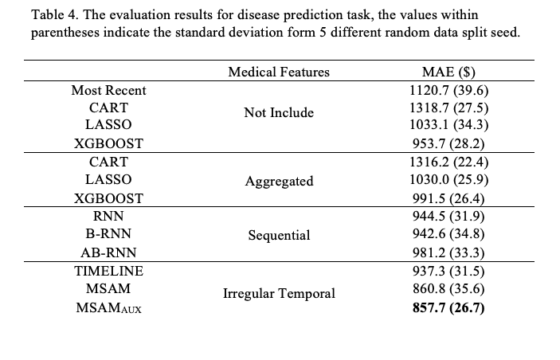
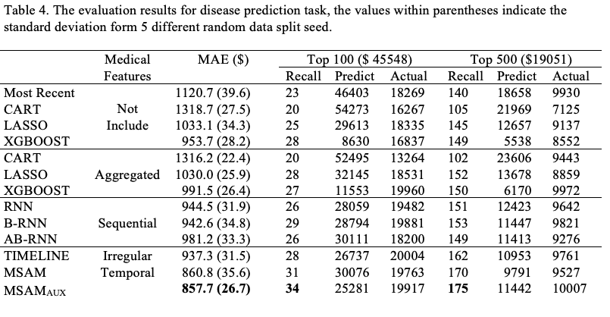
Performance Evaluation: Cost Prediction
Adding aggregated medical features can barely improve the prediction performance [1]
Deep learning models can fully utilized sequential and temporal medical information and gain predictive power from it.
From the transition between aggregated data to sequential data, and then from sequential data to irregular temporal data, we gain more medical information. This increase in medical information helps to improve the performance of the deep learning model.

Slide 15
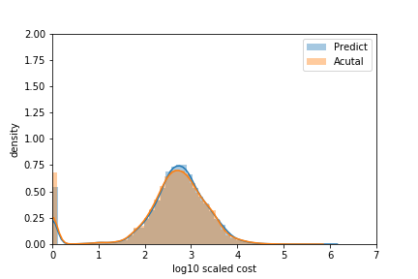
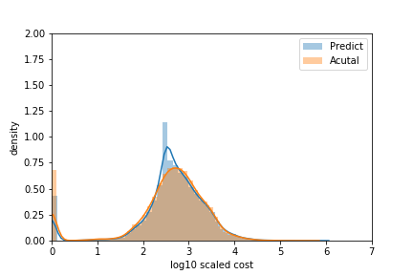
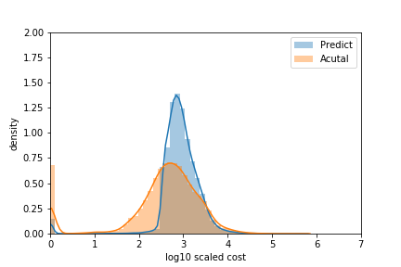


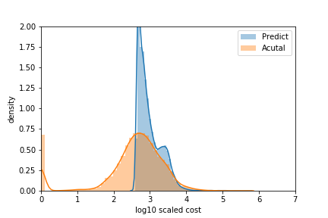
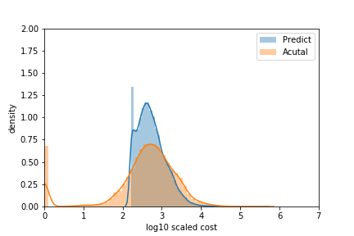
Distribution of the predicted and actual cost
Most Recent
CART
LASSO
XGBOOST
RNN
MASM
MASM_AUX

Slide 16
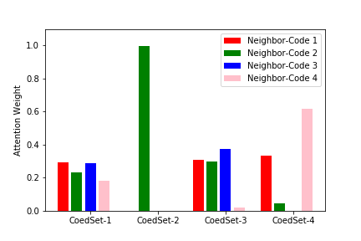
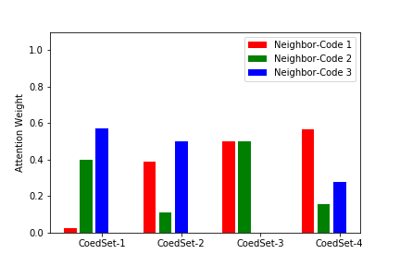
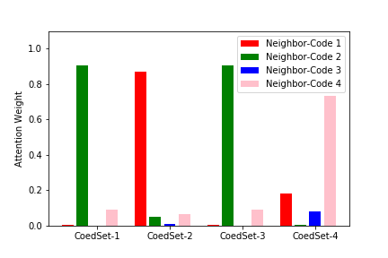
Case study for self-attention mechanism
Attention weight with different code-sets for
code Asthma (ICD9 493.92)
Attention weight with different code-sets for
code Seizures (ICD9 780.39)
Attention weight with different code-sets for
code Diabetes (ICD9 250.00)
Within different code-sets, the attention weights are different. This differences indicate that the underlying relationships between medical codes can be automated capture via self-attention mechanism.

Slide 17
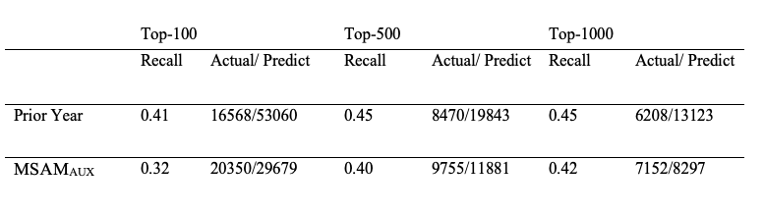
Toward interpretable & preventable care coordination
The patient selected by our model will incur higher medical cost in the next year. Providing care coordination to a more severe group of patients can yield a better outcome.
The difference between actual and predict is small for our model. This difference indicates our model can better evaluate the return of intervention

