Slide 1
COIT20252
Business Process
Management
Week 8
Process Technologies, Robotic Process Automation and Process Cybersecurity

Slide 2
Housekeeping
Work on ePortfolio 3, due in week 10
Presentations continue (for on-campus and off-campus students)
Assessment 3 is due in week 12

Slide 3
Learning Outcomes
On completion of this lecture, you should be able to:
Classify the core functionality of BPM technology
Evaluate different BP technologies
Develop a dynamic case management model
Critique the stages of process mining
Compile a classification scheme for business rule management systems
Identify uses of rules repositories
Evaluate BPMS vendors
Evaluate the role of Robotic Process Automation

Slide 4
Enterprise Technologies
Enterprise technology refers to the concept of information technology (IT) resources and data that are shared across an enterprise
The impetus for the development of enterprise technologies was to have one set of common processes and data that the entire organisation can use to conduct business with their customers and suppliers
Main enterprise-level technologies are enterprise resource planning (ERP), customer relationship management (CRM), and supply chain management (SCM)

Slide 5
BPM Technology
BPM technology has moved from simple workflow modelling tools to complex integrated toolsets that provide a complete operating platform and environment
Business Process Management suites (BPMS) can be implemented on-site or in the cloud and allow rapid redesign of business operations and process execution
BPMS creates a highly modular approach to business process change. Modules are referred to as services. This modularity is what allows data about the organisation, business models, rules, and more to be reused and simply modified at the model level to regenerate modified applications

Slide 6
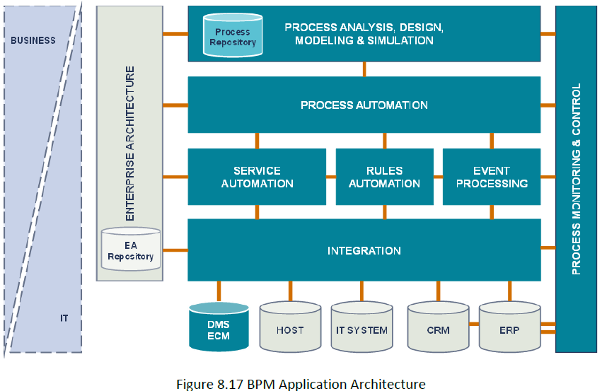
Core Functionality of BPM Technology
(ABPMP International, 2019 Pg. 232)

Slide 7
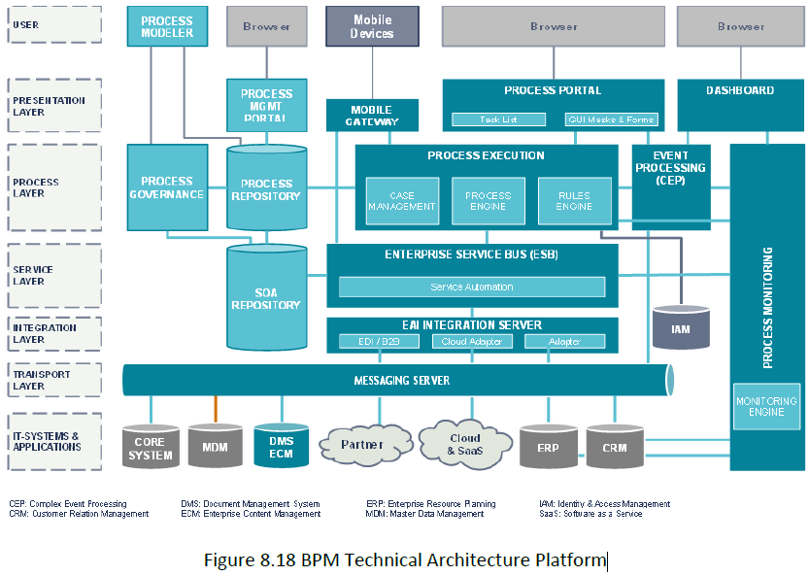
BPM Technical Architecture Platform
(ABPMP International, 2019 Pg. 233)

Slide 8
Intelligent Business Process Management Suites (iBPMS)
Intelligent Business Process Management Suites (iBPMS) are dynamic business applications that can quickly adapt to changing business needs, competitive pressure, and market opportunity
iBPM Capabilities: Advanced analytics, Artificial intelligence, Mobile BPM, Social BPM, Cloud-based BPM, Process mining, Robotic process automation, Predictive analytics, Internet of things (IoT), Blockchain (smart contracts) & Dynamic case management

Slide 9
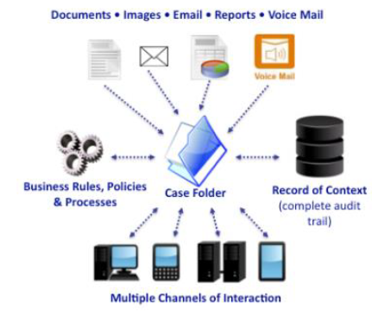
Dynamic Case Management
Dynamic case management (DCM) is the handling of case-related work using technologies that automate and streamline aspects of each case
Dynamic case management is event-driven and is context-aware
Three central types of work that fit the dynamic case management model – Investigative, Service request & Incident management
Figure 8.21 A Dynamic Case Management System (Wyatt 2018), - (ABPMP International, 2019 Pg. 233)

Slide 10
Process Mining
Process mining uses event logs to perform an automated analysis of processes
Three main types of process mining:
  Discovery - Takes an event log and produces a process model without using any prior information, using process mining algorithms
  Conformance - Real processes and models are compared, and resulting coincidences or differences are identified. The results are used to diagnose deviations or inefficiencies between the process model and ideal processes
  Enhancement - Process models are adapted and improved according to the data of the real process

Slide 11
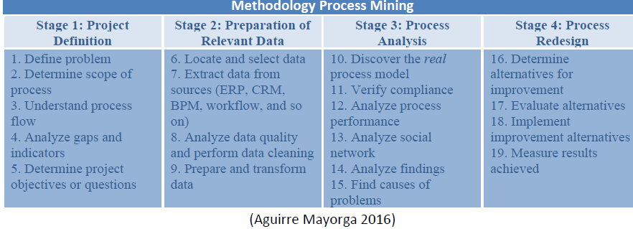
Redesigning and Improving Business Processes Using Process Mining
(ABPMP International, 2019 Pg. 244)

Slide 12
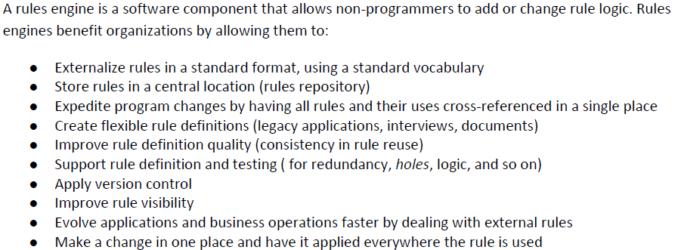
Rule Engines
Rules engines are tools that support the identification, definition, rationalisation, and quality of business and technology rules
Rules engines also provide a repository that allows rules to be checked against one another for definition or context problems, and thus checked for redundancy and definition quality
(ABPMP International, 2019 Pg. 247)

Slide 13
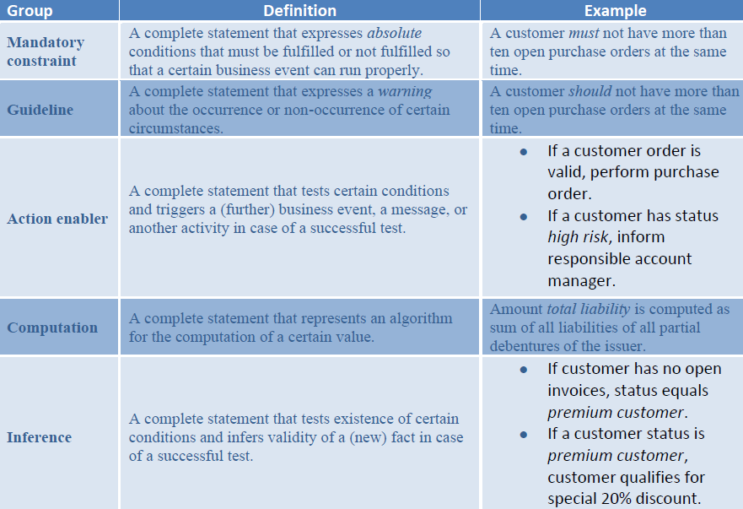
Classification Scheme for Business Rule Management Systems (BRMS) Rules
(ABPMP International, 2019 Pg. 245)

Slide 14
Rules Repositories
A rules repository houses business and technical rules and their definitions.
Rules repositories are commonly used to:
  Capture an organisation’s institutional knowledge in a central place
  Find currently defined rules and their definitions
  Support rule execution by programs and manage rule use
  Analyse key performance indicators
  Manage quality and integrity of rules and rule sets
  Build what-if analytics to analyse interrelated rules and rule use
  Validate that the right data is being used by rules
  Use, edit, and test data; use of legacy data

Slide 15
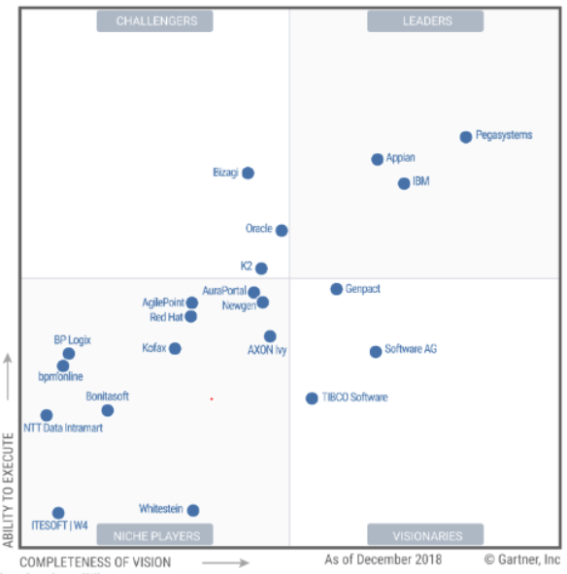
BPMS Vendors
(ABPMP International, 2019 Pg. 248)

Slide 16
Emerging BPM Technologies
Robotic Process Automation (RPA) – In this unit, we focus on RPA
Additional Reading: Other technologies such as Blockchain, Artificial Intelligence (AI), Machine Learning and Internet of Things (IoT) are covered in sections 8.6.2 to 8.6.7.5.

Slide 17
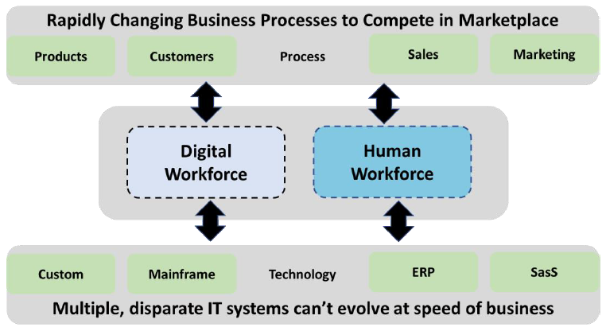
Robotic Process Automation (RPA)
RPA is the application of software-based technology to automate repetitive office tasks and rule-based processes, which were previously carried out manually by humans on a computer (Chugh et al., 2022)
Also defined as ‘The use of software with artificial intelligence (AI) and machine learning capabilities to handle high-volume, repeatable tasks that previously required humans to perform.’
Figure 8.25 RPA (Digital and Human Workforce), (ABPMP International, 2019 Pg. 251)

Slide 18
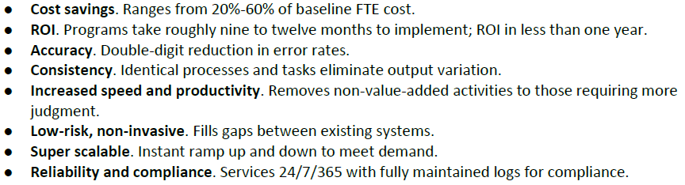
Benefits of RPA
Protect and leverage investments
Time dividends for knowledge workers
Optimisation of delivery and outcomes
(ABPMP International, 2019 Pg. 256)

Slide 19
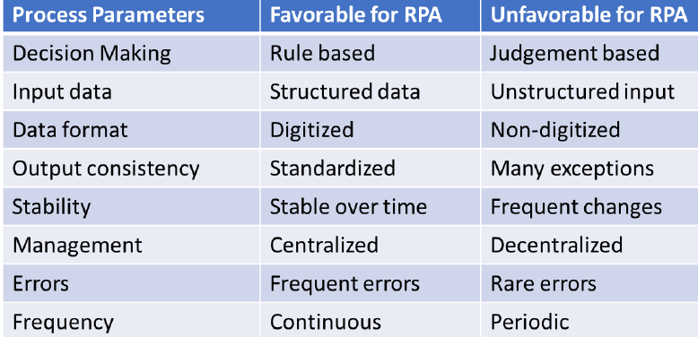
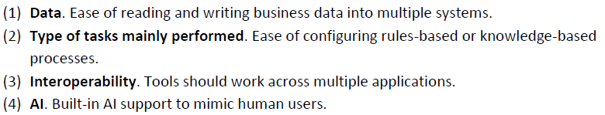
Process Selection Criteria for RPA
RPA Tool Selection
(ABPMP International, 2019 Pg. 256)
(ABPMP International, 2019 Pg. 257)

Slide 20
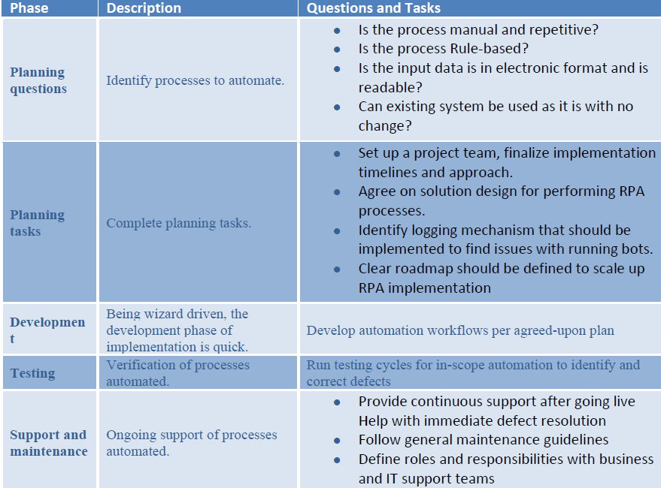
RPA Implementation
(ABPMP International, 2019 Pg. 257)

Slide 21
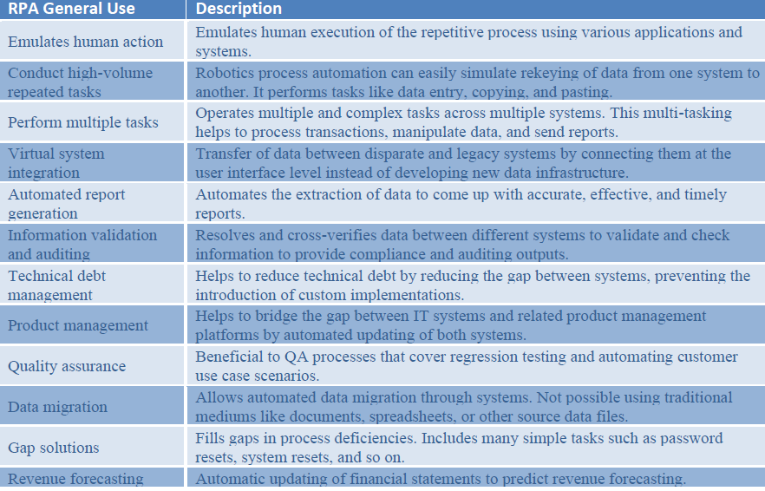
General Uses of RPA
What are RPA’s uses in different industries?
(ABPMP International, 2019 Pg. 258)

Slide 22
Reasons RPA Deployments Fail
Best Practices for RPA Success
Management hesitation
Lack of training
Wrong use cases
Excluding IT and security input
Excluding the app developers
Do your research
Educate staff about RPA
Determine where the technology will work best
Keep it simple and modular
Don’t neglect data security
Test implementations regularly
Develop a cross-functional Centre of Excellence
Prepare for future advances and challenges

Slide 23
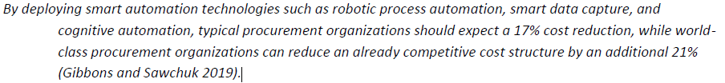
Digital Procurement Using RPA
Procurement tends to be more of a transactional process — procure to pay, source to manufacture, and so on — which makes it a good choice for RPA
(ABPMP International, 2019 Pg. 260)

Slide 24
Process Cybersecurity
Process cybersecurity refers to the practices, technologies, and strategies organisations use to protect their processes and systems from cyber threats
Process cybersecurity aims to ensure the availability, integrity, and confidentiality of processes and systems
Malware, phishing, denial of service, social engineering, and insider threats are some common cyber threats
Successful cyberattacks can lead to production disruptions, safety incidents, financial losses, and loss of goodwill
(Humayun et al., 2020; Parker et al. 2023)

Slide 25
Process Cybersecurity Standards and Frameworks
A standard is a set of guidelines or best practices that organisations can use to improve their cybersecurity. A framework refers to the overall structure to supports a system.
ISO 27001 Information Security Management
Service Organisation Control 2 (SOC2)
Information Security Manual (ISM)
NIST Cyber Security Framework
International Society of Automation’s International Electrotechnical Commission(IEC) 62443
(SecurityBase, 2021; Syafrizal et al., 2020)

Slide 26
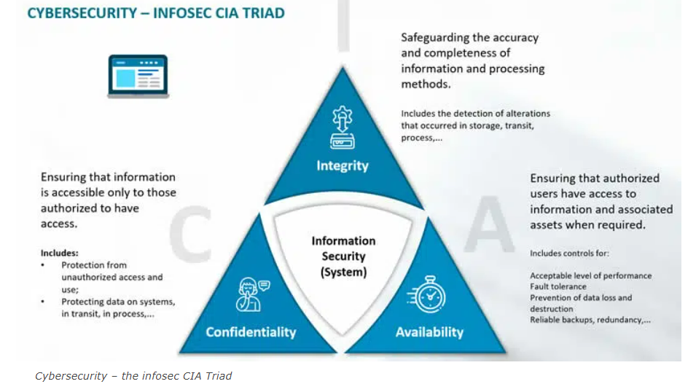
The CIA Triad
(iScoop, 2023)

Slide 27
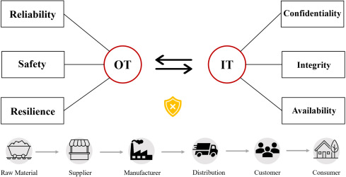
Cyber-Secure Supply Chain
(Parker et al. 2023, p. 14)

Slide 28
Best Practices for Implementing Process Cybersecurity Measures
Use strong passwords, limit access to critical systems, implement software updates and patches, and monitor system logs for suspicious activity
Regular testing and evaluation of security measures to ensure they are effective and robust
Effective process cybersecurity measures, such as conducting a risk assessment, implementing access controls and network segmentation, vulnerability management and providing security awareness training to employees, are critical
(Cybok, 2019)

Slide 29
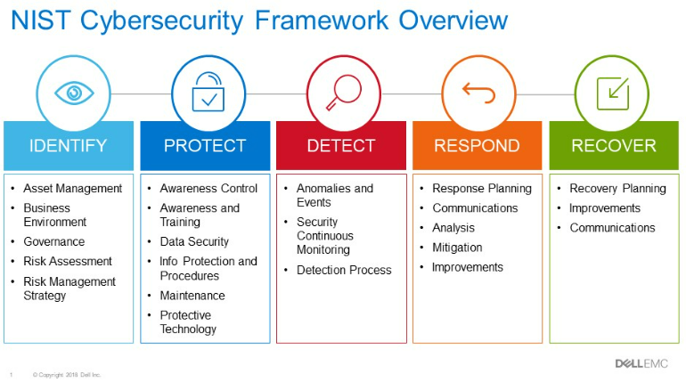
NIST Cybersecurity Framework
(Dell Technologies, 2019)

Slide 30
Summary
Common enterprise technologies are ERP, CRM and SCM
BPMSs allow rapid redesign of business operations and process execution
Newer platforms with closely integrated capabilities are Intelligent Business Process Management Suites (iBPMS)
RPA is an application of technology, governed by business logic and structured inputs, aimed at automating business processes
Protecting processes and systems from cyber threats requires a comprehensive, multi-layered approach to cybersecurity

Slide 31
Lecture Content
ABPMP International, 2019, BPM CBOK® Version 4.0: Guide to the Business Process Management Common Body of Knowledge, Association of Business Process Management Professionals, ISBN: 9781704809342, https://www.abpmp.org/page/guide_BPM_CBOK.
Chapters 8 (Sections 8.4 to 8.6.1.12)

Slide 32
Lecture Content
Chugh, R., Macht, S., & Hossain, R. (2022). Robotic Process Automation: a review of organizational grey literature. International Journal of Information Systems and Project Management, 10(1), 5-26.
Cybok, 2009, The Cyber Security Body of Knowledge, https://www.cybok.org/media/downloads/CyBOK-version-1.0.pdf
Dell Technologies, 2019, Strengthen Security of Your Data Center with the NIST Cybersecurity Framework, https://www.dell.com/en-us/blog/strengthen-security-of-your-data-center-with-the-nist-cybersecurity-framework/
Humayun, M., Niazi, M., Jhanjhi, N. Z., Alshayeb, M., & Mahmood, S. (2020). Cyber security threats and vulnerabilities: a systematic mapping study. Arabian Journal for Science and Engineering, 45, 3171-3189.
iSoop, 2023, The CIA triad of confidentiality, integrity and availability, https://www.i-scoop.eu/cybersecurity/cia-confidentiality-integrity-availability-security/
Parker, S., Wu, Z., & Christofides, P. D. (2023). Cybersecurity in process control, operations, and supply chain. Computers & Chemical Engineering, 108169.
SecurityBase, 2021, Cyber Security Standards and Frameworks – overview, https://securitybase.com.au/articles/cyber-security-standards-and-frameworks-an-overview)
Syafrizal, M., Selamat, S. R., & Zakaria, N. A. (2020). Analysis of cybersecurity standard and framework components. International Journal of Communication Networks and Information Security, 12(3), 417-432.

Slide 33
Next Week
Process Management Organisation and Culture
Chapter 9

