Slide 1
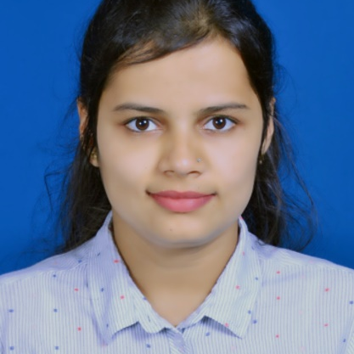



Anjali L Rabade
Analyst/Software Engineer
Bachelor of Engineering
Computer Science : 2020 - 2021
Skills
Mumbai
Java 8 /J2EE | Java Basics, OOPS, Generics, Collections, Arrays, Loops, Lambda Exp, Stream API Junit
Spring core | IOC & Dependency Injection, Autowire
Spring REST | REST controllers, Implementation of GET, POST, PUT & DELETE, Bean Validation & Exception Handling, Testing Services, Controller & Repository layer
Spring Data JPA | Implement DAO layer using spring Data repositories, Transaction Management
Spring Boot Microservices | Spring Boot Starters, annotations, Messaging Service, Sync/Async comms, Swagger API specifications
Spring Cloud | Eureka, Netflix Ribbon, Feign Client, Hystrix, Zuul & Config Server
React | Components, Hooks, Event handling, Redux, Reducers, Testing using Jasmin & Karma
Angular | Components, Services, Modules, Routing, Forms & Validation, Testing using Jasmin & Karma
Database | MongoDB and SQl
UI Tech | HTML 5 & CSS 3,JavaScript, ES6 & TypeScript Reusable templates, Optimized UI Designed
Tools | Git, Postman, Maven, IDE
Add On skills | Communications, Team management. Peer learning
anjali.rabade@capgemini.com
+91 8010841079
A4
Hands on experience in developing web pages using HTML5, CSS3, Object Oriented Java script, JSON, XML. Good understanding of Document Object Model (DOM) and DOM Functions.
Hands-on creating Microservices using Spring Boot, Spring Cloud API Gateway, Eureka Server, Load Balancing, and Swagger.
Hands-on creating UI using Angular.
Java Microservice Development knowledge using Spring boot and spring cloud framework on an intermediate level.
E-Commerce Shopping Cart Application
Completed end to end case study of Shopping Cart Application along with JWT authentication, Swagger and payment testing using Braintree in MERN Stack. Material-UI and React Bootstrap used for user interface.
HelpingAds
Description of the project:
HelpingAds application for helpless people Just user watch the add on our platform, and we will help the people through donation Responsibility : Requirement analysis, Development for Web API , Manual Testing
Completed ”Testing automation“ course at Coursera
Check out my work on GitHub & Video Profile

