Slide 1
瓦谢尔生物研究院论文粗读分析（第一周）
YOUR LOGO
20XX.XX.XX
2026.3 香港中文大学（深圳）SSE CE
汇报人：汪希翔 - 121090528

Slide 2
目录
01
主页面论文粗读
02
特异性粗读
03
单击添加目录项标题
04
单击添加目录项标题

Slide 3
主页面论文粗读
01

Slide 4
miRTarBase update 2018: a resource for experimentally validated microRNA-target interactions
Chih-Hung Chou1,2,†, Sirjana Shrestha2,†, Nucleic acid research 46(D1), D296-302, 2018, Cited 1880 ,2018
Abstract: Update Database about miRtarBase which provieds imfor about MTIs
Method: A large number of experimental results of MTIs curated by strong evidence，and use these result about target site sequence to train ML model.
Aim: helping evaluate miRNA-target prediction tools.
Solved Problem: Increase amout of sample,
increase the accuracy of evaluation and analysis tools.
Important Word:
MTIs:微小核苷酸-靶标相互作用
target site sequence: 靶向位点序列

Slide 5
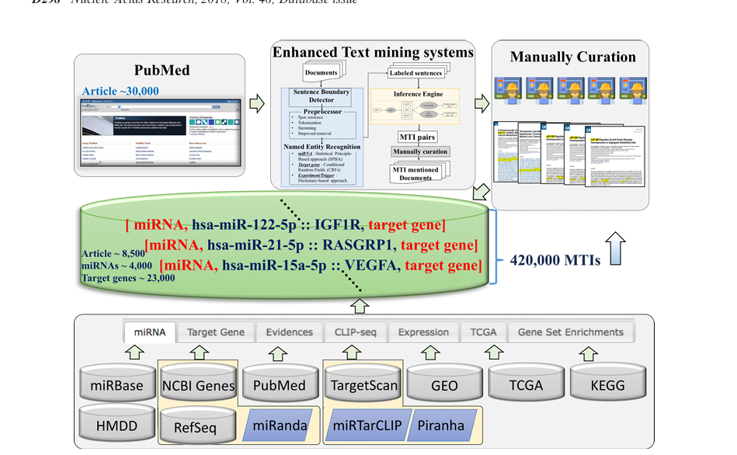

Slide 6
Plants send small RNAs in extracellular vesicles to fungal pathogen to silence virulence genes
Qiang Cai 1, Lulu Qiao 1 2, Ming Wang, cience
. 2018 Jun 8;360(6393):1126-1129. doi: 10.1126/science.aar4142. Epub 2018 May 17. Cited Can’t Find
Abstract: Research sRNA transfer model between hosts and pests.
Method: Research special sampeles about host Arabidopsis cells and fungal pathogen Botrytis cinerea
Aim: Looking for the impact on the gene expression of both side caused by the bidirectional transfer of different sRNAs between different individuals
Solved Problem: Using sRNA transferring to create new special immune response.
Important Word:
sRNA: Short RNA that does not encode proteins which is made of 20~30 nucleotides.

Slide 7
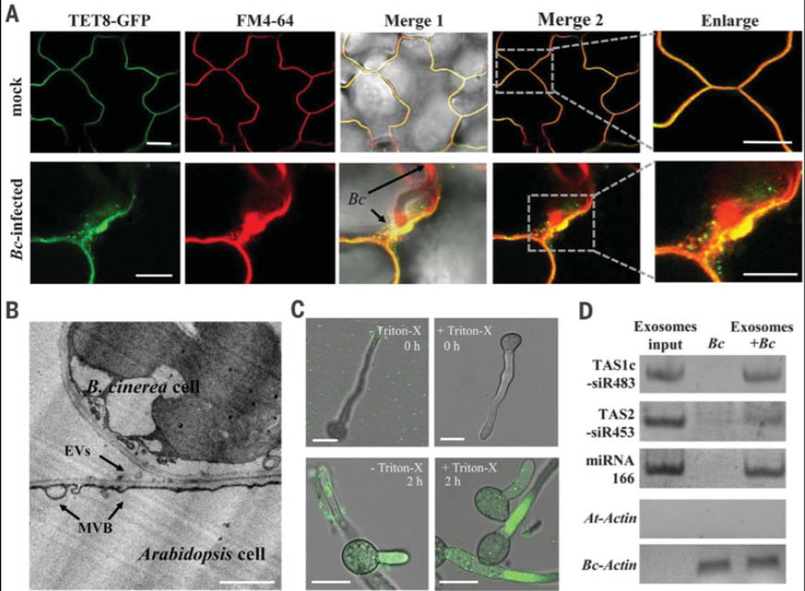

Slide 8
MicroRNA-224 down-regulates Glycine N-methyltransferase gene expression in Hepatocellular Carcinoma
Jung-Hsien Hung 1 2, Chung-Hsien Li, Sci Rep
. 2018 Aug 16;8(1):12284. doi: 10.1038/s41598-018-30682-5. Cited Can’t Find
Abstract: Verify the regulatory mechanism of miR-224 and GNMT in liver cancer
Method: Hepatocellular carcinoma cells and mice were treated with CCl4 to establish a liver injury model, monitoring the changes and expression levels of GNMT and miR-224.
Aim: Controlling the progression of liver cancer using AAV-mediated GNMT.
Solved Problem:Slow down the progression of liver cancer and assist in the treatment of liver cancer.
Important Word:
GNMT: 肝脏高表达关键代谢酶, 调控一碳代谢、SAM/SAH 平衡、维持基因组稳定
miR-224: 致癌微小 RNA, 专门废掉 GNMT（护肝抑癌基因）
AAV: 腺相关病毒，一种安全、常用、不致病的基因递送工具

Slide 9
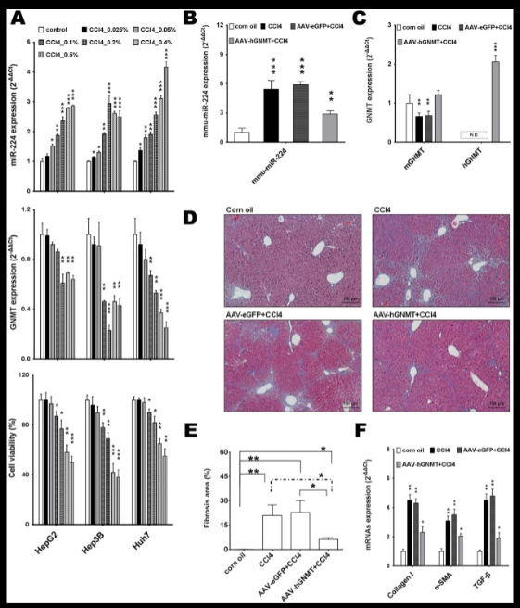
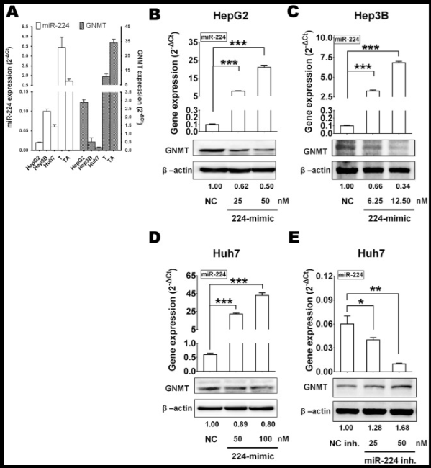

Slide 10
Large-Scale Functional Analysis of CRP-Mediated Feed-Forward Loops
Chi-Dung Yang 1 2 3 4 5, Hsi-Yuan Huang 6 7 8 9. Int J Mol Sci. 2018 Aug 9;19(8):2335. doi: 10.3390/ijms19082335.
Abstract: Research the regulatory mechanism of CRP-FFLsMethod:
Methods: Through gene chip experiments, monitoring the expression of target genes downstream of CPR-FFL under different concentrations of cAMP.
Aim: Research genes’ expression through CRP-FFL with 8 different models.
Solved Problem: Don’t really know.
Important Word:
FFL (Feed-forward loop) 前馈环路: 基因调控网络里最常见的三元小回路，稳基因表达、滤掉噪声、响应环境
CRP：大肠杆菌核心全局转录调控蛋白，感知能量 / 营养（cAMP），控制几百个基因
cAMP: 环磷酸腺苷, 细胞里的小分子信号、第二信使，是细胞的能量警报器

Slide 11
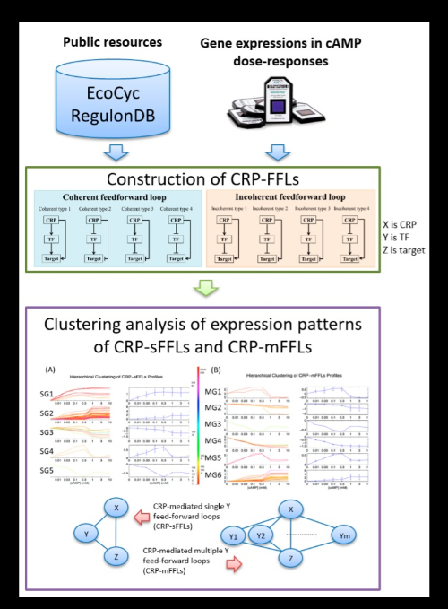
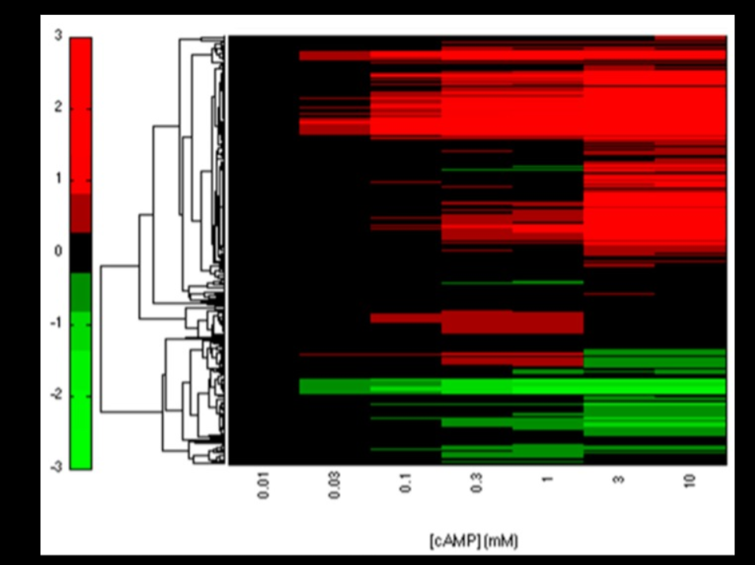

Slide 12
Ouroboros resembling competitive endogenous loop (ORCEL) in circular RNAs revealed through transcriptome sequencing dataset analysis
Yu-Chen Liu 1 2 3, Hsiao-Chin Hong 2. BMC Genomics. 2018 May 9;19(Suppl 2):171. doi: 10.1186/s12864-018-4456-9.
Abstract: A type of circular RNA was found to have a head-to-tail self-cyclic regulatory pattern. (ORCEL)
Method: Analyze 465 sets of transcriptome sequencing data + 22 existing literatures
Aim: predict and analyze cooperation between circRNA and miRNA, showing new RNA Self-regulatory mechanism.
Solved Problem: Don’t really know
Important Word:
circRNA: 首尾连成圈，很稳定、寿命长
miRNA sponge: 海绵一样把 miRNA 吸住，导致miRNA失效，基因表达不再被抑制
ORCEL：自我闭环调控的回路，形成：宿主基因 → circRNA ↔ miRNA → 抑制宿主基因

Slide 13
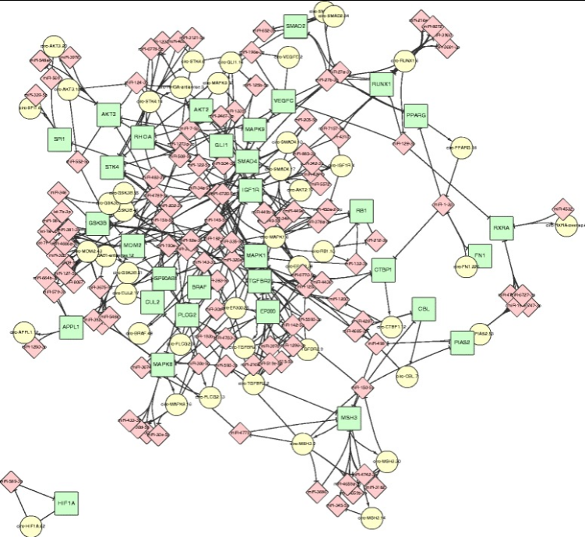
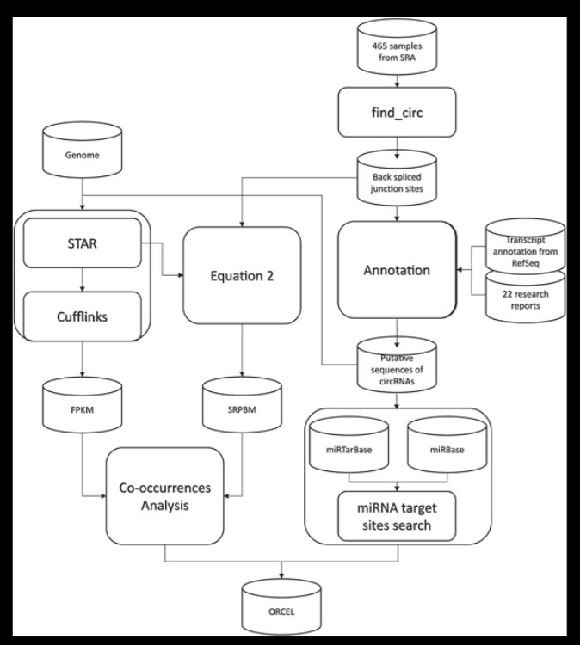

Slide 14
第一部分小结： 做了五个黄教授的首页论文的分析，黄教授的项目有关microRNA的数据库搭建，其他四个都不是黄教授的一作，为一些具体的实操和实验的的项目，包括sRNA, GNMT-miR-224、CPR-FFL, ORCEL, 可用于补充大型的microRNA工作数据库的辅助，但有部分实验较难理解，涉及专业领域太多。 后续将着重黄教授的一作论文：包括microRNA数据库的构建和更新，机器学习在生物信息工程环境下的训练的方法模型和肝癌相关实验和模型论文。
01

Slide 15
特异性粗读
02

Slide 16
miRTarBase update 2018: a resource for experimentally validated microRNA-target interactions
Chih-Hung Chou1,2,†, Sirjana Shrestha2,†. D296–D302 Nucleic Acids Research, 2018, Vol. 46, Database issue, cited by 1880, 2018
Abstract: Update miTarBase database, organize 422517 samples for MTIs, Newly added functions include target site download, machine learning feature extraction, and diversified browsing.
Method: 8500 documents
Aim: Provide a more accurate miRNAdatabase to improve the accuracy of related tools
Solved Problem: not enough data and data training for MTIs
Important Word:
MTIs:微小核苷酸-靶标相互作用
target site sequence: 靶向位点序列

Slide 17
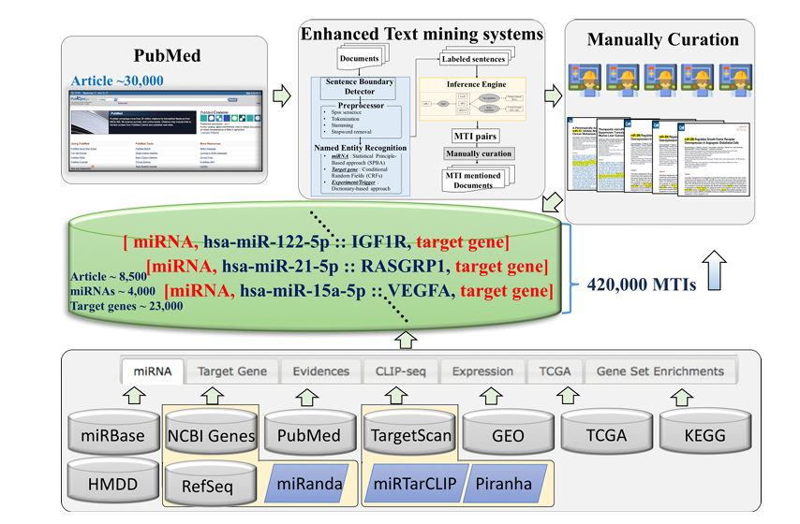

Slide 18
miRTarBase: a database curates experimentally validated microRNA–target interactions
Sheng-Da Hsu1, Feng-Mao Lin1, Wei-Yun Wu1, Chao Liang1, Wei-Chih Huang1, Nucleic Acids Research, 2011, Vol. 39, Database issue D163–D169,Cited by 1607, 2011
Abstract: Includes 3576 MTIs from 17 species
Method: Using the system data to find special articles and verifies the data through experiments.
Aim: Construct a miRTarBase database with abundant data and experimentally verified information
solved Problems: The amount of relevant research data in similar databases is insufficient.
Important Word:
MTIs:微小核苷酸-靶标相互作用, 指 miRNA 通过碱基互补配对的方式，结合到靶基因的信使 RNA（mRNA）上（主要结合位点为 mRNA 的 3' 非编码区，即 3'UTR，少数在 5'UTR 或编码区），进而在转录后水平对靶基因的表达进行负调控的分子相互作用关系，是 miRNA 实现对细胞生命活动调控的唯一途径。

Slide 19
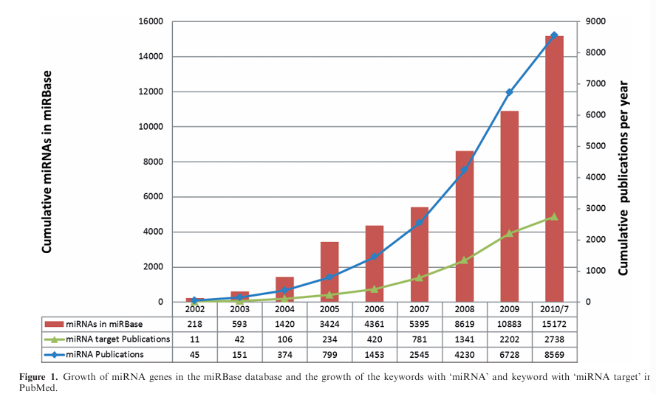

Slide 20
Fungal Small RNAs Suppress Plant Immunity by Hijacking Host RNA Interference Pathways
Science. 2013 October 4; 342(6154): 118–123. doi:10.1126/science.1239705，Arne Weiberg1,2,3,*, Ming Wang1,2,3,*, Feng-Mao Lin4，cited by 1546
Abstract: Prove small RNAs secreted by Botrytis cinerea can cilent plant immune genes.
Method: Construct Arabidopsis ago1 mutants(突变体) and Botrytis cinerea dcl1 dcl2 double mutants, and verify the pathogenic regulatory function(治病调控功能） of Bc-sRNAs through molecular interaction detection.
Aim: Research how small RNA influent other plants’ immune mechanism by sRNA robs RNAi system in the plants, whtich cause suppress immunity.
solved Problems: Find a new method to Regulate host gene expression
Important Word:
Bc-sRNAs：灰葡萄孢产生的致病性小 RNA，可劫持植物 RNAi 系统、沉默宿主免疫基因，帮助真菌侵染致病。
AGO1 蛋白：植物核心 RNA 干扰通路关键蛋白，可结合真菌 Bc-sRNAs，介导宿主免疫基因沉默、助力病原菌侵染。

Slide 21
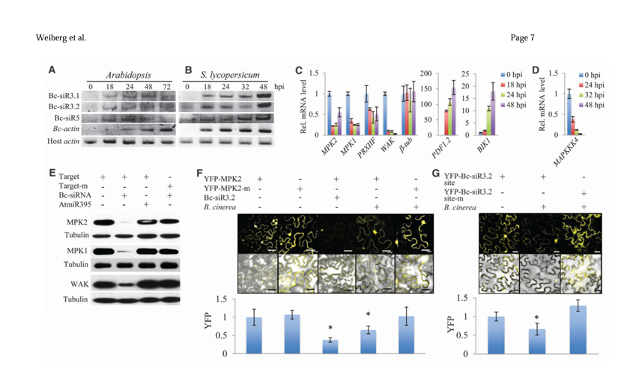

Slide 22
miRTarBase 2016: updates to the experimentally validated miRNA-target interactions database
Nucleic Acids Research, Volume 44, Issue D1, 4 January 2016, Pages D239–D247,Chih-Hung Chou , Nai-Wen Chang , Sirjana Shrestha , Cited by 1184
Abstract: The miRTarBase database has been newly updated and expanded, integrating a large amount of experimental data to make it a more comprehensive miRNA-target gene interaction database.
Method: The system integrates(整合) CLIP-seq data, classical experimental verification results, and TCGA expression profiles(表达谱)
Aim: Provide a better miRNA database
solved Problems: The problems of scattered interaction data(分散的交互数据) and inconsistent verification information.
Important Word:
CLIP‑seq: 结合交联、免疫富集与高通量测序，鉴定 RNA 结合蛋白在体内 RNA 精准结合位点的技术。
TCGA: 表达谱是癌症基因组图谱计划收录、涵盖海量肿瘤与正常样本的 miRNA 及基因全局表达大数据资源

Slide 23
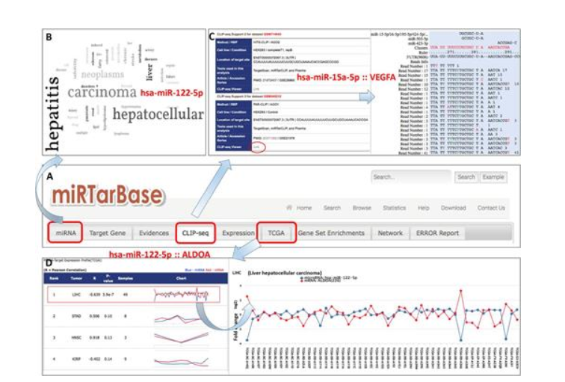

Slide 24
α-ketoglutarate orchestrates macrophage activation through metabolic and epigenetic reprogramming
Nature Immunology volume 18, pages985–994 (2017)Cite this article, Pu-Ste Liu, Haiping Wang, Xiaoyun Li, Tung Chao, Cited by 1151
Abstract: Shows that αKG produced by glutamine metabolism(谷氨酰胺代谢) and the remodeling of its ratio with succinate(其与琥珀酸盐比例的重塑) regulate macrophage(巨噬细胞） M1/M2 polarization（极化） and immune tolerance.
Method: Regulate the proportion of αKG, observe data on macrophage polarization responses
Aim: Find deeper mechanism between aKG and macrophage M1/M2
solved Problems: The core mechanism of different immune reaction of macrophages and endotoxin tolerance(内毒素耐受）.
Important Word:
αKG: α- 酮戊二酸，是谷氨酰胺分解代谢产物，可调控巨噬细胞 M2 极化、表观遗传重编程及免疫稳态。
M1/M2: 巨噬细胞在微环境信号调控下极化为促炎杀菌的 M1 型和抗炎修复的 M2 型，是免疫应答双向调控的核心机制。

Slide 25


Slide 26
miRTarBase update 2022: an informative resource for experimentally validated miRNA–target interactions
Nucleic Acids Research, Volume 50, Issue D1, 7 January 2022, Pages D222–D230, Hsi-Yuan Huang , Yang-Chi-Dung Lin , Shidong Cui, Cited by 980
Abstract: The core mechanism of different immune phenotypes of macrophages and endotoxin tolerance.
Method: Integrate massive literature(文献） and CLIP-seq data, optimize the scoring system, annotate variations(编译注释） and expression profiles（表达谱）, and improve the interface and binding site analysis.
Aim: Make a comprehensive, accurate, and user-friendly experimentally validated miRNA-target gene interaction database
solved Problems: It solves the problems of scattered(分散的） miRNA target data, incomplete annotations, and unfriendly scoring and interface, and provides high-quality retrievable MTI resources.

Slide 27
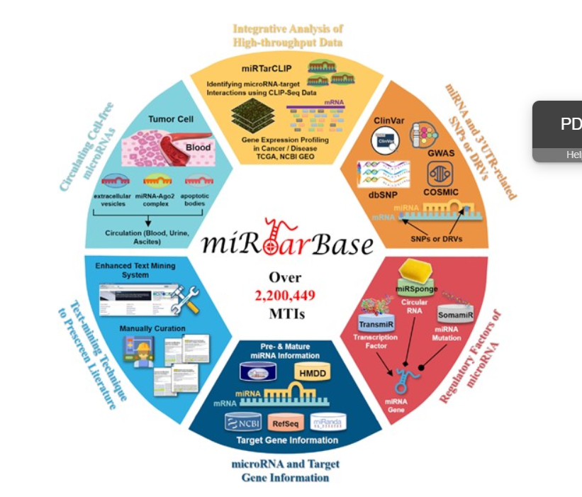

Slide 28
单击此处添加标题
单击此处输入你的正文
Abstract:
Method:
Aim:
solved Problems:
Important Word:

Slide 29
THANK YOU
YOUR LOGO
汇报人：稻壳儿

