Slide 1
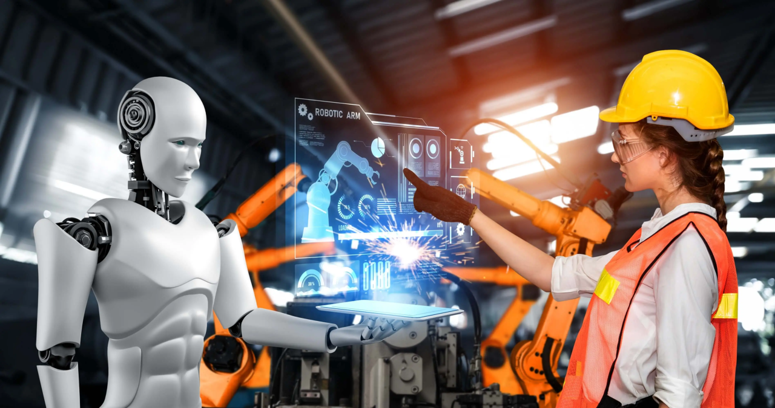
Hi, my friend, I think you need my help!!
BRILLIANT!!!

