Slide 1



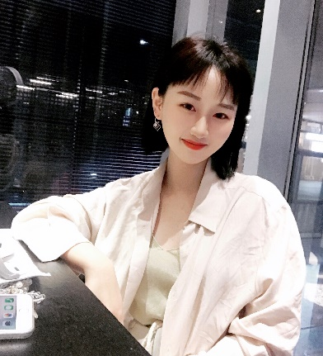

My name is YANG KEQI
Hello everyone！
Native place：The earth
Age：18
School：Xiamen University Malaysia

Slide 2




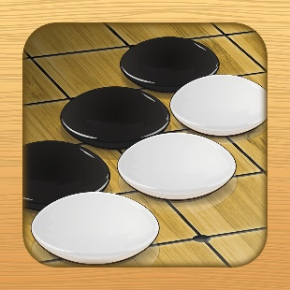
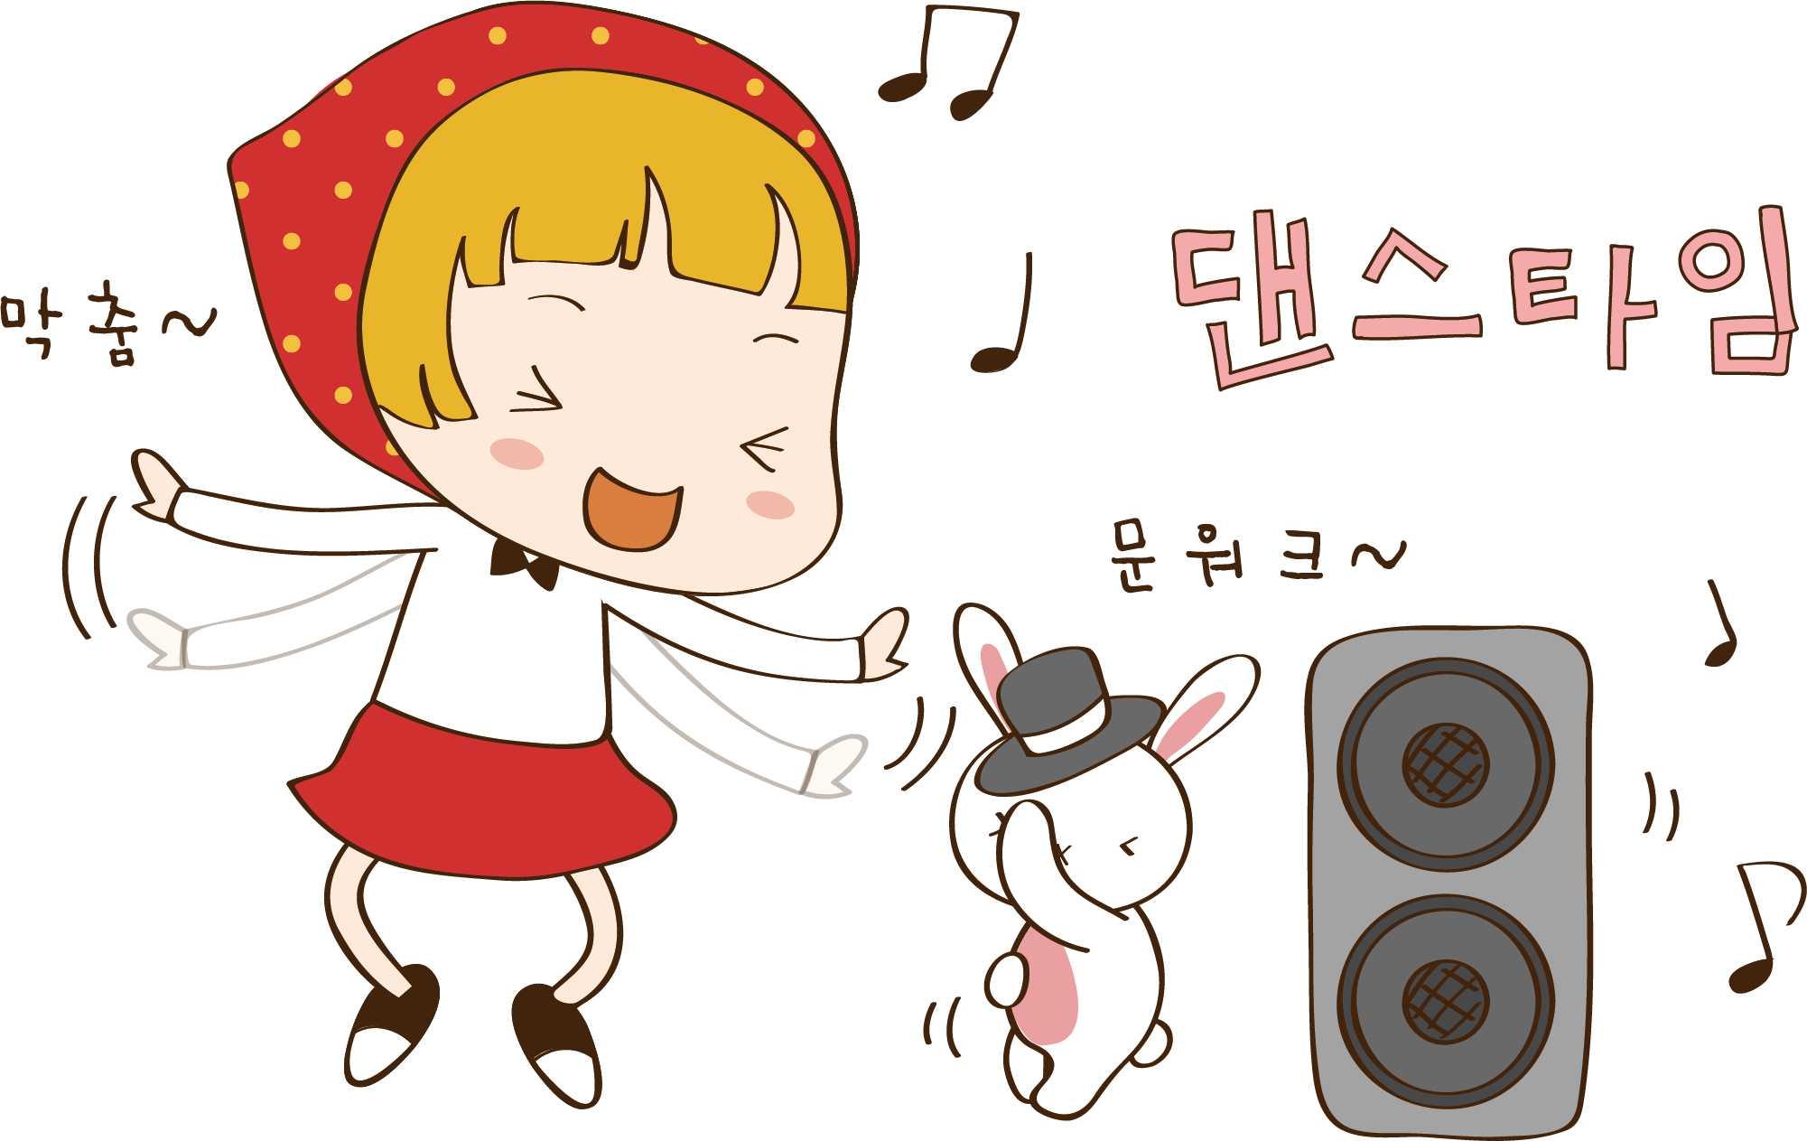
My
hobby
I like reading. Because books can make me get a lot of new knowledge.
I also play go in my spare time.
Like many people, I listen to music to relax.

Slide 3

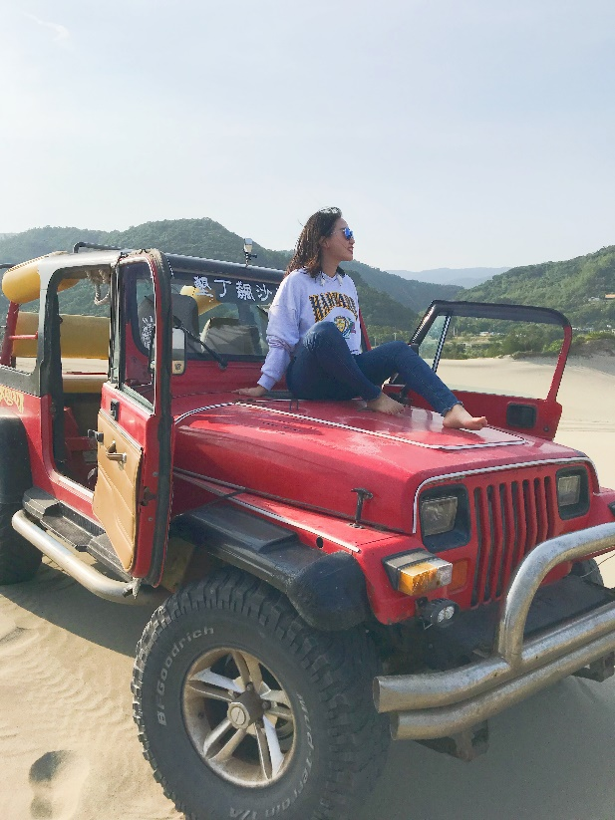
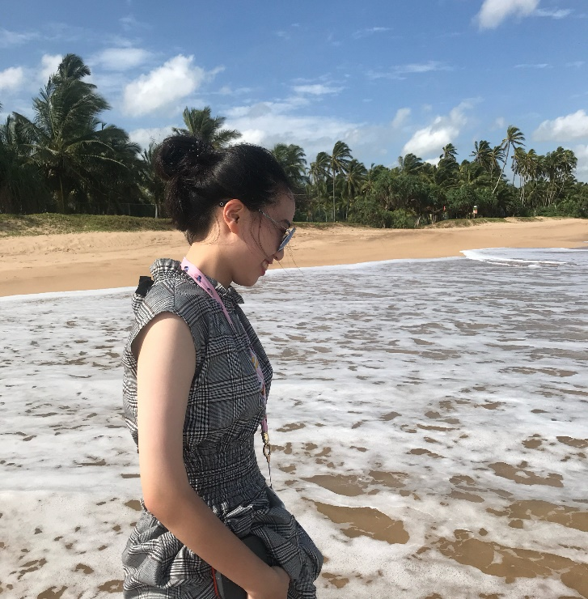
My life
In Sri Lanka
I like to go far away to look for the most beautiful scenery.
In Taiwan

Slide 4


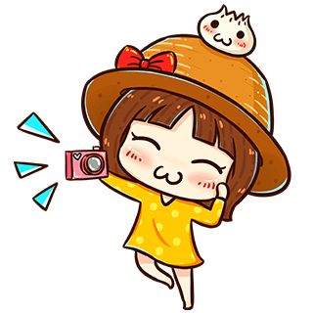
Thank you!!
I hope everyone can like me!!

