Slide 1
DecisionPoint-3 Training Day 1 November 2013

Slide 2

Agenda
 | Introduction
 | Training Objectives
 | DecisionPoint 3 Overview

Slide 3
Introduction
About Veda
Veda is the largest credit reference agency in Australia and New Zealand.
It provides Credit Reporting, Credit Scoring, and Marketing analytics services.
Largest, most comprehensive and current data source in Australia and New Zealand.
Veda has international footprint in Singapore, Malaysia, Cambodia and Saudi Arabia.

Slide 4
Introduction
About DecisionPoint3
DecisionPoint 3 is Veda’s 3rd generation decisioning system, designed to help Veda’s customers automate their decisioning process - to enable fast but accurate decisions.
DecisionPoint 3 allows a clients’ business team to drive decisioning policies, strategies and rules through the framework of a strategy design studio (DecisionPoint 3 Studio).
DecisionPoint 3 is a risk data and bureau management solution which helps the business to create a complete picture of the customer through information gathering and data modelling to provide better informed credit decisions. Everyday decisions can be improved for questions such as:
Should I increase the customer’s credit limit?
Should I offer the customer a new loan account?
Should I add a credit card facility to the customer’s account?

Slide 5
Training Objectives
Training Objectives are as below -
Understanding the concepts around DecisionPoint3 product
Setup and configure the DP3 product
Perform Data Modelling, Scripting & Building DataLink Paths
Building Decision Paths & Process Paths
Packaging and Publishing Business Services
Create paths using all available path objects
Getting familiar to Connectors, Trade Credit Solution
Develop and deploy DP3 Solution

Slide 6
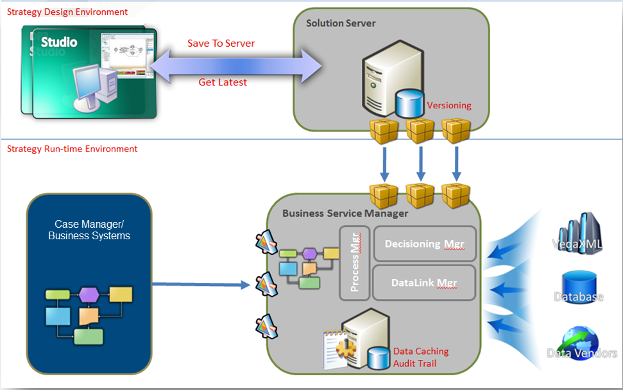
DecisionPoint3 Overview
DecisionPoint 3 tools:
Studio
Solution Server
Business Service Manager
Case manager
Case Manager Management Console
DecisonPoint 3 Studio allows the user to design Solutions in line with their credit risk strategies in order to retrieve data and make decisions for credit applications
DataLink Manager
Decision Manager
Process Manager

Slide 7
DecisionPoint3 Overview
DecisionPoint 3 tools:
Studio
Solution Server
Business Service Manager
Case manager
Case Manager Management Console
DecisonPoint 3 Studio allows the user to design Solutions in line with their credit risk strategies in order to retrieve data and make decisions for credit applications
DataLink Manager
Decision Manager
Process Manager

Slide 8
DecisionPoint3 Overview
DecisionPoint 3 is made up of three modules:
DataLink Manager
Decision Manager
Process Manager
One can elect to implement all, a combination, or just one of these components with existing decisioning or workflow engine.

Slide 9
DecisionPoint3 Overview
DecisionPoint 3 is made up of three modules:
DataLink Manager
Decision Manager
Process Manager
One can elect to implement all, a combination, or just one of these components with existing decisioning or workflow engine.

Slide 10
DecisionPoint3 Overview
DataLink Manager :
It gathers, interacts with, and derives customer information from internal and external data sources and credit bureaux.
The business can design data strategies which control what data is requested from which data sources, how data is analysed and decisions communicated back to Case Manager or business systems.
DataLink Manager allows the business to convert the raw bureau data into meaningful information which can be fed back into the business’ decisioning strategy and provide decisions.
Caching capabilities allow to define rules to control costs, by checking cached
records – before making a decision on repurchasing data records.

Slide 11
DecisionPoint3 Overview
Decision Manager :
It enables the user to create scorecards and policies and draw data through dedicated Decision paths which enable deeper analysis and segmentation of customers.
The Decision Manager allows the user to create Decision Models and apply Policy Rules against decision outcomes such as approving or declining a credit application.
Additionally, the Decision Manager allows the user to add product offerings and apply terms of business, by way of Strategy Tables.
For example each business unit of an enterprise can implement its own risk strategies, to account for risks relevant to each unit – this flexibility results in more tailored strategies across different business units

Slide 12
DecisionPoint3 Overview
Process Manager :
IT provides the link between DataLink Manager and Decision Manager.
The user can create Process paths which can incorporate both DataLink paths and Decision paths allowing the user to combine the functionality of both modules in a single workflow.
In addition the process paths allow the user to add notifications and documents to the path to alert customers or DecisionPoint 3 users as to application progress or send standard letters, for example.

Slide 13
DecisionPoint3 Overview
Benefits of using DecisionPoint3 Studio
A powerful and user friendly strategy design environment that lets you create and manage data strategies and decision paths
Define the data you need with the automatic WSDL Generator ‘Your Data strategy’. When the strategy is rolled-out to production, the web service WSDL is automatically generated
Derive new characteristics from data using Action Scripting - a powerful scripting language that can be applied to business operations and accompanying calculations
Streamlined deployment enables an efficient integration process for creating, packaging, and deploying paths into production or test environments
Don’t re-invent the wheel. With object sharing and re-use, you can define once, share with others - and then re-use
Choose which information you share - whether it’s strategy paths, data objects and classes, rules, or actions. You can share this enterprise-wide, or at your discretion.

Slide 14
Thank You

