Slide 1
计算机系统结构实验课
JSI
Slides taken (with permission) from:
Derek Chiou (UT Austin)
Arvind and collaborators (MIT)

Slide 2
Outlines
Introduction
Bluespec: Combinational Circuits
Bluespec: Sequential Circuits
Practices:
1: Right Shifter (Gate Primitives)
2: Right Shifter (Pipelined)
3: SMIPS Microprocessor (Unpipelined)
4: SMIPS Microprocessor (Pipelined)

Slide 3
Outlines
Introduction
Bluespec: Combinational Circuits
Bluespec: Sequential Circuits
Practices:
1: Right Shifter (Gate Primitives)
2: Right Shifter (Pipelined)
3: SMIPS Microprocessor (Unpipelined)
4: SMIPS Microprocessor (Pipelined)

Slide 4
What is Bluespec?
A hardware design environment
A language(Bluespec System Verilog)
A workstation
A compiler
A simulator

Slide 5
Practice Environment
Lab Server:
IP Address: 123.56.146.28
Port: 5126
Username: your student ID (e.g., SY1906310)
Password: your student ID (e.g., SY1906310)
Change the password after you login in.
Note that Your account is created temporarily and shall be deleted at the end of this course, so don’t leave important data there.

Slide 6
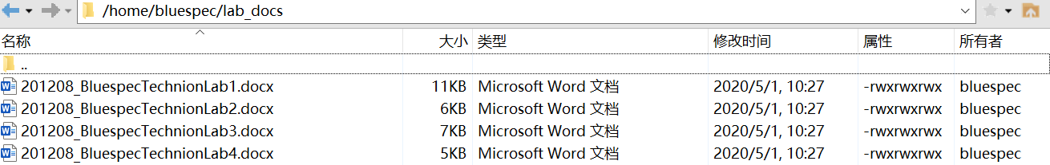
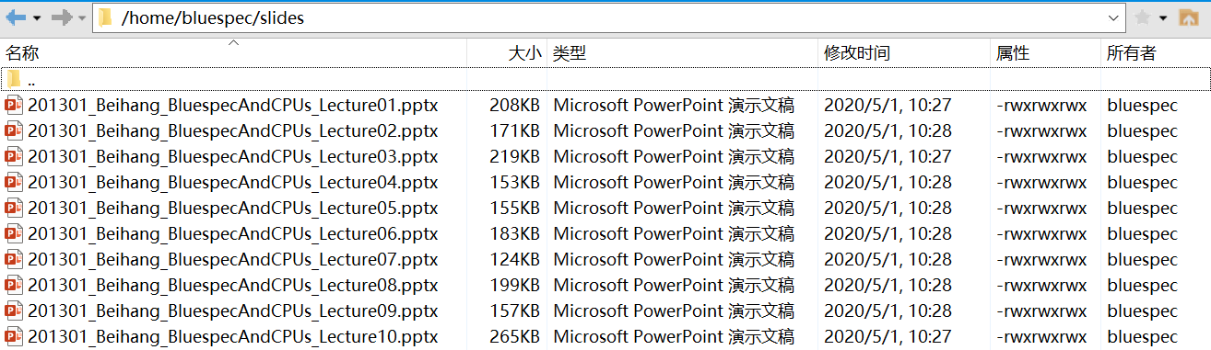
Practice Materials
Lab Docs (/home/bluespec/lab_docs)
Slides (/home/bluespec/slides)

Slide 7
License Server
Open file ~/.bashrc
Set the Environment Variable
export BLUESPEC_HOME=/tools/bluespec
export BLUESPECDIR=$BLUESPEC_HOME/lib
export PATH=$PATH:$BLUESPEC_HOME/bin
export LM_LICENSE_FILE=/home/bluespec/license/Bluespec_20200428.lic
source ~/.bashrc

Slide 8
HOWTO
1. Copy the lab_template folder to your own dir.
[SY1906310@cu07 ~]$ cp –r /home/bluespec/lab_template/ ./
2. Untar the Lab.tgz files (Lab1 as an example).
[SY1906310@cu07 ~]$ cd lab_template/
[SY1906310@cu07 lab_template]$ tar -xvf Lab1.tgz
3. Enter the directory and run the spec file.
[SY1906310@cu07 lab_template]$ cd Lab1/
[SY1906310@cu07 Lab1]$ bluespec Lab1.bspec

Slide 9
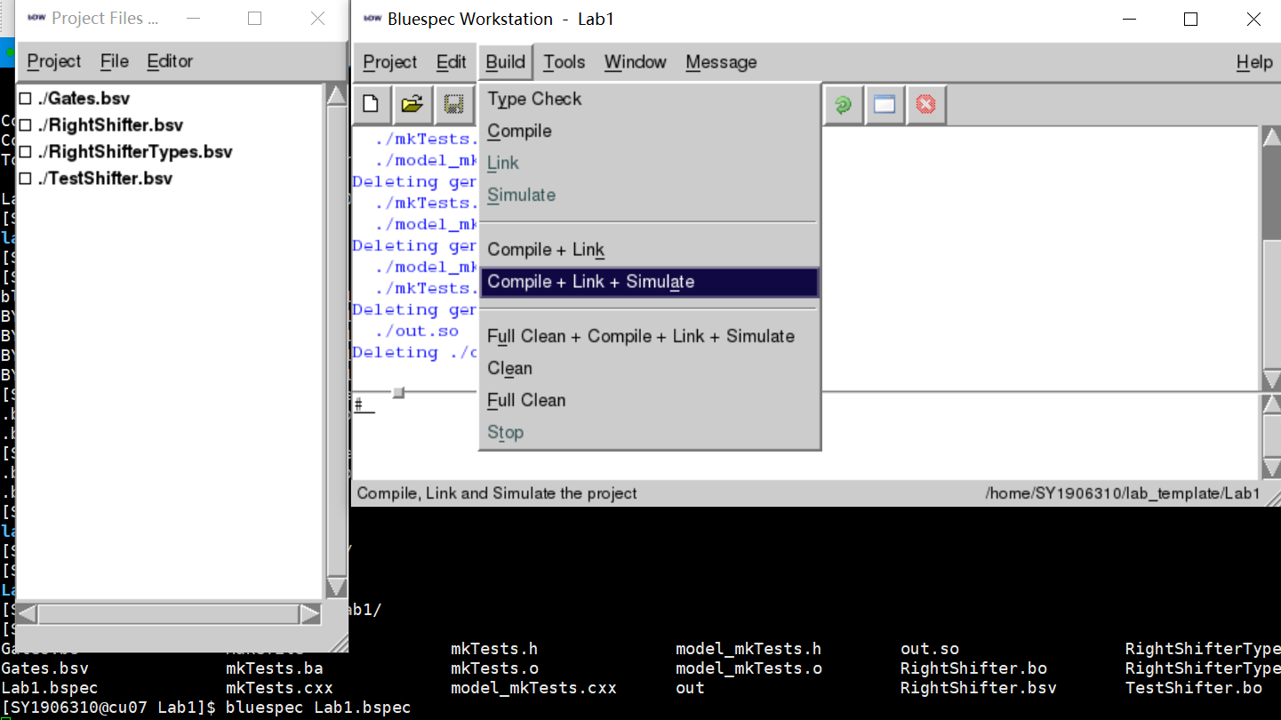
Lab1 Example

Slide 10
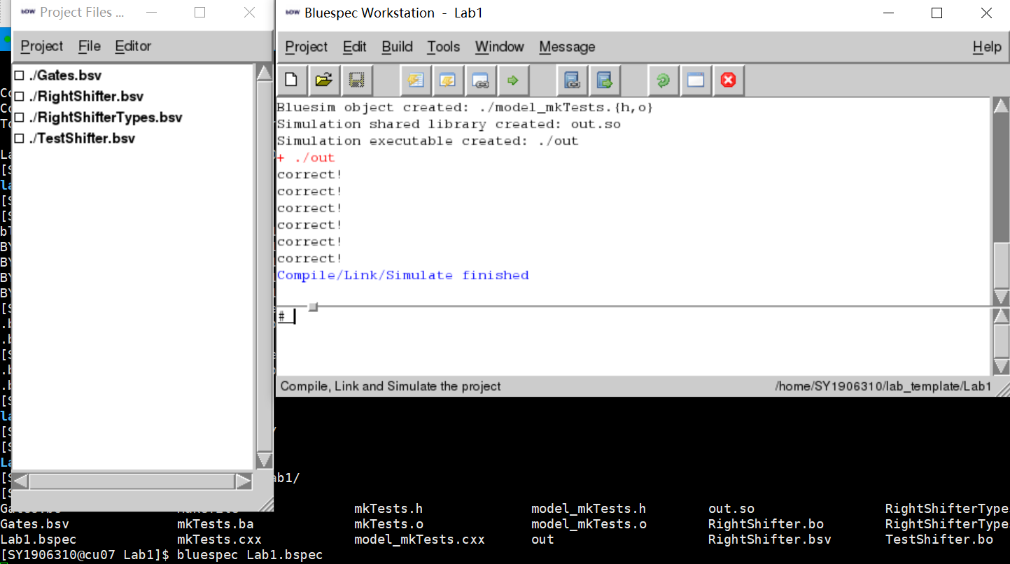
Lab1 Example

Slide 11
Outlines
Introduction
Bluespec: Combinational Circuits
Bluespec: Sequential Circuits
Practices:
1: Right Shifter (Gate Primitives)
2: Right Shifter (Pipelined)
3: SMIPS Microprocessor (Unpipelined)
4: SMIPS Microprocessor (Pipelined)

Slide 12
Content
Design of a combinational ALU starting with primitive gates And, Or and Not
Combinational circuits as acyclic wiring diagrams of primitive gates
Introduction to BSV
Intro to types – enum, typedefs, numeric types, int#(32) vs integer, bool vs bit#(1), vectors
Simple operations: concatenation, conditionals, loops
Functions
Static elaboration and a structural interpretation of the textual code

Slide 13
Combinational circuits are acyclic interconnections of gates
And, Or, Not
Nand, Nor, Xor
…

Slide 14
Simple combinational circuits:
Ripple-carry Adder

Slide 15
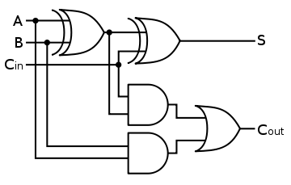
Full Adder: A one-bit adder
function fa(a, b, c_in);
s = (a ^ b)^ c_in;
c_out = (a & b) | (c_in & (a ^ b));
return {c_out,s};
endfunction
Structural code – only specifies interconnection between boxes
Not quite correct –needs type annotations

Slide 16
Full Adder: A one-bit adder corrected
function Bit#(2) fa(Bit#(1) a, Bit#(1) b,
Bit#(1) c_in);
Bit#(1) s = (a ^ b)^ c_in;
Bit#(1) c_out = (a & b) | (c_in & (a ^ b));
return {c_out,s};
endfunction
“Bit#(1) a” type declaration says that a is one bit wide
{c_out,s} represents bit concatenation
How big is {c_out,s}?
2 bits

Slide 17
Types
A type is a grouping of values
Integer: 1, 2, 3, …
Bool: True, False
Bit: 0,1
A pair of Integers: Tuple2#(Integer, Integer)
A function fname from Integers to Integers:
function Integer fname (Integer arg)
Every expression and variable in a Bluespec program has a type; sometimes it is specified explicitly and sometimes it is deduced by the compiler
Thus we say an expression has a type or belongs to a type
Each expression has a unique type

Slide 18
Type declaration versus deduction
The programmer writes down types of some expressions in a program and the compiler deduces the types of the rest of expressions
If the type deduction cannot be performed or the type declarations are inconsistent then the compiler complains
function Bit#(2) fa(Bit#(1) a, Bit#(1) b,
Bit#(1) c_in);
Bit#(1) s = (a ^ b)^ c_in;
Bit#(2) c_out = (a & b) | (c_in & (a ^ b));
return {c_out,s};
endfunction
type error
Type checking prevents lots of silly mistakes

Slide 19
2-bit Ripple-Carry Adder
Fa can be used as a black box as long as we understand its type signature and its function
x[0]
y[0]
x[1]
y[1]
fa
c[1]
fa
c[0]
c[2]
s[0]
s[1]
function Bit#(3) add(Bit#(2) x, Bit#(2) y,
Bit#(1) c0);
Bit#(2) s = 0; Bit#(3) c=0; c[0] = c0;
let cs0 = fa(x[0], y[0], c[0]);
c[1] = cs0[1]; s[0] = cs0[0];
let cs1 = fa(x[1], y[1], c[1]);
c[2] = cs1[1]; s[1] = cs1[0];
return {c[2],s};
endfunction
The “let” syntax avoids having to write down types explicitly

Slide 20
“let” syntax
The “let” syntax: asks compiler to infer type
avoids having to write down types explicitly
let cs0 = fa(x[0], y[0], c[0]);
Bits#(2) cs0 = fa(x[0], y[0], c[0]);
The same

Slide 21
Parameterized types: #
A type declaration itself can be parameterized by other types
Parameters are indicated by using the syntax ‘#’
For example Bit#(n) represents n bits and can be instantiated by specifying a value of n
Bit#(1), Bit#(32), Bit#(8), …

Slide 22
An w-bit Ripple-Carry Adder
function Bit#(w+1) addN(Bit#(w) x, Bit#(w) y,
Bit#(1) c0);
Bit#(w) s; Bit#(w+1) c=0; c[0] = c0;
for(Integer i=0; i<w; i=i+1)
begin
let cs = fa(x[i],y[i],c[i]);
c[i+1] = cs[1]; s[i] = cs[0];
end
return {c[w],s};
endfunction
Not quite correct
Unfold the loop to get the wiring diagram
x[0]
y[0]
x[1]
y[1]
x[w-1]
y[w-1]
fa
c[1]
fa
c[2]
c[w-1]
fa
c[w]
c[0]
cs
…
s[0]
s[1]
s[w-1]

Slide 23
Instantiating the parametric Adder
function Bit#(w+1) addN(Bit#(w) x, Bit#(w) y,
Bit#(1) c0);
Define add32, add3 … using addN
// concrete instances of addN!
function Bit#(33) add32(Bit#(32) x, Bit#(32) y,
Bit#(1) c0) = addN(x,y,c0);
function Bit#(4) add3(Bit#(3) x, Bit#(3) y,
Bit#(1) c0) = addN(x,y,c0);

Slide 24
valueOf(w) versus w
Each expression has a type and a value and these come from two entirely disjoint worlds
w in Bit#(w) resides in the types world
Sometimes we need to use values from the types world into actual computation. The function valueOf allows us to do that
Thus
i<w is not type correct
i<valueOf(w)is type correct

Slide 25
TAdd#(w,1) versus w+1
Sometimes we need to perform operations in the types world that are very similar to the operations in the value world
Examples: Add, Mul, Log
We define a few special operators in the types world for such operations
Examples: TAdd#(m,n), TMul#(m,n), …

Slide 26
A w-bit Ripple-Carry Adder corrected
function Bit#(TAdd#(w,1)) addN(Bit#(w) x, Bit#(w) y,
Bit#(1) c0);
Bit#(w) s; Bit#(TAdd#(w,1)) c=0; c[0] = c0;
let valw = valueOf(w);
for(Integer i=0; i<valw; i=i+1)
begin
let cs = fa(x[i],y[i],c[i]);
c[i+1] = cs[1]; s[i] = cs[0];
end
return {c[valw],s};
endfunction

Slide 27
A w-bit Ripple-Carry Adder
function Bit#(TAdd#(w,1)) addN(Bit#(w) x, Bit#(w) y,
Bit#(1) c0);
Bit#(w) s; Bit#(TAdd#(w,1)) c; c[0] = c0;
let valw = valueOf(w);
for(Integer i=0; i<valw; i=i+1)
begin
let cs = fa(x[i],y[i],c[i]);
c[i+1] = cs[1]; s[i] = cs[0];
end
return {c[valw],s};
endfunction
types world
equivalent of w+1
Lifting a type into the value world
Structural interpretation of a loop – unfold it to generate an acyclic graph

Slide 28
Static Elaboration phase
When Bluespec program are compiled, type checking is done first. Then the compiler eliminates many constructs which have no direct hardware meaning, like Integers, loops
for(Integer i=0; i<valw; i=i+1) begin
let cs = fa(x[i],y[i],c[i]);
c[i+1] = cs[1]; s[i] = cs[0];
end
cs0 = fa(x[0], y[0], c[0]); c[1]=cs0[1]; s[0]=cs0[0];
cs1 = fa(x[1], y[1], c[1]); c[2]=cs1[1]; s[1]=cs1[0];
…
csw = fa(x[valw-1], y[valw-1], c[valw-1]);
c[valw] = csw[1]; s[valw-1] = csw[0];

Slide 29
Integer versus Int#(32)
In mathematics integers are unbounded but in computer systems integers always have a fixed size
Bluespec allows us to express both types of integers, though unbounded integers are used only as a programming convenience
for(Integer i=0; i<valw; i=i+1)
begin
let cs = fa(x[i],y[i],c[i]);
c[i+1] = cs[1]; s[i] = cs[0];
end

Slide 30
Type synonyms
typedef bit [7:0] Byte;
typedef Bit#(8) Byte;
typedef Bit#(32) Word;
typedef Tuple2#(a,a) Pair#(type a);
typedef Int#(n) MyInt#(type n);
typedef Int#(n) MyInt#(numeric type n);
The same
The same
Notes:
Define MyInt

Slide 31
Arithmetic-Logic Unit (ALU)
Op
- Add, Sub, ...
- And, Or, Xor, Not, ...
- GT, LT, EQ, Zero, ...
A
ALU
Result
B
Comp?
ALU performs all the arithmetic and logical functions
We first implement individual functions like Add and then combine them to form an ALU

Slide 32
Shift operators

Slide 33
Logical right shift by 2
a b c d
0
0
0 0 a b
Fixed size shift operation is cheap in hardware – just wire the circuit appropriately
Rotate, sign-extended shifts – all are equally easy

Slide 34
Conditional operation: shift versus no-shift
0
0
s
We need a mux to select the appropriate wires: if s is one the mux will select the wires on the left otherwise it would select wires on the right
(s==0)?{a,b,c,d}:{0,0,a,b};

Slide 35
A 2-way multiplexer
A
A
AND
B
OR
S
B
AND
S
(s==0)?A:B
Gate-level implementation
We will use conditional expressions which will be synthesized using muxes

Slide 36
A 4-way multiplexer
A
case {s1,s0} matches
0: A;
1: B;
2: C;
3: D;
endcase
B
S₀
C
S₁
D
S₀

Slide 37
Logical right shift by n
Shift n can be broken down in log n steps of fixed-length shifts of size 1, 2, 4, …
Shift 3 can be performed by doing a shift 2 and shift 1
We need a mux to omit a particular size shift
Shift circuit can be expressed as log n nested conditional expressions
0
0
s1
0
s0
You will write a Blusepec program to produce a variable size shifter in Lab 1

Slide 38
A Degression on Types
Suppose we have a variable c whose values can represent three different colors
We can declare the type of c to be Bit#(2) and say that 00 represents Red, 01 Blue and 10 Green
A better way is to create a new type called Color as follows:
typedef enum {Red, Blue, Green}
Color deriving(Bits, Eq);
Types prevent us from mixing raw bits and bits that represent color
The compiler will automatically assign some bit representation to the three colors and also provide a function to test if two colors are equal. If you do not use “deriving” then you will have to specify the representation and equality

Slide 39
Enumerated types
typedef enum {Red, Blue, Green}
Color deriving(Bits, Eq);
typedef enum {Eq, Neq, Le, Lt, Ge, Gt, AT, NT}
BrFunc deriving(Bits, Eq);
typedef enum {Add, Sub, And, Or, Xor, Nor, Slt, Sltu, LShift, RShift, Sra}
AluFunc deriving(Bits, Eq);
Each enumerated type defines a new type
Notes:
Can same text be in 2 enumerated types?

Slide 40
Combinational ALU
function Data alu(Data a, Data b, AluFunc func);
Data res = case(func)
Add : (a + b);
Sub : (a - b);
And : (a & b);
Or : (a | b);
Xor : (a ^ b);
Nor : ~(a | b);
Slt : zeroExtend( pack( signedLT(a, b) ) );
Sltu : zeroExtend( pack( a < b ) );
LShift: (a << b[4:0]);
RShift: (a >> b[4:0]);
Sra : signedShiftRight(a, b[4:0]);
endcase;
return res;
endfunction
Given an implementation of the primitive operations like addN, Shift, etc. the ALU can be implemented simply by introducing a mux controlled by op to select the appropriate circuit

Slide 41
Comparison operators
function Bool aluBr(Data a, Data b, BrFunc brFunc);
Bool brTaken = case(brFunc)
Eq : (a == b);
Neq : (a != b);
Le : signedLE(a, 0);
Lt : signedLT(a, 0);
Ge : signedGE(a, 0);
Gt : signedGT(a, 0);
AT : True;
NT : False;
endcase;
return brTaken;
endfunction
Notes:
41

Slide 42
ALU including Comparison operators
a
b
…
Eq
LShift
…
Add
func
mux
mux
brFunc

Slide 43
Complex combinational circuits
Multiplication

Slide 44
Multiplication by repeated addition
b Multiplicand
a Muliplier *
1101 (13)
1011 (11)
1101
+ 1101
+ 0000
+ 1101
10001111 (143)
a0
m0
a1
m1
0
add4
a2
m2
add4
a3
m3
mi = (a[i]==0)? 0 : b;
add4

Slide 45
Combinational 32-bit multiply
function Bit#(64) mul32(Bit#(32) a, Bit#(32) b);
Bit#(32) prod = 0; Bit#(32) tp = 0; for(Integer i = 0; i < 32; i = i+1) begin Bit#(32) m = (a[i]==0)? 0 : b; Bit#(33) sum = add32(m,tp,0); prod[i] = sum[0]; tp = truncateLSB(sum); end return {tp,prod}; endfunction

Slide 46
Design issues with combinational multiply
Lot of hardware
32-bit multiply uses 31 add32 circuits
Long chains of gates
32-bit ripple carry adder has a 31-long chain of gates
32-bit multiply has 31 ripple carry adders in sequence!
The speed of a combinational circuit is determined by its longest input-to-output path
Can we do better?

Slide 47
What Did We Learn?
Combinational circuits in Bluespec
Add, shift, multiply
Bluespec Types
Parameterized
valueOf
Tadd#
Integer vs Int#
Enumerated Types
Static Elaboration

Slide 48
Outlines
Introduction
Bluespec: Combinational Circuits
Bluespec: Sequential Circuits
Practices:
1: Right Shifter (Gate Primitives)
2: Right Shifter (Pipelined)
3: SMIPS Microprocessor (Unpipelined)
4: SMIPS Microprocessor (Pipelined)

Slide 49
Content
Introduce sequential circuits as a way of saving area
Edge-triggered Flip-flop
Register
New Bluespec concepts
state elements
rules and actions for describing dynamic behavior
modules and methods

Slide 50
Combinational 32-bit multiply
function Bit#(64) mul32(Bit#(32) a, Bit#(32) b);
Bit#(32) prod = 0; Bit#(32) tp = 0; for(Integer i = 0; i < 32; i = i+1) begin Bit#(32) m = (a[i]==0)? 0 : b; Bit#(33) sum = add32(m,tp,0); prod[i] = sum[0]; tp = truncateLSB(sum); end return {tp,prod}; endfunction
Combinational circuit uses 31 add32 circuits
We can reuse the same add32 circuit if we can store the partial results in some storage device, e.g., register

Slide 51
Combinational circuits
Sel
Sel
lg(n)
lg(n)
A₀
A₁
A_{n-1}
O₀
O₁
O_{n-1}
.
O
.
A
.
.
Demux
.
Mux
.
OpSelect
- Add, Sub, ...
- And, Or, Xor, Not, ...
- GT, LT, EQ, Zero, ...
O₀
O₁
O_{n-1}
.
A
.
Decoder
.
A
lg(n)
ALU
Result
B
Comp?
Such circuits have no cycles (feedback) or state elements

Slide 52
A simple synchronous state element
Edge-Triggered Flip-flop
D
ff
Q
C
C
D
Q
Metastability possible if data available too late
Data is sampled at the rising edge of the clock

Slide 53
Flip-flops with Write Enables
EN
D
D
ff
Q
EN
ff
Q
C
C
dangerous!
EN
C
EN
0
1
D
D
C
ff
Q
Q
Data is captured only if EN is on
Notes:
Why dangerous?
Glitches

Slide 54
Registers
D
D
D
D
D
D
D
D
En
C
ff
ff
ff
ff
ff
ff
ff
ff
Q
Q
Q
Q
Q
Q
Q
Q
Register: A group of flip-flops with a common
clock and enable
Register file: A group of registers with a common
clock, input and output port(s)

Slide 55
Register Files
Clock
WE
ReadSel1
ReadData1
Register
file
2R + 1W
ReadSel2
ReadData2
WriteSel
WriteData
RSel1
WSel
C
WData
RData1
register 0
WE
RSel2
register 1
RData2
Reads are combinational and not affected by the write until the next clock cycle

Slide 56
Register Files and Ports
WE
ReadSel1
ReadData1
Register
file
2R + 1W
ReadSel2
ReadData2
WriteSel
WriteData
WE
ReadSel
ReadData
R/WSel
Register
file
1R + 1R/W
R/WData
Ports are expensive ⇒ multiplex single port for read & write

Slide 57
We can build useful and compact circuits using registers
Circuits containing state elements are called sequential circuits

Slide 58
Expressing a loop using registers
int s = s0;
for (int i = 0; i < 32; i = i+1) { s = f(s); } return s; C-code
We need two registers to hold s and i values from one iteration to the next.
These registers are initialized when the computation starts and updated every cycle until the computation terminates
+1
0
f
s0
sel
sel
en
i
en
s
sel = start
en = start | notDone
< 32
notDone

Slide 59
Expressing sequential circuits in Bluespec
Sequential circuits, unlike combinational circuits, are not expressed structurally (as wiring diagrams) in Bluespec
For sequential circuits a designer defines:
State elements by instantiating modules
Reg#(Bit#(32)) s <- mkRegU();
Reg#(Bit#(6)) i <- mkReg(32);
Rules which define how state is to be transformed atomically
rule step if (i < 32); s <= f(s); i <= i+1; endrule
make a 32-bit register which is uninitialized
make a 6-bit register with initial value 32
the rule can execute only when its guard is true
actions to be performed when the rule executes

Slide 60
Rule Execution
When a rule executes:
all the registers are read at the beginning of a clock cycle
the guard and computations to evaluate the next value of the registers are performed
at the end of the clock cycle registers are updated if the guard is true
Muxes are need to initialize the registers
Reg#(Bit#(32)) s <- mkRegU();
Reg#(Bit#(6)) i <- mkReg(32);
rule step if (i < 32); s <= f(s); i <= i+1; endrule
+1
0
f
s0
sel
sel
en
i
en
s
< 32
sel = start
en = start | notDone
notDone

Slide 61
Multiply using registers
function Bit#(64) mul32(Bit#(32) a, Bit#(32) b);
Bit#(32) prod = 0; Bit#(32) tp = 0; for(Integer i = 0; i < 32; i = i+1) begin Bit#(32) m = (a[i]==0)? 0 : b; Bit#(33) sum = add32(m,tp,0); prod[i] = sum[0]; tp = truncateLSB(sum); end return {tp,prod}; endfunction
Combinational version
Need registers to hold a, b, tp, prod and i
Update the registers every cycle until we are done

Slide 62
Sequential multiply
Reg#(Bit#(32)) a <- mkRegU();
Reg#(Bit#(32)) b <- mkRegU();
Reg#(Bit#(32)) prod <-mkRegU(); Reg#(Bit#(32)) tp <- mkRegU();
Reg#(Bit#(6)) i <- mkReg(32);
rule mulStep if (i < 32); Bit#(32) m = (a[i]==0)? 0 : b; Bit#(33) sum = add32(m,tp,0); prod[i] <= sum[0]; tp <= sum[32:1];
i <= i+1; endrule
state elements
a rule to describe the dynamic behavior
similar to the loop body in the combinational version
The rule won’t fire until i is set to value smaller than 32
Notes:
Need to provide values to a and b at some point.

Slide 63
Dynamic selection requires a mux
i
when the selection indices are regular then it is better to use a shift operator (no gates!)
a
a[i]
>>
a
0
a[0],a[1],a[2],…

Slide 64
Replacing repeated selections by shifts
Reg#(Bit#(32)) a <- mkRegU();
Reg#(Bit#(32)) b <- mkRegU();
Reg#(Bit#(32)) prod <-mkRegU(); Reg#(Bit#(32)) tp <- mkRegU();
Reg#(Bit#(6)) i <- mkReg(32);
rule mulStep if (i < 32); Bit#(32) m = (a[0]==0)? 0 : b;
a <= (a >> 1); Bit#(33) sum = add32(m,tp,0); prod <= {sum[0], (prod >> 1)[30:0]}; tp <= sum[32:1];
i <= i+1; endrule

Slide 65
Circuit for Sequential Multiply
bIn
aIn
s1
b
0
0
+1
0
<<
s1
add
<<
s1
s1
32:1
0
31
[30:0]
s2
i
s2
a
s2
tp
prod
s2
31:0
0
== 32
done
result (high)
result (low)
s1 = start_en
s2 = start_en | !done

Slide 66
Circuit analysis
Number of add32 circuits has been reduced from 31 to one, though some registers and muxes have been added
The longest combinational path has been reduced from 31 serial add32’s to one add32 plus a few muxes
The sequential circuit will take 31 clock cycles to compute an answer

Slide 67
Modules
We often package sequential circuits into modules to hide the details

Slide 68
Multiply Module
Bit#(32)
interface Multiply;
method Action start
(Bit#(32) a, Bit#(32) b);
method Bit#(64) result();
endinterface
Bit#(32)
en
start
rdy
Multiply
module
Bit#(64)
rdy
result
A module in Bluespec is like an object in an object-oriented language and can only be manipulated via the methods of its interface
However, unlike software, a method in Bluespec can be applied only when it is “ready”
Furthermore, application of an action method, i.e., a method that changes the state of a module, is indicated by asserting the associated enable wire

Slide 69
Multiply Module
module mkMultiply32 (Multiply);
Reg#(Bit#(32)) a <- mkRegU();
Reg#(Bit#(32)) b <- mkRegU();
Reg#(Bit#(32)) prod <-mkRegU(); Reg#(Bit#(32)) tp <- mkRegU();
Reg#(Bit#(6)) i <- mkReg(32);
rule mulStep if (i != 32);
Bit#(32) m = (a[0]==0)? 0 : b; Bit#(33) sum = add32(m,tp,0); prod <= {sum[0], (prod >> 1)[30:0]}; tp <= truncateLSB(sum); a <= a >> 1; i <= i+1;
endrule
method Action start(Bit#(32) aIn, Bit#(32) bIn)
if (i == 32);
a <= aIn; b <= bIn; i <= 0; tp <= 0; prod <= 0;
endmethod
method Bit#(64) result() if (i == 32);
return {tp,prod};
endmethod endmodule
State
Internal
behavior
External
interface
method guards

Slide 70
Module: Method Interface
bIn
aIn
bIn
en
rdy
aIn
s1
b
0
start
s1
0
+1
0
<<
s1
add
<<
s1
s1
32:1
0
31
[30:0]
result
rdy
result
s2
i
s2
a
tp
prod
s2
s2
31:0
0
== 32
result (high)
result (low)
done
s1 = start_en
s2 = start_en | !done
s1
OR
s2

Slide 71
Polymorphic Multiply Module
n
Bit#(32)
n
Bit#(32)
n could be
32, 13, …
en
start
rdy
Multiply
module
implicit conditions
Tadd(n,n)
Bit#(64)
rdy
result
#(Numeric type n)
interface Multiply;
method Action start (Bit#(32) a, Bit#(32) b);
method Bit#(64) result();
endinterface
n
n
TAdd#(n,n)
The module can easily be made polymorphic

Slide 72
Sequential n-bit multiply
module mkMultiplyN (MultiplyN#(n));
Reg#(Bit#(n)) a <- mkRegU();
Reg#(Bit#(n)) b <- mkRegU();
Reg#(Bit#(n)) prod <-mkRegU(); Reg#(Bit#(n)) tp <- mkRegU();
let nv = fromInteger(valueOf(n)); Reg#(Bit#(TAdd#(TLog#(n),1))) i <- mkReg(nv);
rule mulStep if (i != nv);
Bit#(n) m = (a[0]==0)? 0 : b; Bit#(Tadd#(n,1)) sum = addN(m,tp,0); prod <= {sum[0], (prod >> 1)[(nv-2):0]}; tp <= truncateLSB(sum); a <= a >> 1; i <= i+1;
endrule
method Action start(Bit#(n) aIn, Bit#(n) bIn) if (i == nv);
a <= aIn; b <= bIn; i <= 0; tp <= 0; prod <= 0;
endmethod method Bit#(Tadd#(n,n)) result() if (i == nv);
return {tp,prod};
endmethod endmodule

Slide 73
Multiply Module
interface Multiply;
method Action start (Bit#(32) a, Bit#(32) b);
method Bit#(64) result();
endinterface
The same interface can be implemented in many different ways:
module mkMultiply (Multiply)
module mkBlockMultiply (Multiply)
module mkBoothMultiply (Multiply)…

Slide 74
What Did We Learn?
State
Sequential circuits
Reduce duplication/area at the cost of speed, additional state, and control
How to implement sequential circuits in Bluespec

Slide 75
Outlines
Introduction
Bluespec: Combinational Circuits
Bluespec: Sequential Circuits
Practices:
1: Right Shifter (Gate Primitives)
2: Right Shifter (Pipelined)
3: SMIPS Microprocessor (Unpipelined)
4: SMIPS Microprocessor (Pipelined)

Slide 76
Practice 1 (Lab1.docx)
To build up a right shifter from gate primitives
First, you will build a simple 1-bit multiplexer
Next, you will write a simple polymorphic multiplexer using for loops
Using the gate-level multiplexer function, you will then construct a combinational right-shifter
Finally, add a simple gate-level modification to the right shifter to support the arithmetic right shift operation

Slide 77
Files
RightShifter.bsv(wait to be modified), RightShifterTypes.bsv, Gates.bsv, and RightShifterTest.bsv.
Test
Use RightShifterTest.bsv to test your code（RightShifter.bsv）
There are many ways to write tests.

Slide 78
Practice 2 (Lab2.docx)
This lab is to implement a sequential circuit version of your shifter and a pipelined version of your shifter.
Notes:
This lab is to implement a sequential circuit version of your shifter and a pipelined version of your shifter.

Slide 79
File
RightShifter.bsv(wait to be modified), RightShifterTypes.bsv, Gates.bsv, and TestShifterPipe.bsv
Test
Use TestShifterPipe.bsv to test your code（RightShifter.bsv）

Slide 80
Practice 3 (Lab3.docx part1)
Working with a two stage, unpipelined sequential circuit version of a SMIPS microprocessor
completing the code and adding a third stage (still unpipelined) to the code.
Resolving mispredicted branches

Slide 81
SMIPS is a simplified MIPS ISA

Slide 82


Modify a two stages unpipelined sequential circuit version to a third stages unpipelined version

Slide 83
Practice 4 (Lab3.docx part2)
A two stage pipelined version of the SMIPS processor
You need to modify the code to send the branch resolution to fetch stage, irrespective of whether it's mispredicted or not
On a branch mispredict, change the epoch, to throw away wrong path instructions

Slide 84
Files
Part1:/proc/Unpipelined/2cyc_Harvard.bsv
Part2:/proc/ControlHazardOnly/pcMsg_epoch.bsv
Test
/proc/ControlHazardOnly/test.bsv

Slide 85
The MIPS ISA
Registers
Processor State
32 32-bit GPRs, R0 always contains a 0
PC, the program counter
some other special registers
Data types
8-bit byte, 16-bit half word
32-bit word for integers
Load/Store style instruction set
data addressing modes- immediate & indexed
branch addressing modes- PC relative & register indirect
All instructions are 32 bits
Byte addressable memory- big endian mode
r0 - r31
PC
Floating point, memory management and other systems instructions are not includes in the SMIPS subset

Slide 86
Instruction formats
6 5 5 5 5 6
opcode rs rt rd shamt func R-type
6 5 5 16
opcode rs rt immediate I-type
6 26
opcode target J-type
Only three formats but the fields are used differently by different types of instructions

Slide 87
Instruction formats cont
Computational Instructions
Load/Store Instructions
6 5 5 5 5 6
0 rs rt rd 0 func rd ← (rs) func (rt)
opcode rs rt immediate rt ← (rs) op immediate
6 5 5 16 addressing mode
opcode rs rt displacement (rs) + displacement
31 26 25 21 20 16 15 0
rs is the base register
rt is the destination of a Load or the source for a Store

Slide 88
Control Instructions
Conditional (on GPR) PC-relative branch
target address = (offset in words)×4 + (PC+4)
range: ±128 KB range
Unconditional register-indirect jumps
Unconditional absolute jumps
target address = {PC<31:28>, target×4}
range : 256 MB range
6 5 5 16
opcode rs offset BEQZ, BNEZ
6 5 5 16
opcode rs JR, JALR
6 26
opcode target J, JAL
jump-&-link stores PC+4 into the link register (R31)

Slide 89
Instruction Execution
Execution of an instruction involves
1. Instruction fetch
2. Decode
3. Register fetch
4. ALU operation
5. Memory operation (optional)
6. Write back
and the computation of the next instruction address

Slide 90
Implementing an ISA
Instruction fetch
requires an Instruction memory, PC
Decode
requires understanding the instruction format
Register Fetch
requires interaction with a register file with a specific number of read/write ports
ALU
must have the ability to carry out the specified ops
Memory operations
requires a data memory
Write-back
requires interaction with the register file
Update the PC
requires arithmetic ops to calculate pc and condition

Slide 91
A single-cycle implementation
pc
CPU
rf
fetch & execute
iMem
dMem
A single-cycle MIPS implementation requires:
A register file with 2 read ports and a write port
An instruction memory, separate from data memory so that we can fetch an instruction as well as perform a data operation (Load/store) on the memory

Slide 92
Single-Cycle SMIPS
2 read & 1 write ports
Register File
PC
Decode
Execute
+4
Inst
Memory
separate Instruction & Data memories
Data
Memory
Datapath is shown only for convenience; it will be derived automatically from the high-level textual description
Notes:
92

Slide 93
Single-Cycle SMIPS
Register File
PC
Decode
Execute
+4
Inst
Memory
Data
Memory
performance?
The whole system was described using one rule; lots of big combinational functions
Notes:
93

Slide 94
Single-Cycle SMIPS code structure (simplified)
module mkProc(Proc);
Reg#(Addr) pc <- mkRegU;
RFile rf <- mkRFile;
IMemory iMem <- mkIMemory;
DMemory dMem <- mkDMemory;
rule doProc(Cop.started);
let inst = iMem.req(pc);
let dInst = decode(inst);
let rVal1 = rf.rd1(validRegValue(dInst.rSrc1));
let rVal2 = rf.rd2(validRegValue(dInst.rSrc2));
let eInst = exec(dInst, rVal1, rVal2, pc, ?);
update rf, pc and dMem
Notes:
94

Slide 95
Decoding Instructions: extract fields needed for execution from each instruction
decode
31:26
instType
31:26
aluFunc
5:0
instruction
Lot of pure combinational logic: will be derived automatically from the high-level description
31:26
branchComp
20:16
15:11
rDst
25:21
rSrc1
20:16
rSrc2
Not all fields are defined for every instruction
15:0
25:0
ext
imm
immValid
Notes:
95

Slide 96
Typedefs
typedef enum {Alu, Ld, St, J, Jr, Jal, Jalr, Br}
IType deriving(Bits, Eq);
typedef enum {Eq, Neq, Le, Lt, Ge, Gt, AT, NT}
BrFunc deriving(Bits, Eq);
typedef enum {Add, Sub, And, Or, Xor, Nor, Slt, Sltu,
LShift, RShift, Sra}
AluFunc deriving(Bits, Eq);

Slide 97
Decoding Instructions: input-output types
decode
31:26, 5:0
iType
IType
31:26
Type DecodedInst
aluFunc
5:0
AluFunc
instruction
Bit#(32)
31:26
brFunc
BrFunc
20:16
15:11
rDst
Maybe#(FullIndx)
Mux control logic not shown
25:21
rSrc1
Maybe#(FullIndx)
20:16
rSrc2
Maybe#(FullIndx)
15:0
imm
25:0
ext
Maybe#(Data)
Notes:
97
Green is type…

Slide 98
Decode Function
function DecodedInst decode(Bit#(32) inst);
DecodedInst dInst = ?;
let opcode = inst[ 31 : 26 ];
let rs = inst[ 25 : 21 ];
let rt = inst[ 20 : 16 ];
let rd = inst[ 15 : 11 ];
let funct = inst[ 5 : 0 ];
let imm = inst[ 15 : 0 ];
let target = inst[ 25 : 0 ];
case (opcode)
...
endcase
return dInst;
endfunction
initially undefined

Slide 99
Instruction Encoding
Bit#(6) opADDIU = 6’b001001;
Bit#(6) opSLTI = 6’b001010;
Bit#(6) opLW = 6’b100011;
Bit#(6) opSW = 6’b101011;
Bit#(6) opJ = 6’b000010;
Bit#(6) opBEQ = 6’b000100;
…
Bit#(6) opFUNC = 6’b000000;
Bit#(6) fcADDU = 6’b100001;
Bit#(6) fcAND = 6’b100100;
Bit#(6) fcJR = 6’b001000;
…
Bit#(6) opRT = 6’b000001;
Bit#(6) rtBLTZ = 5’b00000;
Bit#(6) rtBGEZ = 5’b00100;
Notes:
Better as enum…

Slide 100
Decoding ALU Instructions
case (opcode)
opADDIU, opSLTI, opSLTIU, opANDI, …: begin
dInst.iType = Alu;
dInst.aluFunc = case (opcode)
opADDIU, opLUI: Add;
opSLTI: Slt;
…
endcase;
dInst.dst = validReg(rt);
dInst.src1 = validReg(rs);
dInst.src2 = Invalid;
dInst.imm = Valid(case (opcode)
opADDIU, opSLTI, opSLTIU: signExtend(imm);
opLUI: {imm, 16'b0};
default: zeroExtend(imm);
endcase);
dInst.brFunc = NT;
Notes:
100

Slide 101
Decoding Load Instructions
opLB, opLH, opLW, opLBU, opLHU: begin
dInst.iType = Ld;
dInst.byteEn = replicate(False);
case (opcode)
opLB, opLBU: dInst.byteEn[0] = True;
opLH, opLHU: begin
dInst.byteEn[0] = True;dInst.byteEn[1] = True;
end
opLW: dInst.byteEn = replicate(True);
endcase
…
dInst.aluFunc = Add;
dInst.dst = validReg(rt);
dInst.src1 = validReg(rs); dInst.src2 = Invalid;
dInst.imm = Valid(signExtend(imm));
dInst.brFunc = NT;
end
Notes:
101

Slide 102
Decoding Jump Instructions
opJ, opJAL:
begin
dInst.iType = J;
dInst.dst = opcode == opJ? Invalid: validReg(31);
dInst.src1 = Invalid;
dInst.src2 = Invalid;
dInst.imm = Valid(zeroExtend({target,2'b00}));
dInst.brFunc = AT;
end
Notes:
102

Slide 103
Decoding Branch Instructions
opBEQ, opBNE, opBLEZ, opBGTZ, opRT:
begin
dInst.iType = Br;
dInst.brFunc = case(opcode)
opBEQ: Eq;
opBNE: Neq;
opBLEZ: Le;
opBGTZ: Gt;
opRT: (rt==rtBLTZ ? Lt : Ge);
endcase;
dInst.dst = Invalid;
dInst.src1 = validReg(rs);
dInst.src2 = (opcode==opBEQ || opcode==opBNE)? validReg(rt) : Invalid;
dInst.imm = Valid(signExtend(imm) << 2);
end
Notes:
103

Slide 104
Reading Registers
Read registers
RSrc1
RF
RVal1
RSrc2
RVal2
Pure combinational logic
Notes:
104

Slide 105
Executing Instructions
execute
iType
dInst
rDst
rVal2
either for rf write or St
data
ALU
rVal1
either for memory reference or branch target
ALUBr
addr
Pure combinational logic
Branch
Address
brTaken
pc
Notes:
105
ALU should be split…

Slide 106
Some Useful Functions
function Maybe#(FullIndx) validReg(RIndx idx) = Valid (FullIndx{regType: Normal, idx: idx});
function Maybe#(FullIndx) validCop(RIndx idx) = Valid (FullIndx{regType: CopReg, idx: idx});
function RIndx validRegValue(Maybe#(FullIndx) idx) = validValue(idx).idx;

Slide 107
Execute Function
function ExecInst exec(DecodedInst dInst, Data rVal1, Data rVal2, Addr pc, Addr ppc, Data copVal);
ExecInst eInst = ?;
Data aluVal2 = isValid(dInst.imm) ? validValue(dInst.imm) : rVal2;
let aluRes = alu(rVal1, aluVal2, dInst.aluFunc);
eInst.iType = dInst.iType;
eInst.data = dInst.iType == Mfc0? copVal :
dInst.iType == Mtc0? rVal1 :
dInst.iType==St? rVal2 :
(dInst.iType==J || dInst.iType==Jr) ?
(pc+4) : aluRes;
eInst.byteEn = dInst.byteEn;
eInst.unsignedLd = dInst.unsignedLd;

Slide 108
Execute Function (2)
let brTaken = aluBr(rVal1, rVal2, dInst.brFunc);
let brAddr = brAddrCalc(pc, rVal1, dInst.iType, validValue(dInst.imm), brTaken);
eInst.mispredict = brAddr != ppc;
eInst.brTaken = brTaken;
eInst.addr = (dInst.iType == Ld || dInst.iType == St) ? aluRes : brAddr;
eInst.dst = dInst.dst;
return eInst;
endfunction

Slide 109
ALU
function Data alu(Data a, Data b, AluFunc func);
Data res = case(func)
Add : (a + b);
Sub : (a - b);
And : (a & b);
Or : (a | b);
Xor : (a ^ b);
Nor : ~(a | b);
Slt : zeroExtend( pack( signedLT(a, b) ) );
Sltu : zeroExtend( pack( a < b ) );
LShift: (a << b[4:0]);
RShift: (a >> b[4:0]);
Sra : signedShiftRight(a, b[4:0]);
endcase;
return res;
endfunction
Notes:
109

Slide 110
Branch Resolution
function Bool aluBr(Data a, Data b, BrFunc brFunc);
Bool brTaken = case(brFunc)
Eq : (a == b);
Neq : (a != b);
Le : signedLE(a, 0);
Lt : signedLT(a, 0);
Ge : signedGE(a, 0);
Gt : signedGT(a, 0);
AT : True;
NT : False;
endcase;
return brTaken;
endfunction
Notes:
110

Slide 111
Branch Address Calculation
function Addr brAddrCalc(Addr pc, Data val, IType iType, Data imm, Bool taken);
Addr pcPlus4 = pc + 4;
Addr targetAddr = case (iType)
J : {pcPlus4[31:28], imm[27:0]};
Jr : val;
Br : (taken? pcPlus4 + imm : pcPlus4);
Alu, Ld, St, Mfc0, Mtc0, Unsupported: pcPlus4;
endcase;
return targetAddr;
endfunction
Notes:
111

Slide 112
Single-Cycle SMIPS
module [Module] mkProc(Proc);
Reg#(Addr) pc <- mkRegU;
RFile rf <- mkRFile;
IMemory iMem <- mkIMemory;
DMemory dMem <- mkDMemory;
Cop cop <- mkCop;
rule doProc(cop.started);
let inst = iMem.req(pc);
let dInst = decode(inst);
// trace - print the instruction
diplay("pc: %h inst: (%h) expanded: ", pc, inst, showInst(inst));
// read register values
let rVal1 = rf.rd1(validRegValue(dInst.src1));
let rVal2 = rf.rd2(validRegValue(dInst.src2));
Notes:
112

Slide 113
Single-Cycle SMIPS atomic state updates
let eInst = exec(dInst, rVal1, rVal2, pc, ?, copVal); // The fifth argument is the predicted pc, to detect if it was mispredicted. Since there is no branch prediction, this field is sent with a random value
if(eInst.iType == Ld)
begin
let data <- dMem.req(MemReq{op: Ld, addr: eInst.addr, byteEn: ?, data: ?});
eInst.data = gatherLoad(eInst.addr, eInst.byteEn, eInst.unsignedLd, data);
end
else if(eInst.iType == St)
begin
match {.byteEn, .data} = scatterStore(eInst.addr, eInst.byteEn, eInst.data);
let d <- dMem.req(MemReq{op: St, addr: eInst.addr, byteEn: byteEn, data: data});
end
Notes:
113

Slide 114
Single-Cycle SMIPS(2) atomic state updates
// write back
if(isValid(eInst.dst) && validValue(eInst.dst).regType == Normal)
rf.wr(validRegValue(eInst.dst), eInst.data);
// update the pc depending on whether the branch is taken or not
pc <= eInst.brTaken ? eInst.addr : pc + 4;
Notes:
114

Slide 115
What Did We Learn?
SMIPS ISA
Full, single cycle implementation

