Slide 1
Economic Principles for BUAA Engineers
Instructor: Xueying YU
Facilitation: School of Economics and Management
Email: xueying@buaa.edu.cn

Slide 2
If we already have a perfect market, then why government?
Justification I for government interventions
Monopoly
Oligopoly
Monopolistic competition
Justification II for government interventions
Externality
Public goods

Slide 3
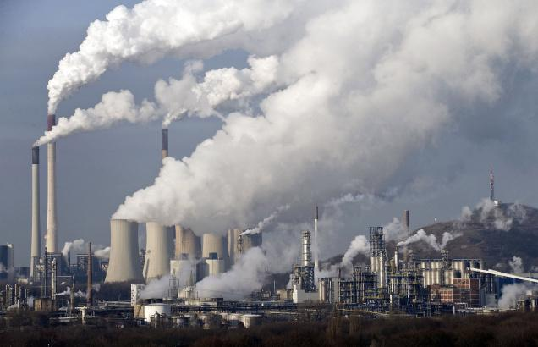



What is externality
Negative Externality
Positive Externality

Slide 4
Externalities: Definition
An externality exists whenever an individual or firm undertakes an action that impacts another individual or firm in an unintended way for which the latter is not compensated (a negative externality), or for which the latter does not pay (a positive externality).
Asymmetry between benefits and costs.

Slide 5

Negative Externalities
Car Buyers:
Down Pay
Gasoline
Tires
Maintenance
……n Hudson River 1973 and Beijing in 2013
The Society:
Exhaust
Smog
Atmosphere capacity
River 1973 and Beijing in 2013

Slide 6
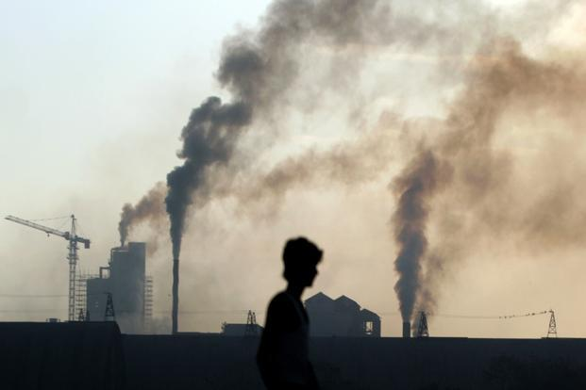
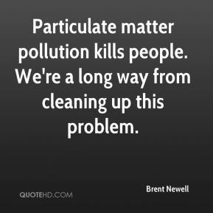
Negative Externalities
Steel furnaces typically burn coal, emitting sulfur dioxide, nitrous oxides, and particular matter.

Slide 7
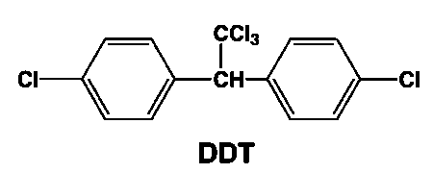

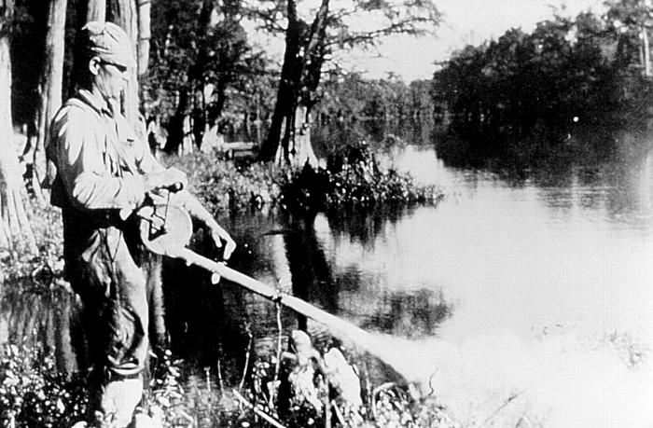
Negative Externalities
Now suppose that the production of pesticides leads to the release of harmful chemicals into groundwater, which in turn causes cancer, birth defects, and/or negatively affects wildlife.
DDT being sprayed to control malaria in 1958.

Slide 8
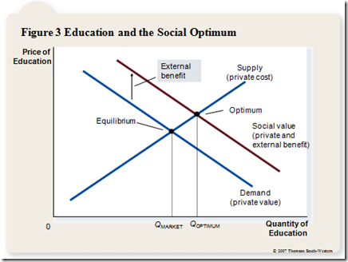
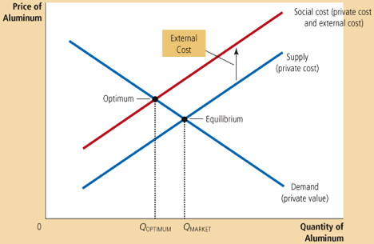
Over Supply and Under Supply
Negative Externality
Positive Externality

Slide 9
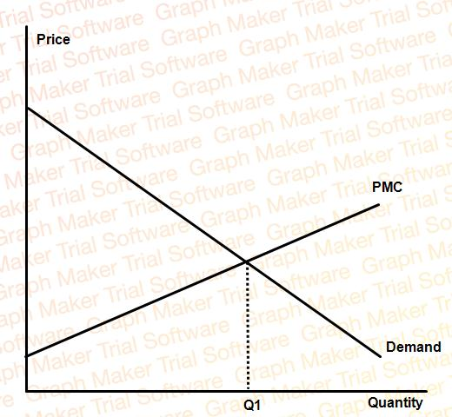
How do Externalities Cause Market Failure?
DWL = unrealized surplus.
PMC: Private Marginal Cost
MD: Marginal Damage (Marginal External Cost)
SMC: Social Marginal Cost
Q1: Private optimal production (market equilibrium)
Q2: Social optimal production (efficient outcome)
River 1973 and Beijing in 2013
Deadweight loss under unregulated negative externalities
SMC
MD
Q2

Slide 10
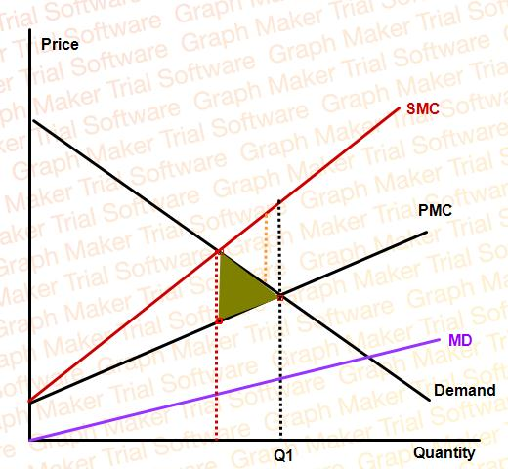
How do Externalities Cause Market Failure?
The difference between the avoided pollution damage and the lost consumer and producer surplus
Lost consumer and producer surplus
Q2
Q2<Q1: In the absence of regulation, the market yields too much of a bad thing.
Notes:
对于positive externality的分析作为课后作业讨论。

Slide 11

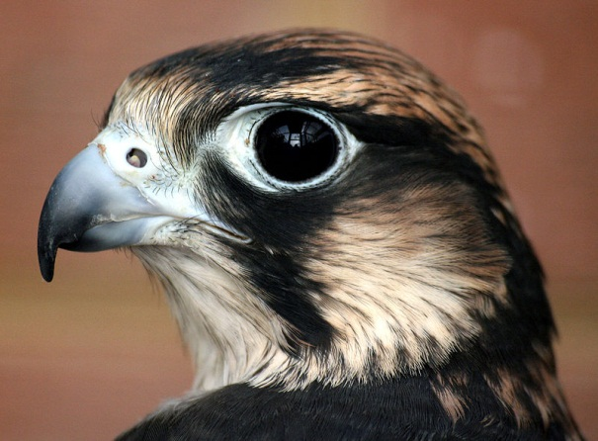
DDT and the Birth of the US Environmental Movement
The resurgence of the Peregrine Falcon from near extinction is largely attributed to the ban on DDT in the US.
The publication of Silent Spring by Rachel Carson in 1962 helped lead to the US ban of DDT in 1973.

Slide 12
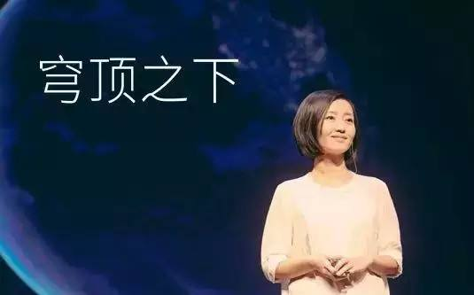
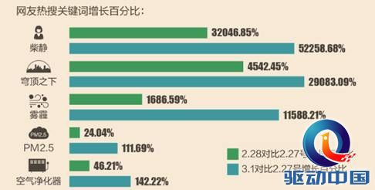
“Under the Dome” and the Rise of the China’s Environmental Concern
Environmental Minister Chen Jining reportedly praised Under the Dome, comparing it to Silent Spring--which helped galvanize the U.S. environmental movement by exposing the deleterious effects of pesticides.
The release of the documentary “Under the Dome” on February 28, 2015 by Chai Jing helped raise awareness of the dangers to human life posed by air pollution.
Awareness is the first part of the battle, and Chai's video has already had an outsize impact

Slide 13
How to solve the problems associated with externality
Set up and pass down social norms, e.g. your parents may tell you that Do not throw your garbage!
Philanthropic solutions, e.g. alumni’s donation to university education
Internalizing the externalities
Coase Theorem: property rights definition
Regulations
Taxes and subsidies
Tradable permits

Slide 14
Coase Theorem
Two adjacent farmers, no fences
One raising cattle
One growing wheat
Scenario A: The cattle rancher is liable for damages the cows cause
Rancher’s option I: put up a fence
Rancher pays damages to wheat farmer
Rancher will consider costs of both to make choice
Scenario B: The cattle rancher has the right to freely ranching on the farm
Wheat farmer pays to cattle rancher for less ranching
Ranching will also be reduced

Slide 15
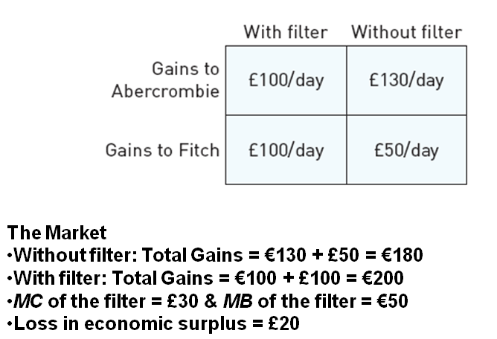
Abercrombie v.s. Fitch (Part I)

Slide 16
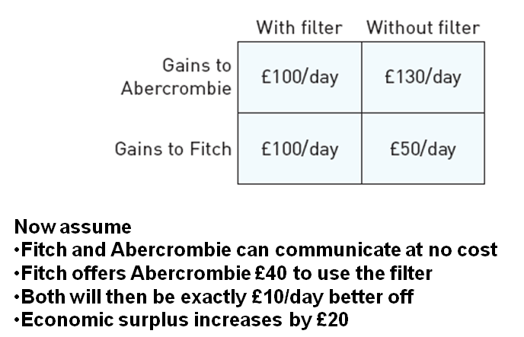
Abercrombie v.s. Fisherman (Part II)

Slide 17
The Efficient Level of Emissions
MSC
$/E
P*_{D}
With
Tax
MCA
Standard
Emissions

Slide 18
Taxes vs. Standards
When policymakers have full information, either instrument can be used to achieve a given amount of abatement.
If all firms have the same cost structure, then fees and standards have the same costs in the short run.
If their costs differ, then taxes have lower costs to society.

Slide 19
Fees vs. Standards When Firms Have Different Costs
MCA₂
MCA₁
$
Firm 1’s increased costs
from a standard
Total costs are
higher with a standard!
3
Firm 2’s Reduced
Costs from a
standard
6
7
8
Emissions

Slide 20
Fees vs. Standards
When firms differ in their costs of abatement, a fee reduces total social costs because it allows firms flexibility in how to respond.
In addition, a fee gives firms incentives to innovate and reduce pollution so as to save on pollution taxes. A standard provides no incentives to go beyond compliance.
Why do environmental groups often advocate standards instead of fees?

Slide 21
Prices vs. Quantities with Steep MSC and Flat MCA
MSC
P
In this case, a standard
Is preferable to a fee!
$8
An error in setting the
standard
An error in
setting the fee
MCA
8
Emissions

Slide 22
Prices vs. Quantities with Steep MSC and Flat MCA
MSC
P
An error in
setting the fee
Again, a standard
Is preferable to a fee!
$8
An error in setting the
standard
MCA
8
Emissions

Slide 23
Prices vs. Quantities with Flat MSC and Steep MCA
P
In this case, a fee is preferable
to a standard!
MSC
$8
An error in setting
the standard
An error in setting
the fee
MCA
8
Emissions

Slide 24
Public goods and common pool resources
Background: two characteristics of a good:
Excludable (or nonexcludable)
Rival (or nonrival)
Excludable: Does an individual have the legal right and physical ability to exclude others from using the good? If so: “excludable”. If not: “nonexcludable”
Rival: Does an individual’s consumption of the good reduce the amount available to others?
If so: “rival”. If not: “nonrival”

Slide 25
Classification of Goods
 |  | Rival
 |  | Yes | No
Excludable | Yes | Private Goods | Club Goods
 | No | Common-Pool Resources | Public Goods

Slide 26
Common Pool Resources
•deep-see fishery
•freeway
•public wifi
•national defense
•public radio
•clean air
•scientific knowledge
•common-pool oil field
•free bike sharing
Nonexcludability
OPEN-ACCESS RESOURCES
PURE PUBLIC GOODS
PURE PRIVATE GOODS
CLUB GOODS
•candy bar
•car sharing services
•shoes
•toll road
•private (secured) wifi
•cable TV
Nonrivalry

Slide 27
Public goods and common pool resources
Externality as another common feature of public goods and common pool resources
Externality: an uncompensated impact of one’s actions on the well-being of another
Can be negative or positive
Negative externalities (e.g., use of river water as a commons)
Positive externalities (e.g., Kyoto Protocol)

Slide 28
Public Goods
Public goods are
Nonrival: The amount of any individual’s consumption does not diminish the amount available for others
Non excludable: Individuals cannot be prevented from enjoying a public good
Examples:
National defense: all citizens living within the same country are afforded the same level of protection; the security enjoyed or “consumed” by one citizen does not diminish that of her neighbor
Bio-diversity: everyone enjoys the benefits of biodiversity (even if they will never walk in those wild places), and no one person’s enjoyment reduce the amount available to others

Slide 29
Economics of a public good
Point 1. Aggregate demand for a public good
Non-rivalry means that individuals are not in competition for a given supply of a public good
Vertical summation of individual demand curves
Contrast with horizontal summation with a private good
Point 2. Efficient quantity of a public good
Condition: MB of person 1 + MB of person 2 = MC of supply

Slide 30
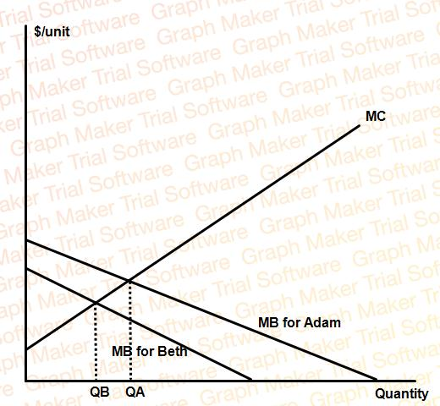
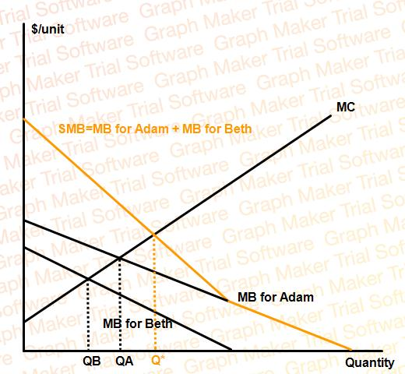
Adam & Beth’s Garden Caring Story
Adam and Beth live on either side of a flower garden that they own in common. As far as they are concerned, the garden is essentially a public good.

Slide 31
Adam & Beth’s Garden Caring Story
Supply shortage: Although both neighbors enjoy the garden, Adam values it more. Under the free market outcome, QA units of the good are produced.
This presents us with a seeming paradox: Both Adam and Beth would be better off if more of the good were provided.
Private provision of public goods is inefficiently low.

Slide 32
Economics of a public good (cont.)
Point 3. Market failure: under provision of a public good by a private market
Non-rival and non-excludable
The Free Rider Problem: Individuals have little (or no) incentive to pay for public goods because they can enjoy
the benefits by free riding on the payments of others
The level of provision will be inefficiently low (market failure)
Intuition follows from recognizing that provision generates
a positive externality

Slide 33
The Free-Rider Problem
Free rider problem: People want to consume a public good, but they don’t want to contribute.
Everybody hopes that someone else will contribute, and they’ll consume that other person’s contribution
I don’t want to contribute, because other people benefit from my contribution
Analogy: Team production problem.
How do we solve this problem?

Slide 34
Public goods provision as a positive externality
The public goods problems in the real world are much more complex than our simple two-person example.
As the number of individuals grow, cooperation become more the more difficult
The marginal benefits of individuals shrink relative to the marginal benefits to the society
Public goods provision as a positive externality:
The market failure that arises in public goods provision, comes from the divergence between private and social marginal benefits
Just as the unregulated market tends to produce too much of a bad thing, so private provision of a public good yields too little of a good thing

Slide 35
Common Pool Resources
The tragedy of commons:
A number of people sharing common access to a natural resource will tend to overexploit it, unless they can develop effective government institutions.
Each shepherd bears only a portion of the costs to the commons from the grazing of an additional animal, but he receives the entire gain from increasing his private flock.
The tragedy as a negative externality problem:
The ill effects of one person’s overexploitation are not borne exclusively by that person, but also his peers.

Slide 36
Moving Beyond the Tragedy
Need to overcome two scholarly approaches
Seeking universal theories and solutions
Focusing on the unique aspect of every site
We will illustrate how we can begin to move beyond the limits of these two approaches
We will link a diagnostic framework with a theory of self-organization to explain why two fishing communities in Mexico self-organized and one did not.

Slide 37
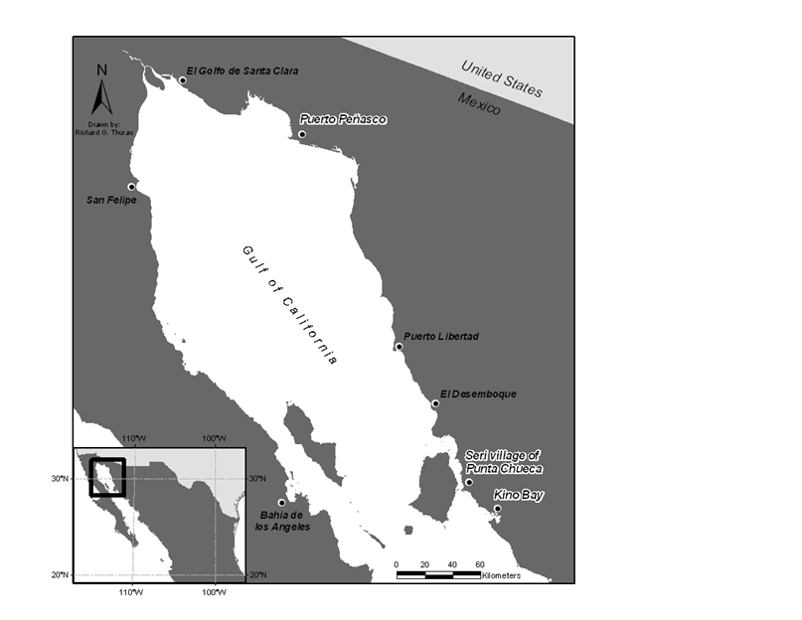
Selected Fishing Villages in the
Northern Gulf of California, Mexico

Slide 38
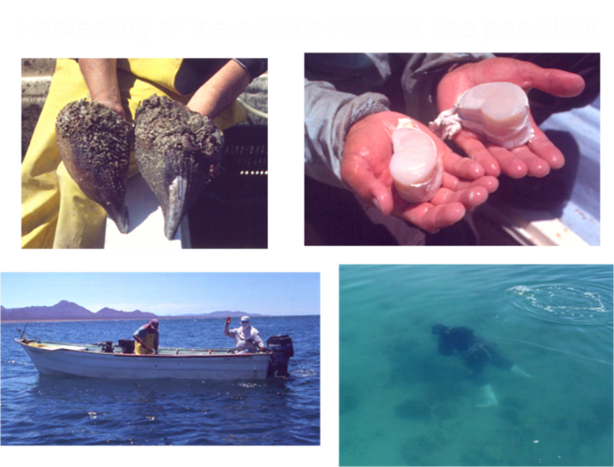
Harvesting of the Sessile Mollusk Sea Pen Shell
Left to right. Photo#1: Two adult specimens of the sessile bivalve mollusk commonly known as sea pen shell (Atrina tuberculosa) and harvested by small-scale fishers of the three communities under study. Photo #2: Shows two abductor muscles pertaining to the two individuals of photo#1. Sea pen shells are harvested for their abductor muscle, which reaches high prices in the Mexican national seafood market. Fishers are paid up to $20 usd per kilogram at the beach –therefore there is great demand for them. Only shrimp and abalone reach such high prices. Their U.S. analogue are bay scallops. Photo #3: Typical small-scale fishing boat used in the Gulf of California, Mexico. Benthic mollusks are harvested by diving (photo #4), note the air compressor in the middle of the boat in photo 3 that provides air to the diver in photo # 4. Diver in Photo # 4 is walking on the bottom (using plastic boots) harvesting sea pen shells in a shallow fishing area.

Slide 39
Using a Diagnostic Framework and Theory
Need a common language among those disciplines analyzing resource problems so we can learn from individual studies, develop better theory, test that theory in the field and the lab, and build still better theory
Can only provide a brief overview of our effort to do this
Will illustrate with the results of extensive field research conducted by Xavier Basurto and colleagues over several years
Let’s look at the broadest tool first

Slide 40
A multitier framework for analyzing a social-ecological system
Source: Ostrom (2007b: 15182).

Slide 41
Second-Tier Variables in Framework for Analyzing a Social-Ecological System Social, Economic, and Political Settings (S) S1- Economic development. S2- Demographic trends. S3- Political stability. S4- Government resource policies. S5- Market incentives. S6- Media organization.
Resource System (RS) | Governance System (GS)
RS1- Sector (e.g., water, forests, pasture, fish) RS2- Clarity of system boundaries* RS3- Size of resource system* RS4- Human-constructed facilities RS5- Productivity of system RS5a. Indicators of the system* RS6- Equilibrium properties RS7- Predictability of system dynamics* RS8- Storage characteristics RS9- Location | GS1- Government organizations GS2- Non-government organizations GS3- Network structure GS4- Property-rights systems* GS5- Operational rules* GS6- Collective-choice rules* GS7- Constitutional rules* GS8- Monitoring & sanctioning processes*
Resource Units (RU) | Users (U)
RU1- Resource unit mobility* RU2- Growth or replacement rate RU3- Interaction among resource units RU4- Economic value RU5- Size RU6- Distinctive markings RU7- Spatial & temporal distribution | U1- Number of users* U2- Socioeconomic attributes of users U3- History of use U4- Location U5- Leadership/entrepreneurship* U6- Norms/social capital* U7- Knowledge of SES/mental models* U8- Dependence on resource* U9- Technology used*
Interactions (I) → Outcomes (O)
I1- Harvesting levels of diverse users * I2- Information sharing among users I3- Deliberation processes I4- Conflicts among users * I5- Investment activities I6- Lobbying activities | O1- Social performance measures (e.g., efficiency, equity, accountability) O2- Ecological performance measures * (e.g., overharvested, resilience, diversity) O3- Externalities to other SESs
Related Ecosystems (ECO) ECO1- Climate patterns. ECO2- Pollution patterns. ECO3- Flows into and out of focal SES.
Source: Adapted from Ostrom (2007b: 15183).

Slide 42
Who Will Self-Organize?
In analyzing a particular case, a core question is which factors affect the potential benefits and costs that users face in continuing present rules and strategies or changing them
One would posit that each user compares the expected net benefits of harvesting, using the old operational rules, with the benefits they expect to achieve using a new set of operational rules
Each user must ask whether their incentive to change is positive or negative

Slide 43
If All Agree on Benefits and Costs
Adopt new rules if benefits of new system of rules are perceived to be greater than costs
Stay with old system – open access – if adopting new rules will not provide sufficient benefits to overcome the costs involved in adopting a new set of rules
If some variance, depends on B-C for those in “winning coalition” in that site
Rarely have the information on the estimated costs and benefits of developing rules of self-organization related to who can harvest when, where, and how and who will monitor

Slide 44
Which Variables are Relevant from Diagnostic Framework?
Depends on the theoretical question one wants to address in particular types of SES
To examine the question of why some resource users would self-organize, a growing theory is developing from the extensive research of the last two decades
Starts with a set of variables about resources and their users that have made a difference in the likelihood of self-organization in extensive empirical studies

Slide 45
Attributes of Resource Systems
Size of resource system (RS3): The CPR is sufficiently small, given communication and transportation technologies in use, that the users can acquire accurate knowledge about the boundaries and dynamics of the system.
Productivity of system (RS5): The productivity of the CPR has not been exhausted nor is it so abundant that there is no need to organize.
Predictability of system dynamics (RS7): The system dynamics are sufficiently predictable that users can estimate what would happen if they continued old rules or changed the rules and strategies in use.
Indicators of the productivity of the system (RS5a): Reliable and valid indicators of CPR conditions are available at a low cost.

Slide 46
Attributes of Users
Leadership (U5): Some users of a resource have skills of organizing and local leadership as a result of prior organization for other purposes or learning from neighboring groups.
Norms/social capital (U6): Users have generally developed trust in one another so as to keep promises and return reciprocity with reciprocity.
Knowledge of the social-ecological system (U7): Users share knowledge of relevant CPR attributes and how their own actions affect each other.
Dependence on resource (U8): Users are dependent on the CPR for a major portion of their livelihood.

Slide 47
Let’s Compare the Three Cases
Rarely have quantitative information about the specific benefits and costs for particular users
With good fieldwork, however, can make a good estimate of the differences among cases on a key set of diagnostic variables
Let’s look at a comparative table

Slide 48
Comparison of Key Variables for Three Coastal Fisheries in the Gulf of California

Slide 49
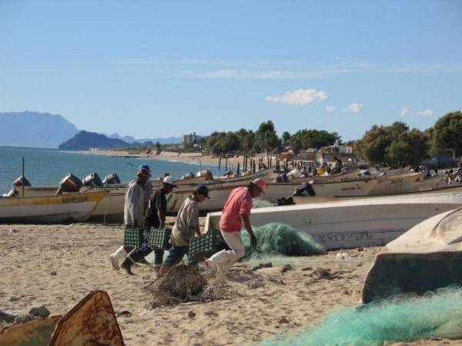
Kino Bay = Open access
Sea pen shells have been overexploited (Moreno et al., 2005)
This is a picture showing the number of boats working off Kino Bay fishing grounds. Kino Bay is governed under an open access regime. Our boat counts regularly yielded 70+ boats, a symptom of their inability to control access to other fishers. As a result of the open access regime, their sea pen shell fishery (sea pen shells =a sessile mollusk that lives buried in the sand) has been overexploited. In this context, overexploitation is measured by fishers’ inability to sustain constant harvesting of sea pen shells year-round before they become too scarce and small in size. In contrast, the Seri are able to sustain their fishery year-round.

Slide 50
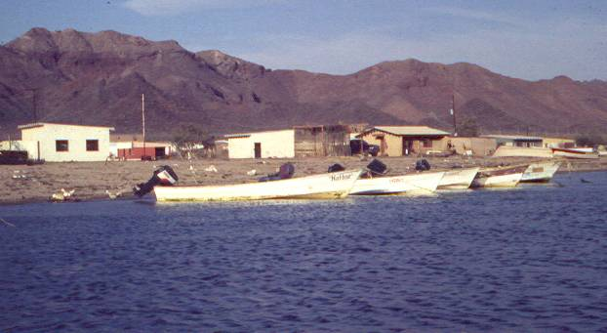
Seri Village of Punta Chueca
In the Seri village of Punta Chueca (which means crooked point), the Seri have developed a common-property regime to govern their sea pen shell fishery, and successfully control the number of boats that have access to their fishing grounds. At any given time, you observe only 10-15 outboard motor boats using their fishing grounds.

Slide 51
The Seri Fishery is Also Robust Over Time
6 of the 8 design principles characterized both the Seri and Peñasco fisheries:
Clearly defined boundaries; Congruence; Collective-choice arrangements; Monitoring; Graduated sanctions, and Conflict-resolution mechanisms
The Peñasco system lacked formal recognition and integration of their self-governance local regime with multiple layers of nested enterprises
The Seri system had both of these design principles

Slide 52
Design Principles Illustrated by Long-Enduring
Common-Pool Resource Institutions
1. Clearly Defined Boundaries: Individuals or households with rights to withdraw resource units from the common-pool resource, and the boundaries of the common-pool resource itself, are clearly defined.
2. Congruence:
A. The distribution of benefits from appropriation rules is roughly proportionate to the costs imposed by provision rules.
B. Appropriation rules restricting time, place, technology, and quantity of resource units are related to local conditions.
3. Collective-Choice Arrangements: Most individuals affected by operational rules can participate in modifying operational rules.
4. Monitoring: Monitors, who actively audit common-pool resource conditions and user behavior, are accountable to the users or are the users themselves.
5. Graduated Sanctions: Users who violate operational rules are likely to receive graduated sanctions (depending on the seriousness and context of the offense) from other users, from officials accountable to these users, or from both.
6. Conflict-Resolution Mechanisms: Users and their officials have rapid access to low-cost, local arenas to resolve conflict among users or between users and officials.
7. Minimal Recognition of Rights to Organize: The rights of users to devise their own institutions are not challenged by external governmental authorities.
For common-pool resources that are parts of larger systems:
8. Nested Enterprises: Appropriation, provision, monitoring, enforcement, conflict resolution, and governance activities are organized in multiple layers of nested enterprises.
Source: Adapted from E. Ostrom (1990: 90).

Slide 53
The Invisible Hand
Adam Smith’s “invisible hand” idea in the Wealth of Nations implied that competitive markets send resources to their highest valued use in society.
Consumers and producers pursue their own self-interest and interact in markets.
Market transactions generate an efficient—highest valued—use of resources.

