Slide 1
Economic Principles for BUAA Engineers
Instructor: Xueying YU
Facilitation: School of Economics and Management
Email: xueying@buaa.edu.cn

Slide 2
What is Economics
Economics is the study of how economic players (individuals, firms, governments) make choices in a world of scarcity and the results of those choices for society.
Scarcity is a fundamental fact of life while wants and needs are boundless.
Therefore, we have to choose among competing alternatives and face trade-offs.
The theories of economics can be applied to any scarce resource, not just traditional commodities.
Economics is not simply about money. Economists study how incentives/constraints affect people’s behavior, and use this to better design policy.

Slide 3
MARKET OR GOVERNMENT ACTIONS

Slide 4
Outline
The ideal scenario for most economists: A competitive market
When government steps in……
Price ceiling
Price floor
tax
Justification I for government interventions
Fight against market power
Justification II for government interventions
Externality
Public goods

Slide 5
Market and Efficiency
Market: a decentralized collection of all actual and potential buyers and sellers whose interactions determine the allocation of a good or service through exchange.
A demand curve (describing consumers’ behavior): a schedule or graph showing the quantity of a good that buyers wish to buy at each price. Marginal willingness to pay schedule.
A supply curve (describing suppliers’ behavior): a curve or schedule showing the quantity of a good that sellers wish to sell at each price. Reservation price (willingness to accept) schedule.

Slide 6
The Demand Curve
Market demand aggregated from individual demand curves.
Horizontal interpretation: if buyers face a price of $4/lobster, they will wish to purchase 4000 lobsters a day.
Vertical interpretation: if buyers are currently buying 4000 lobsters a day, the demand curve tells us that the marginal buyer’s reservation price is $4 per lobster (i.e., the marginal buyer would be willing to pay at most $4 for one additional lobster.)

Slide 7
Intuitions for Downward Slope Demand Curves
As the good becomes more expensive, people switch to substitutes. This is the substitution effect. For example: pizza price goes up, switch to hamburger; Coke price goes up, switch to Pepsi).
As the good becomes more expensive, people can’t afford to buy as much of it – purchasing power is lowered. This is the income effect. For example: pizza prices goes up, we simply cannot afford as much.

Slide 8
The Supply Curve
Horizontal interpretation: If sellers face a price of $4/lobster, they will wish to sell 2000 lobsters a day.
Vertical interpretation: if sellers are currently selling 2000 lobsters a day, the reservation price of the marginal seller is $4 per lobster.

Slide 9
Intuitions for Upward Sloped Supply Curves
As we expand the production of any good, we turn first to those whose opportunity costs of producing that good are lowest, and only then to others with higher opportunity costs (harvest lobster that are closest to the shore first).
Sellers must receive a higher price to produce additional units of product to cover the higher opportunity costs of each additional unit.

Slide 10
Market Equilibrium Quantity and Price
Equilibrium occurs at the price-quantity pair for which both buyers and sellers are satisfied with their respective quantities at the market price. No tendency for any change in both price and quantity.

Slide 11
Do Markets Leads to Efficient Outcomes?
Buyer’s (consumer) surplus: the difference between the buyer’s reservation price and the price he or she actually pays;
Seller’s (producer) surplus: the difference between the price received by the seller and her reservation price
Total surplus: the difference between the buyer’s reservation price and the seller’s reservation price. A measure of social welfare
Socially optimal quantity: the quantity of a good that results in the maximum possible total surplus.
Pareto Efficiency: A situation is said to be Pareto efficient if there is no way to rearrange things to make at least one person better off without making anyone worse off. A policy or action that makes at least one person better off without hurting anyone is called a Pareto improvement.

Slide 12
Market Equilibrium and Efficiency
In a perfectly competitive economy, a market equilibrium is Pareto optimal (The first theorem of welfare economics).
A market equilibrium also maximizes total surplus, achieving social optimal quantity.
“Invisible Hand” theory.
Laissez-Faire — An economic philosophy that argues for an absence of government intervention in the marketplace.

Slide 13
Consumer surplus
h = $1/gallon
b = 4,000
Consumer surplus
= (1/2)(4,000)(1)
= $2,000/day
3.00
S
2.50
Price ($/gallon)
2.00
1.50
1.00
Producer surplus
.50
D
0
1
2
3
4
5
6
7
8
9
10
11
12
Quantity (1,000s of gallons/day)

Slide 14
Efficiency v.s. Welfare Distribution
Pareto optimality: A situation is said to be Pareto efficient if there is no way to rearrange things to make at least one person better off without making anyone worse off. A policy or action that makes at least one person better off without hurting anyone is called a Pareto improvement.
Total welfare (Efficiency):
Total CO2/SO2 abatement: CDM mechanism
Total emission/discharge
Total forestland conservation
Distribution:
Hazard “hotspots”: Cancer villages
Environmental justice

Slide 15
Economic Efficiency v.s. Engineering Efficiency
To an engineer, being efficient means maximizing output with fixed inputs, or vice versa
To an economist, being efficient means maximizing benefits with fixed costs, or vice versa
Compact fluorescent lamps (CFLs) have been proven to be an efficient replacement for incandescent lightbulbs, but have not become popular, why?

Slide 16
Economic Efficiency v.s. Engineering Efficiency
As an incomplete list of the reasons:
Opportunity costs:
Your usual plumber is not willing or able to replace CFLs
Changes with the quality of the CFL services
Rebound effects:
Households may consume more electricity when they adopt the energy-efficient CFLs
Investment constraints:
Low-income households face significant credit constrains when making the current-future trade-off
Incomplete market:
Landlords born the costs of CFL purchases, but tenants receive cost-savings from using CFLs

Slide 17
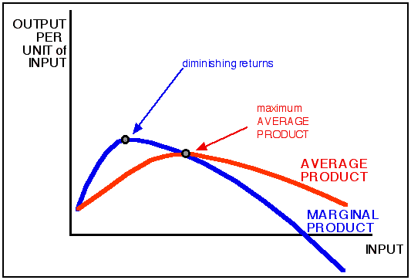
How Economists Look at the World Differently?
Biological Capital
Economic Capital
1100s-1700s
Ecologists: Maximum sustained yield (MSY) solution
1849-
Economists: Maximum sustained revenue (MSR) solution

Slide 18
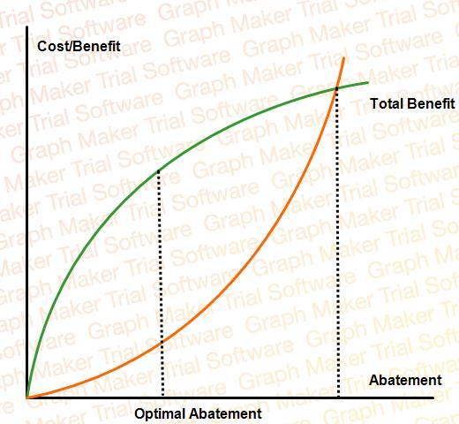

How Economists Look at the World Differently?
Maximizing NET Benefit!
Zero Pollution
Optimal Pollution

Slide 19
Departing from the Competitive Assumptions
The ability of competitive markets to achieve efficiency may be impaired because of:
imperfect competition (market power)
externalities (costs or benefits not adequately reflected in market price, pollution)
public goods
imperfect information

Slide 20

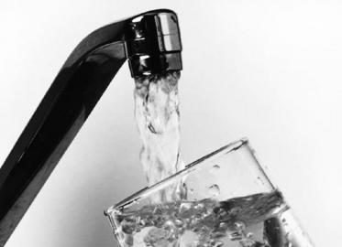
A Competitive Market?

Slide 21
The First Theorem of Welfare Econ.
No externalities
No monopoly buyers and sellers (No market manipulation power)
No increasing returns to scale
No information problems
No transaction costs
No taxes
No other distortions btw the costs paid by buyers and the benefits received by sellers
Homogeneous products
Free entrance and withdraw from the market

Slide 22
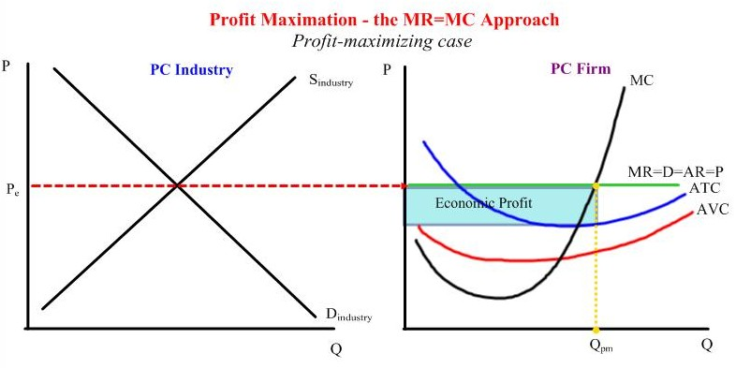
Firms Behavior in a Competitive Market

Slide 23
Thinking Practice
When a firm in purely competitive markets makes profit?
When a firm in purely competitive markets continues its business with a financial loss? And why?
When a firm in purely competitive markets quits the business?
Do you ever heard of sink cost? How does it differ from total cost, fixed cost, variable cost, average cost, and marginal cost?

Slide 24
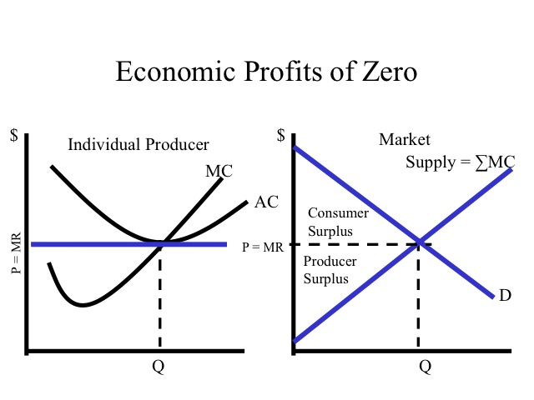
Is the competitive market efficient?

Slide 25
The government steps in……

Slide 26
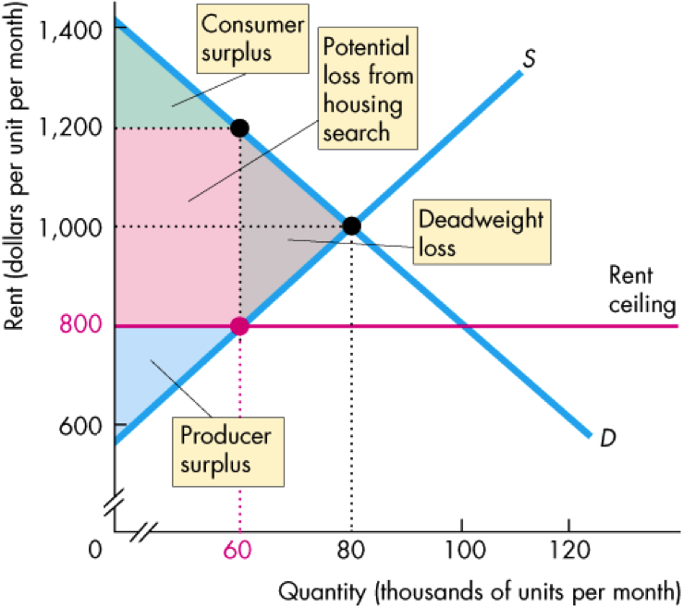
Price Ceiling

Slide 27
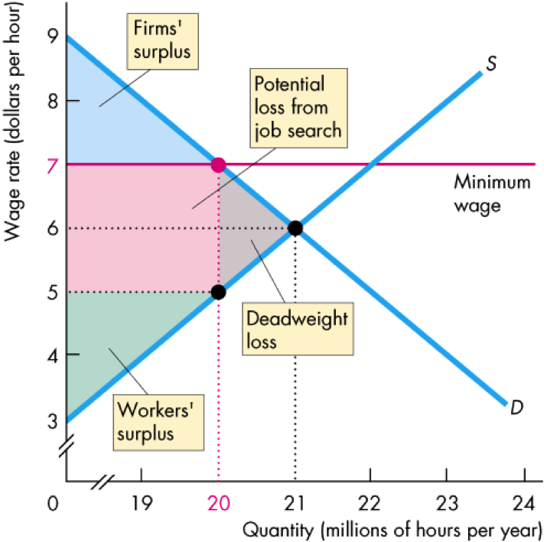
Price Floor

Slide 28
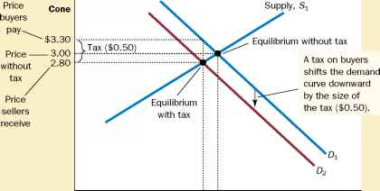
Taxes on Buyers

Slide 29
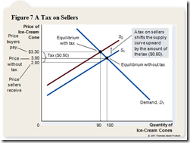
Taxes on Sellers

