Slide 1
Economic Principles for BUAA Engineers
Instructor: Xueying YU
Facilitation: School of Economics and Management
Email: xueying@buaa.edu.cn

Slide 2
If we already have a perfect market, then why government?
Justification I for government interventions
Monopoly
Oligopoly
Monopolistic competition
Justification II for government interventions
Externality
Public goods

Slide 3
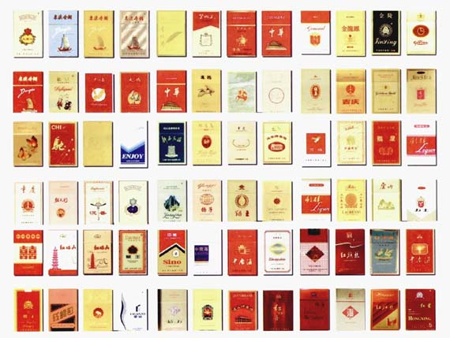

Monopoly
A single seller dominating the market
No substitutive products
Extremely high barrier from entering the market

Slide 4
Monopoly
Natural monopoly: high-quality diamond supply, drinking water supply, electricity supply
The supply of some products is restricted to a single firm because it controls the key resources or because production by a single firm is more efficient than a large number of firms.
Government-granted monopoly: tobacco industry, taxi industry, and non-generic medicines
In some cases, there are benefits and costs such as patents and copyrights.
In other cases, there are few benefits such as taxi and trucking licenses.

Slide 5
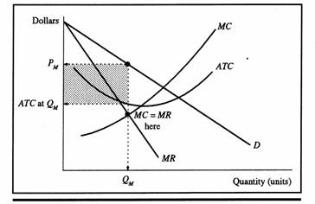
Monopoly firms’ business strategy

Slide 6
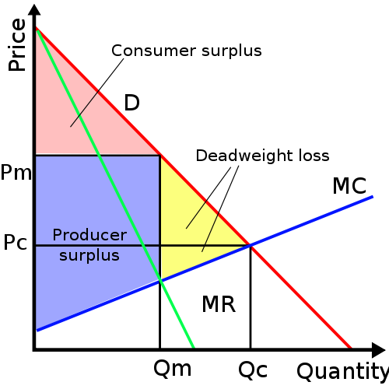
Monopoly & Social Welfare

Slide 7

DiDi: A Real Life Case of Monopoly
For traditional taxis, fares are regulated and not determined by the market.
a) Draw a diagram of a taxi market where fares are capped with an enforced price ceiling that is set at 2.30 RMB per kilometer whereas the free market equilibrium price would be 3.00 RMB per kilometer.
b) Using your diagram, critically comment on whether all consumers are actually better off under this price ceiling compared to a free market equilibrium. Explain your answer in detail.
c) Explain the potential lost surplus due to search activity that may result above.
d) What would happen if the price ceiling was set at 3.50 RMB per kilometre? Explain your answer.
e) Why would the government set such a non-binding price ceiling in (d)?

Slide 8
DiDi: A Real Life Case of Monopoly
f) Under DiDi, where there is no price ceiling, there is surge pricing. Research and explain what ‘surge pricing’ is.
g) Use a graph of the market to depict such a situation of surge pricing that takes the price beyond 3.00 RMB per kilometer to 4.00 RMB per kilometer. Compare the two free market equilibrium points.
DiDi as a new Monopoly in the market?

Slide 9

Monopoly & (Innovation) Entrepreneurship
To an economist, every monopoly looks the same, whether it deviously eliminates rivals, secures a license from the state, or innovates its way to the top, but we do need to separate them and focus on the kind of monopoly that is so good at what its does that no other firm can offer a close substitute, like Google.
A monopoly like Google has wider latitude to care about its workers, its products, and its impact on the wider world. It is successful enough to take ethics seriously without jeopardizing its own existence.
Monopoly can afford to think about things other than making money, while non-monopolists cannot.

Slide 10
If we already have a perfect market, then why government?
Justification I for government interventions
Monopoly
Oligopoly
Monopolistic competition
Justification II for government interventions
Externality
Public goods

Slide 11
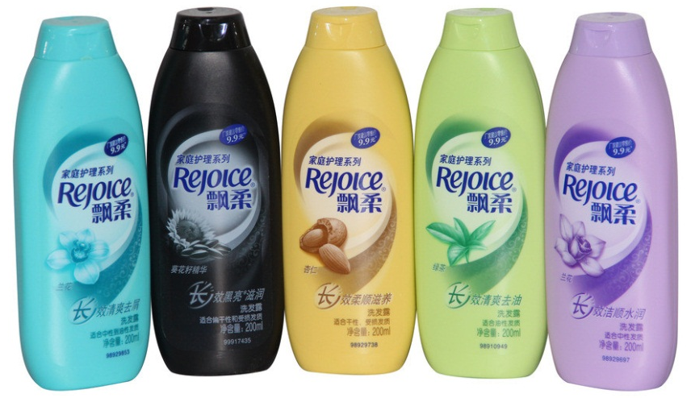
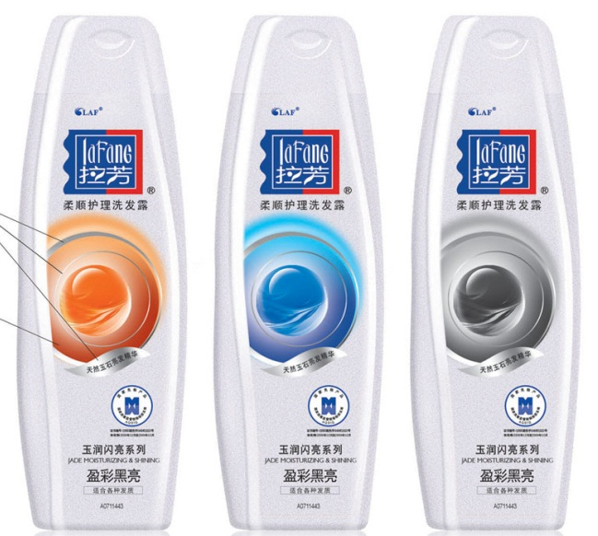

Oligopoly
Few sellers offering similar or identical products
Interdependent firms
Strong barriers from entering the market

Slide 12
Duopoly as the simplest type of oligopoly
A duopoly is an oligopoly with only two members.
Oligopolies pay attentions to rival firms behavior.
Each firm can influence the price, and hence affect rival firms.
The two members may compete or collude with each other
Nash equilibrium is a situation in which economic actors interacting with one another each choose their best strategy given the strategies that all the others have chosen.

Slide 13
Prisoners’ Dilemma: A Practice for N.E.
Prisoner A’s Decision
Confess
Deny
5 years each
A gets 8 years
B gets 0 years
Confess
Prisoner B’s Decision
A gets 0 years
B gets 8 years
1 year each
Deny
Notes:
31
31
31
31

Slide 14
Nash Equilibrium in the World Oil Market
Iraq’s Decision
High Volume
Low Volume
Iraq earns $ 40 billion
Iran earns $ 40 billion
Iraq earns $ 30 billion
Iran earns $ 60 billion
High Volume
Iran’s Decision
Iraq earns $ 60 billion
Iran earns $ 30 billion
Iraq earns $ 50 billion
Iran earns $ 50 billion
Low Volume
Notes:
31
31
31
31

Slide 15
Why we have arm race?
U.S.’ Decision
Arm
Disarm
Both countries
at risk
U.S. at risk and weak
USSR safe and powerful
Arm
USSR’s Decision
U.S. safe and powerful
USSR at risk and weak
Both countries
safe
Disarm
Notes:
32
32
32
32

Slide 16
If we already have a perfect market, then why government?
Justification I for government interventions
Monopoly
Oligopoly
Monopolistic competition
Justification II for government interventions
Externality
Public goods

Slide 17
The Spectrum of Market Structures
Notes:
3
3
3
3
2

Slide 18
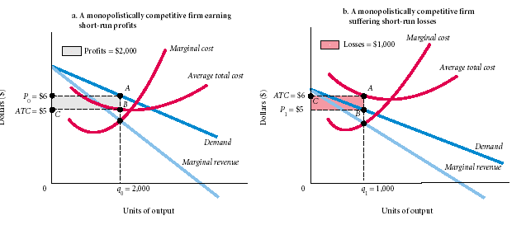
Monopolistic firms’ business strategy

Slide 19
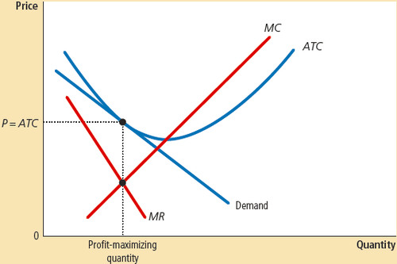
Monopolistic firms’ business strategy

Slide 20
A monopolistic competitive market resembles a monopoly one as the price in this market must exceed firms’ marginal costs.
A monopolistic competitive market resembles a competitive one as the equilibrium price in this market must equal firms’ average total costs.

