Slide 1


Lookahead Optimizer: k steps forward, 1 step back
Author: Michael R. Zhang, James Lucas, Geoffrey Hinton, Jimmy Ba

Slide 2

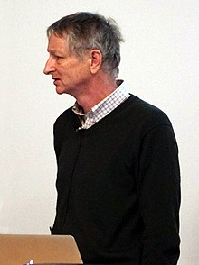
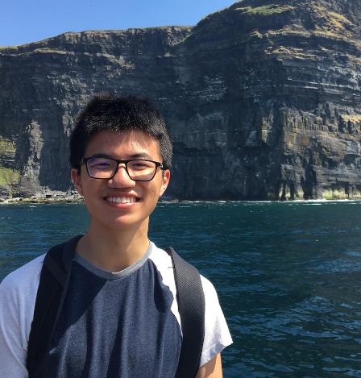

Background information
Jimmy Ba
Adam Optimizer
Geoffrey Hinton
Turing Award
Michael Zhang

Slide 3
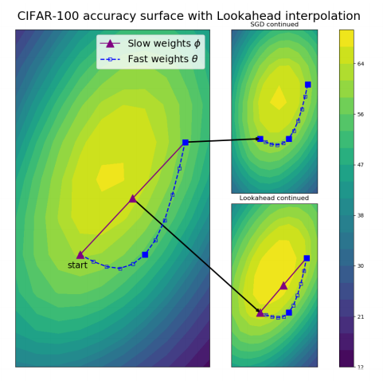
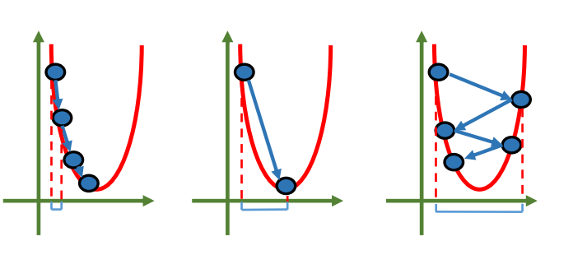
Insight
Take advantage of the special structure of loss landmark near local minima.
First studied in 1988 on convex optimization.
2

Slide 4
Method
Look ahead k steps.
Update parameter by displacement * α.
3

Slide 5
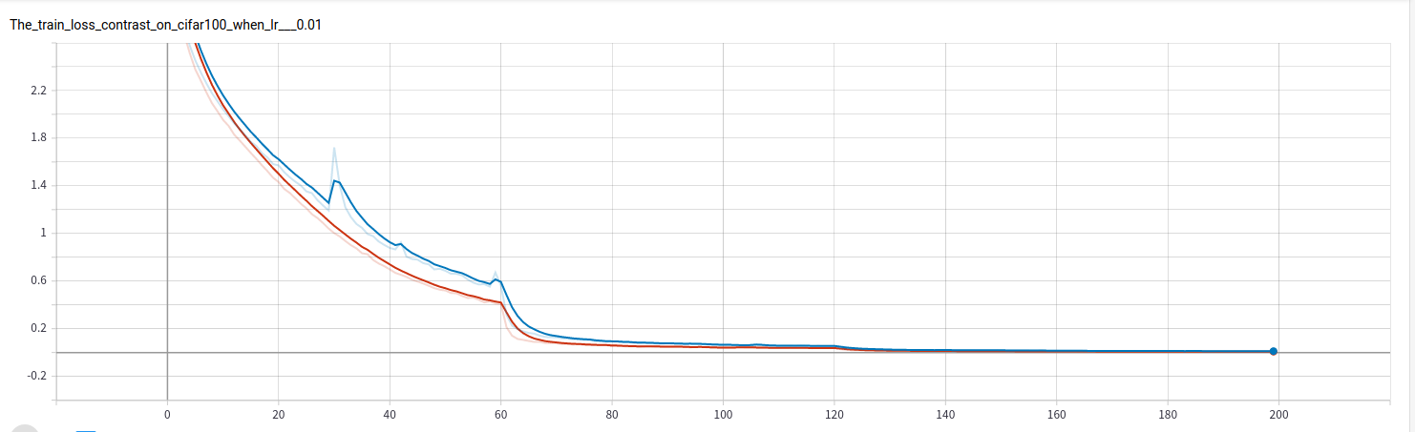
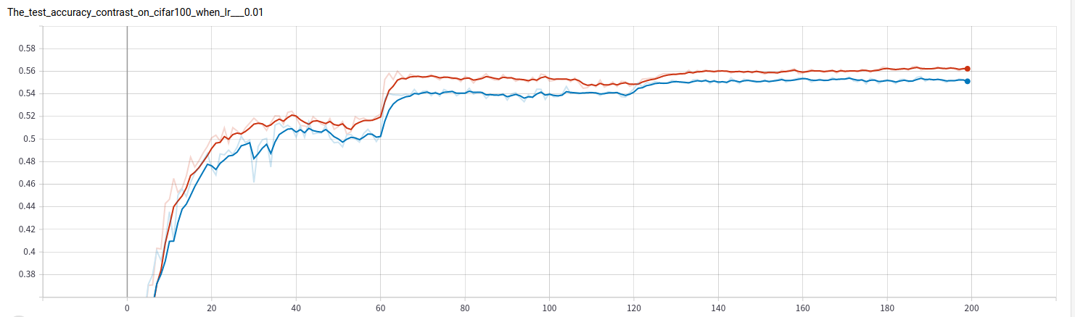
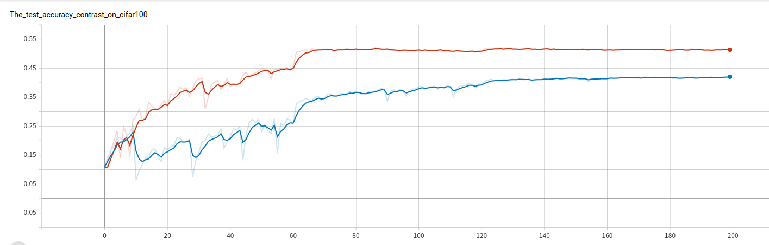
Better performance
RAdam (SOTA, implemented by our group)
Loss
RAdam+
Lookahead
Dataset: cifar-100
Acc.
(+1.31%)
4

Slide 6
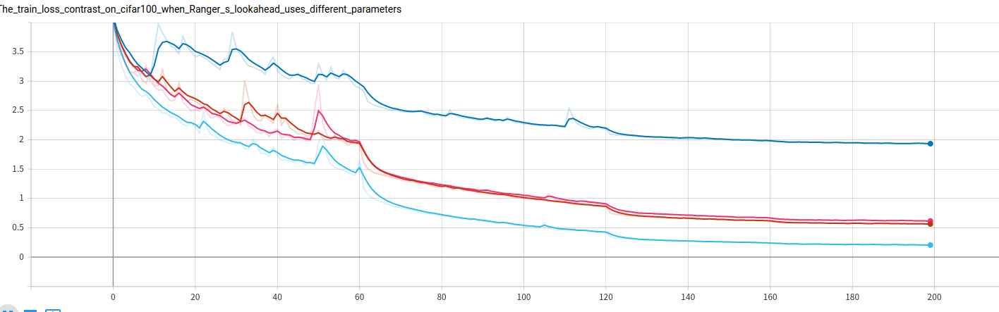
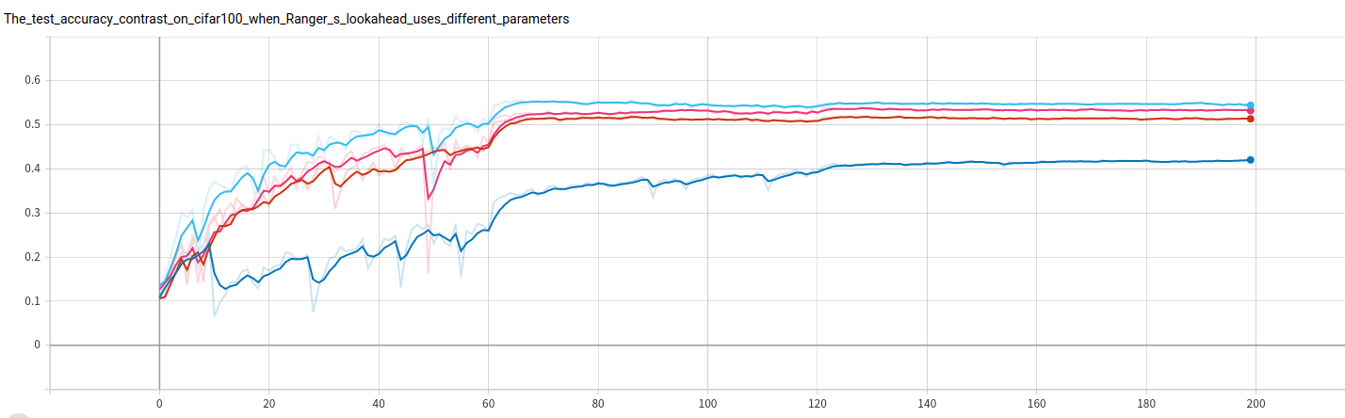
Robust to hyperparameter changes
RAdam baseline
k=5, α=0.8
Loss
k=10, α=0.8
k=5, α=0.5
Dataset: cifar-100
Baseline: RAdam
Learning rate: 0.1
Acc.
5

Slide 7
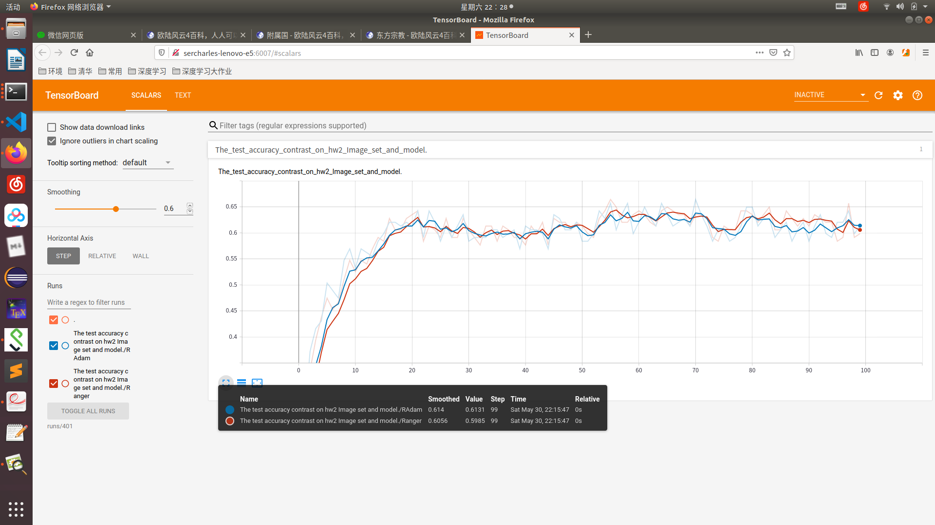

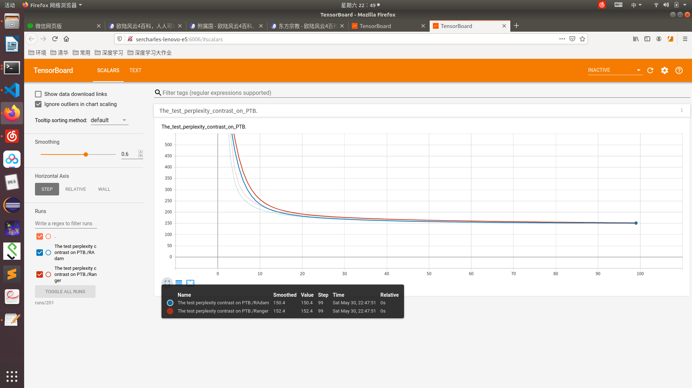
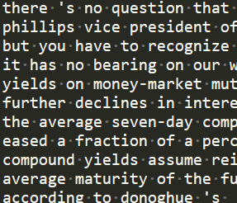
Performance on other tasks
RAdam baseline
Lookahead
homework2 acc.
Marginal gain,
or even worse!
homework3 ppl.
6

Slide 8
Questions

