Slide 1
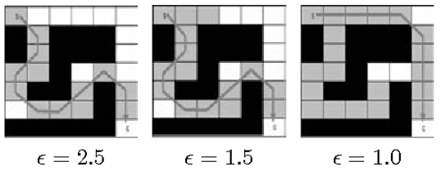
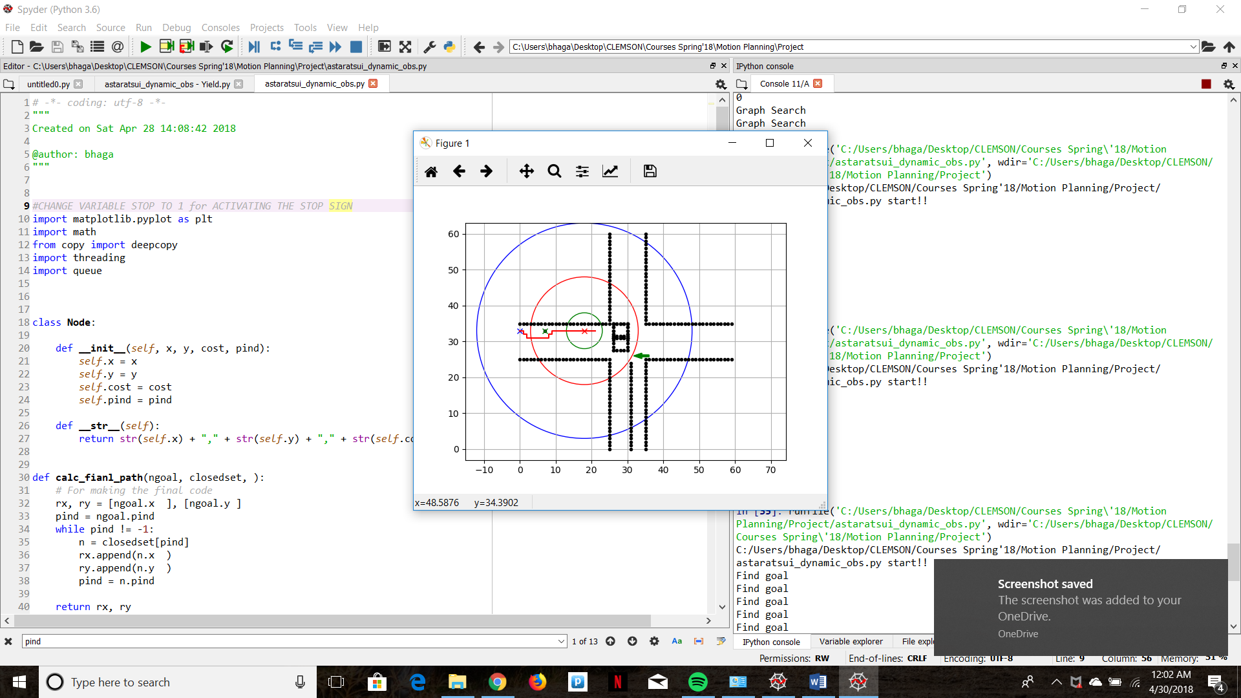
Anytime A* and Vehicle Control Simulation
We implemented Anytime A* for our Dynamic Global Motion Planner.
Anytime A* is a simple approach where the graph search return an initial suboptimal solution quickly and then iterates to reach an optimal solution based on the available time.
The level of optimality of a solution is controlled by varying the heuristic by multiplying it by a weighting factor. The search is initiated with a high weight or multiplier for the heuristic and this weight is reduced in each of the subsequent iterations until time runs out.
The above concept was implemented by defining separate sensing and control horizons for the vehicle as depicted in the image
Blue Horizon – Dynamic Obstacle Detection (Simulating a Radar)
Red Horizon – Static Obstacle Detection (Simulating a Lidar or a Camera)
Green Horizon – Control Boundary (Simulating control capabilities)
Likhachev, Maxim et al. “ARA*: Anytime A* with Provable Bounds on Sub-Optimality.” NIPS (2003).

Slide 2
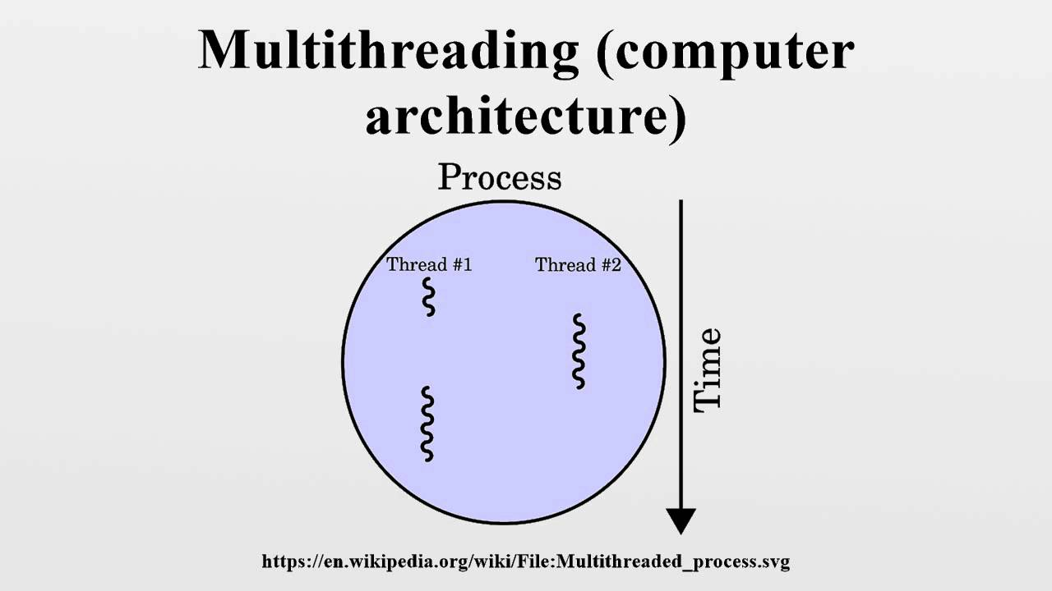
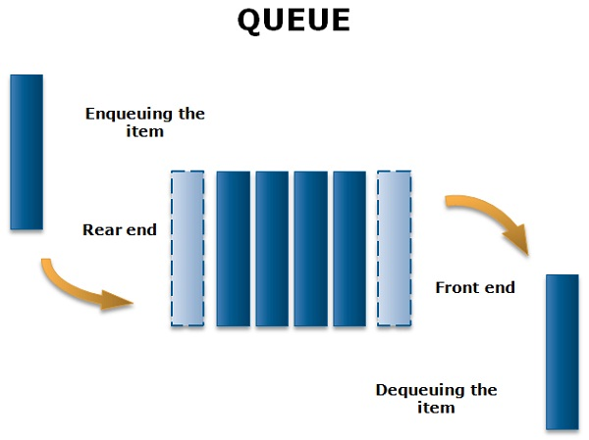
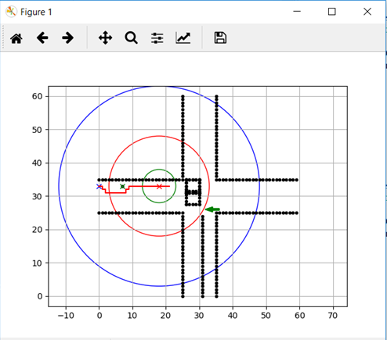
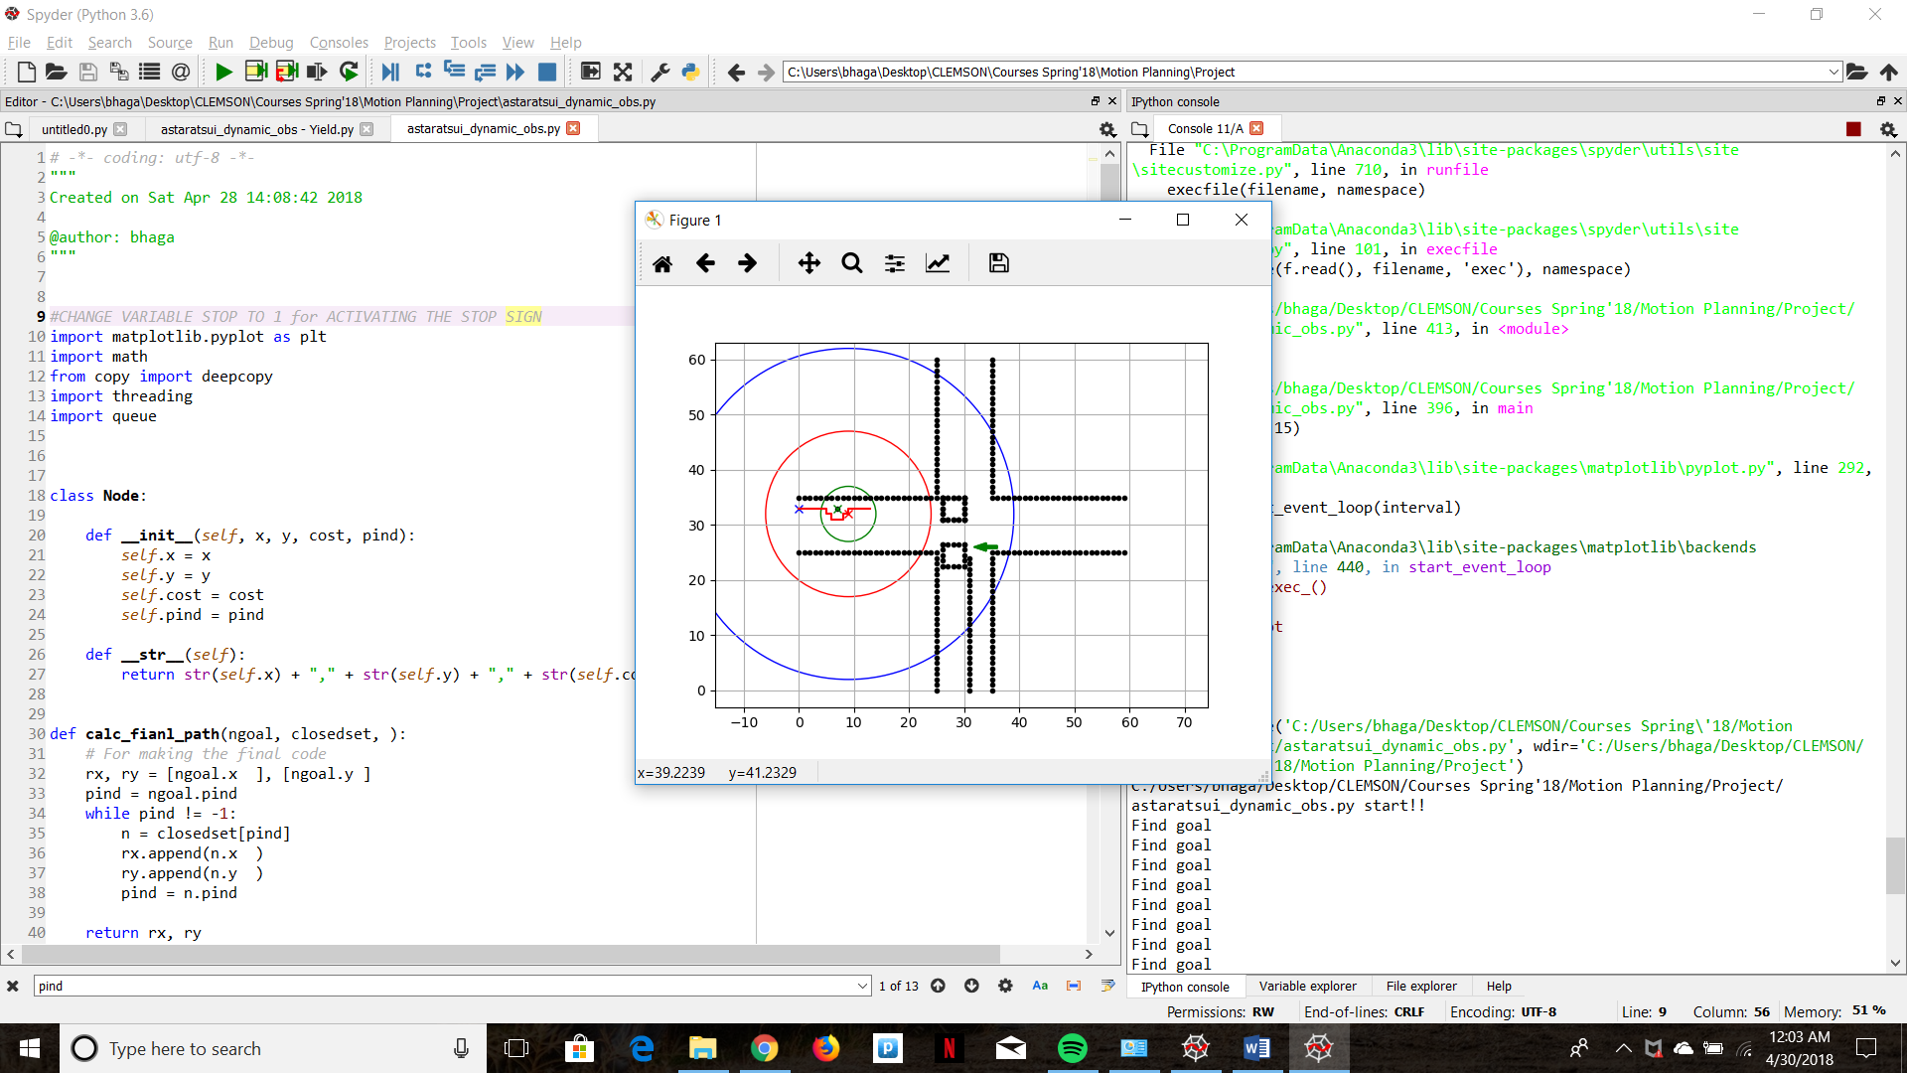
Simulating Multiple Vehicle Controllers (Concurrent Programming)
Generally the motion planning algorithms are implemented in a higher level controller and the results are relayed in small packages to the lower level controller.
This division of tasks allows algorithms like Anytime A* to run in the background at a different frequency while the vehicle is controlled to fulfill the previous search result.
For simulating the above concept, we implemented multithread programming.
After the first detection the A* algorithm is initiated with a new thread.
This thread shares data(graph results) with the main thread using a FIFO queue
While the A* thread is running, the motion model of the vehicle continues to run on the previously generated path until the queue is empty.
As soon as a result is added to the queue, the path is updated, heuristic weight reduced and the A* thread is activated again.
This process continues to loop until the detected obstacle is within the control horizon at which point the path is finalized, locked and pursued and the A* thread is shut down.
Detection
While q is empty
A* thread
YES
Update Map
Motion model
If d to obstacle is < control horizon
Lock map

Slide 3
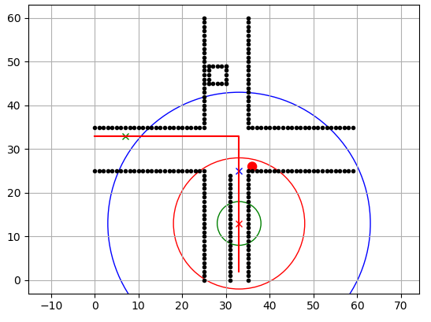
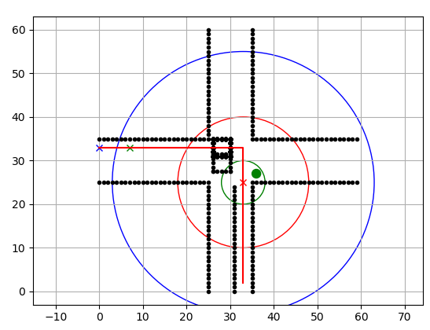
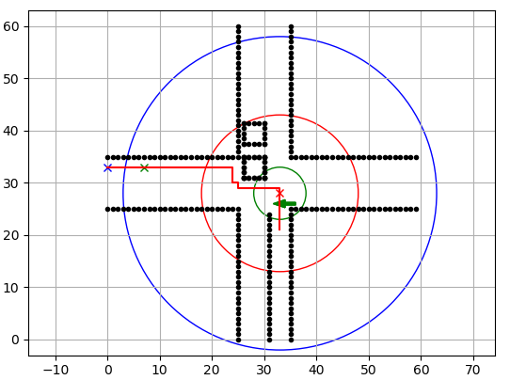
Behavioral Planning
Three real-life intersection scenarios were chosen to implement in our behavioral module.
Car detects a Red Light (Stop)
We programmed a state machine that changes the goal to the stop sign until the sign turn green.
Detection of obstacles and preplanning is halted as long as the car is stopped at the intersection.
Car Detects a Solid Green Light(Yield and go)
The car is programmed to detect a solid green light and continue on its path.
If it detects oncoming traffic and detects a dynamic collision then the car yields to the oncoming traffic and only takes a turn after the car has passed.
Car Detects a Left Arrow(Priority turn)
In this case, the car assumes priority and always goes before the oncoming traffic by preplanning accordingly.

