Slide 1
10 Top Windows 10 Features for Consumers
By Ed Bott

Slide 2
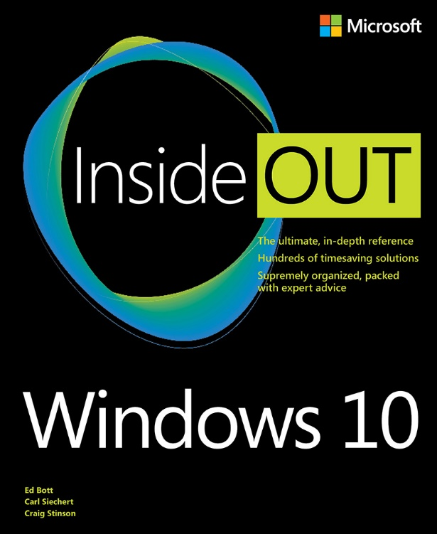
Windows 10 Inside Out
http://aka.ms/win10insideout
Coming this fall!
Discount code in MVA!

Slide 3
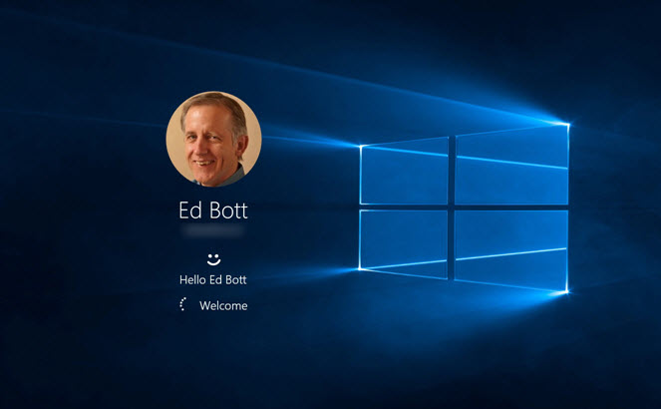
Windows Hello
Notes:
Leads to a discussion of security in general. Show that Windows Hello is not an isolated feature.

Slide 4
Windows 10 Inside Out
http://aka.ms/win10insideout
Coming this fall!
Discount code in MVA!

Slide 5
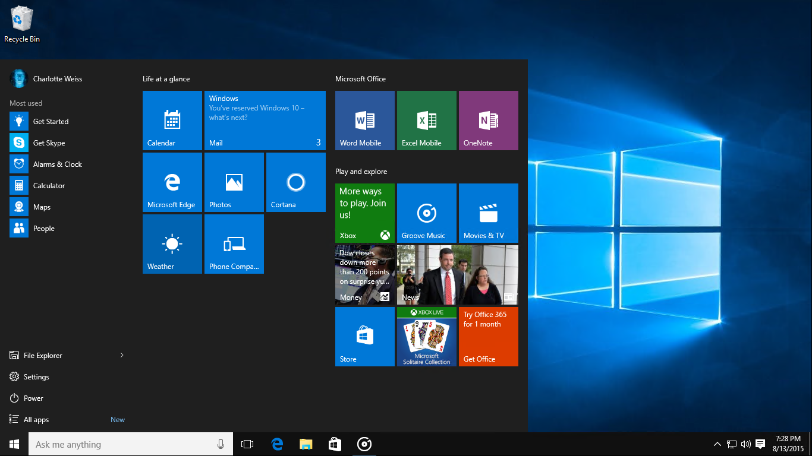
The familiar Start menu and desktop
Notes:
Of course

Slide 6
Windows 10 Inside Out
http://aka.ms/win10insideout
Coming this fall!
Discount code in MVA!

Slide 7
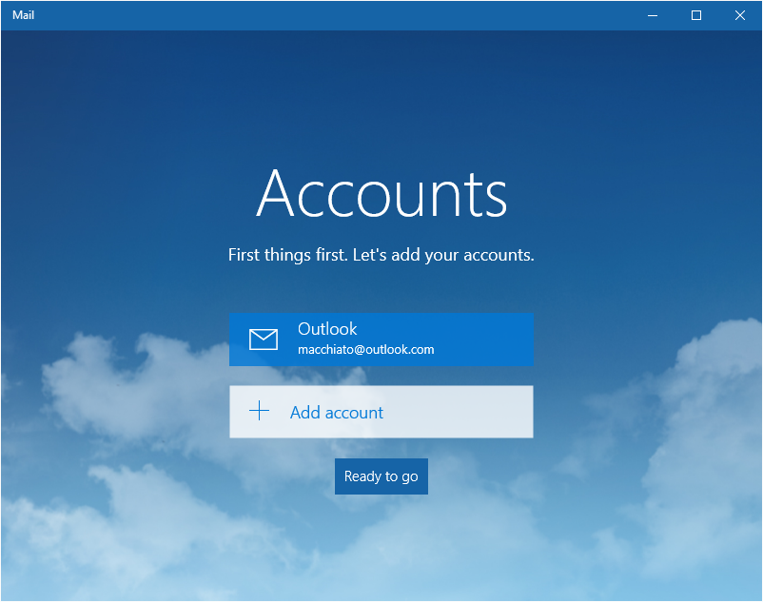
Outlook Mail and Calendar

Slide 8
Windows 10 Inside Out
http://aka.ms/win10insideout
Coming this fall!
Discount code in MVA!

