Slide 1
Credit Card
Weekly Status Report

Slide 2
Project Objective
To develop a comprehensive credit card weekly dashboard that provides real time insights into key performance metrics and trends, enabling stakeholders to monitor and analyze credit card operations effectively.

Slide 3
Project Insights
Overall revenue is 55M.
Total interest is 7.8M.
Total transaction amount is 45M.
Male customers are contributing more in revenue 30M, female 25M.
Blue & Silver credit card are contributing to 93% of overall transactions.
TEXAS, NEWYORK, CALIFORNIA is contributing to 68%.
Overall Delinquent rate is 6.07%.
Overall Activation rate is 57.5%.

Slide 4
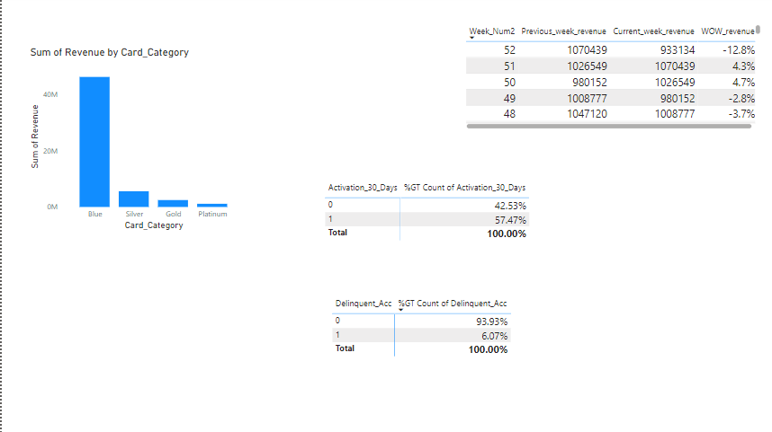
Project Insights Chart

Slide 5
Thank You

