Slide 1
Quiz Game Project
An Interactive Knowledge Testing Application
Presented by: Topuri Lakshmi
Date: 6/2/2025

Slide 2
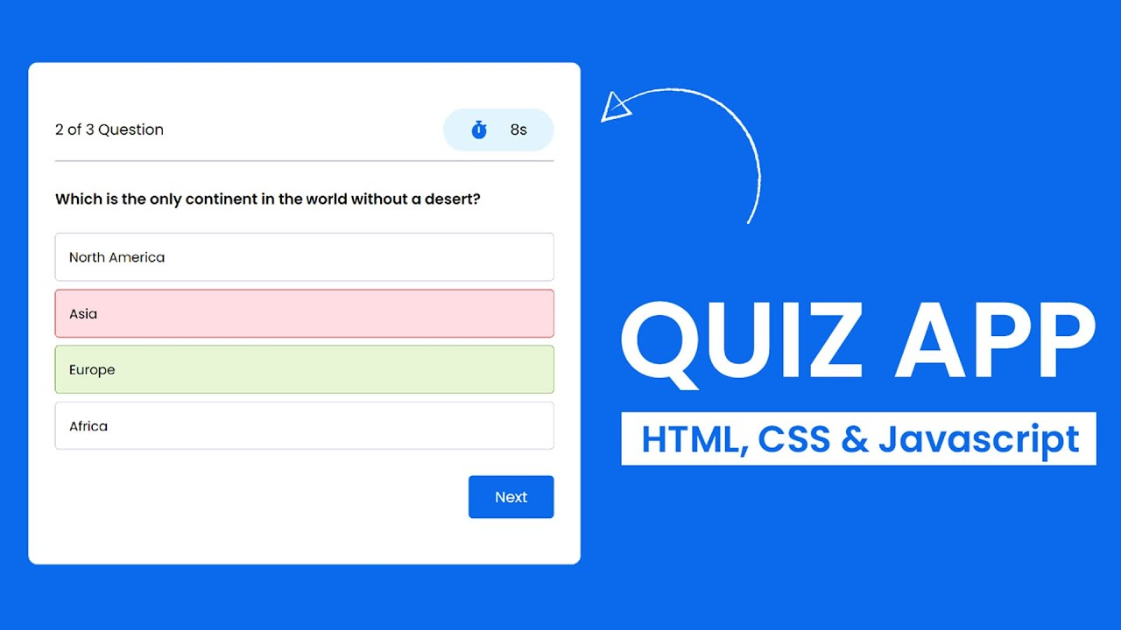
Project Overview:
A web-based quiz application
Tests user knowledge on various topics
Presents multiple-choice questions
Tracks score and provides feedback

Slide 3
Project Objectives:
Build an educational and fun quiz platform
Enhance frontend development skills
Practice using dynamic data and UI interactions
Explore backend integration (optional)

Slide 4
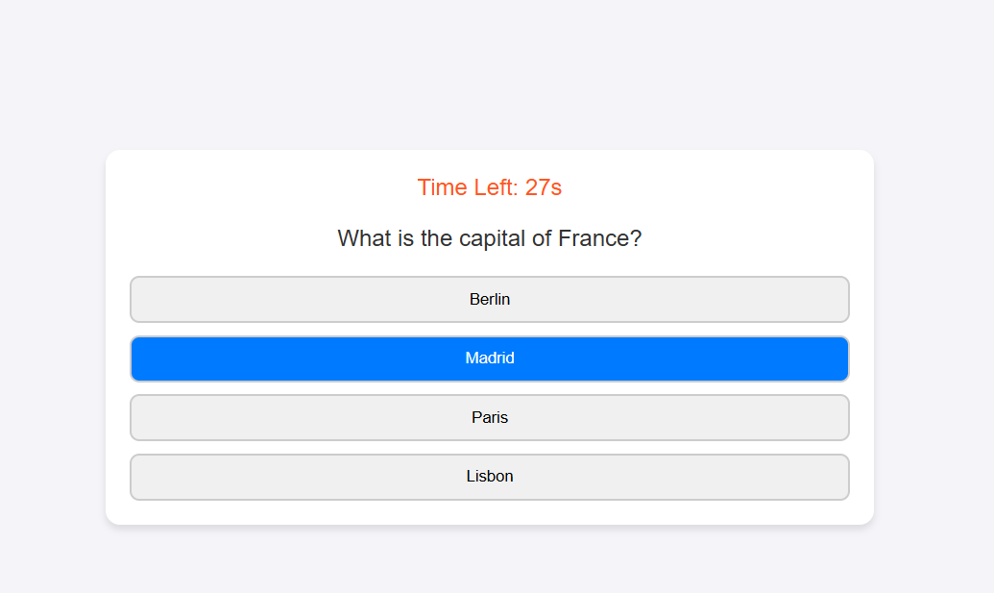
Core Features:
Multiple-choice questions with options
Score tracking throughout the quiz
Feedback on correct/incorrect answers
Timer for each question or full quiz
Topic/category selection before starting

Slide 5
Optional Features:
Difficulty levels (easy, medium, hard)
Randomized question order
Sound effects for answers
User login and quiz history
Leaderboard for top scorers

Slide 6
Technology Stack:
Frontend: HTML, CSS, JavaScript / React
Backend (optional): Node.js + Express or Firebase
Database: MongoDB or Firebase Firestore
Design: Tailwind CSS or Bootstrap

Slide 7
Data Structure Example:
{
"question": "What is the capital of France?",
"options": ["Berlin", "Madrid", "Paris", "Rome"],
"correctAnswer": "Paris",
"explanation": "Paris is the capital city of France."
}

Slide 8
Challenges Faced:
Managing quiz state and transitions
Designing a responsive UI
Implementing timer functionality
Storing and retrieving quiz data
Dynamic question loading
Validating user input

Slide 9
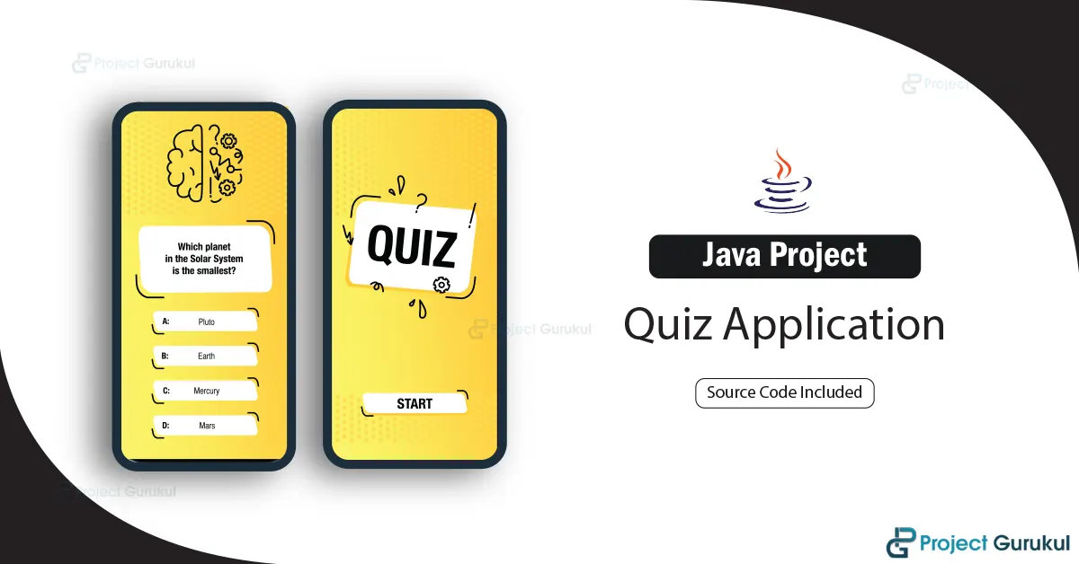
Future Enhancements:
Add multimedia questions (images/videos)
Multi-language support
Admin panel for question management
Offline access to quizzes
Voice Support/Accessibility

Slide 10
Conclusion:
Successfully built a dynamic quiz game
Learned key frontend and optional backend skills
Gained experience in UI/UX design and logic handling
Ready for further improvements and deployment

