Slide 1
the problem
01 / 06
ONE METER.
THIRTY MACHINES.
A small Indian factory has one electricity meter, at the door. It reports that the plant burned 48,000 units last month. It cannot say which machine burned them — so the waste has nowhere to be found.
₹6,00,000
48,000 kWh
to sub-meter all thirty
burned last month, unattributed
the only measurement point
thirty machines, one measurement point — 35–40% of India’s industrial energy runs unmeasured
Notes:
One meter at the door. 48,000 units a month, unattributed. Sub-metering all thirty costs six lakh plus panel downtime, so nobody does it.

Slide 2
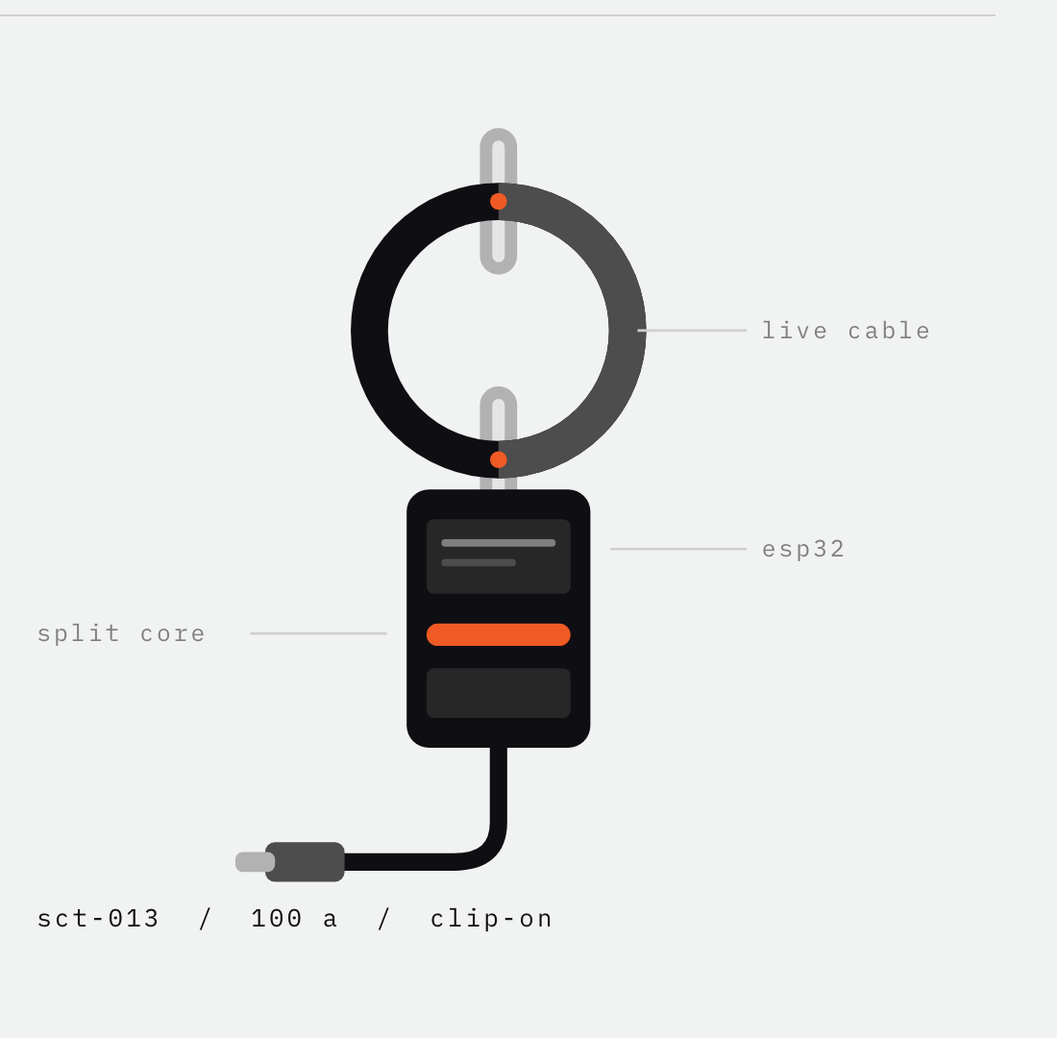
the idea
02 / 06
ONE CLAMP.
EVERY MACHINE.
We clip one split-core current transformer around the incoming cable and recover what every machine behind it is drawing — second by second — from that single signal. No rewiring. No meter per machine. Nothing stops.
₹1,500
₹6,00,000
onemeter, one clamp
sub-metering thirty machines
0 min install · no production stoppage
Notes:
One clamp, fifteen hundred rupees, clipped around one cable. It is non-contact — the jaw closes around insulated wire, nothing is ever touched live.

Slide 3
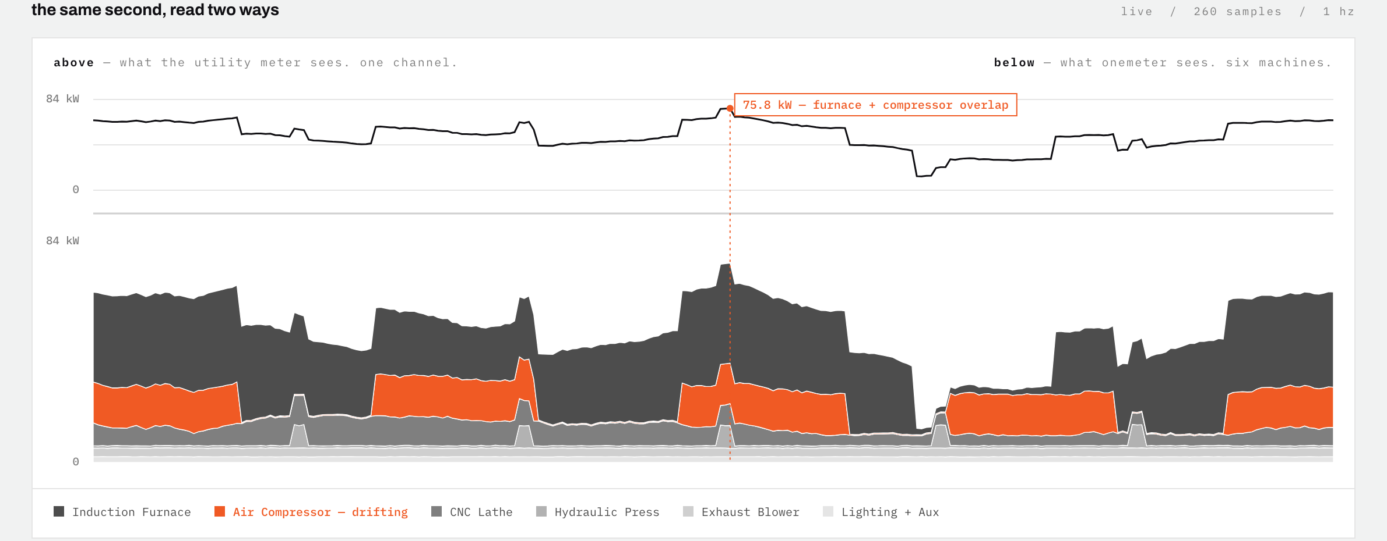
what you see
03 / 06
THE SAME SECOND, READ TWO WAYS
above
below
the spike
one channel — what the utility meter records
six machines, from that one channel
75.8 kW — furnace and compressor, overlapping
Notes:
Top line is what the meter gives you. Bottom is the same seconds split by machine. A spike up top always has a named cause below.

Slide 4
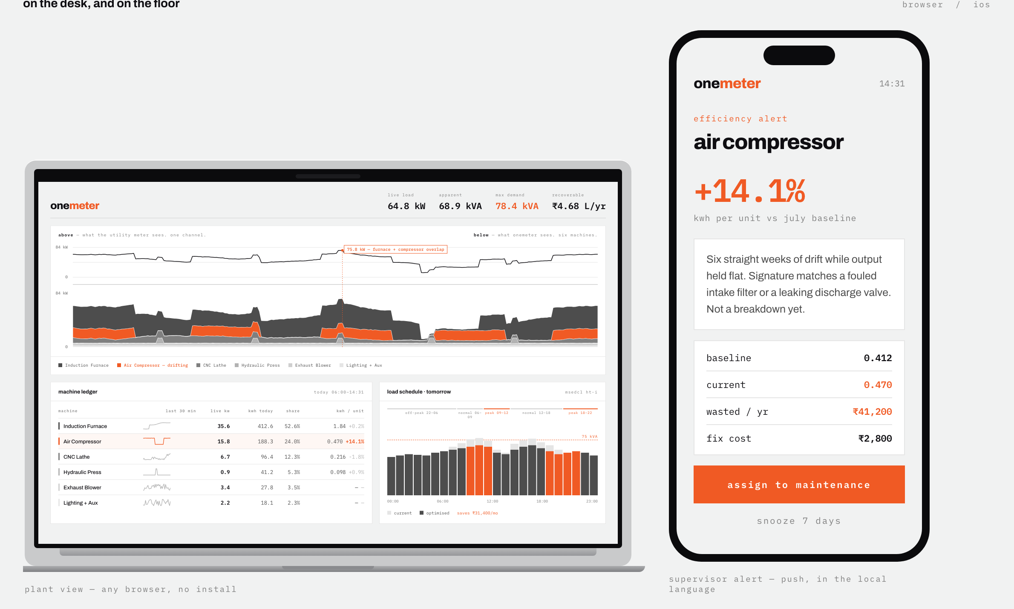
what you do with it
04 / 06
SEE. SAVE. SHIFT.
SEE
Per-machine kWh from one sensor. The first time anyone in the building knows where the bill goes.
SAVE
kWh per unit of output, baselined. When it drifts up, the machine is degrading and wasting at once — caught with no second sensor on it.
SHIFT
Reschedule the deferrable load around maximum-demand penalties and time-of-day slabs.
plant owner on the desktop · supervisor pushed the compressor alert on the floor
Notes:
See, save, shift. The middle one matters most — energy drift finds a failing machine without a vibration sensor, which is what every competitor sells.

Slide 5
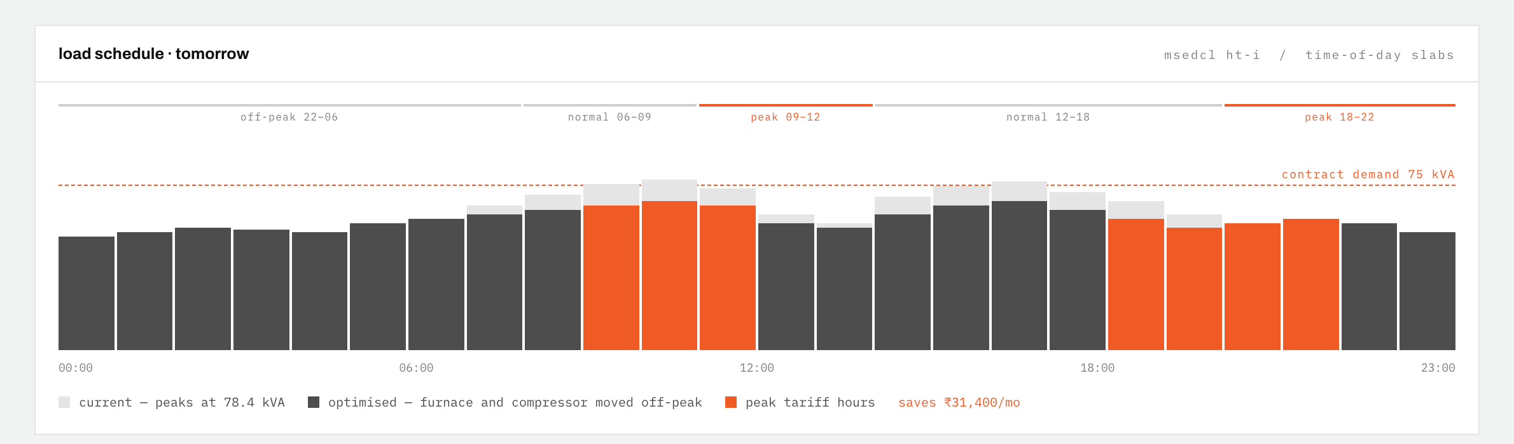
the money
05 / 06
THE MONEY IS ON THE BILL
msedcl ht-i · demand charge on max 15-min kVA
₹4.68 L
78.4 kVA
₹31,400
recoverable per year, modelled
max demand against a 75 kVA contract — every month, a penalty
per month from rescheduling alone, before a single repair
Notes:
Indian HT tariffs bill on the highest fifteen-minute demand of the month, and charge more in peak slabs. Both are schedulable. The DISCOM penalty is the trigger that makes someone pay.

Slide 6
why schneider
06 / 06
WE DON’T COMPETE
WITH ECOSTRUXURE.
WE FEED IT.
what is actually proven
VALIDATED
On HIPE — real measured data from a production plant, with per-machine ground truth. Not a simulation.
NOT YET
Never run in a live factory. We are saying so before you ask.
Schneider sells a meter, then sells software on top of it. We sell one meter into a market that cannot afford thirty — then tell that customer exactly which three machines are worth a real PowerLogic. It is a lead-generation layer for hardware Schneider already makes, reaching a segment its own economics cannot.
NEXT
One pilot shop, and the F1 score on its first week.
1234620.github.io/onemeter
yuva yodha 2026 · smart manufacturing
Notes:
Close on the honest slide. Volunteering that it has never run in a live factory scores better than being caught on it.

